Slide 1


Aeropuerto Internacional “Felipe Ángeles”
{{MES_ANIO}}

Slide 2

Operaciones en la Terminal de Carga
01 Ene. al {{DIA}} {{MES_CORTO_ANIO}}
AEROLÍNEA | OPERACIONES | CARGA EN TONELADAS
AERONAVES TSM | {{H1_OPS_1}} | {{H1_TON_1}}
AEROUNIÓN | {{H1_OPS_2}} | {{H1_TON_2}}
AIR CANADA | {{H1_OPS_3}} | {{H1_TON_3}}
AIR FRANCE CARGO | {{H1_OPS_4}} | {{H1_TON_4}}
AMERIJET | {{H1_OPS_5}} | {{H1_TON_5}}
CARGOJET | {{H1_OPS_6}} | {{H1_TON_6}}
CARGOLUX | {{H1_OPS_7}} | {{H1_TON_7}}
CATHAY PACIFIC | {{H1_OPS_8}} | {{H1_TON_8}}
COPA CARGO | {{H1_OPS_9}} | {{H1_TON_9}}
DHL GUATEMALA | {{H1_OPS_10}} | {{H1_TON_10}}
EMIRATES | {{H1_OPS_11}} | {{H1_TON_11}}
ESTAFETA | {{H1_OPS_12}} | {{H1_TON_12}}
LUFTHANSA CARGO | {{H1_OPS_13}} | {{H1_TON_13}}
MAS DE CARGA | {{H1_OPS_14}} | {{H1_TON_14}}
QATAR | {{H1_OPS_15}} | {{H1_TON_15}}
TM AEROLINEAS | {{H1_OPS_16}} | {{H1_TON_16}}
TURKISH CARGO | {{H1_OPS_17}} | {{H1_TON_17}}
UPS | {{H1_OPS_18}} | {{H1_TON_18}}
AEROMÉXICO | {{H1_OPS_19}} | {{H1_TON_19}}
CONVIASA | {{H1_OPS_20}} | {{H1_TON_20}}
MEXICANA | {{H1_OPS_21}} | {{H1_TON_21}}
VIVA AEROBUS | {{H1_OPS_22}} | {{H1_TON_22}}
VOLARIS | {{H1_OPS_23}} | {{H1_TON_23}}
ABSA | {{H1_OPS_24}} | {{H1_TON_24}}
ABX AIR | {{H1_OPS_25}} | {{H1_TON_25}}
AERO SUCRE | {{H1_OPS_26}} | {{H1_TON_26}}
AEROLINEAS ARGENTINAS CARGO | {{H1_OPS_27}} | {{H1_TON_27}}
AIR CHINA CARGO | {{H1_OPS_28}} | {{H1_TON_28}}
AIR EXPRESS | {{H1_OPS_29}} | {{H1_TON_29}}
ATLAS AIR INC | {{H1_OPS_30}} | {{H1_TON_30}}
BERRY AVIATION INC | {{H1_OPS_31}} | {{H1_TON_31}}
CHINA SOUTHERN CARGO | {{H1_OPS_32}} | {{H1_TON_32}}
ETHIOPIAN CARGO | {{H1_OPS_33}} | {{H1_TON_33}}
EVERST AIR CARGO | {{H1_OPS_34}} | {{H1_TON_34}}
FEDEX | {{H1_OPS_35}} | {{H1_TON_35}}
GALISTAIR | {{H1_OPS_36}} | {{H1_TON_36}}
GLOBAL CROSSING AIRLINES | {{H1_OPS_37}} | {{H1_TON_37}}
IFL GROUP | {{H1_OPS_38}} | {{H1_TON_38}}
KALITTA AIR | {{H1_OPS_39}} | {{H1_TON_39}}
KALITTA CHARTERS | {{H1_OPS_40}} | {{H1_TON_40}}
LAN CARGO | {{H1_OPS_41}} | {{H1_TON_41}}
LATAM CARGO | {{H1_OPS_42}} | {{H1_TON_42}}
LYNDEN AIR CARGO | {{H1_OPS_43}} | {{H1_TON_43}}
MCNEELY CHARTER | {{H1_OPS_44}} | {{H1_TON_44}}
NATIONAL AIR CARGO GROUP | {{H1_OPS_45}} | {{H1_TON_45}}
SAUDI CARGO | {{H1_OPS_46}} | {{H1_TON_46}}
SILKWAY WEST | {{H1_OPS_47}} | {{H1_TON_47}}
SKY LEASE CARGO | {{H1_OPS_48}} | {{H1_TON_48}}
SUPARNA AIRLINES | {{H1_OPS_49}} | {{H1_TON_49}}
UKRAINE | {{H1_OPS_50}} | {{H1_TON_50}}
UNIWORLD AIR CARGO | {{H1_OPS_51}} | {{H1_TON_51}}
WESTERN GLOBAL | {{H1_OPS_52}} | {{H1_TON_52}}
USAJET | {{H1_OPS_53}} | {{H1_TON_53}}
LEGENDS AIRWAYS | {{H1_OPS_54}} | {{H1_TON_54}}
CAVOK AIR | {{H1_OPS_55}} | {{H1_TON_55}}
CHINA CARGO AIRLINES | {{H1_OPS_56}} | {{H1_TON_56}}
AIR ATLANTA EUROPE | {{H1_OPS_57}} | {{H1_TON_57}}
AMERISTAR AIR CARGO | {{H1_OPS_58}} | {{H1_TON_58}}
TOTAL | {{H1_OPS_TOTAL}} | {{H1_TON_TOTAL}}
OPERANDO ACTUALMENTE
{{N_REGULAR}} | CARGA REGULAR
{{N_FLETAMENTO}} | FLETAMENTO
{{N_MIXTA}} | CARGA MIXTA
 |  | OPERACIONES | TONELADAS
{{ANIO_1_ETQ}} |  | {{ANIO_1_OPS}} | {{ANIO_1_TON}}
{{ANIO_2_ETQ}} |  | {{ANIO_2_OPS}} | {{ANIO_2_TON}}
{{ANIO_3_ETQ}} |  | {{ANIO_3_OPS}} | {{ANIO_3_TON}}
{{ANIO_4_ETQ}} |  | {{ANIO_4_OPS}} | {{ANIO_4_TON}}
Carga | {{DIA_FECHA}} | {{DIA_OPS}} | {{DIA_TON}}
ACUMULADO |  | {{ACUM_OPS}} | {{ACUM_TON}}
AEROLÍNEAS QUE OPERAN AERONAVES BAJO LA FIGURA DE ARRENDAMIENTO HÚMEDO (WET LEASE)
AEROLÍNEA | ARRENDADOR
AEROUNION | AVIANCA CARGO
MAS AIR | GALISTAIR

Slide 3
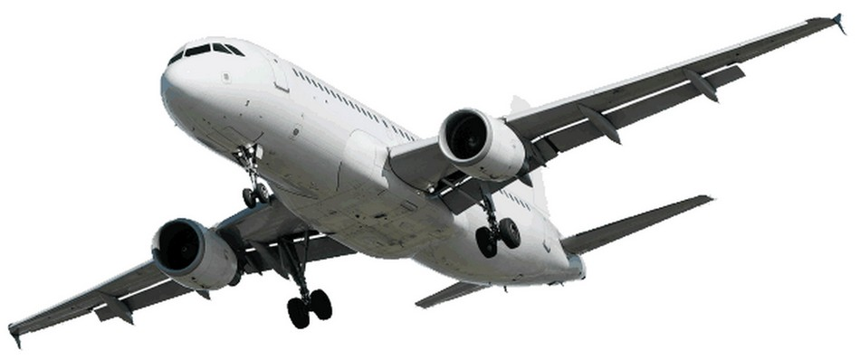
Aerolíneas que operan con un contrato de Servicios Aeroportuarios:

Slide 4
Aerolíneas que operan en la modalidad de fletamento de carga:

Slide 5
Aerolíneas que operan en la modalidad de carga:

Slide 6
Aerolíneas que realizan operaciones mixtas (carga y pasajeros):

Slide 7


Cifras acumuladas desde el inicio de operaciones de la Terminal de Carga:
Total de operaciones
Total de carga transportada (tons.)
{{ACUM_OPS}}
{{ACUM_TON}}

Slide 8
Aerolíneas de carga que operan en el AIFA
No. | Aerolínea | Tipo de operación | Situación actual
1 | Cathay Pacific Airways Limited | Regular con contrato de Servicios Aeroportuarios | Operando
2 | Turk Hava YOralli., A.O. (Turkish)
3 | DHL Guatemala, S.A.
4 | Estafeta Carga Aérea, S.A. de C.V.
5 | Societe Air France
6 | Cargolux Airlines International, S.A.
7 | DHL Express México, S.A. de C.V. (Cargojet)
8 | Emirates
9 | Aerotransportes Mas de Carga S.A. de C.V. (Mas Air)
10 | Lufthansa Cargo Aktiengesellschaft
11 | Aero Transportes de Carga Unión, S.A. de C.V.
12 | Amerijet International Inc.
13 | Qatar Airways Company Q.C.S.C.
14 | United Parcel Service CO.
15 | TM Aerolíneas, S.A. de C.V. (Awesome Cargo) |  | .
16 | Air Canadá
17 | Aeronaves T S M, S.A. de C.V.
18 | La Nueva Aerolínea, S.A. (Copa Cargo)
Las aerolíneas Volaris, Conviasa, Mexicana, Viva Aerobús y Aeroméxico realizan operaciones mixtas (pasajeros y carga).

Slide 9
Aerolíneas de carga que operan en el AIFA
No. | Aerolínea | Tipo de operación | Situación actual
1 | Absa Aerolinhas Brasileiras | Fletamento de Carga, (no necesitan contrato) | Operando
2 | ABX Air
3 | Air China
4 | Atlas Air Inc
5 | Berry Aviation
6 | China Southern Airlines
7 | Kalitta Air
8 | Ethiopian Cargo
9 | Federal Express Corporation
10 | Galistair Trading Limited
11 | National Air Cargo
12 | Silway West Airlines
13 | Sky Lease Cargo
14 | Ukraine Air Alliance
15 | Western Global Airlines
16 | Lan Cargo
17 | Mcnelly Charter
18 | Usa Jet
19 | Lynden Air Cargo
20 | Air Express
21 | Everts Air Cargo
22 | Kalitta Charters
23 | Aero Sucre, S.A.
24 | Uniworld Air Cargo
25 | Latam Cargo
26 | Aerolíneas Argentinas Cargo
27 | Global Crossing Airlines
28 | Saudía Cargo
29 | IFL Group
30 | Suparna Airlines
31 | Legends Airways
32 | Cavok Air
33 | China Cargo Airlines
34 | Air Atlanta Europe
35 | Ameristar Air Cargo

Slide 10
GRACIAS

