Slide 1
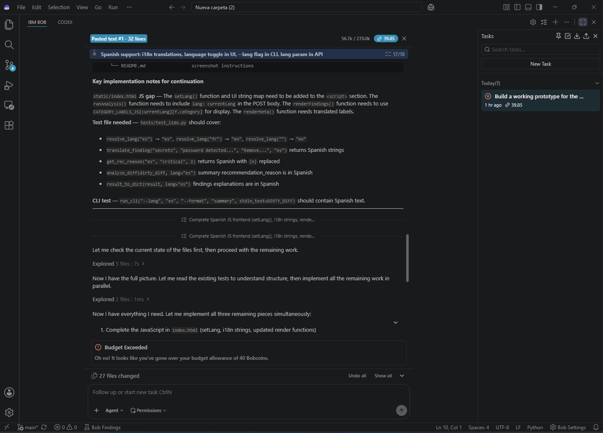
INTELLIGENT
Code Review
Coach
Fast, explainable review of Git diffs
IBM Bob Hackathon prototype
Python • Local-first • English and Spanish
Notes:
Timing: 20 seconds.
Introduce the project as a local static-analysis coach for Git diffs, created for the IBM Bob Hackathon.

Slide 2
The review gap
A synthetic auth-service diff shows where automation saves reviewer time
Manual first pass
Code Review Coach
~11 min
<5 ms
Reviewer outcome
Mechanical scanning moves to the tool.
The reviewer focuses on judgment, context, and the final decision.
Scan credentials
Check injection risks
Review errors and tests
Write actionable comments
Produces severity, file and line
Explains why each issue matters
Suggests a concrete fix
Summarizes the review decision
Benchmark source: bundled Demo 1
Notes:
Timing: 35 seconds.
The comparison uses the repository's repeatable synthetic Demo 1. The value is speed on routine checks, while human judgment remains essential.
Source: local README.md, Demo script and manual review comparison.

Slide 3
How the system works
A deterministic pipeline turns untrusted diff text into an explainable review
1
2
3
4
5
Git diff
Hunk parser
Typed rules
Review result
Delivery
CLI, web API, or PR webhook
Tracks added, removed, and context lines
Nine explicit security and quality checks
Severity, explanation, fix, and summary
Terminal, browser, JSON, or GitHub
Security boundary
Diffs remain text. The engine never imports or executes submitted code. The API rejects payloads above 500 KB.
Notes:
Timing: 40 seconds.
Walk left to right. Highlight the hunk-aware parser and explicit registry because they make context handling predictable and rule behavior maintainable.

Slide 4
Coverage and product surfaces
The same analysis engine supports local use, automation, and bilingual output
Nine rule categories
183
Exposed secrets
Unsafe input
Error handling
Likely bugs
Weak tests
Sensitive logging
Dangerous deserialization
Path traversal
Insecure dependencies
automated tests passing
EN / ES
UI, CLI, API, and findings
Installable package
CLI and web entry points verified in the built wheel
Python
JavaScript
TypeScript
requirements.txt
package.json
Notes:
Timing: 35 seconds.
Explain that one engine powers every interface. Mention the test count and bilingual support as evidence that the prototype is ready to demonstrate and share.
Source: local test suite and package verification completed on 2026-09-26.

Slide 5
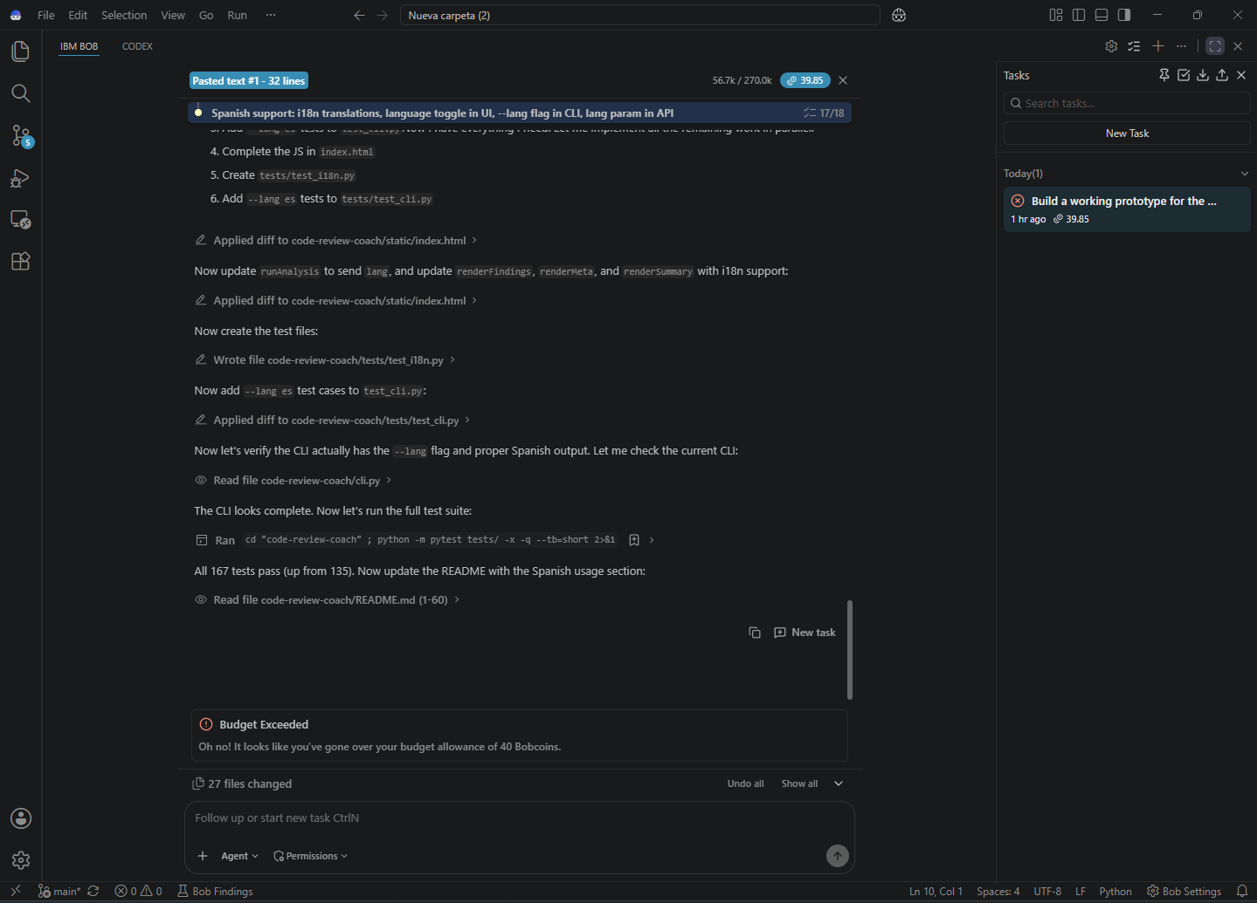
From Bob prototype to shareable repository
Bob built the product foundation. Codex completed the architecture and release-quality pass
Codex
Packaged the CLI, web app, demos, and UI
Added hunk-aware parsing and isolated context
Introduced the typed rule registry and category catalog
Expanded verification to 183 tests and checked the wheel
Committed and pushed the finished repository
IBM Bob
Core analyzer, web experience, Spanish support, demos, and initial tests
github.com/MafiaCut/code-review-coach
Notes:
Timing: 40 seconds.
Credit both tools clearly. Close by opening the dirty demo, switching to Spanish, then showing the clean demo if time permits.

