Slide 1
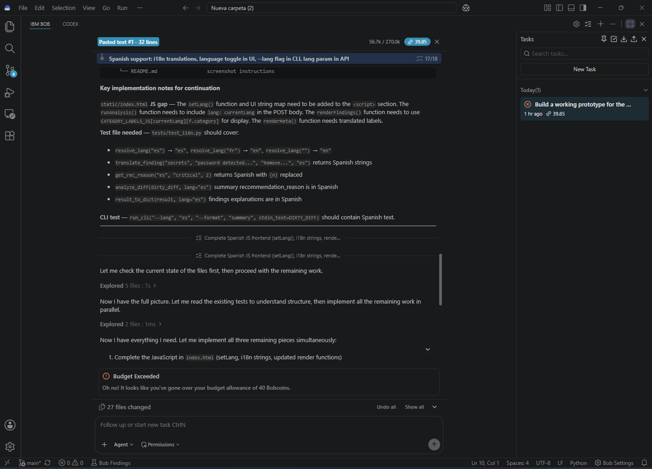
INTELLIGENT
Code Review
Coach
Fast, explainable review of Git diffs
IBM Bob Hackathon prototype
Python • Local-first • English and Spanish
Notes:
Timing: 20 seconds.
Introduce the project as a local static-analysis coach for Git diffs, created for the IBM Bob Hackathon.

Slide 2
Utility example: command injection
A Python handler sends user input directly to the operating system shell
Added code
Coach finding
os.system(cmd)
HIGH
Recommended fix
Use subprocess.run() with an argument list.
Keep shell=False and validate user-controlled values.
cmd comes from a request
The shell interprets its content
An attacker can append commands
The risk may reach production
Category: Unsafe Input
Risk: command injection
File and line included
Fix explained in plain language
Rule: unsafe input. Deterministic and offline.
Notes:
Timing: 35 seconds.
Walk through the unsafe line, the high-severity finding, and the recommended subprocess.run replacement. Emphasize that the coach provides the file, line, explanation, and fix without executing the submitted code.
Source: bundled Demo 1 and analyzer/rules.py.

Slide 3
How the system works
A deterministic pipeline turns untrusted diff text into an explainable review
1
2
3
4
5
Git diff
Hunk parser
Typed rules
Review result
Delivery
CLI, web API, or PR webhook
Tracks added, removed, and context lines
Nine explicit security and quality checks
Severity, explanation, fix, and summary
Terminal, browser, JSON, or GitHub
Security boundary
Diffs remain text. The engine never imports or executes submitted code. The API rejects payloads above 500 KB.
Notes:
Timing: 40 seconds.
Walk left to right. Highlight the hunk-aware parser and explicit registry because they make context handling predictable and rule behavior maintainable.

Slide 4
Coverage and product surfaces
The same analysis engine supports local use, automation, and bilingual output
Nine rule categories
183
Exposed secrets
Unsafe input
Error handling
Likely bugs
Weak tests
Sensitive logging
Dangerous deserialization
Path traversal
Insecure dependencies
automated tests passing
EN / ES
UI, CLI, API, and findings
Installable package
CLI and web entry points verified in the built wheel
Python
JavaScript
TypeScript
requirements.txt
package.json
Notes:
Timing: 35 seconds.
Explain that one engine powers every interface. Mention the test count and bilingual support as evidence that the prototype is ready to demonstrate and share.
Source: local test suite and package verification completed on 2026-09-26.

Slide 5
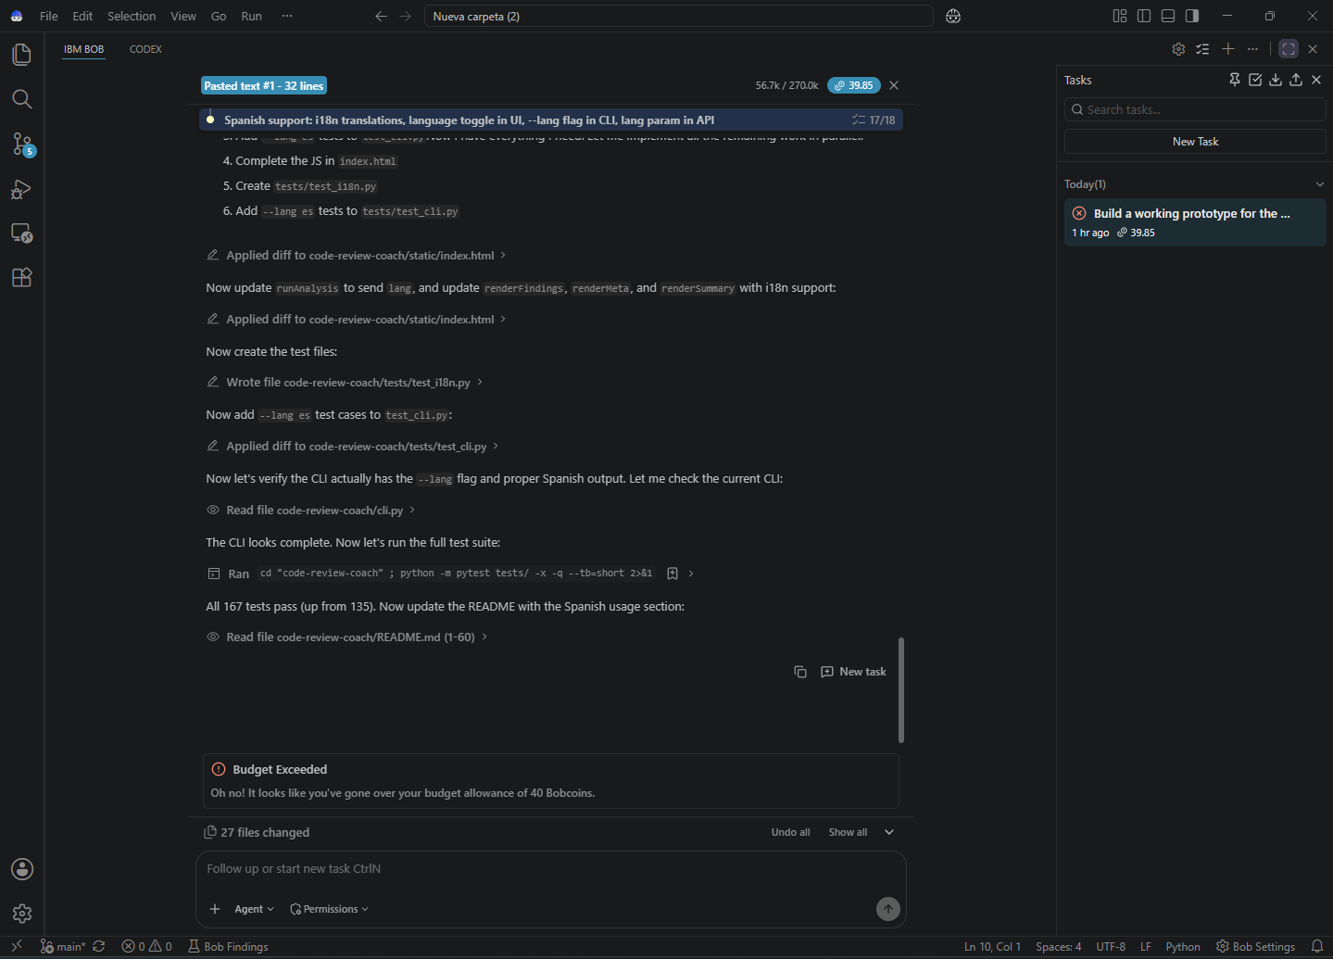
From Bob prototype to shareable repository
Bob built the product foundation. Codex completed the architecture and release-quality pass
Codex
Packaged the CLI, web app, demos, and UI
Added hunk-aware parsing and isolated context
Introduced the typed rule registry and category catalog
Expanded verification to 183 tests and checked the wheel
Committed and pushed the finished repository
IBM Bob
Core analyzer, web experience, Spanish support, demos, and initial tests
github.com/MafiaCut/code-review-coach
Notes:
Timing: 40 seconds.
Credit both tools clearly. Close by opening the dirty demo, switching to Spanish, then showing the clean demo if time permits.

