Slide 1
2022 CLIMATE CHANGE BELIEF ANALYSIS
2021/22 Climate Change Believe Analysis
Predict an individual sentiment on climate change based on historical tweet data

Slide 2






Data Science
Lifecycle
Business
Understanding
Data
Collection
Model
Deployment
Data
Preprocessing
Model
Evaluation
Data
Exploration (EDA)
Modelling
Data
Engineering

Slide 3
Natural Language Processing
Lifecycle
Data Preprocessing
Build Model
Data Exploration (EDA)
Feature Text Engineering
Hyperparameter Tuning
Visualizing
Model Performance
Data Visualization
Feature Analysis
Data Cleaning
Normalizing
Vectorizing
Scaling
Imbalanced Data
GridSearchCV
Model Evaluation

Slide 4

Understanding Problem Statement
Missing Values
Missing Values
Translate Language
Machine Learning Techniques to translate language
Sentimental
Insights
Drawing insights from what people have twitted about climate change
Climate Change
All humans have the fundamental rights to live in a sustainable environment.

Slide 5
Number of Messages Per Sentiment
8000
6000
Count
4000
2000
Negative
Neutral
Positive
Factual
0
-1 0 1 2
Sentiment

Slide 6
Percentage of Messages per Sentiment
Negative
8.2%
Neutral
14.9%
Positive
53.9%
23.0%
Factual

Slide 7
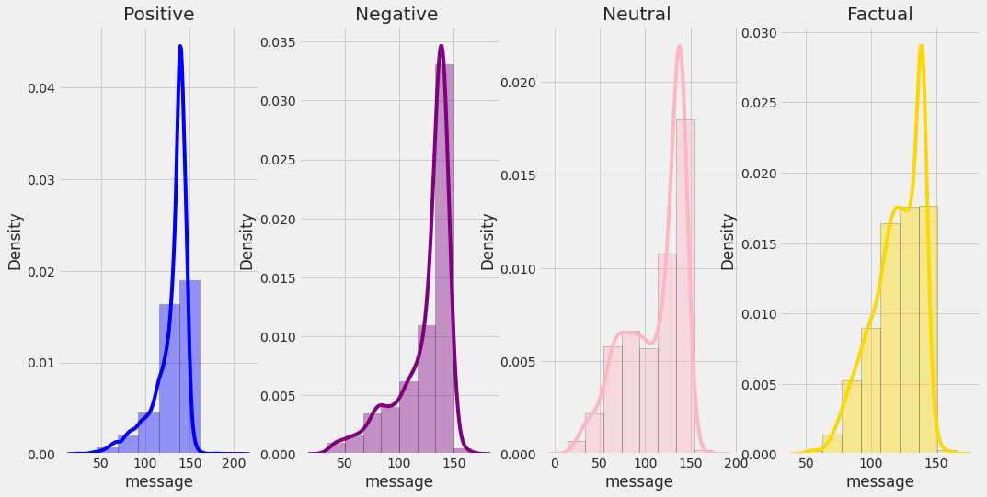
Distribution of Length per Label

Slide 8
Average Length of Messages by Sentiment
120
100
80
Length
60
40
20
Negative
Neutral
Positive
News
0
-1 0 1 2
Sentiment

Slide 9
Data Preprocessing
Data Cleaning
Tokenize
Stopwords
Stemming
Lemmitizing
Remove Noise
Tokens of strings
English Stopwords
Roor meaning of a word
Returning the dictionary meaning of a word

Slide 10
Data Preprocessing
Characters
Hashtags
URLs
Retweets
Mentions
Emojis
Punctuations
Remove [!*&%_-?\/.,<,>]
Data Cleaning
Numbers
Remove Numbers
Lower char
Transform to
lowercase characters

Slide 11

Data Preprocessing Example
‘PolySciMajor EPA chief doesn't think carbon dioxide is main cause of global warming and.. wait, what!? https://t.co/yeLvcEFXkC via @mashable’
polyscimajor epa chief doesnt think carbon dioxide is main cause of global warming and wait what urlweb via mashable
Data preprocessor

Slide 12
Data Normalization
Remove Stopwords
Tokenize
DataFrame
Lemitize
Stemming
Bag of words

Slide 13
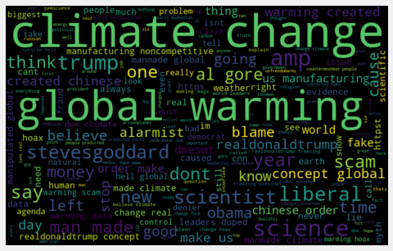
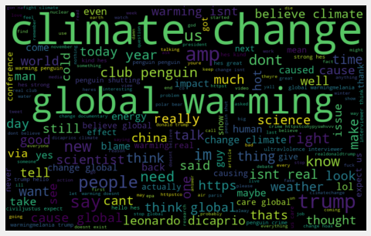
Further Text Exploration using wordcloud
Class -1 Class 0

Slide 14
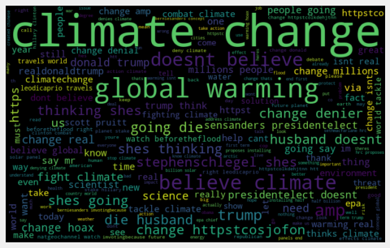
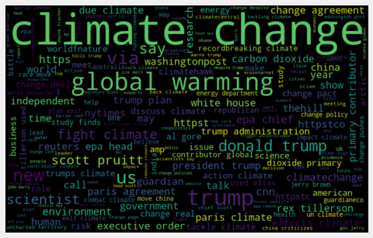
Further Text Exploration using wordcloud
Class 1 Class 2

Slide 15
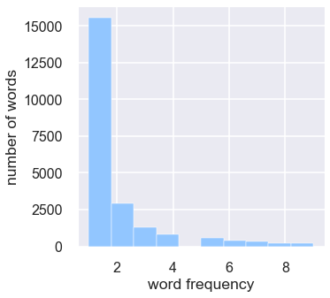
Distribution of words Appearing < 10

Slide 16
Frequent HashTags for all the classes

Slide 17
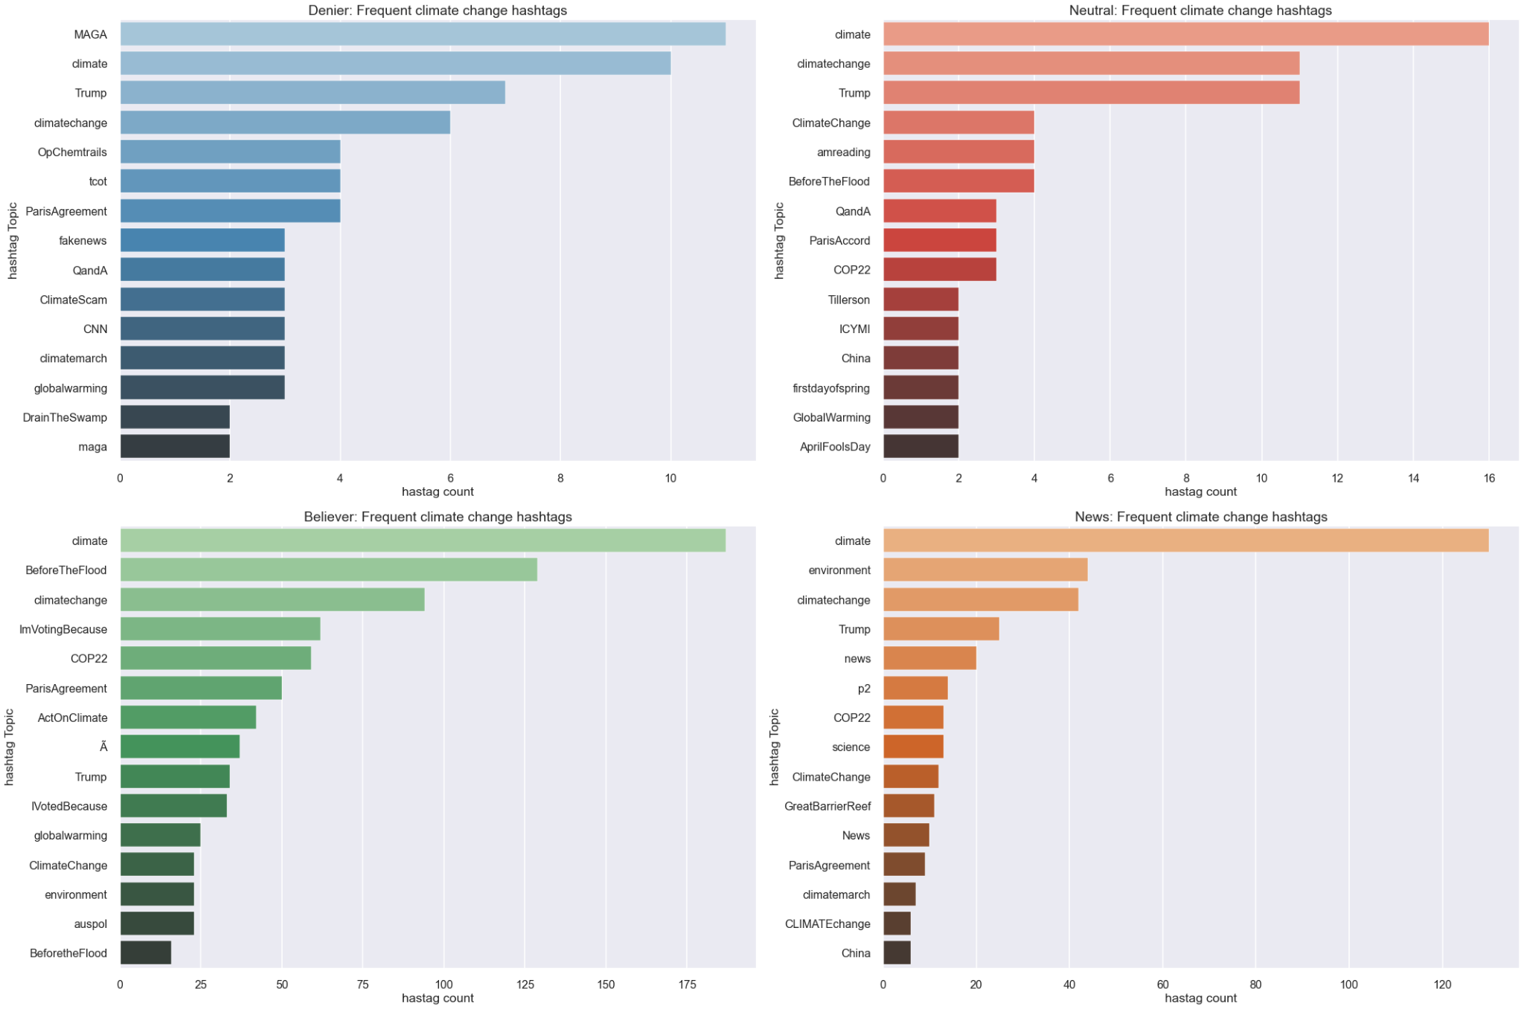

Slide 18
Data Preprocessing
192
Rear words
192
Short Words

Slide 19
Experiments
LESS
NOISE
CLEAN SENTENCES
VS
STEMMED
CLEAN SENTENCES
LEMMATIZED
CLEAN
SENTENCES
CLEAN SENTENCES
VS
VS

Slide 20
Text Imbalance
8000
6000
Count
4000
2000
Negative
Neutral
Positive
Factual
0
-1 0 1 2
Sentiment
Models become better at predicting one class over the others.
Inherent predictive bias.

Slide 21
Upsampled Data
Downsampled Data
8000
8000
6000
Count
6000
4000
4000
2000
2000
Negativee
Neutral
Positive
Factual
Negative
Neutral
Positive
Factual
0
0
-1 0 1 2
-1 0 1 2
Sentiment
Sentiment
- Risk overfitting, can check against Test data.
- Generally better than downsampling
- Risk losing valuable information.
- Reduces dataset to a more manageable size.

Slide 22
Feature Text Engineering
Vectorizing
Cleaned Data
Scaling
Train Test Split

Slide 23
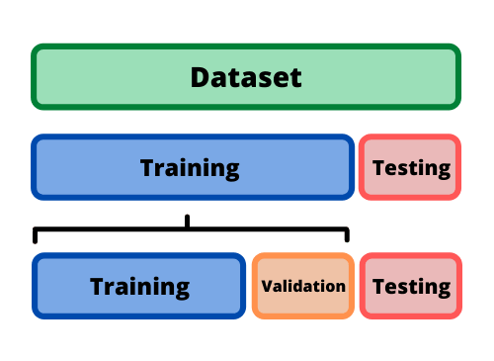
Train Test Split

Slide 24
Text Vectorisation
A document term matrix is generated and each column represents an individual unique word.
Each cell contains a weight value that signifies how important a word is for an individual text message or document.
Different from the count vectorization in the sense that it takes into considerations not just the occurrence of a word in a single document but in the entire corpus.
TF-IDF gives more weight to less frequently occurring events and less weight to expected events. So, it penalizes frequently occurring words that appear frequently in a document such as “the”, “is” but assigns greater weight to less frequent or rare words.

Slide 25
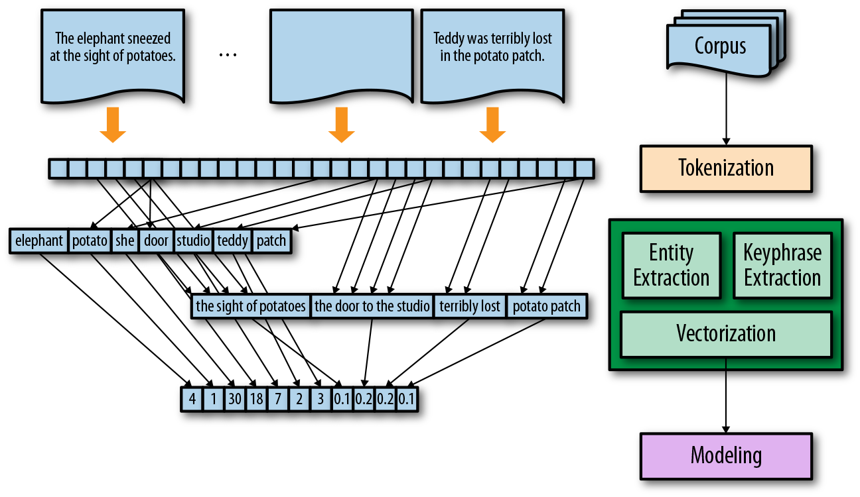
Text Vectorisation

Slide 26
Data Scaling
Min Absolute Scaler
Scale each feature by its maximum absolute value.
This estimator scales and translates each feature individually such that the maximal absolute value of each feature in the training set will be 1.0. It does not shift/center the data, and thus does not destroy any sparsity.
This scaler can also be applied to sparse matrices.

Slide 27
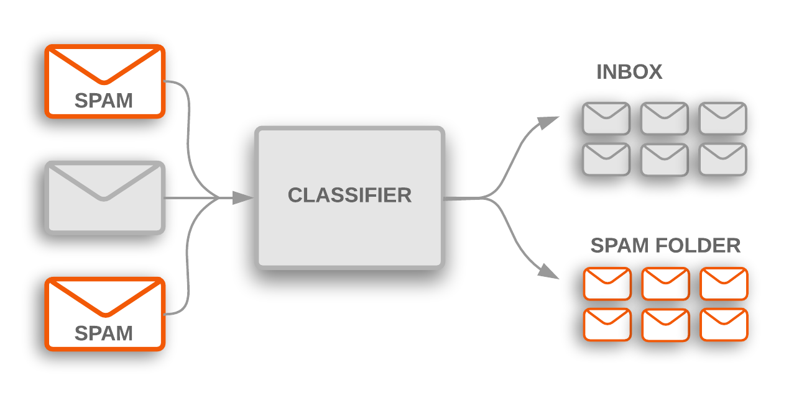
Modelling

Slide 28
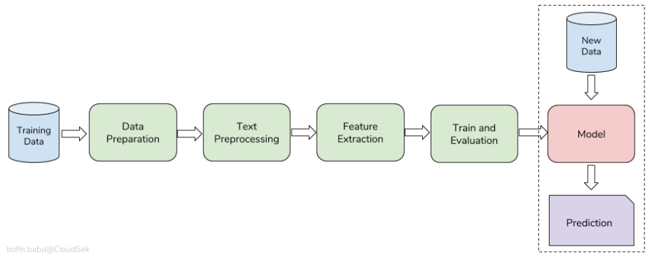
Modelling

Slide 29
Classification Algorithms
Logistic Regression
Naive Bayes
Support Vector
K-Nearest Neighbor

