Slide 1
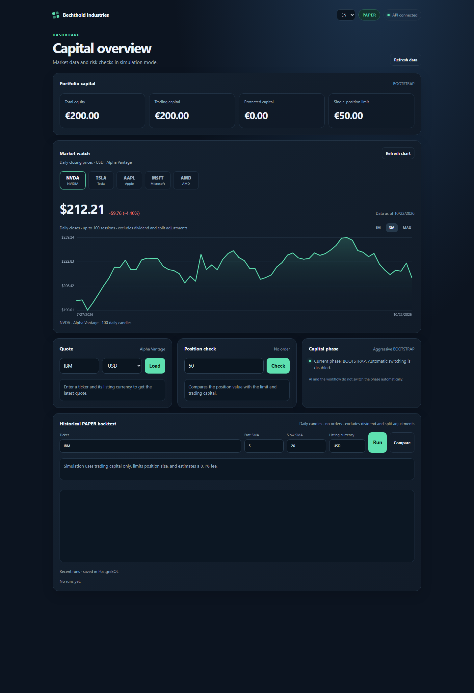
BECHTHOLD
INDUSTRIES
AI MARKET RESEARCH
& PAPER STRATEGY TESTING
A local-first platform for market context,
capital controls and repeatable analysis.
PRODUCT CASE STUDY · 2026
RESEARCH / RISK / PAPER
Notes:
Portfolio case study for the existing Bechthold Industries project. The application is a local-first market research and PAPER-only strategy analysis tool. No broker connection or live trading is implemented.

Slide 2
THE PRODUCT
A focused workspace for market research
Market data, risk limits and strategy tests belong in one clear view.
01
RESEARCH
Five-stock watchlist with selectable daily charts
02
CONTROL
The platform brings daily market context together with explicit capital boundaries and historical strategy analysis.
Total, protected and trading capital stay distinct
03
TEST
SMA strategies compared on a later holdout period
BECHTHOLD INDUSTRIES / AI MARKET RESEARCH
02
Notes:
Market watch contains NVDA, TSLA, AAPL, MSFT and AMD; it is a curated list, not a live volume ranking.

Slide 3
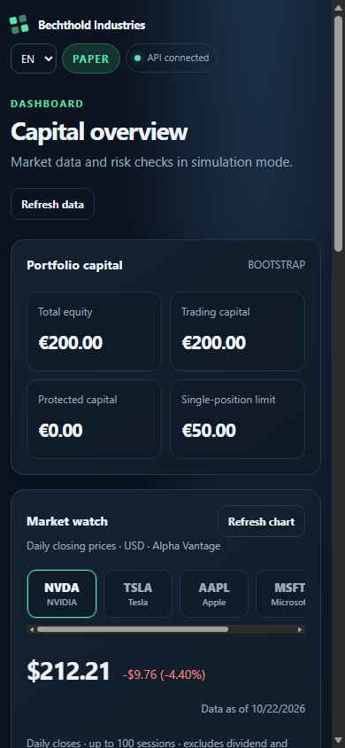
PRODUCT INTERFACE
Market context at a glance
A compact market watch keeps the current ticker one tap away.
Daily closing-price charts
1M · 3M · full available history
No background polling
Alpha Vantage data is cached to reduce repeated requests.
BECHTHOLD INDUSTRIES / AI MARKET RESEARCH
03
Notes:
Screens show the actual responsive dashboard. Daily history can be up to 100 sessions and is raw, not adjusted for dividends or stock splits. It is not a real-time quote stream.

Slide 4
CAPITAL SAFEGUARDS
Capital stays split by purpose
At €350 total equity
€200 is reserved before the phase changes.
€350
Manual confirmation
€150 TRADING
€200 PROTECTED
BOOTSTRAP remains pending
until the owner confirms.
TOTAL EQUITY
Protected capital never enters position sizing.
If equity falls, the protected amount is capped at available equity; trading capital cannot go negative.
BECHTHOLD INDUSTRIES / AI MARKET RESEARCH
04
Notes:
At €350 in BOOTSTRAP, €200 is reserved and €150 remains available for trading. Phase transition requires a token-protected manual action. The UI and n8n do not switch phases automatically.

Slide 5
STRATEGY ANALYSIS
Backtests show assumptions, not promises
A repeatable SMA workflow
01
02
03
04
05
HISTORY
SIGNAL
EXECUTION
COSTS
HOLDOUT
Daily candles
Fast / slow SMA
Next day open
0.1% per side
Later unseen segment
Readouts
Equity curve · drawdown · win rate · annualized return and volatility · Sharpe ratio · buy-and-hold comparison
Analysis only: results do not change account capital or submit orders.
BECHTHOLD INDUSTRIES / AI MARKET RESEARCH
05
Notes:
The backtest starts with trading capital only, caps each position at the active limit, estimates 0.1% fees per side and executes a close signal at the following open. Parameter comparison selects on the first 78% of history and evaluates a later holdout. Simplifying assumptions exclude slippage, taxes and some market frictions.

Slide 6
ARCHITECTURE
A small, understandable system
Local browser experience
POSTGRESQL
FASTAPI
→
Capital state
Cache + history
DESKTOP / IPHONE
Market data
Risk + analytics
→
Responsive PWA
Private Wi-Fi
→
ALPHA VANTAGE
Quotes + daily data
n8n PAPER
Runs the paper workflow and checks risk through FastAPI.
Docker Compose runs the API, PostgreSQL and n8n on the owner’s computer.
BECHTHOLD INDUSTRIES / AI MARKET RESEARCH
06
Notes:
PostgreSQL persists capital state, cached market data and analysis history. n8n is configured for PAPER workflow use. FastAPI requests external market data directly and owns the risk and capital logic.

Slide 7
CURRENT SCOPE
Built for private, local use
What works today
Known boundaries
Responsive desktop + iPhone PWA
Watchlist and daily charts
Capital safeguards and manual phase change
Backtests, comparison and saved history
No broker or real-money orders
No public multi-user hardening
Provider plans can limit market data
Raw prices can misstate split/dividend effects
Next sensible steps
Adjusted-price provenance · access control and security review · broader API integration checks
A personal research tool, clearly scoped as a simulation.
BECHTHOLD INDUSTRIES / AI MARKET RESEARCH
07
Notes:
The app is intended for one trusted local user, not as a hardened production service or an investment recommendation.

Slide 8
RESEARCH WITH
GUARDRAILS
€200
PROTECTED
AT TRANSITION
Bechthold Industries
Local-first market analysis.
Explicit capital protection.
PAPER-only strategy testing.
€150
TRADING
AT €350 EQUITY
PAPER · LOCAL · ANALYTICAL
Notes:
The €350 example is a rule in the simulated capital model, not a statement about investment performance.

