Slide 1
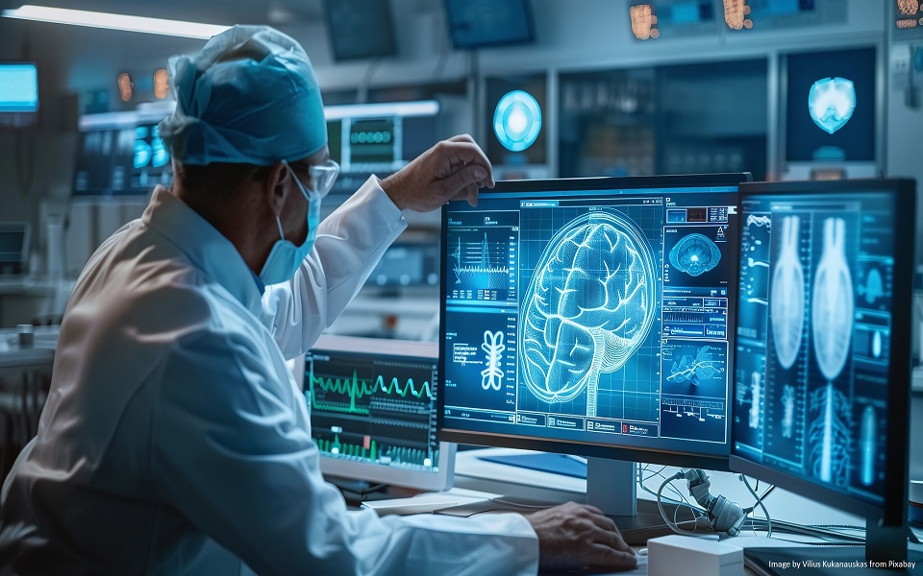
AI-Powered Telemedicine for Remote Diagnostics
Team - HackerZ
Mafuj Gazi – CSBS – 3rd Year
Ashraf Ali – CSBS – 3rd Year

Slide 2
Overview
Our project aims to revolutionize telemedicine by integrating Artificial Intelligence (AI) technologies, to enhance diagnostic accuracy and patient care.
The platform analyzes patient symptoms, provides preliminary diagnoses, and seamlessly integrates with Electronic Health Record (EHR) systems, ensuring a more efficient and personalized healthcare experience.

Slide 3
Problems
Delayed/inaccurate diagnoses
Data interoperability issues
Privacy & compliance concerns
User accessibility challenges

Slide 4
Objective
AI-Powered Diagnostic Assistant.
Seamless EHR Integration.
Data Privacy & Compliance.
User-Centric Telemedicine Interface

Slide 5
Technology Stack
AI Models – TensorFlow/PyTorch for diagnostics
NLP – OpenAI GPT for symptom analysis
Backend : Node.js/Python with FastAPI
Database – PostgreSQL & MongoDB for health records
Security – AES-256 encryption for data protection

Slide 6
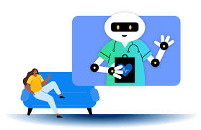
Solution Breakdown

Slide 7
AI-Powered Diagnostic Assistant:
Understands Patients: Uses NLP to analyze symptoms from text or voice
Smart Diagnosis: AI suggests possible conditions based on medical data
Emergency First: Prioritizes urgent cases for faster care
7
7

Slide 8
Seamless EHR Integration
Effortless Connectivity: Integrates smoothly with existing healthcare systems
Automated Updates: Reduces manual data entry & errors
Instant Access: Provides real-time medical history for better care

Slide 9
User-Centric Telemedicine Interface
Intuitive UI/UX: Easy for doctors & patients
Multilingual Support: Voice & text interactions
AI Chatbot: Instant health-related assistance
9

Slide 10
Data Privacy & Compliance
Strong Security: End-to-end encryption & multi-factor authentication
Regulatory Compliance: Follows HIPAA & GDPR standards
Patient Control: Consent-based access to personal medical data
10
10

Slide 11

Marketing strategies
Implement personalized engagement strategies
Tailor campaigns to resonate with specific demographics, fostering a sense of relevance and connection
Collaborate with influencers and thought leaders to amplify our brand message
11

Slide 12

Innovative solutions

Slide 16
Thank you

