Slide 1
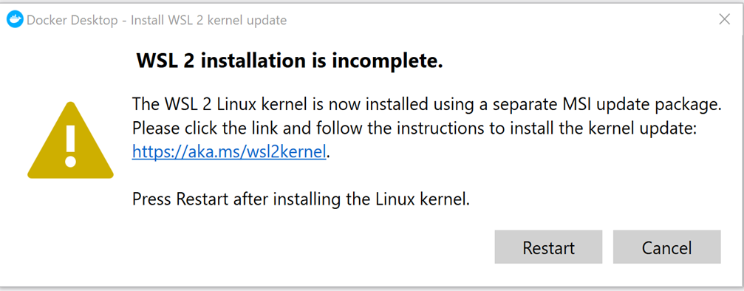
Lab 0 install python and docker
Python v3.11 and above
python --version
Mac user: python3 --version
Replace with python3 for all labs commands.
Docker

Slide 2
OBJECTIVE
Turn Python program(s) into web application(s)/service(s) using Flask.
Web APIs, etc.

Slide 3
INTRODUCTION
Flask is a micro web framework written in Python, which can be used to build websites and web applications.
A framework is a code library/reusable code/extensions to make a developer’s life easier - https://opensource.com/article/18/4/flask
For our purpose, we use Flask to allow Python functions to be called using URLs within HTTP clients such as web browsers and especially by other applications using HTTP methods.
Python module
enable Python app to handle HTTP GET, POST, …
Web server
PHP http://localhost:80/path... -> file.php
Flask
http://localhost:80/path... -> python function
# python function
@app.route("/path")
def doThis(): return “Do this.“

Slide 4
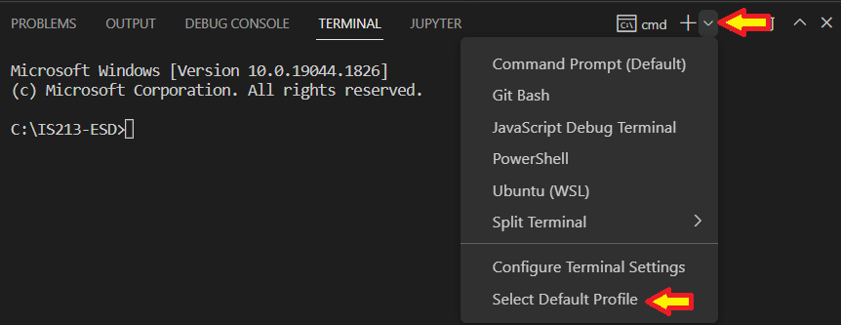
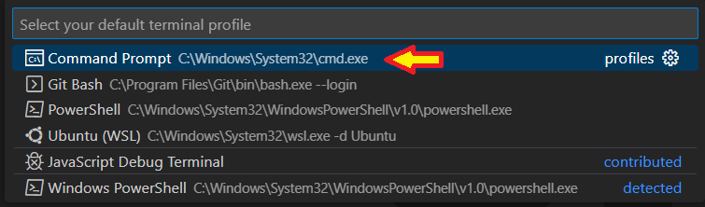
Windows - Labs use CMD

Slide 5
Do lab

Slide 6
Demo

Slide 7
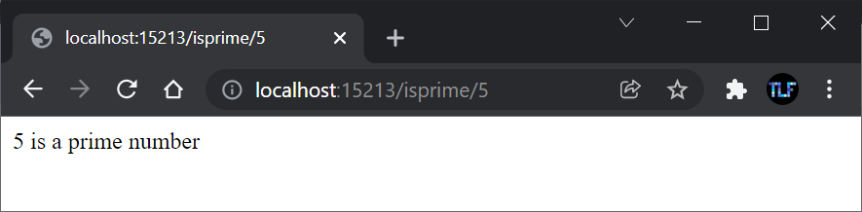
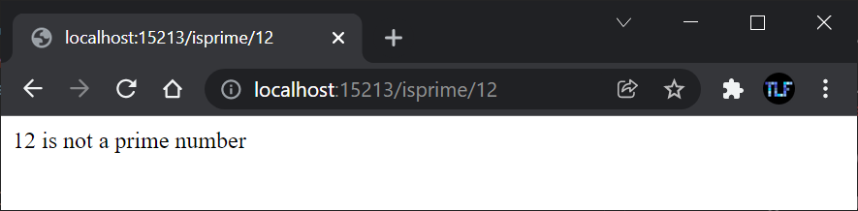
Extra Practise (Optional)
– No submission required
Listen to port 15213

