Slide 1

Intro to R/Rstudio: The Basics Hosted by Methodology Feb 2020

Slide 2
Reproducible Research
Document everything!
Everything is a (text) file.
All files should be human readable.
Explicitly tie your files together.
Have a plan to organize, store, and make your files available.

Slide 3
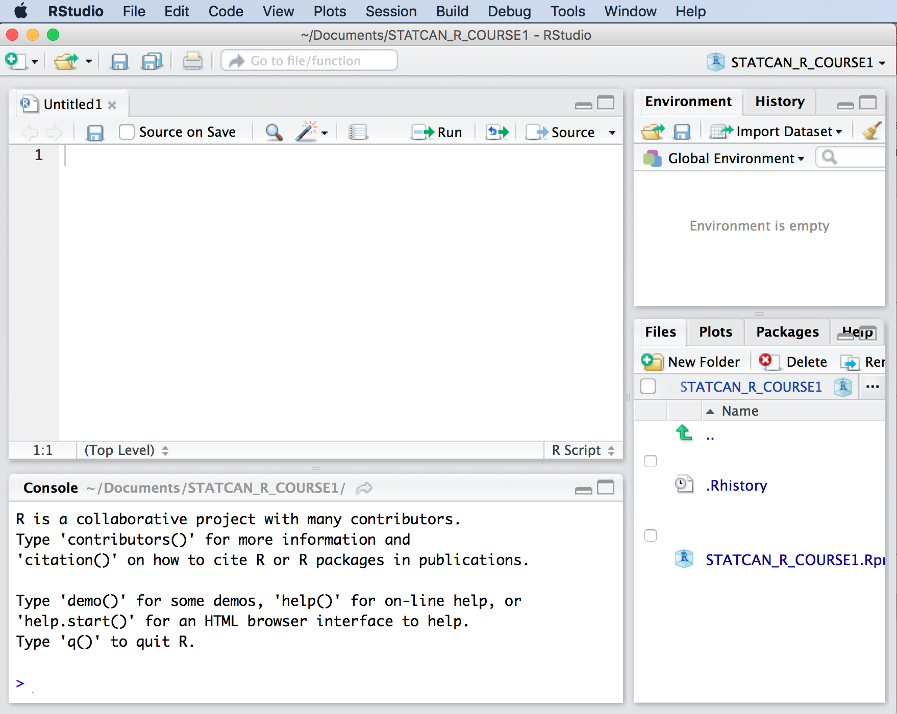
RStudio Environment
Environment/History:
-data frames in memory
-functions
-variables
- History: link to git
Editor Panel
-view scripts
-data files
-text files
Interactive Console:
-base R
-like a SAS output/log
-this is not saved
Files/Plots/Package Viewer:
-saved scripts .R
-view data files
-view text/readme files
Notes:
Let’s get started.
You should have received instructions on getting R and Rstudio setup on your work environment.
OR
Open Rstudio.
Let’s play a little with some of the basic R features to get comfortable with this setup.
How certain code runs can chance from one version of software to another as well as library package versions.

Slide 4
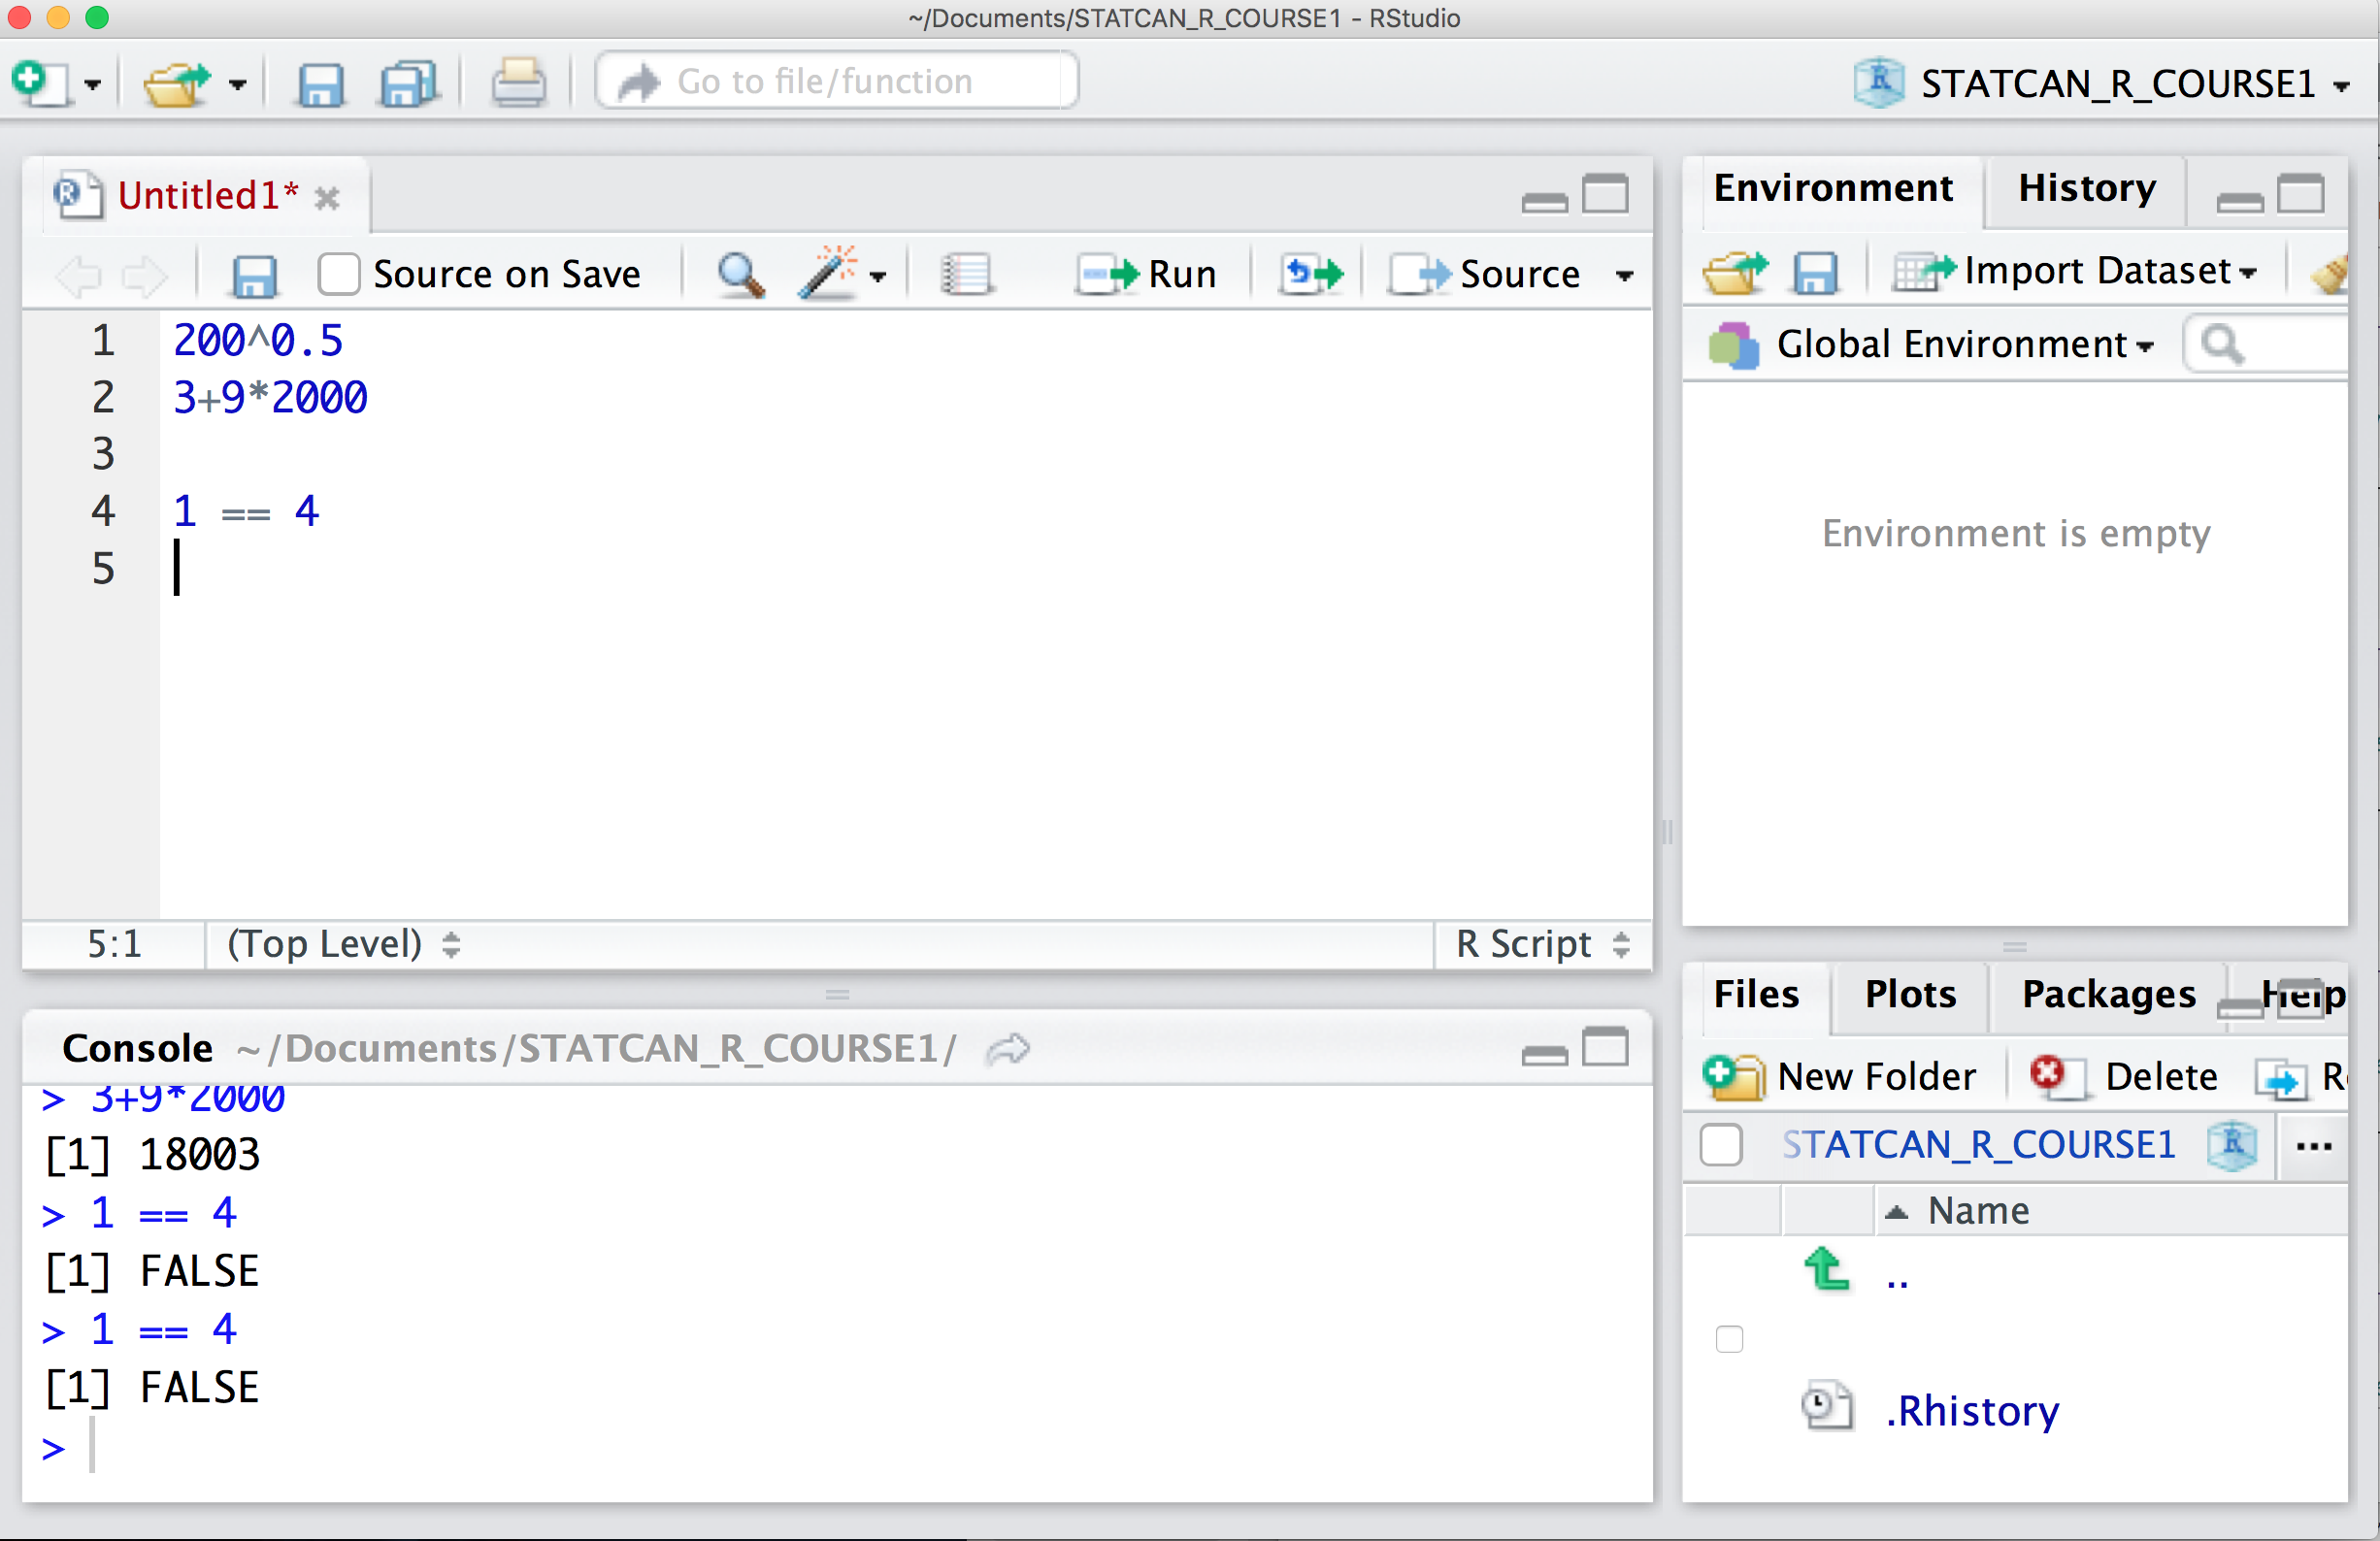
Calculator + Comparator
One questions new R users ask is
“What does this little bracketed one mean?”.
For now you can just ignore that and think of the bracketed
number as a prompt for your
answer.
We will go over an example where the output returns several indexed objects in the next section.
Notes:
Let’s play a little with some of the basic R features to get comfortable with this setup.
-trig functions sin(1)
-basic arithmetic
log(1)

Slide 5
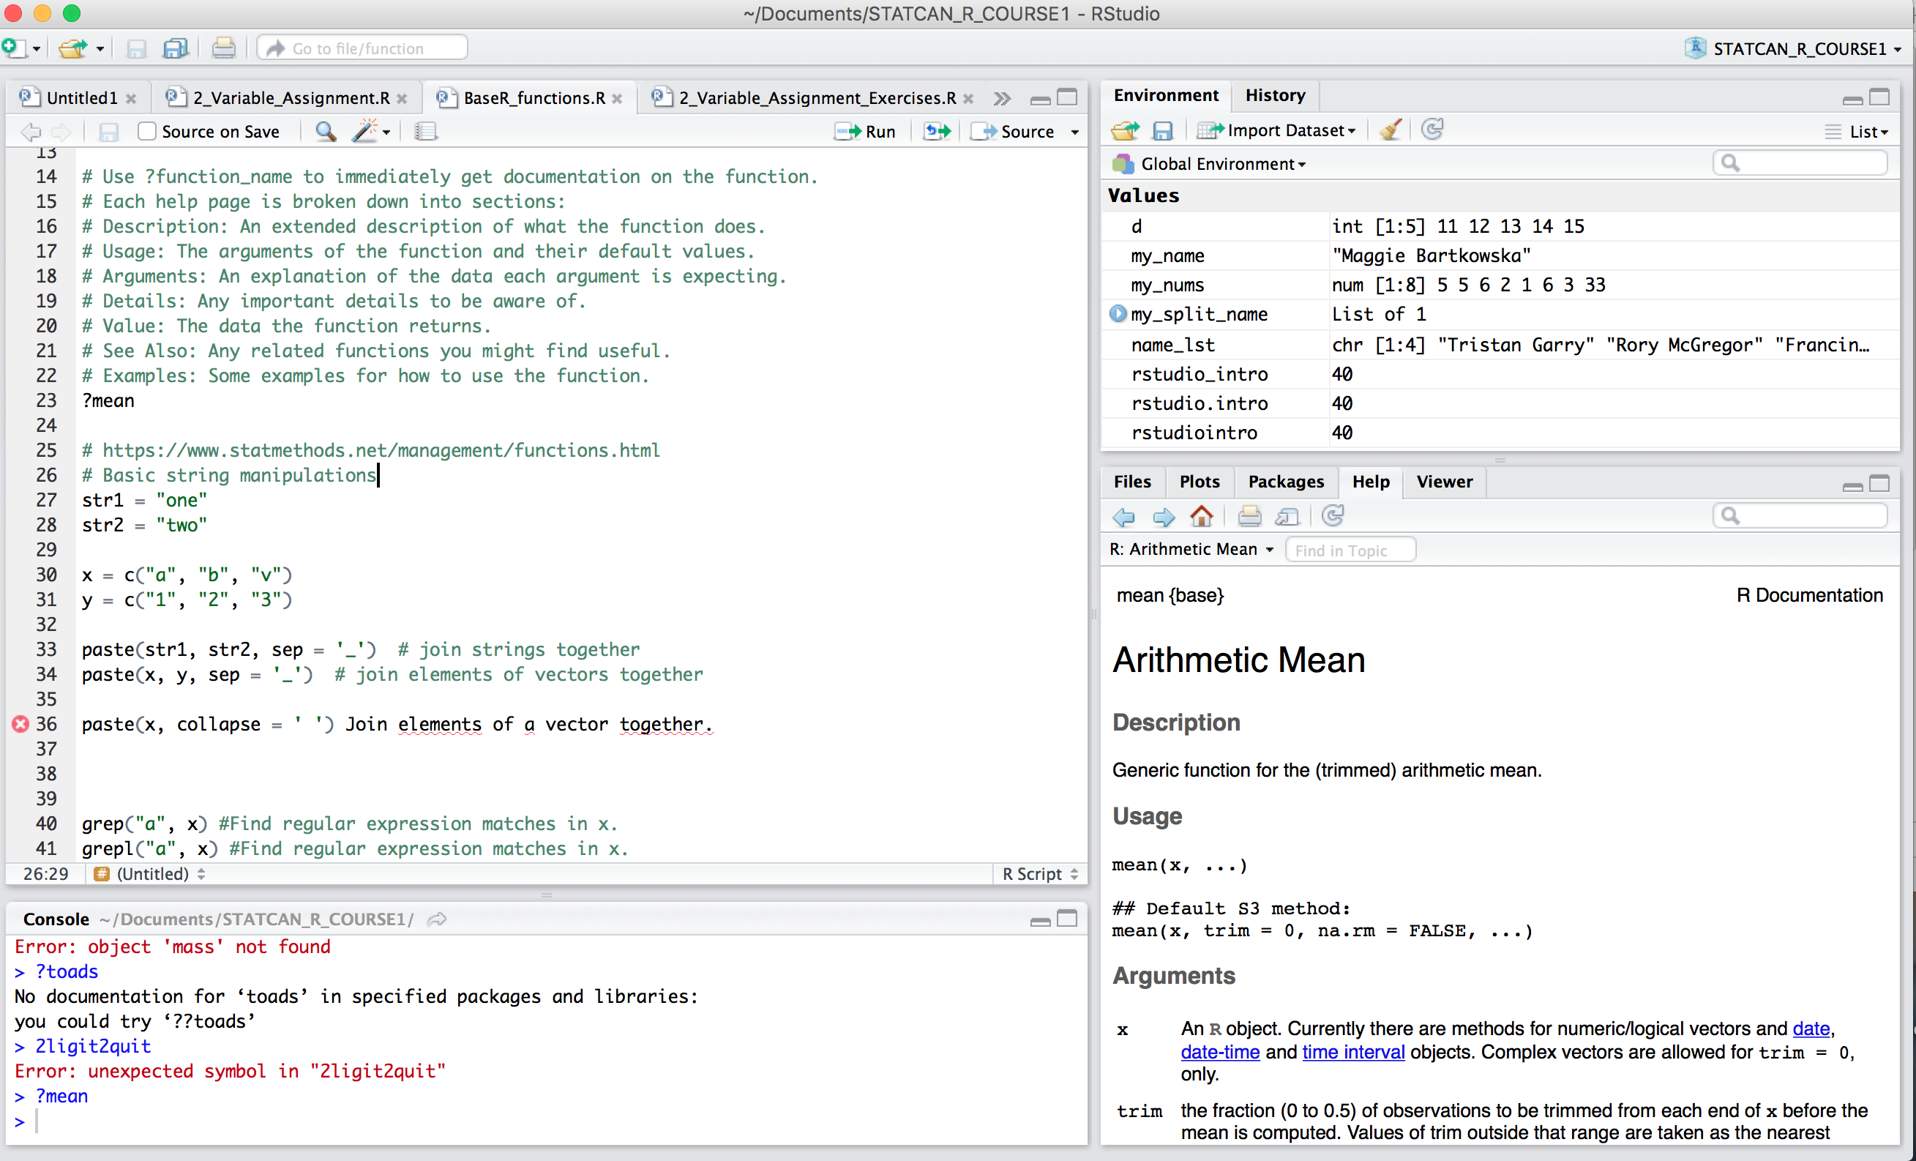
Finding Help
https://stackoverflow.com/
Confluence on Net A
https://confluence.statcan.ca/pages/viewpage.action?pageId=439556887
Use ?function_name to immediately get documentation on the function. Documentation will appear in the viewer panel.
Description:
Usage:
Arguments:
Details
Value
See Also:
Examples:

Slide 6
Calculator/Logic Examples
log(1)
[1] 0
exp(0.5)
[1] 1.648721
sin(1)
[1] 0.841471
200+5
[1] 205
1 >= -9
[1] TRUE
1 < 0
[1] FALSE
1 == 1
[1] TRUE
! != 9
[1] TRUE

Slide 7
Calculator/Logic Examples
log(1)
[1] 0
exp(0.5)
[1] 1.648721
sin(1)
[1] 0.841471
200+5
[1] 205
1 >= -9
[1] TRUE
1 < 0
[1] FALSE
1 == 1
[1] TRUE
! != 9
[1] TRUE

Slide 8
Variable Assignment
Acceptable Names:
rstudiointro <- 40 all lower case
rstudio_intro <- 40 under_score separator
rstudio.intro <- 40 period separator
RstudioIntro <- 40 upper camel case
RstudioIntro2020 <- 40 upper camel case with number
Unacceptable Names
cannot use names that start with numbers. E.g., 1var
cannot start a variable with a $ + !
Many programmers recommend using a particular style for a particular type of object in R. The more consistent you can be with naming conventions the easier it will be to reproduce your work (for yourself and others). Here is one recommended schema:
Data file names should be lower case with underscore separator
Functions defined using period separator
Variables with camel case
Notes:
Let’s play a little with some of the basic R features to get comfortable with this setup.
-trig functions sin(1)
-basic arithmetic
log(1)

Slide 9
1. Assigning Single Values
Assigning numbers
my_number <- 42
Assigning strings / character values
Note that R can accept single and double quotation marks interchangeably for variable assignment
my_name <- "Maggie”
Notes:
Let’s play a little with some of the basic R features to get comfortable with this setup.
-trig functions sin(1)
-basic arithmetic
log(1)

Slide 10
2. Assigning Vectors Arrays and Lists with c()
Vectors are arrays where all entries are the same type. They are building blocks for more complex data structures. In some programming languages there are very specific differences in the data structure of arrays and vectors. For the bulk of typical data science work this distinction will not matter. Using the best data structure and type for a particular problem will become important as computational resources become limiting.
Let's create the vector a and set it to different data types:
vector of numeric values:
a <- c(1, 2, 3, 4, 5)
vector of character values:
a <- c("January", "February", "March", "April", "May")
vector of logicl values:
a<- c("TRUE", "FALSE", "FALSE", "TRUE", "FALSE")
Notes:
Let’s play a little with some of the basic R features to get comfortable with this setup.
-trig functions sin(1)
-basic arithmetic
log(1)

Slide 11
2. Assigning Series Quickly
If you want to create a vector containing a sequence of numbers, you use the : operator
d <- 11:15 # there no need for the c function
d <- c(11:15) #vector of numeric values:
Notes:
Let’s play a little with some of the basic R features to get comfortable with this setup.
-trig functions sin(1)
-basic arithmetic
log(1)

Slide 12
3. Operations on Vectors
Operations are applied across all elements of an vector
E.g.,
d <- c(11:15) #vector of numeric values:
[1] 11 12 13 14 15
d-2
[1] 9 10 11 12 13
d*3
[1] 33 36 39 42 45
Notes:
Let’s play a little with some of the basic R features to get comfortable with this setup.
-trig functions sin(1)
-basic arithmetic
log(1)

Slide 13
4. Accessing Elements in a Vector: Indexing
vector_values <- LETTERS # creates an object with the letters of the alphabetlength(vector_values) # gives you the length of a vector. How many elements it has basicallyvector_values[6] # picking letter number 6vector_values[10:19] # pick letters from 10 to 19vector_values[ -c(10:19)] # remove letters 10 to 19 from this vector
Notes:
Let’s play a little with some of the basic R features to get comfortable with this setup.
-trig functions sin(1)
-basic arithmetic
log(1)

Slide 14
5. Functions and Arguments
Functions are objects which perform specific tasks and arguments control what functions do.
R has many build-in functions. Check out the BaseR.R script showing the most commonly used functions (e.g., mean, median, sin, rnorm)
Functions always have open and closed brackets.
E.g., seq(1,200,20)
Function name 1, 200, 20 : are the function arguments.
We can use the seq() and rep() functions to create vectors with many elements quickly.
> seq(1,200,20)
[1] 1 21 41 61 81 101 121 141 161 181
> rep(c(“cat”, “dog”),2)
[1] cat dog cat dog
Notes:
Let’s play a little with some of the basic R features to get comfortable with this setup.
-trig functions sin(1)
-basic arithmetic
log(1)

