Slide 1

Introduction to R/RStudio Hosted by Methodology February 2020

Slide 2
R has become one of the most commonly used tools across many science and social science disciplines for data manipulation, statistical analysis and creating publication quality data visualizations. As part of its modernization strategy, STATCAN is embracing this tool. Although the use of R at STATCAN is relatively recent, there is already a seasoned R-users group and many teams use this tool to help speed research.
The goal of this course is to provide novice R users a solid foundation in the best practices for data wrangling and analysis, while emphasizing strategies to ensure reproducibility. Learning a new programming language can be difficult. Even if you have coding experience, a new language introduces a new environment, styles, and syntax and can make you feel like a beginner again. There will be lots of opportunity for participants to move through exercises at their own pace and one-on-one assistance will be available throughout the course.
This course is intended for novice R users and analytics team leads/managers who’d like to learn how R/RStudio can be leveraged by their team. Throughout the course material, extra resources that can support further learning are highlighted.
At the end of the two day session you be able to:
1) preform basic data queries using dplyr and baseR
2) perform data manipulations and summaries
3) produce fast plots for data exploration
4) produce publication quality plots using ggplot2

Slide 3
Course Overview
Day 1:
Get one-on-one help opening and navigating R/Rstudio (optional 8:30 am)
Why R/Studio (~30 min)
Into to R/Rstudio IDE
R as a Calculator
Variable Assignment
Data Frames in base R
Installing and loading packages
Day 2
Intro to dplyr
select, filter, summarise, mutate, arrange, joins
Pipe Operations
Intro to ggplot2
Notes:
I’d like to try a hybrid of traditional lecture style and flipped classroom.
Everyone registered will receive instructions on how to request R / Rstudio on their work stations/environments
Teacher + TA can be available for 30 min ahead of the official start time to helps with loading or finalizing installations.

Slide 4
Part 1. Why Bother with R/RStudio
Notes:
15 min, but 30 Min max if there are questions.

Slide 5
Why R/RStudio
Open source
Facilitate collaboration & new team members
Similar analytics tools to SAS, SPSS, STATA, Python-pandas
Most common analytical tool taught across Universities
Easy and beautiful publication quality visualizations
Reproducibility & Git/Github/Gitlab integration
Other cool things with R

Slide 6
Why R/RStudio: open source
CRAN
https://cran.r-project.org/
At STATCAN:
R/Python User Group :
R/Python User Group - About Us (statcan.ca)
Canada Census
cansim
An R package to retrieve and work with public Statistics Canada data tables.
https://mountainmath.github.io/cansim/
cancensus:
provideS users with direct access to the past 3 Canadian Census datasets
https://cran.r-project.org/web/packages/cancensus/vignettes/cancensus.html
Notes:
The cancensus package was developed to provide users with a way to access Canadian Census in a programmatic way following good tidy data practices. While the structure and data in cancensus is unique to Canadian Census data, this package is inspired in part by tidycensus, a package to interface with the US Census Bureau data APIs.
As Statistics Canada does not provide direct API access to Census data, cancensus retrieves Census data indirectly through the CensusMapper API. CensusMapper is a project by Jens von Bergmann, one of the authors of cancensus, to provide interactive geographic visualizations of Canadian Census data. CensusMapper databases store all publicly available data from Statistics Canada for the 2006, 2011, and 2016 Censuses. Censusmapper data can be accessed via an API and cancensus is built to interface directly with it.

Slide 7
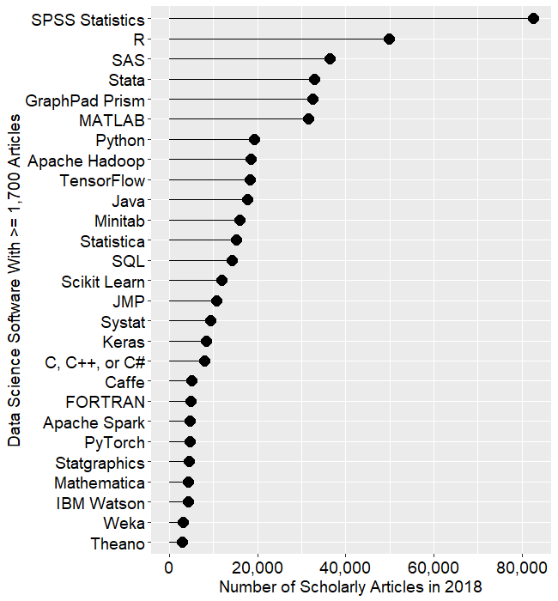
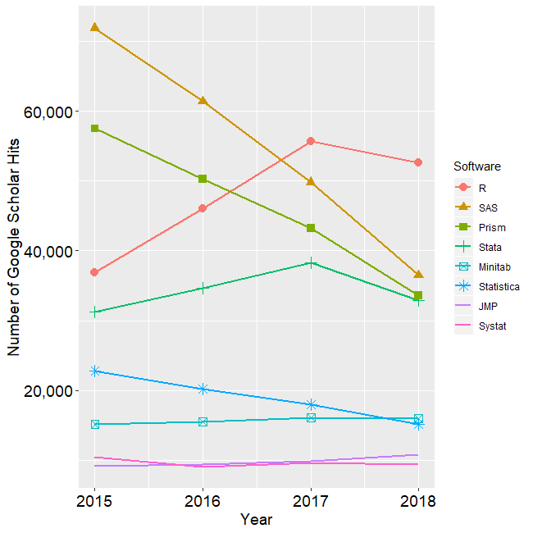
Why R/RStudio: Collaboration and New Staff
Source: Bob Muenchen Data Science Software Used in Journals: Stat Packages Declining (including R), AI/ML Software Growing. April 2019
http://r4stats.com/2019/04/01/scholarly-datasci-popularity-2019/

Slide 8
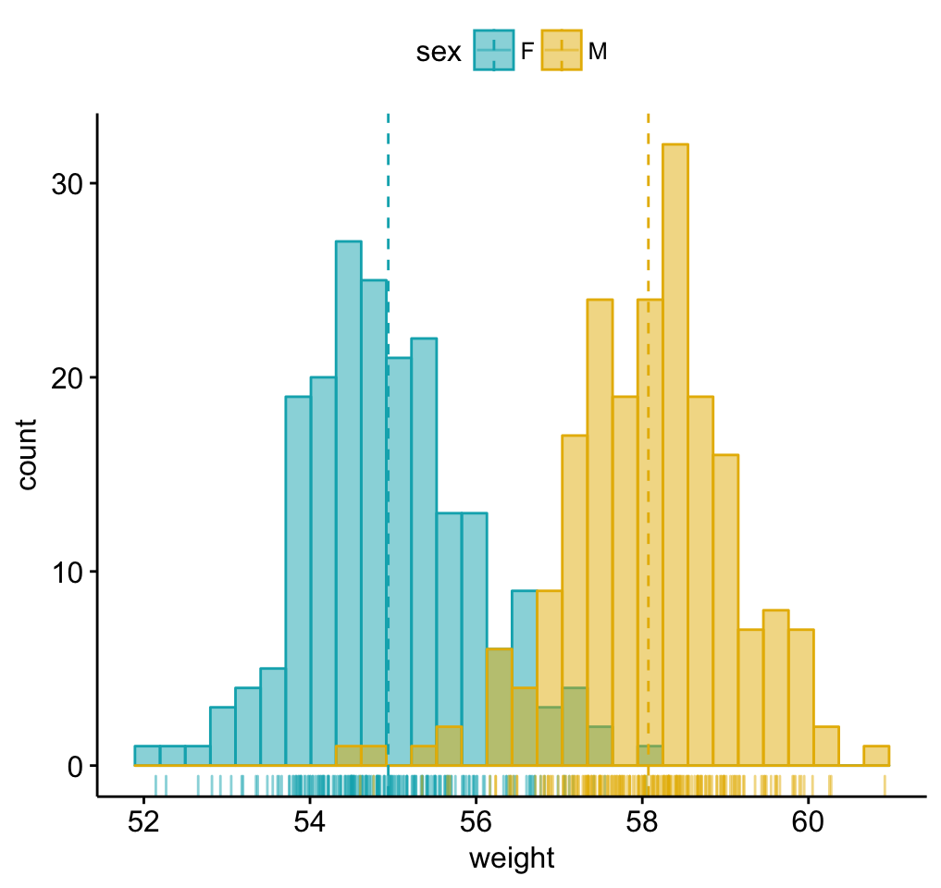
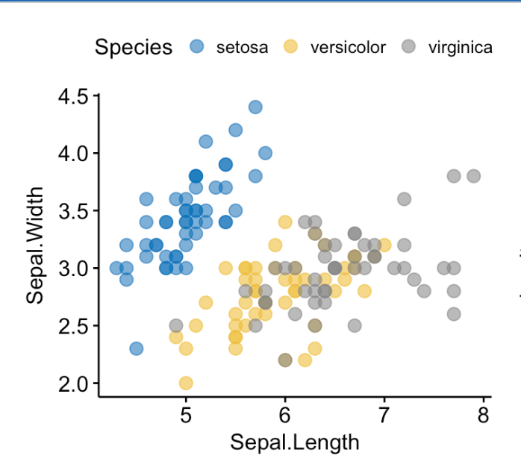
Why R/RStudio: Easy Viz,with baseplot + ggplot2
Gallery: http://www.sthda.com/english/articles/24-ggpubr-publication-ready-plots/

Slide 9
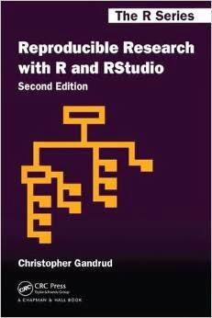
Why R/RStudio: Reproducibility
https://github.com/christophergandrud/Rep-Res-Book
Notes:
R Studio, similar to SAS enterprise guide is setup to facilitate best practices of reproducibility.
Projects are easily delineated and organized.
Project folder structure adheres to best practices, which we will cover as we begin exploring Rstudio (e.g., explicitly tie files together)
See readme files.
Easily document code and file structures.

Slide 10
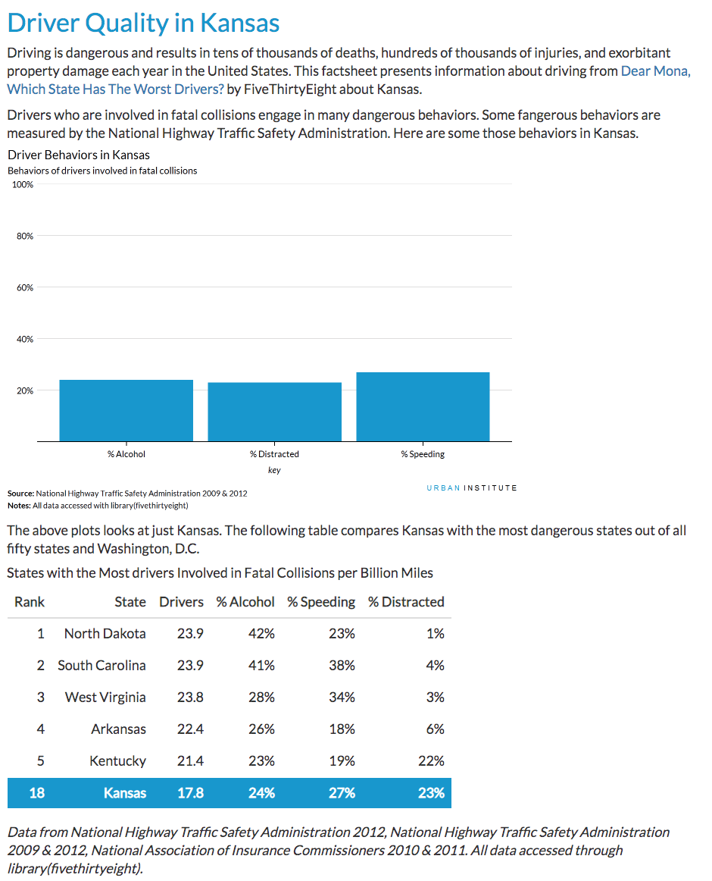
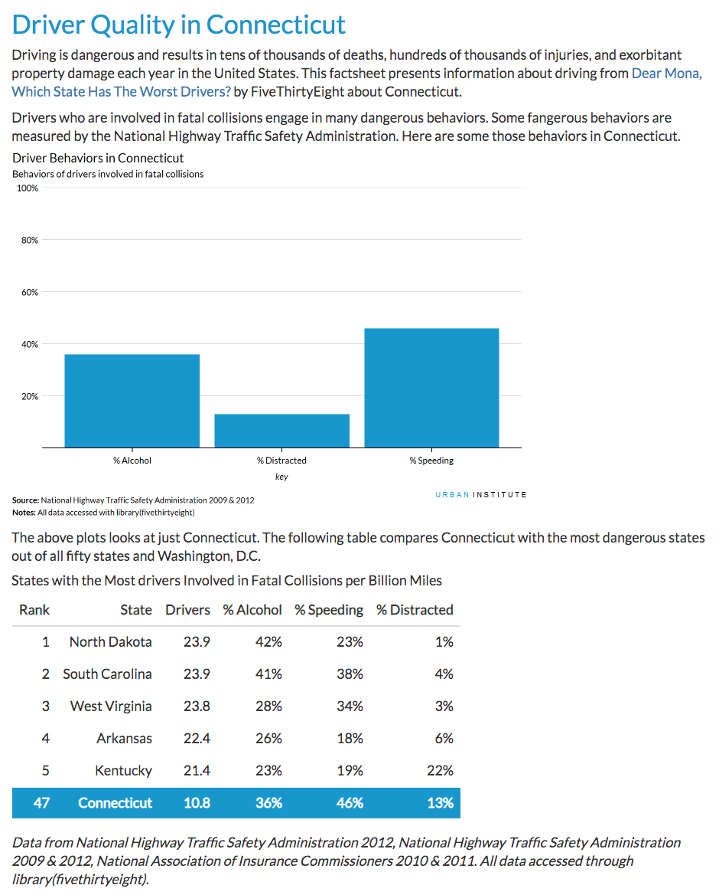
Reproducibility cont.
https://medium.com/@urban_institute/iterated-fact-sheets-with-r-markdown-d685eb4eafce
Notes:
There is a whole other type of R workflow that helps with reproducibility. Using Rmarkdown is a course in itself so we won’t cover it here. But I’m showing this to you so that you can see that if creating similar documents but with different data sources R can greatly speed your work. You can create documents for new data sources with the click of 2 buttons.

Slide 11
Reproducibility cont.
Rmarkdown facilitates report creation
https://medium.com/@urban_institute/iterated-fact-sheets-with-r-markdown-d685eb4eafce
https://github.com/UrbanInstitute/rmarkdown-resources/tree/master/01_driving-example/output
Preview html: http://htmlpreview.github.io/
Notes:
How certain code runs can chance from one version of software to another as well as library package versions.

Slide 12
Other Cool Things To Do With R
Reproducible Word PPT or PDF
Rmarkdown + YAML
Connect to almost any database local or remote
Fit deep learning models with keras and Tensorflow
Analyze data using Spark clusters directly in R
Build and learn R interactively: https://swirlstats.com/
Build interactive web apps
Shiny https://www.shinyapps.io/
https://simplystatistics.org/2019/03/13/10-things-r-can-do-that-might-surprise-you/

Slide 13
Resources
ADI: Analytical Diversification Initiative (sharepoint.com)
Confluence at STATCAN:
Presentations from the R user group https://confluence.statcan.ca/pages/viewpage.action?pageId=464393397
R and Python cheat sheets https://confluence.statcan.ca/pages/viewpage.action?pageId=464393397
Learn R (corporate resources coming):
SWIRL: https://swirlstats.com/
Software Carpentry http://swcarpentry.github.io/r-novice-gapminder/
Viz gallery:
http://www.sthda.com/english/articles/24-ggpubr-publication-ready-plots/
Reproducible Research text book
https://github.com/christophergandrud/Rep-Res-Book

Slide 14
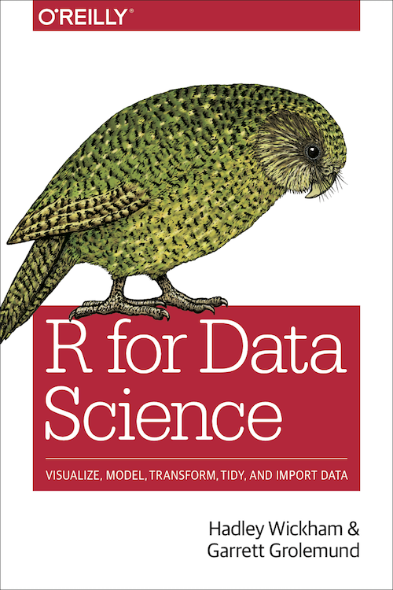

Resources
R for Data Science: https://r4ds.had.co.nz/
The R Book
Software Carpentry R Programming
https://swcarpentry.github.io/r-novice-inflammation/
Data Camp: https://www.statmethods.net/index.html
Toward Data Science: https://towardsdatascience.com/
Stack overflow
Github: https://ubc-dsci.github.io/introduction-to-datascience/index.html

