Slide 1
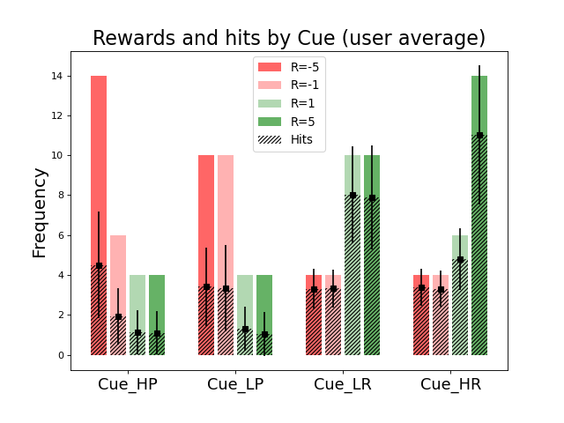
Hit frequency per cue and per reward

Slide 2
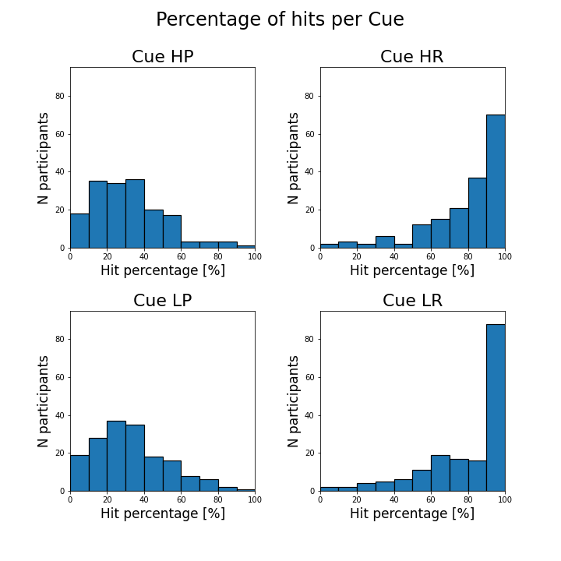
Hit (vs not) percentage per cue
Notes:
They treat the magnitudes very similarly. Scaling in the PEs?

Slide 3
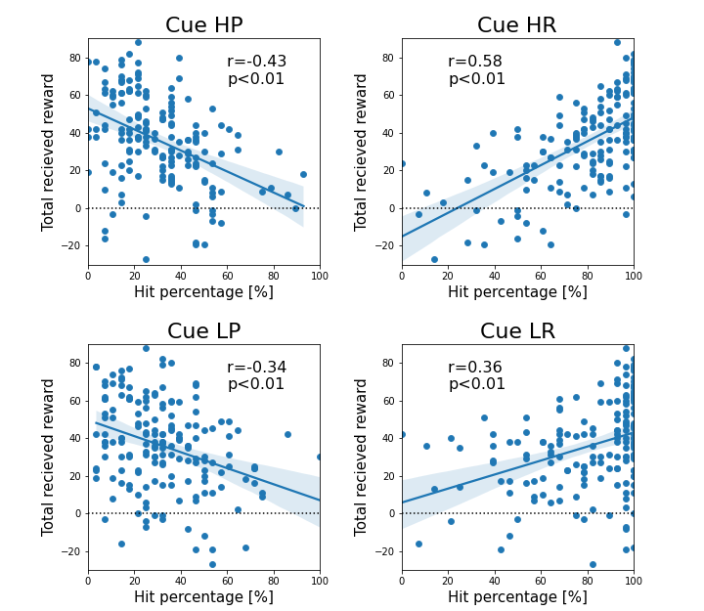
Hit percentage and reward correlation

Slide 4
Hits per cue across time
Different window sizes
Trials = 112
56 trials per run

Slide 5
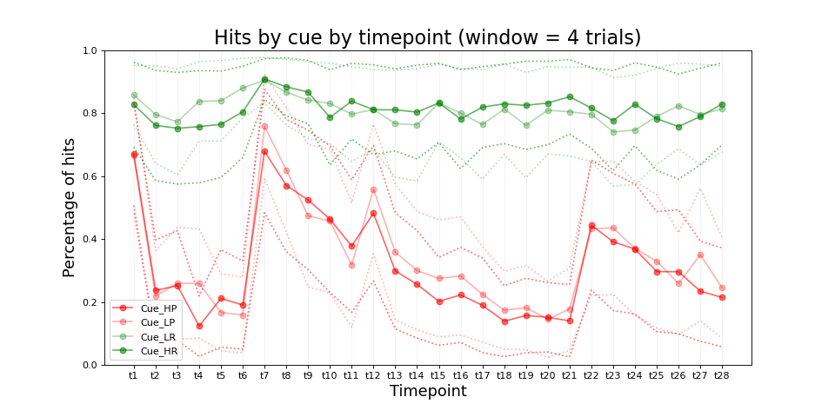
Notes:
Ask nathalie if it was random for each participant
→ do the same with sliding average

Slide 6
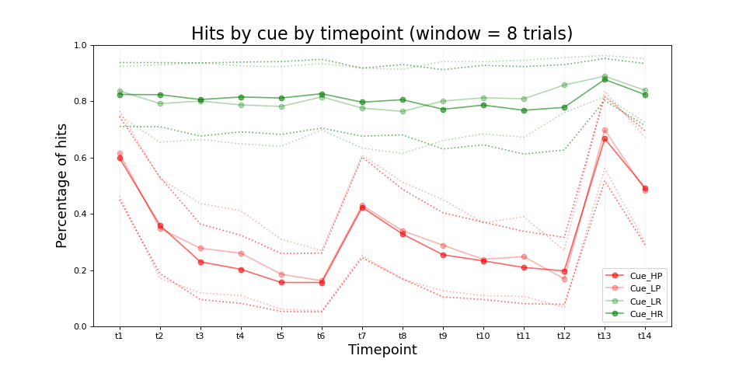

Slide 7
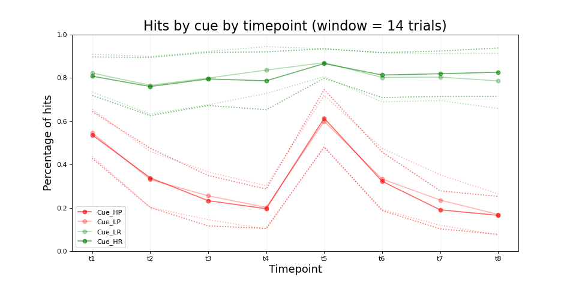
t4 = 14 trial * 4 = 56 trials
🡪 End of run 1
Notes:
Ask nathalie if exactly same condition - did the stimuli change? For modeling: introduce forgetting rate
If change in stimuli: start from zero

Slide 8
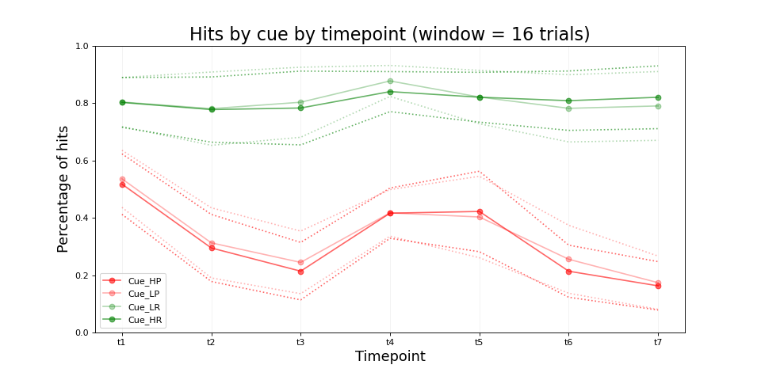
🡪 End of run 1

Slide 9
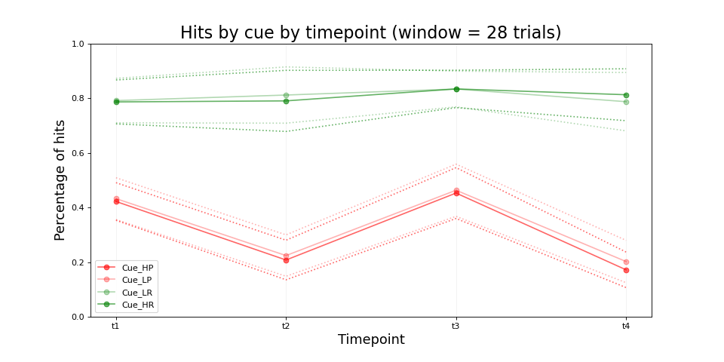
Notes:
Plot HR cue
Plot dot (-5,-1,1,5) of what they see and circle it if they chose it
PNAS effort learning plot how much point they got on the bottom or so
See if they see the same thing
Ask if there are some key individual differences she’s interested in (questionnaire. Demographics etc)
Right down a few models that make sense
Simple RL with 1 learning rate and 1 softmax and a fixed prior at 0.5. Prior vaue as free parameter
Different learning rates for positiv and negativ PEs
A scaling in front of -5 (-5 and -1 have same effect?)

Slide 10
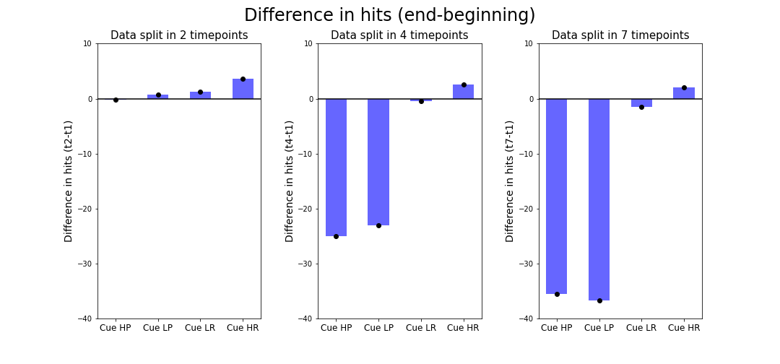
Difference in hits (last window- first window)

Slide 11
Individual plots
Selected some users from the 10 best performing ones (total reward)

Slide 12
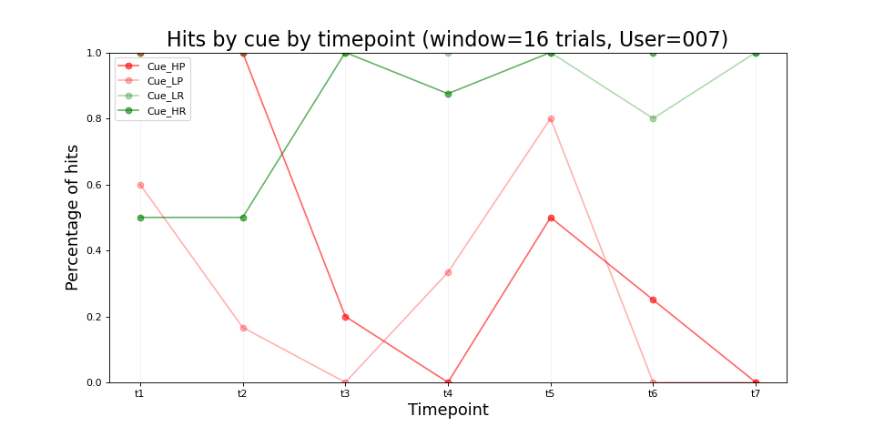
User 007

Slide 13
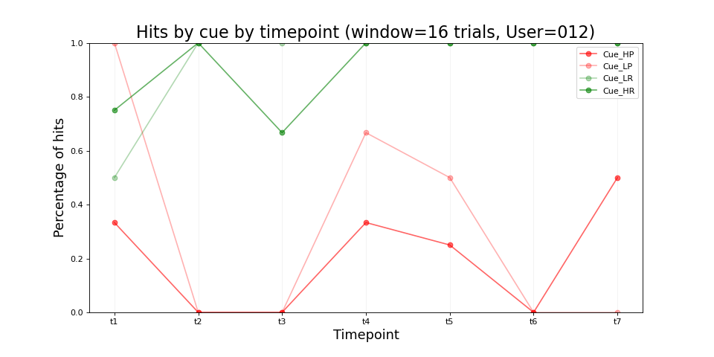
User 012

Slide 14
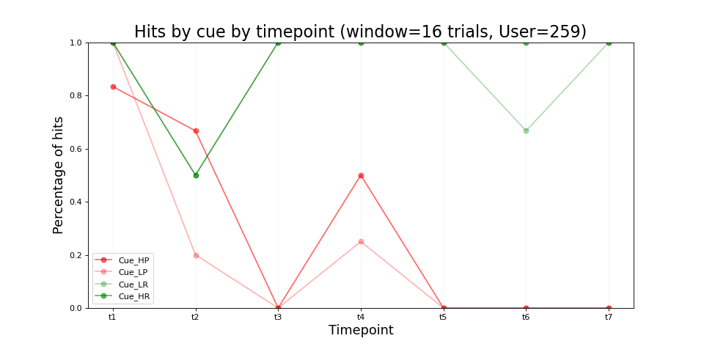
User 259
Notes:
Ask if stimulus picture change and whether it was the same sequence for all

