Slide 1
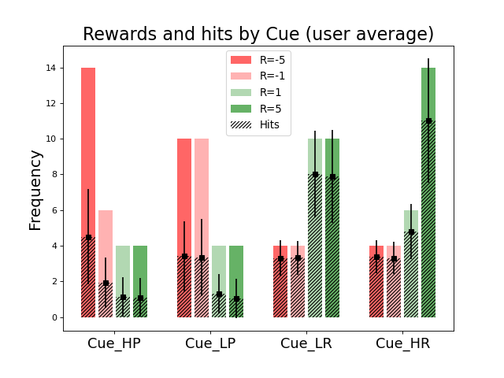
Hit frequency per cue and per reward

Slide 2
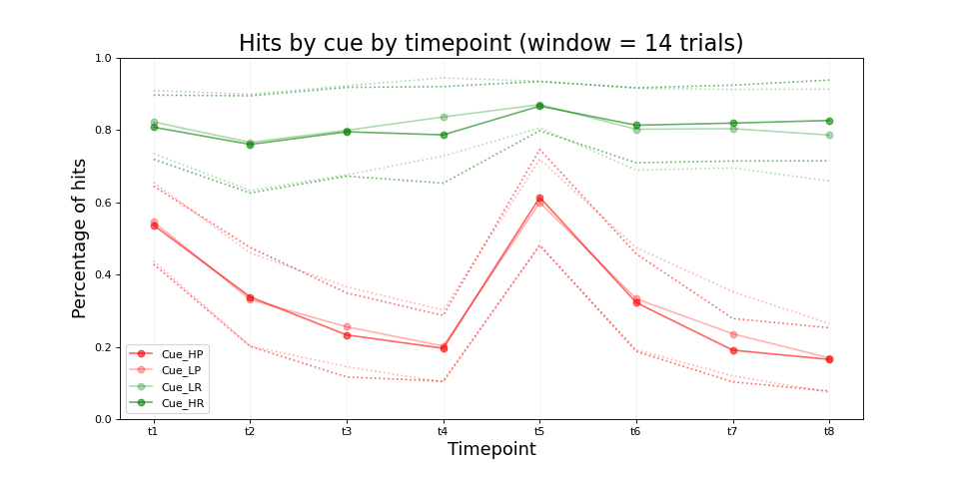
t4 = 14 trial * 4 = 56 trials
-> End of run 1
Notes:
Ask nathalie if exactly same condition - did the stimuli change? For modeling: introduce forgetting rate
If change in stimuli: start from zero

Slide 3
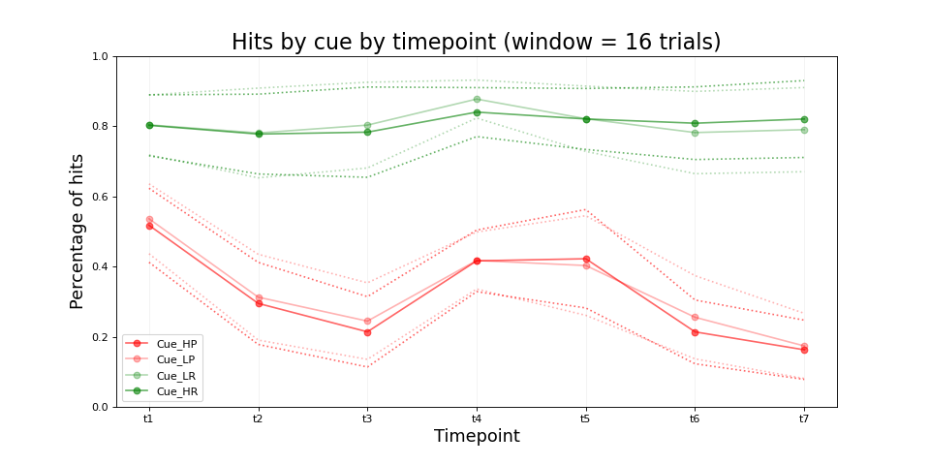
-> End of run 1

Slide 4
Weird bump in punishment
Do they see the same things ?
→ Make plots with what they see and if they choose it
→ They don’t see the same thing
Notes:
Ask if stimulus picture change and whether it was the same sequence for all

Slide 5
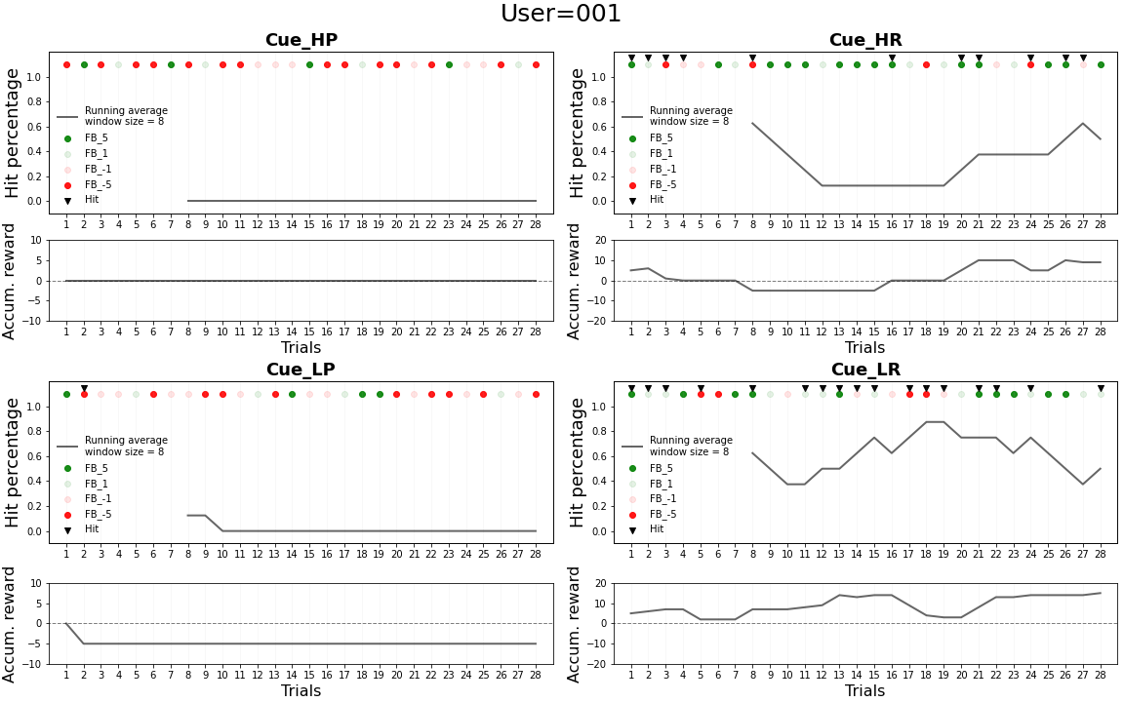

Slide 6
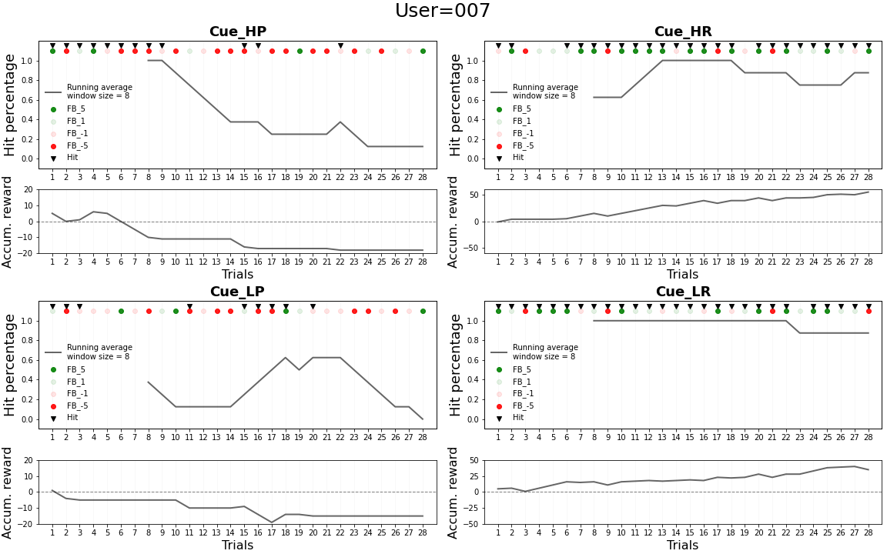

Slide 7
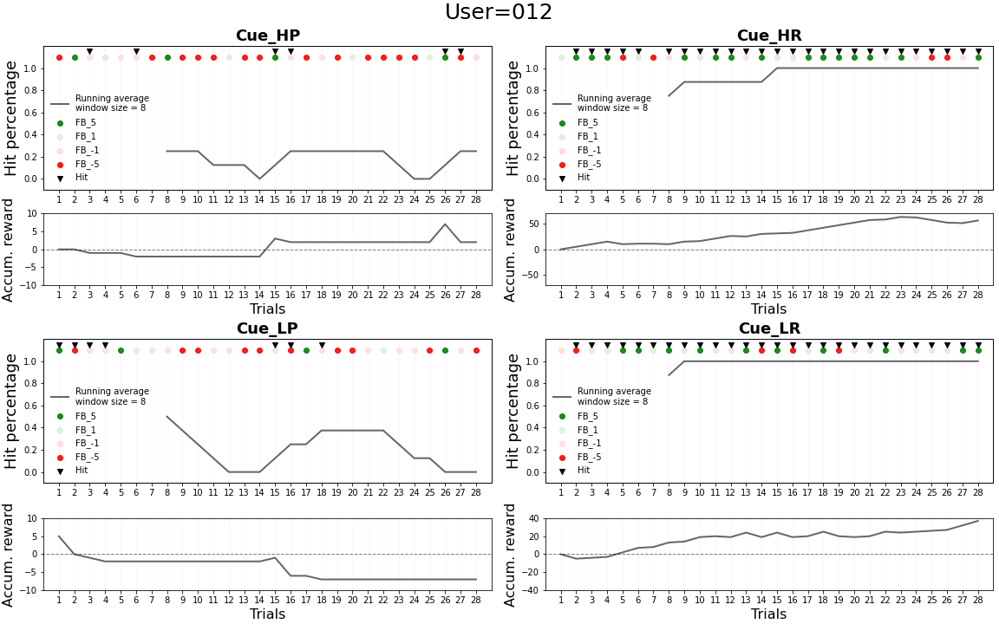

Slide 8
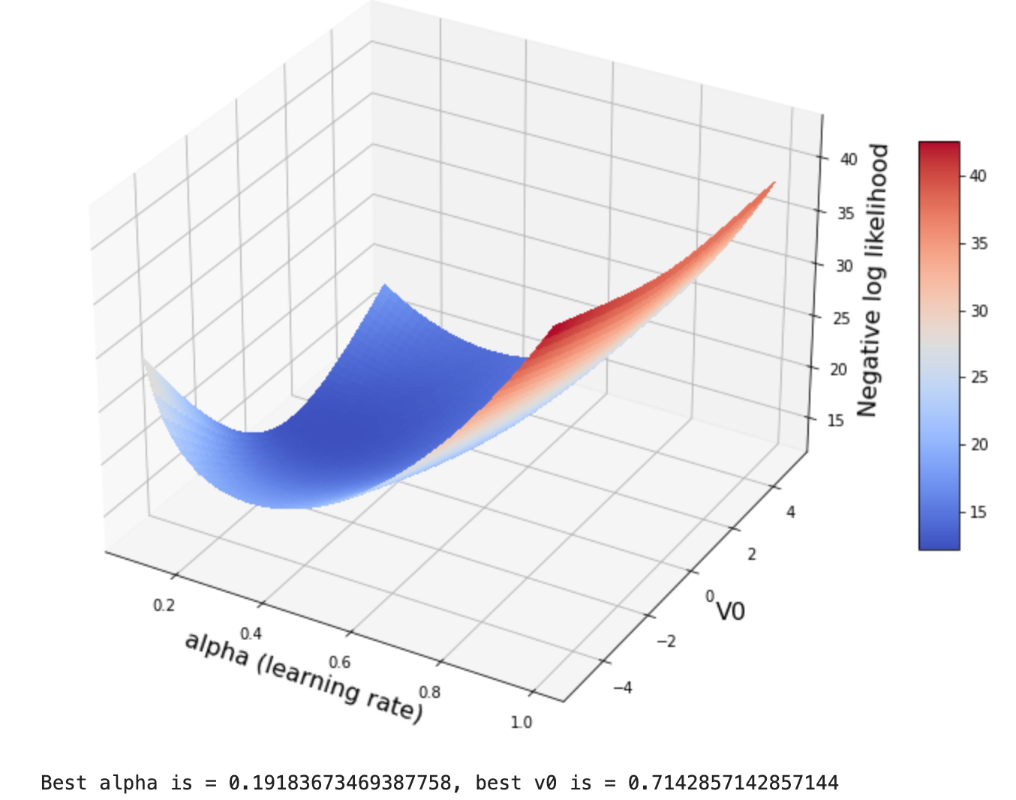
Notes:
For one participant
Simple model with learning rate, v0 and inverse temperature (beta fixed to 1 here)
Shoudl fit all the cues together (1v0 not 4)
Have many of those with different betas
Sscaling factor in front of HR HP
Thesis:
Computtional psychiatry, pharmacology, computationl modeling, individual differences, brain development

Slide 9
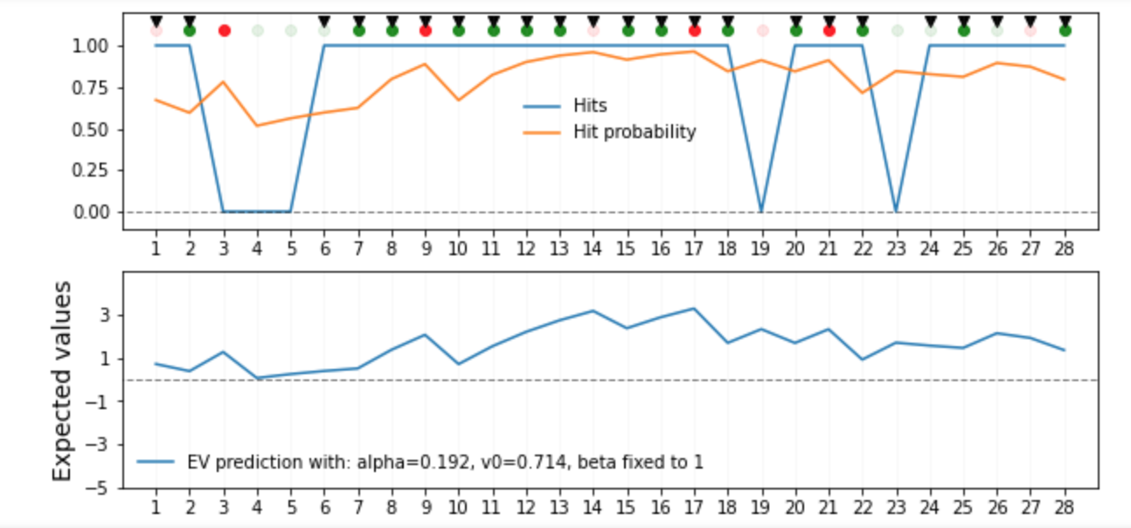
Notes:
Parameters extracted visually, now will try with optimisation methods + fit beta

Slide 10
To ask Nathalie
Ask if there are some key individual differences she’s interested in (questionnaire. Demographics etc)
Right down a few models that make sense
Simple RL with 1 learning rate and 1 softmax and a fixed prior at 0.5. Prior vaue as free parameter
Different learning rates for positiv and negativ PEs
A scaling in front of -5 (-5 and -1 have same effect?)
Ask nathalie if exactly same condition in the 2 runs - did the stimuli change? For modeling: introduce forgetting rate
If change in stimuli: start from zero

