Slide 1
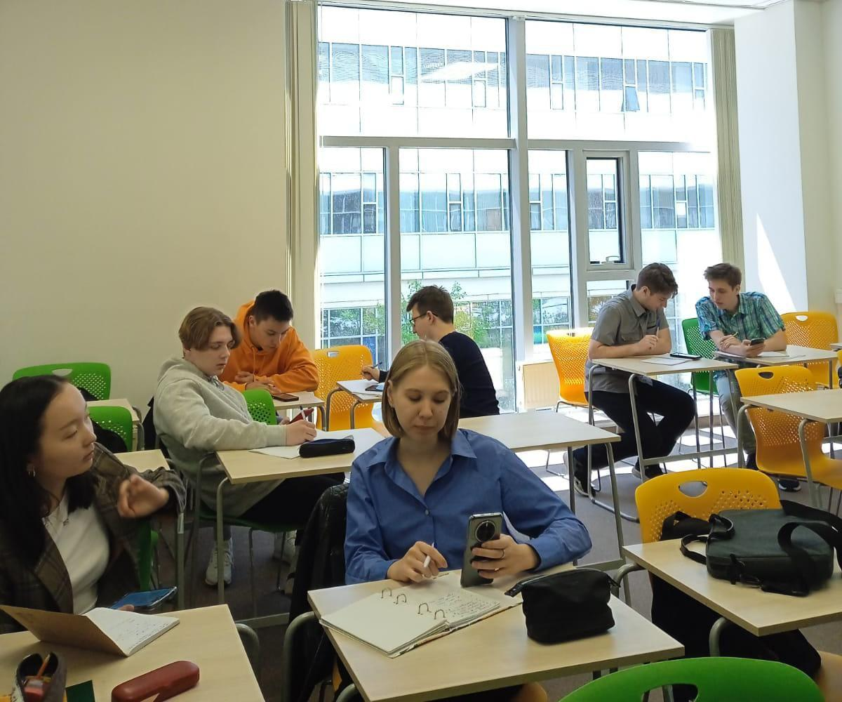
Study smarter, not longer
Good study skills matter now more than ever, and science points to ones that really work

Slide 2
Adjusting to becoming a student with educational ambitions takes
determination,
discipline, and
patience.
Explore the strategies you can implement to make the most of your experience at the University and set yourself up for academic success

Slide 3

SPACE OUT YOUR STUDYING
You’ll learn and remember material better if you space your study sessions over the course of several days.
In one 2009 experiment, college students studied vocabulary words with flash cards. Some students studied all the words in spaced-apart sessions throughout four days. Others studied smaller batches of the words in crammed, or massed, sessions, each over a single day. Both groups spent the same amount of time overall. But testing showed that the first group learned the words better.

Slide 4
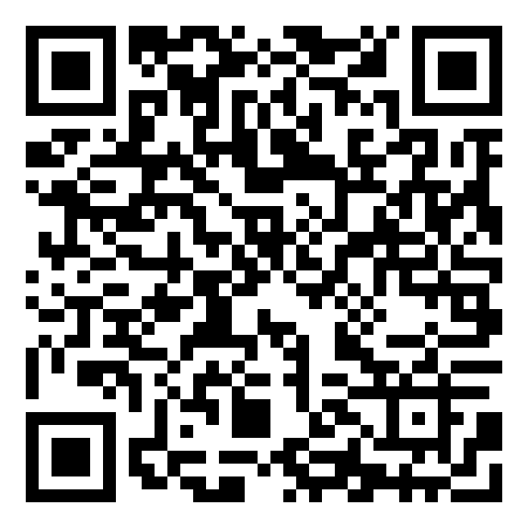
Turn to Practice: Study Schedule Arrangement
Arrange the study schedule for two students, who are preparing for a vocabulary test. Both students have an equal amount of time available for studying, but they have different approaches.
Alice decides to cram all her study sessions into a single day before the test.
Bob chooses to distribute his study sessions across four days leading up to the test.
https://learningapps.org/display?v=pviaza2bc23

Slide 5
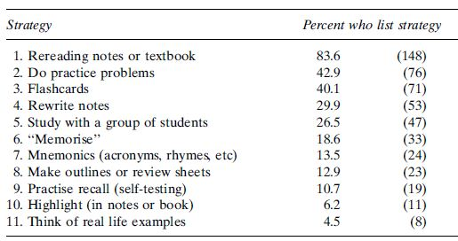
DON’T JUST REREAD BOOKS AND NOTES
it’s superficial
Henry Roediger, Washington University, compared test results of students who reread material to two other groups. One group wrote questions about the material. The other group answered questions from someone else. Those who answered the questions did best. Those who just reread the material did worst.
Study strategies ranking
(from J. Karpicke et al. (2009) Washington University. Similar conclusions: Hartwig & Dunlosky, 2012; Kornell & Bjork, 2007).

Slide 6
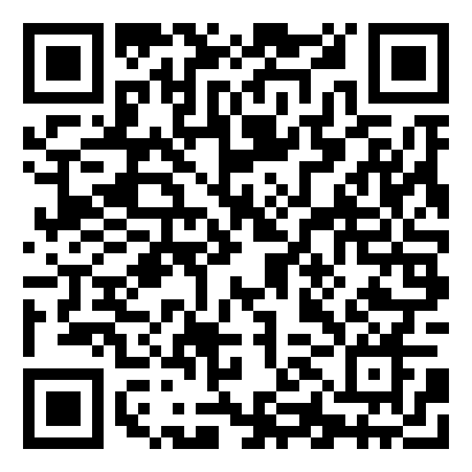
Turn to Practice: Make up pairs
Match the meaning of each word in which it was used in the text
https://learningapps.org/display?v=ppn918xak23

Slide 7
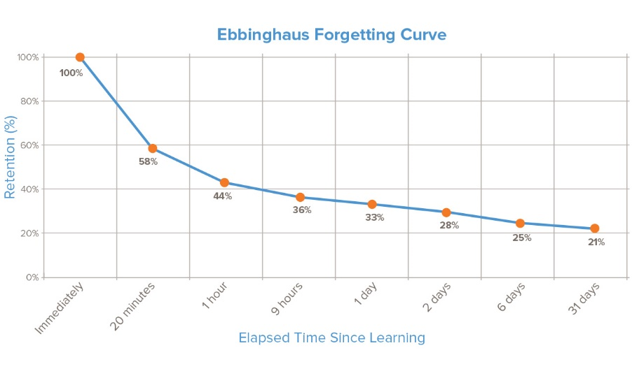
TEST YOURSELF
Self-testing leads to better memory
even compared to concept mapping (Karpicke & Blunt, 2011).
The greatest loss of information occurs almost immediately after memorization (40% is lost, 60% remains). Without consolidation and repetition, we are not able to retain knowledge even for a relatively short time.
Retrieval practice can help nearly everyone.
Create a deck of flash cards every time you learn new information. Put questions on one side and the answers on the other side. Friends can even quiz each other on the phone

Slide 8
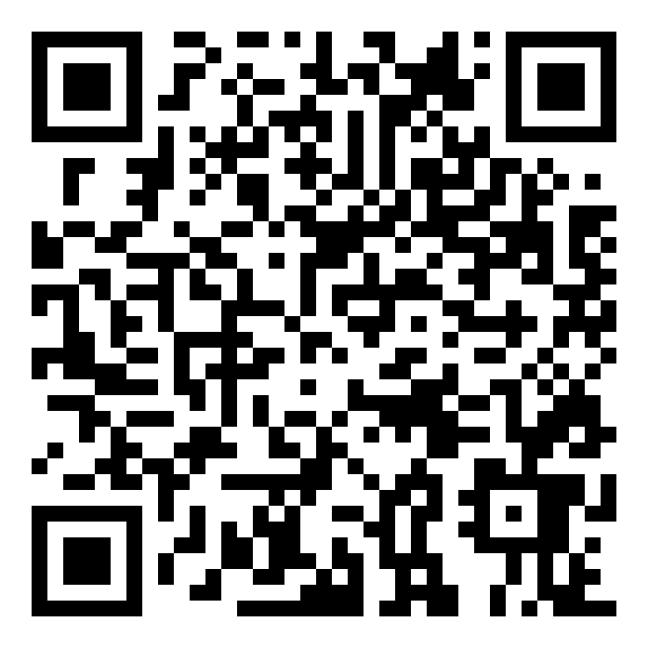
Turn to Practice: Write the percentage
https://learningapps.org/display?v=p4vaz7k6223

Slide 9
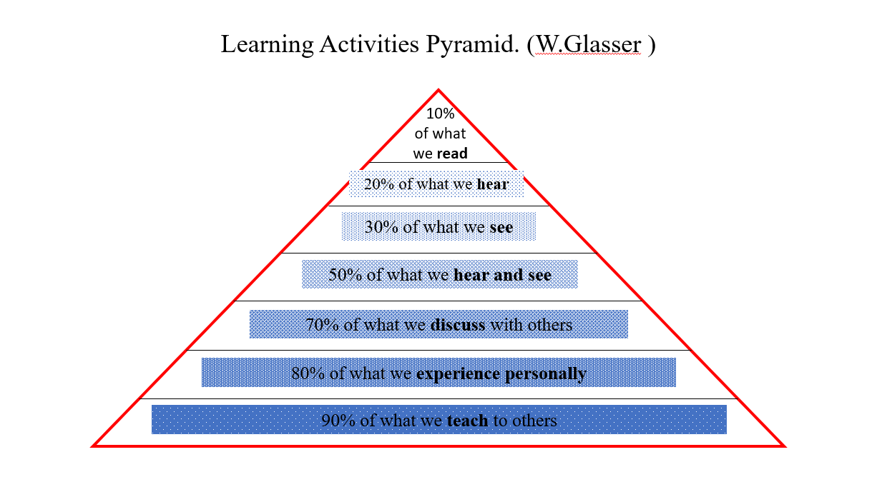
EXPLAIN a difficult idea, concept, problem, or passage to a friend.

Slide 10
THINK LIKE A PROFESSOR
Instructors have reasons for why they craft their courses as they do. Spend some time considering these reasons.
Ask yourself why you’re reading this text and this point in the semester or what this writing assignment is designed to help you to do.
Try to quiz yourself the way the teacher asks questions. Teachers often dig deeper. They don’t just ask for definitions. Often, teachers ask students to compare and contrast ideas. That takes some critical thinking

Slide 11
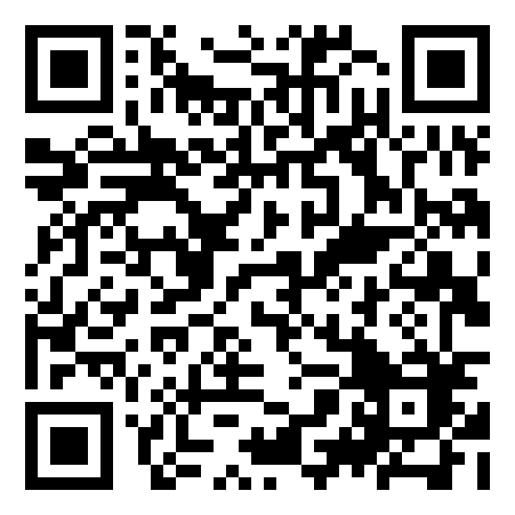
Turn to Practice: Quiz
This quiz comprises a series of questions related to the topic of studying smartly. The questions are designed to assess your grasp of key concepts, as well as your ability to apply these concepts in practical scenarios.
https://learningapps.org/display?v=pwcq3c2ut23

Slide 12
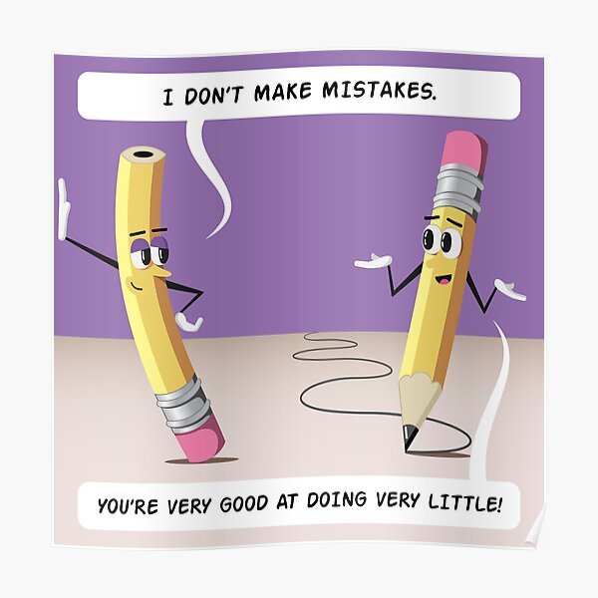
MISTAKES ARE OKAY — as long as you learn from them
It doesn’t really matter how many seconds you spend on each try. But it’s important to go the next step. Check to see if you were right. Then focus on what you got wrong.
A secret of science: Mistakes boost understanding.
Mistakes are actually a primary key to learning.

Slide 13
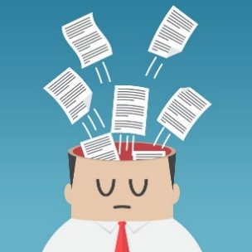
MIX IT UP
Don’t just focus on one thing. Drill yourself on different concepts. Psychologists call this interleaving.
Try to solve problems and recall information on your own. Then check to see if you’re right.
Suppose, for instance, you’re learning about the volume of different shapes in math. You could do lots of problems on the volume of a wedge. Then you could answer more batches of questions, with each set dealing with just one shape. Or you could figure out the volume of a cone, followed by a wedge. Next you might find the volume for a half-cone or a spheroid. Then you can mix them up some more. You might even mix in some practice on addition or division.
It's the process of learning, forgetting, retrieving and relearning that eventually registers the knowledge in our long-term memory.

Slide 14
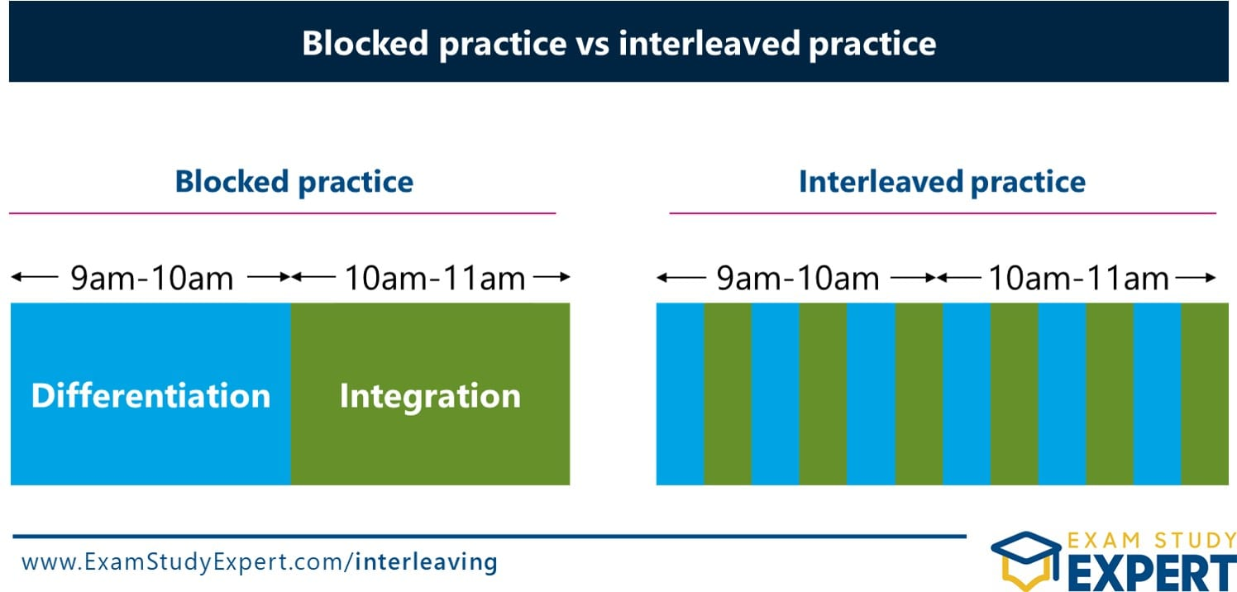
FIND EXAMPLES
Abstract concepts can be hard to understand.
Form a mental image if you
have a concrete example
of something
e.g.
Interleaved learning
Interleaving, the practice of mixing different
topics or subjects during studying,

Slide 15
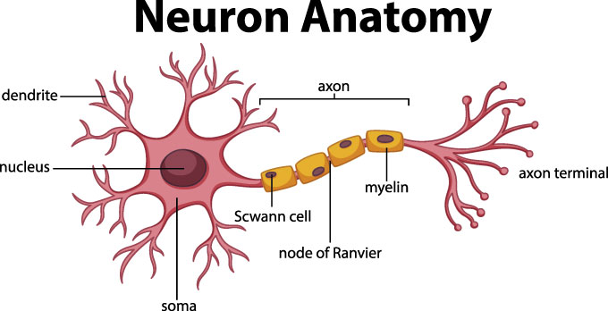
Use pictures
Visual representations help you create more complete mental models.

Slide 16
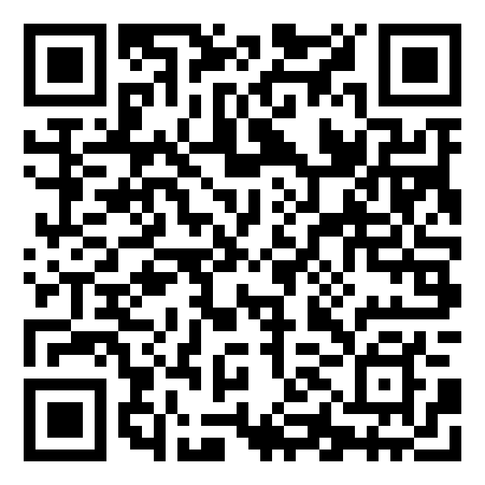
Turn to Practice: Complete the gaps
https://learningapps.org/display?v=pd93khuj323

Slide 17
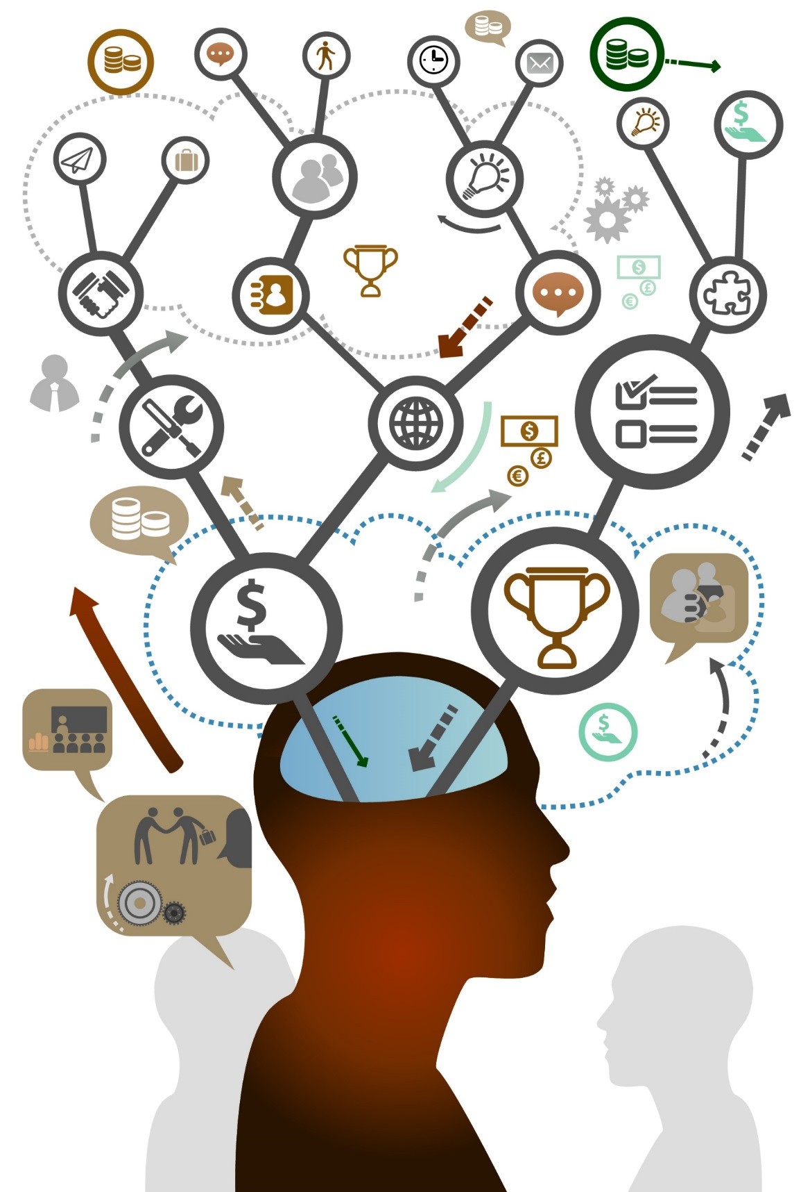
DIG DEEPER
Ask why things are a certain way.
How did they come about?
Why do they matter?
Psychologists call this
elaboration
Elaboration creates a bigger network in your brain of things that relate to one another. That larger network makes it easier to learn and remember things.

Slide 18

TAKE CARE OF YOUR PHYSICAL AND MENTAL HEALTH
Balancing university, work, and life in general can be stressful. That's why it's essential to stay on top of your physical and mental well-being. Build breaks for exercise into your study schedule too. Even a few minutes outside can help you perk up for more studying.

Slide 19
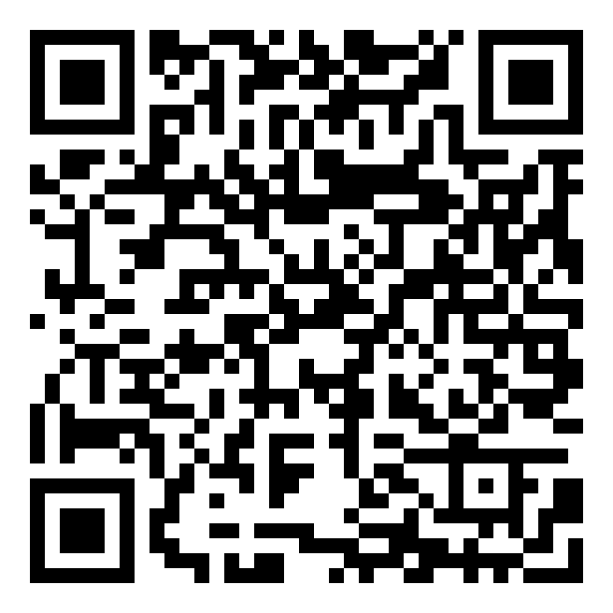
Turn to Practice: Test
Test your knowledge and understanding of key concepts and ideas from the article "Study Smarter, Not Longer“. The test consists of 12 questions designed to assess your comprehension of the text and related vocabulary.
https://learningapps.org/display?v=pyak46t9a23

Slide 20
Reference
Mariana T. Guzzardo, Nidhi Khosla, Annis Lee Adams, Jeffra D. Bussmann, Alina Engelman, Natalie Ingraham, Ryan Gamba, Ali Jones-Bey, Matthew D. Moore, Negin R. Toosi, and Sarah Taylor. "'The ones that care make all the difference': Perspectives on student-faculty relationships." Innovative Higher Education 46 (2021), p. 41-58.
Andy Tix. "Psychological Factors in Student Success." Psychology Today. April 15, 2020.
Weinstein, Y., McDermott, K. B., & Roediger, H. L. III. (2010). A comparison of study strategies for passages: Rereading, answering questions, and generating questions. Journal of Experimental Psychology: Applied, 16(3), 308–316.
Kalif E. Vaughn, Hannah Hausman & Nate Kornell (2017) Retrieval attempts enhance learning regardless of time spent trying to retrieve, Memory, 25:3, 298-316, DOI: 10.1080/09658211.2016.1170152
Nate Kornell (2009) Optimising Learning Using Flashcards: Spacing Is More Effective Than Crammin. Published online 19 January 2009 in Wiley InterScience (www.interscience.wiley.com) DOI: 10.1002/acp.1537
Rachel Kehoe. A secret of science: Mistakes boost understanding /Rachel Kehoe/ Washington, D.C .2020 Available at:https://www.snexplores.org/?p=175735?p=175735
Alison Pearce Stevens. Noticing mistakes boosts learning / Alison Pearce Stevens/ Washington, D.C .2017. Available at: https://www.snexplores.org/article/noticing-mistakes-boosts-learning
Alexander Young. “Interleaving: Boost Learning By Mixing Your Studying.” Available at: https://blog.alexanderfyoung.com/tag/learning/

