Slide 1
Capstone Project
By william rose
6/15/2026

Slide 2
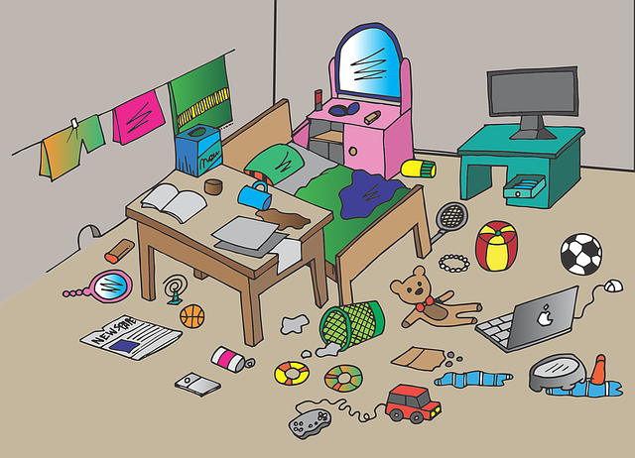
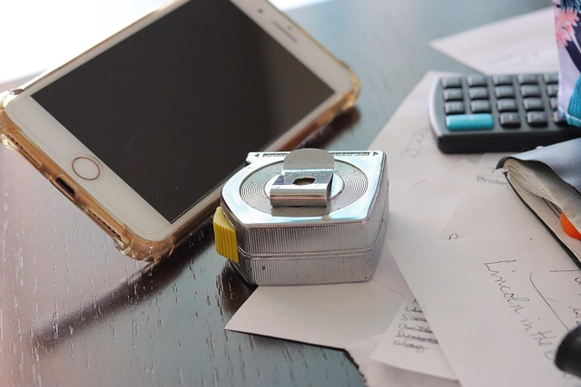
Problems:
Messy and clustered stuff at home

Slide 3
Solution: HomeInventBox
Inventory Manager for home
Object/Items
Category in an items
Where the items is at
Search by items name, category, floor, or room
Scan bar code to search item name
Save and load object with all of data.
No internet connection required

Slide 4
Planning
Initially
Four different application
ETO.Forms for Desktop
Avalonia UI for Mobile
ASP.NET with Angular for docker self hosted
Console
Testing framework
Xunit
Jasmine

Slide 5

Planning (Cont)
Beginning:
Wireframes
Diagrams
Documentation
Core functionality
Later on:
ETO.Forms
Research documentations
Scope down
only desktop application
Object with category, places

Slide 6
User Testing
Multiple users testing the software
A lot of bugs
A lot of users confused with the software
Users does need to install a framework to run
Feature changed
Options to restore data when application crashed
Intro process for new users (wall of text)
Feedback loops for every buttons and functionality
Navigation Button widen
Added lost conditions
Added ability to copy data from right click
Some others.

Slide 7
Features
Scan bar code to filter item
Enter and exit full screen

Slide 8
Technology choices
C#
Windows, MacOS, Linux
ETO.Forms
FlashCap
Xzing.Net
CSVHelpers

Slide 9
Reflection:
Things done differently:
Focus on one or two framework at a time
Find documentation for each framework
Learn and use different language
Thing went well
Core functionality
Organized into different project
Building unit test

Slide 10
Project future:
Change intro process from wall of texts to interactive or grab a youtube video.
Save data to json file along with csv file
Image to items for display
Refactor the code
User account
Mobile app, Self hosted web app, TUI console app.

