Slide 1
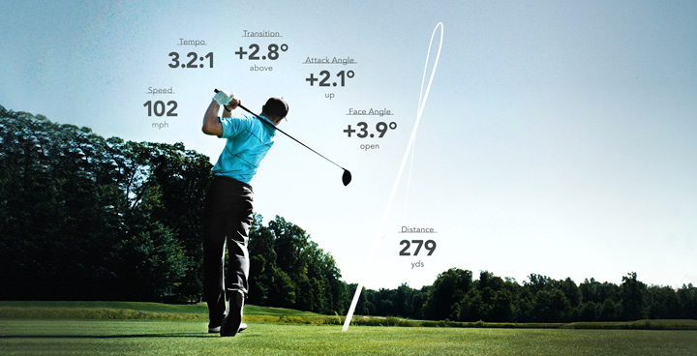
Final Presentation
Jacob Parkinson, Magdalena Quezada, Sabrina Fleig, Harri Rowe

Slide 2
Our chosen data set
Why we selcted this data set
Has 12 different variables and 18043 data points in total making it ideal

Slide 3
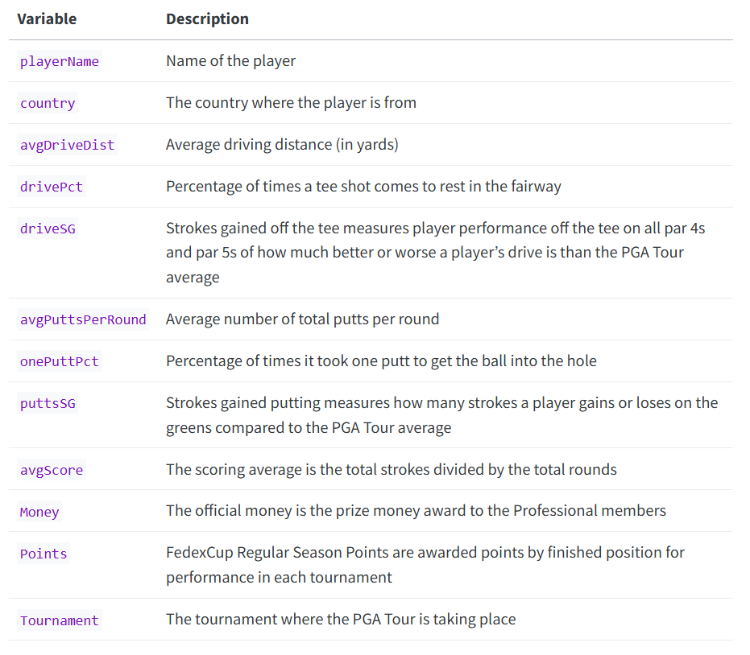
The variables within our data

Slide 4
PlayerName
Name of the player

Slide 5
Country
The country where the player is from

Slide 6
AveDriveDist
Average driving distance (in yards)

Slide 7

DrivePCT
Percentage of times a tee shot comes to rest in the fairway

Slide 8
DriveSG
Strokes gained off the tee measures player performance off the tee on all par 4s and par 5s of how much better or worse a player’s drive is than the PGA Tour average

Slide 9

avgPuttsPerRound
Average number of total putts per round golf

Slide 10
OnePuttPct
Percentage of times it took one putt to get the ball into the hole

Slide 11
PuttsSG
Strokes gained putting measures how many strokes a player gains or loses on the greens compared to the PGA Tour average

Slide 12
AveScore
The scoring average is the total strokes divided by the total rounds

Slide 13
Money
The official money is the prize money award to the Professional members

Slide 14
Points
FedexCup Regular Season Points are awarded points by finished position for performance in each tournament

Slide 15
Tournament
The tournament where the PGA Tour is taking place

Slide 16
Our question
Do American players have an advantage over the foreign players at the PGA tour?

Slide 17
The Venues (2022 PGA Tour)
Locations in America (17)
Wyndham Championship - North Carolina, USA
RBC Heritage - South Carolina, USA
THE PLAYERS Championship - Florida, USA
The Honda Classic - Florida, USA
Arnold Palmer Invitational - Florida, USA
The Genesis Invitational - California, USA
AT&T Pebble Beach Pro-Am - California, USA
Farmers Insurance Open - California, USA
WM Phoenix Open - Arizona, USA
Valero Texas Open - Texas, USA
Travelers Championship - Connecticut, USA
PGA Championship - Varies, but typically USA
John Deere Classic - Illinois, USA
Memorial Tournament - Ohio, USA
Charles Schwab Challenge - Texas, USA
AT&T Byron Nelson - Texas, USA
The American Express - California, USA
International Locations (1)
RBC Canadian Open - Canada (location varies, but it's held in different venues across Canada)

Slide 18
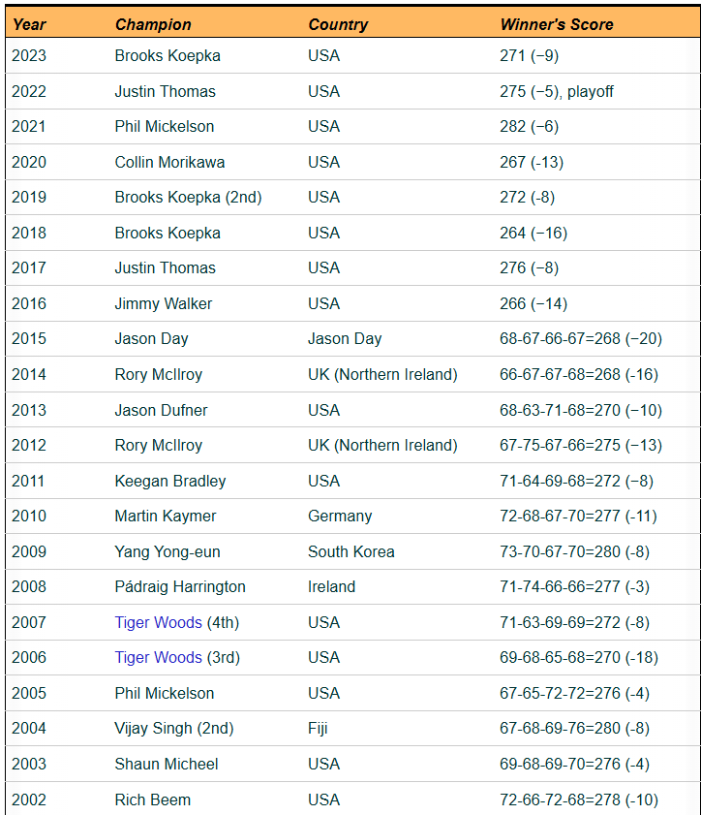
History of American players at the PGA tour
From 1916 to present day 82.86% of the PGA tour winners have been Americans

Slide 19
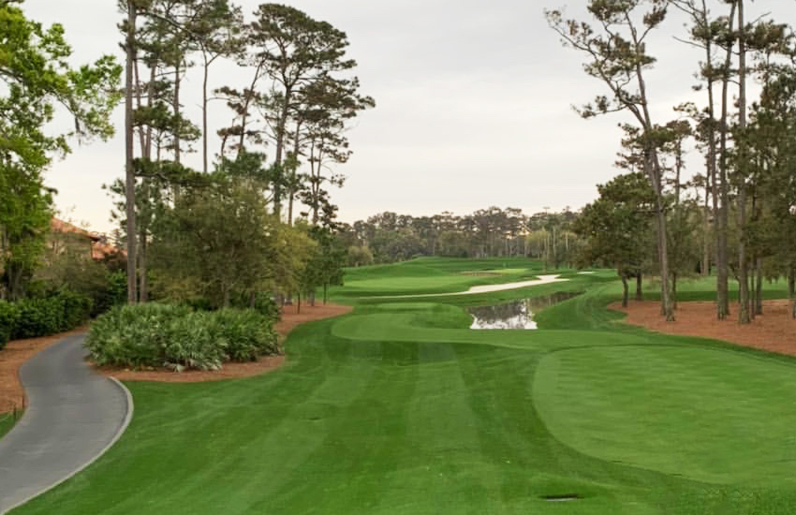
The differences between American Courses and international courses

Slide 20
Course design/ style
American Courses are Known for their meticulously maintained fairways, greens, and bunkers, with a focus on presenting a perfect aesthetic. Courses may have more artificial water hazards and extensive landscaping.
Rest of the World: Links courses are more common, these courses are typically set along the coast, with sandy soil, dunes, and natural landscapes. They have fewer trees, and the layout uses natural land features rather than heavy landscaping. Examples include St. Andrews (Scotland) and Royal Portrush (Northern Ireland).

Slide 21
Grass Types
American Courses: Typically use cool-season grasses like Bentgrass and Poa Annua in northern states and warm-season grasses like Bermuda and Zoysia in southern states. These grasses are chosen for their durability and aesthetics in specific climates.
Rest of the World: In Europe, courses might use native grasses like fescue, especially on links courses. Fescue is more tolerant of wind and salty air, providing a different playing surface that often results in firmer, faster fairways.

Slide 22
Course length and setup
American Courses: Often set up to be longer, with an emphasis on rewarding powerful, long-distance hitters. Courses for PGA Tour events are regularly over 7,200 yards.
Rest of the World: Courses might be shorter but more challenging in terms of layout, natural hazards, and weather. Many traditional links courses are designed to test strategic play and shot-making rather than just length.

Slide 23
Hazard and Bunker style
American Courses: Typically feature large, well-maintained bunkers and artificial water hazards (lakes, ponds). The hazards are often carefully placed to challenge the modern power game.
Rest of the World: In the UK and Ireland, you’ll find pot bunkers, which are smaller but much deeper. These bunkers are a staple of links courses, designed to be a significant challenge. Water hazards are less common due to the natural drainage properties of links courses.

Slide 24
Question 1
Does a higher average drive distance correlate with better performance in tournaments, how does this compare with Amercian player to foreign players?

Slide 25
WHY
Due to the longer fairways on American courses, do players get rewarded for a higher average drive distance and does this give the American players an advantage.

Slide 26
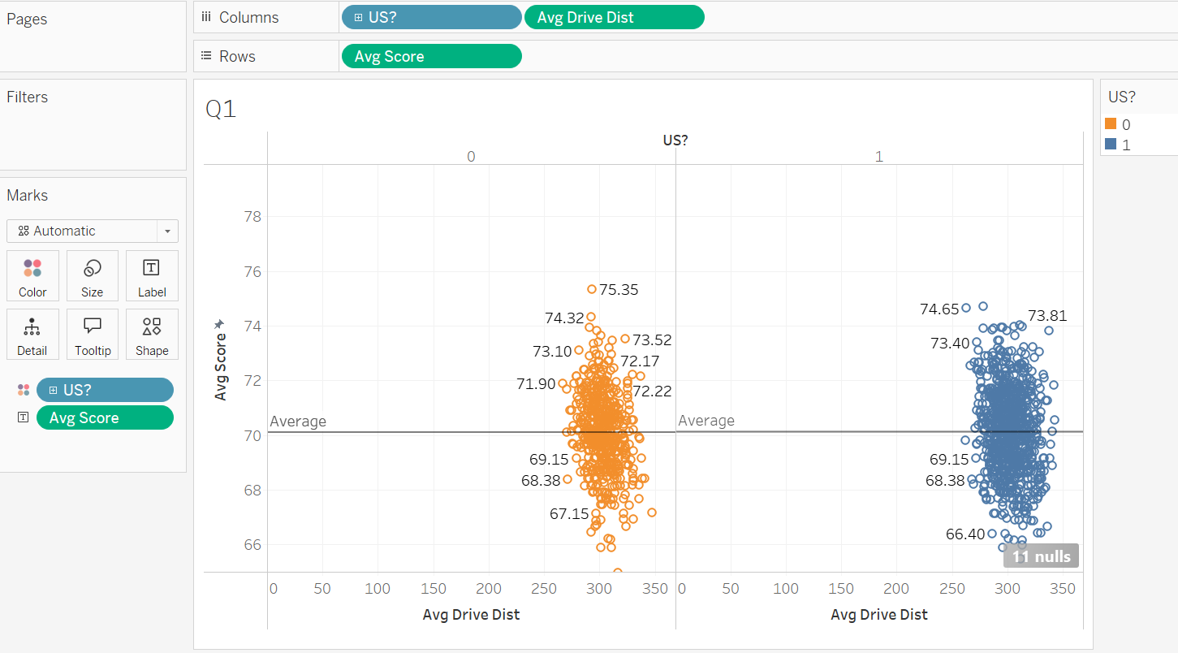
Findings for question 1
Average score and average drive distance of US teams and non-US teams are correlated and almost the same.
No signs on significance of advantage of American players

Slide 27
Question 2
How does the number of putts per round affect a player's total earnings, how does this compare with American players to foreign players?

Slide 28
WHY
Did the Americans have such an advantage getting to the green that the foreigners had to make up for this with better putting performance? Could the Amercian payers afford to have a slightly worse putting performance?

Slide 29
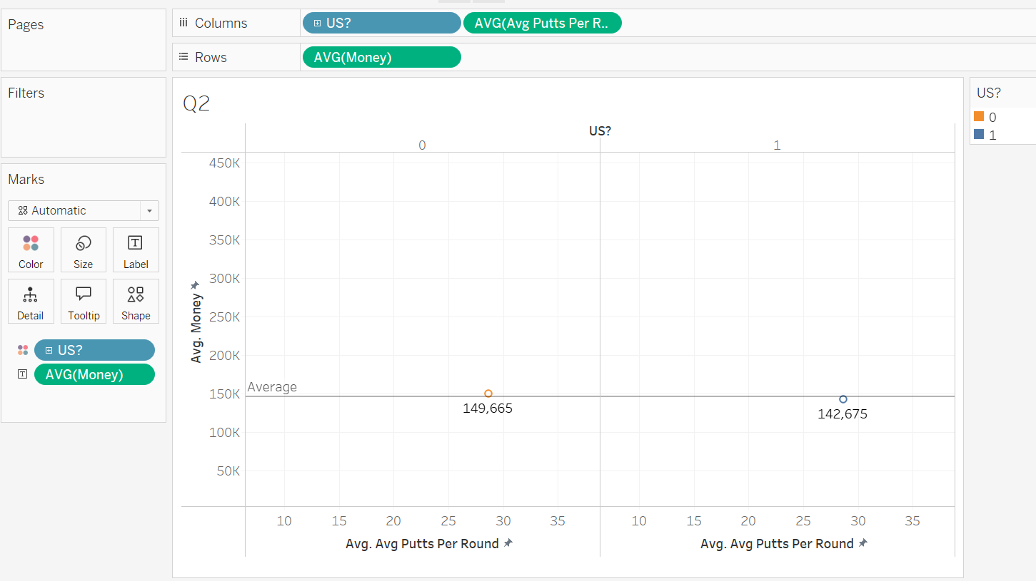
Findings for question 2
On average non-US players did better in terms of average putts and money.
US players where more constant if we consider all the tournaments, because the standard deviation is smaller for US-teams

Slide 30
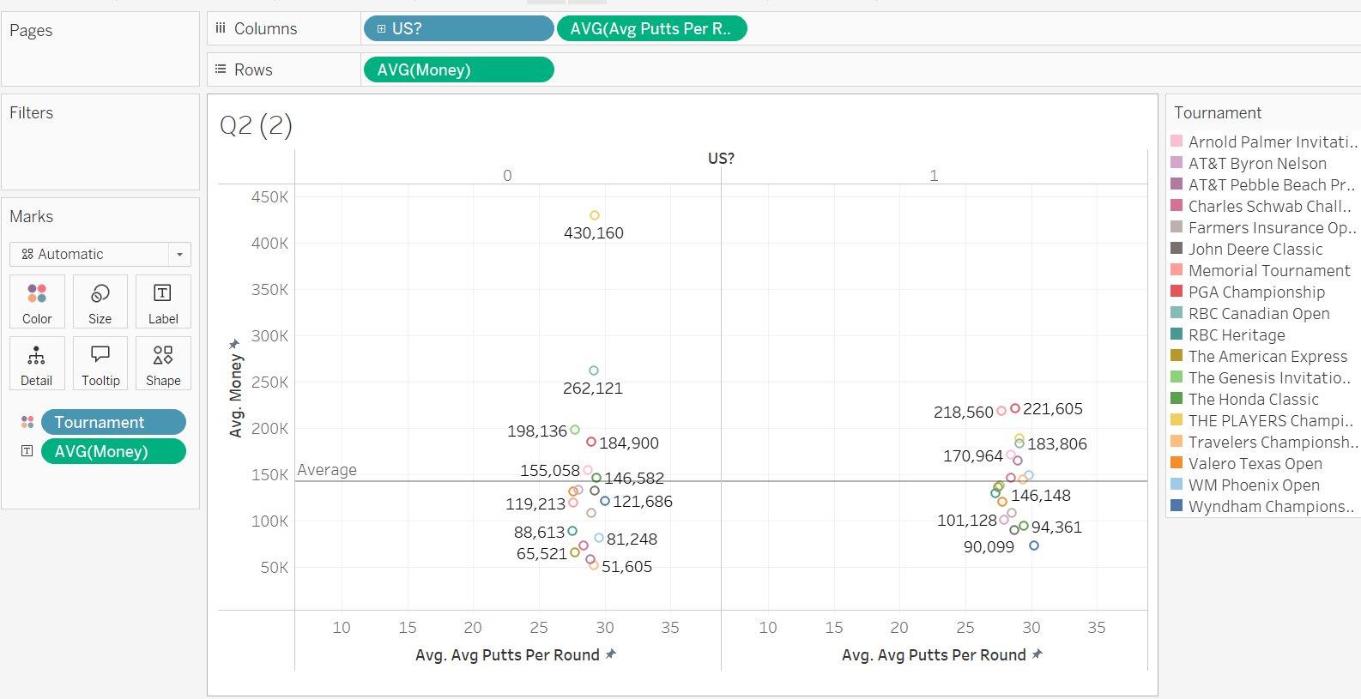
Question 2:

Slide 31
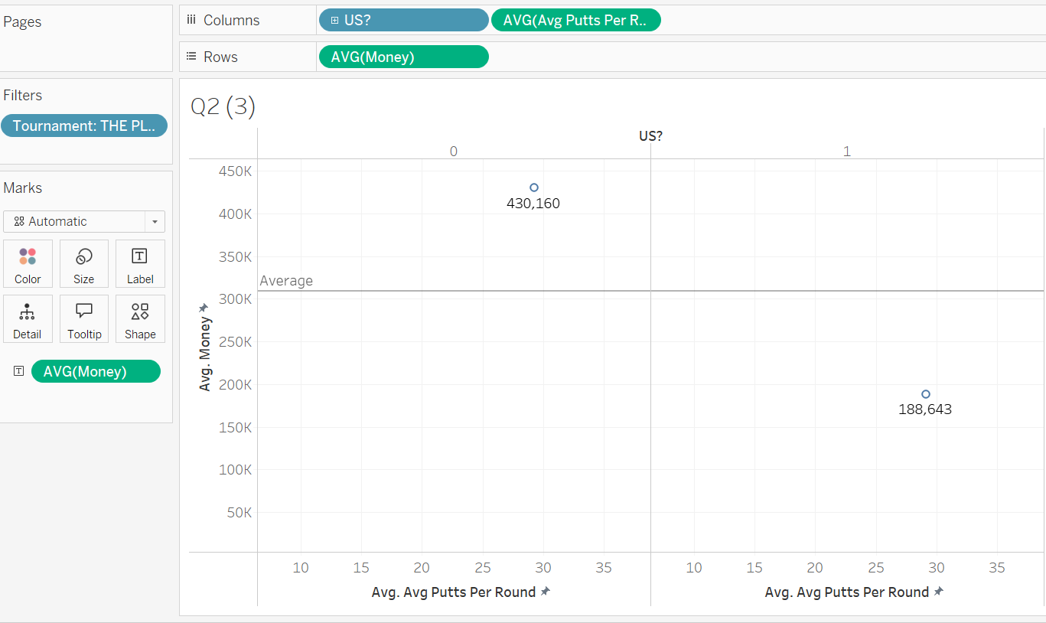
Question 2

Slide 32
Question 3
3. How does each tournament impact a golfer’s ranking in the tournament? Is there a difference between American a non-American player?

Slide 33
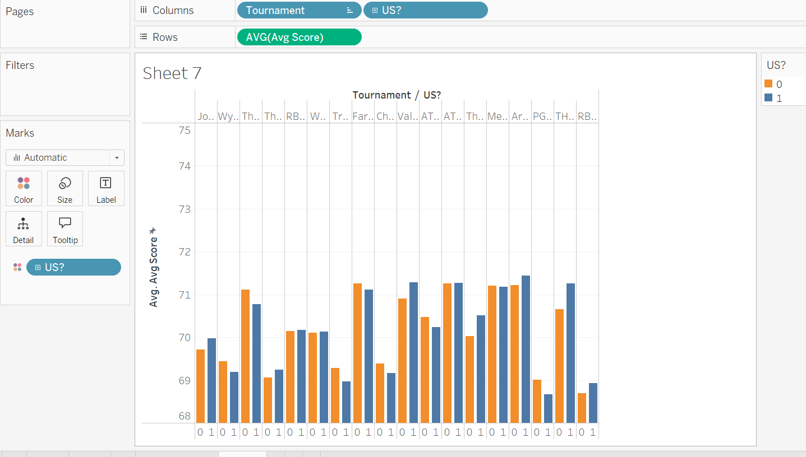
Findings for question 3

Slide 34
WHY
To confirm or debunk the home advantage hypothesis.
To highlight any systemic disparities between American and international players in achieving high rankings.
To provide actionable insights into how course design and environmental familiarity influence competitive golf outcomes.

Slide 35
Conclusion
Our answer to the initial question: Do American players have an advantage over the foreign players at the PGA tour?

