Slide 1
Clinical Metagenomics
EMD 531
Lecture 5
Joseph Fauver, PhD

Slide 2
Learning objectives
Understand challenges associated with of clinical metagenomics
Describe and use the IDSeq pipeline

Slide 3
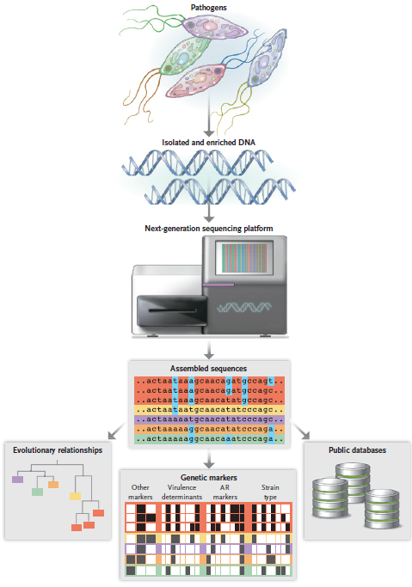
Armstrong et al. (2019) NEJM

Slide 4
What is metagenomics?
Notes:
Seems like it should be a relatively simple answer, but actually isnt

Slide 5
Metagenomics
“A process by which a metagenome is created”- Hoyles et al. 2019
Set of research techniques, as well as a field of research.
Notes:
Its called a ton of different names- not universally agreed upon.
It is going to be referred to as all sorts of different things. When describing metagenomics, someone could be talking about a bioinformatic analysis specifically, or more broadly as a field like environmental metagenomics.

Slide 6
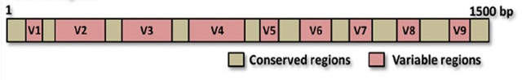
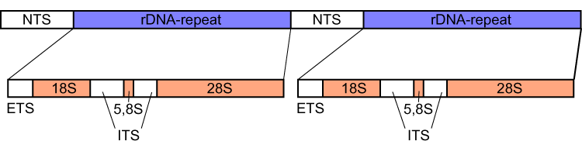
Species identification using variable genes
Pioneered in environmental microbiology
Prokaryotes
16s sequencing (ribosome)
Eukaryotes
ITS sequencing (ribosome)
COX1 sequencing (mitochondria)
“Barcode of Life”
16s rRNA gene
Ranjith et al. 2016
Eukaryotic rRNA gene
Wikipedia
Notes:
The majority of microorganisms, whether it be bacteria, viruses, algae, protozoa, etc. cannot be cultured. However their nucleic acid exists samples none the less.
16s is a component of the bacterial ribosome. Ribosomes are responsible for protein synthesis through translation of RNA. Biological equivalent of 16s in eukaryotic cells is 18s.
This gene has been targeted for phylogenetics of bacterial species for decades. Though process being its easy to make amplicons. You can align primers to these conserved regions, and amplify the hyper variable regions between them. Similar to internal transcribed spacer for eukaryotic organisms. So if you are interested in characterizing these microorganisms from a given environment, this has shown to be a reliable way to do it.
Big idea here- you can identify “species” or “strains” (biological definition of either of these things is hotly contested) by sequencing these genes without having to isolate the organism itself.

Slide 7
Metagenomics for our purposes
“a sequencing approach that identifies all nucleic acid in a sample”
Notes:
The simplest way to think about it, in my opinion, and how I would like use to think about it for this class is metagenomics is “a sequencing approach that identifies all nucleic acid in a sample”

Slide 8
Clinical metagenomics
Notes:
Metagenomic sequencing for clinical applications! We are specifically limiting this portion to “pathogen identification in clinical samples using metagenomic sequencing”

Slide 9
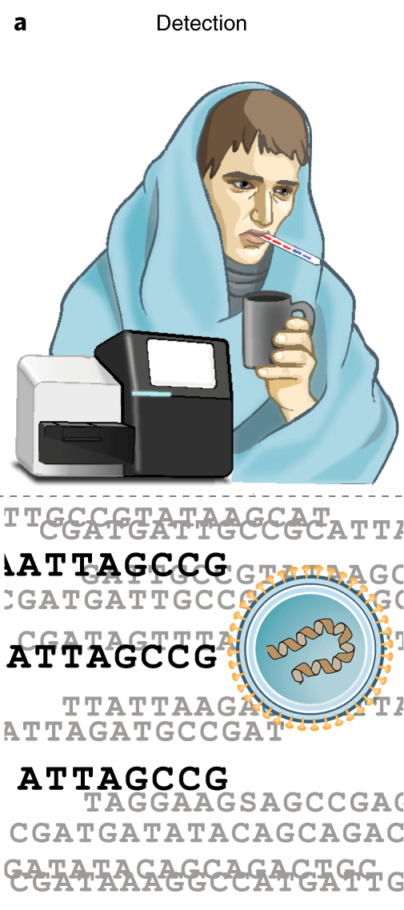
Pathogen genomic applications
Detection
Discovery of a novel coronavirus associated with a cluster of pneumonia cases (n=59) linked to a fish market (?) in Wuhan, China (happening now)
Detection of MRSA isolates associated with an outbreak in a neonatal intensive care unit (case study)
Identification of chikungunya virus as an unrealized cause of pediatric meningitis in Bangladesh (case study, guest lecture)
Notes:
Horses, not zebras.

Slide 10
Class Discussion
Give an example from your disease system of choice of how diagnostics are performed

Slide 11
Identifying complicated illness through mNGS
Why do it?
Pros
Doesn’t require prior knowledge of pathogen
Can identify unexpected or previously unknown pathogens
Provide additional information not detected through conventional diagnostics
AMR
Metatranscriptomics
Genomic epidemiology
Cons
Price
Cost of data generation and analysis
Infrastructure cost to perform in actionable timeframe
Huge potential for contamination and misinterpretation
Notes:
Note the table in the paper. It compares and contrasts all these different methods for diagnosing diseases. Where is the need? Well, most illnesses never receive a definitive diagnosis. Can help us decide when and where we should generate better diagnostics. Why diagnosis disease in the first place? Better treatment. Better public health. Really generates a data source that we previously haven’t had.
Pros
No prior knowledge. Our diagnostic repertoire is quite limited. We have good diagnostics for the most common pathogens, not for uncommon. There is a lot of overlap between symptoms of pathogens. Nueroinvasie Chikungunya virus.
You can actually get a lot of information from mNGS in a clinical sample. ALL DEPENDS ON QUANTITY OF DATA. Can identify host factors that exacerbate disease, whether or not your identified organism is susceptible to antimicrobials, and for this class, if we sequence complete genomes (or informative genes), we can begin to answer basic epidemiological questions.

Slide 12
Identifying complicated illness through mNGS
Why do it?
Pros
Doesn’t require prior knowledge of pathogen
Can identify unexpected or previously unknown pathogens
Provide additional information not detected through conventional diagnostics
AMR
Metatranscriptomics
Genomic epidemiology
Cons
Price
Cost of data generation and analysis
Infrastructure cost to perform in actionable timeframe
Huge potential for contamination and misinterpretation
Notes:
Let's discuss the Cons here and practicality. 1. NGS is expensive. The cost of data generation itself is expensive.

Slide 13
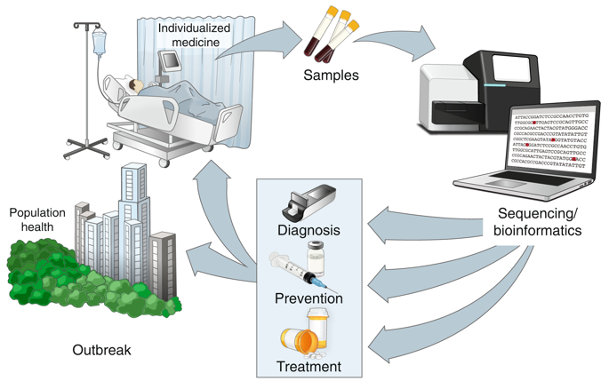
Where does clinical mNGS fit into routine care?
Currently exists largely as a research technique
Most likely scenario is mNGS will exist in well-funded hospitals for use in the most complicated of cases
Ladner et al., 2019. Precision epidemiology for infectious disease control. Nature Medicine

Slide 14
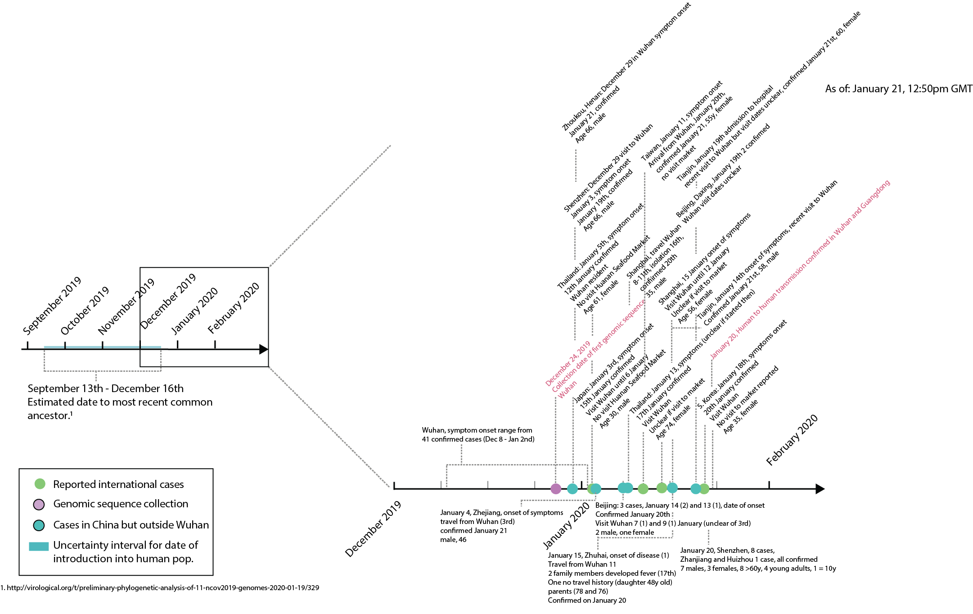
Wuhan Coronavirus Outbreak
Notes:
What did we learn from clinical metagenomics here?
What the likely causative agent is
When the spill over event may have occurred
Whether ongoing transmission is still occurring or not
Allows now for basic N.A. based diagnostics

Slide 15
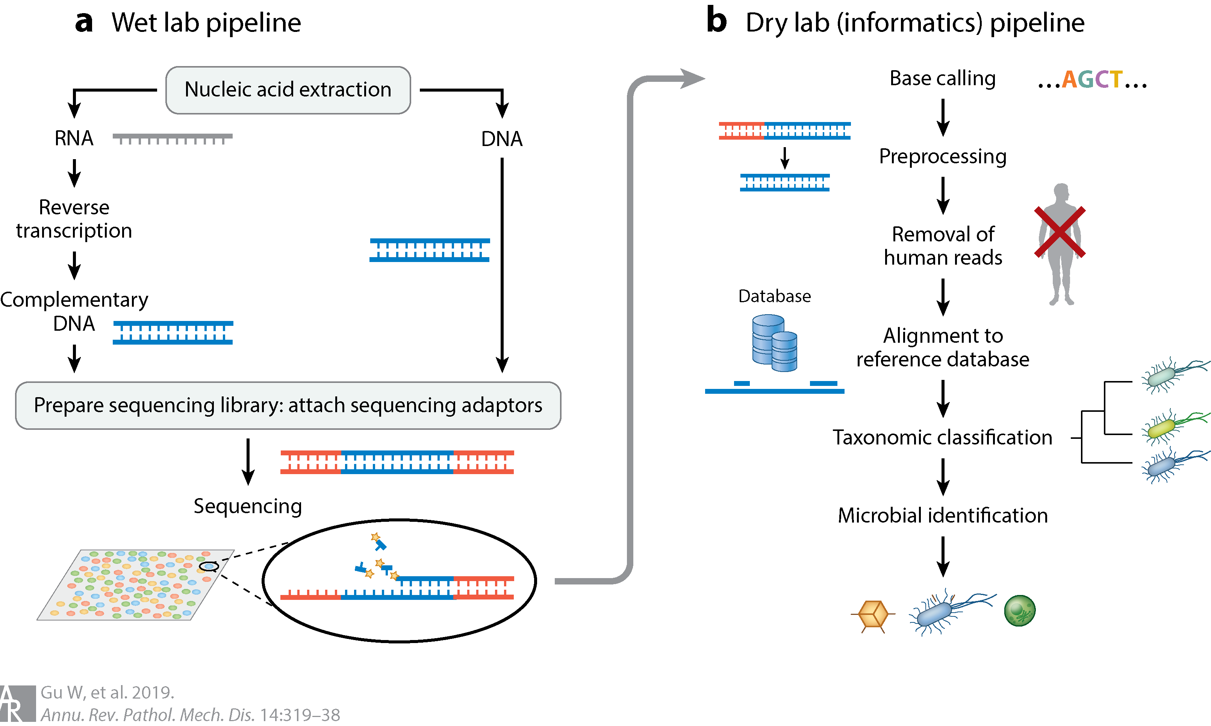
General workflow
Notes:
Figure 1 from our paper. We discussed the wet lab pipeline in depth on Thursday, so lets start talking about the dry lab portion.

Slide 16
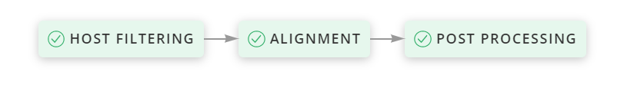
IDSeq- analysis pipeline that identifies pathogens from mNGS data

Slide 17
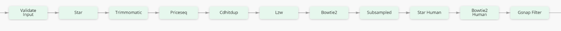
IDSeq- Host Filtering
Goals of host filtering step
Remove any human genome data (Star, Bowtie2, Gsnap filter)
Data Quality Control (Trimmomatic, Priceseq, Cdhitdup, LZW)

Slide 18
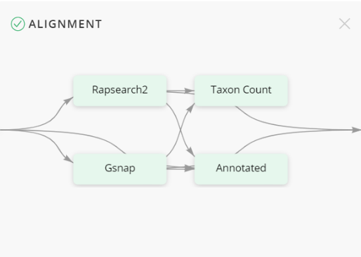
IDSeq- Alignment
Goals of alignment step
Align individual reads (Gsnap) to curated databases (NT [nucleotide] & NR [protein])
Assemble “contigs” (Rapsearch2), align to down sampled databases (NT and NR)
Based on alignments, ascribe taxonomic identifications from accession numbers

Slide 19
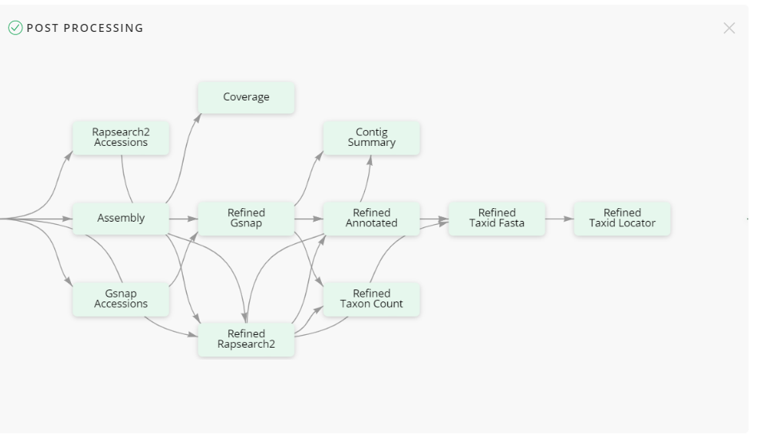
IDSeq- Post Processing
Goals of Post Processing step
Refine both Gsnap and Rapsearch2 results
Generate summary statistics
Create visualizations

