Slide 1
Estimating selection pressures
EMD 531
Lecture 11
nathan grubaugh, phd

Slide 2
Learning objectives
Students will be able to:
Discuss the types of pathogen selection that are important for public health, and when they may occur
Understand the basic principles of selection and genetic drift
Estimate selection pressures from genetic/genomic data
Start Exercise #5: Estimating selection using Datamonkey

Slide 3
Evolutionary rate is the product of 4 factors
Mutation rate
Generation time
Effective population size (N_{e})
Natural selection (Fitness)

Slide 4
Why should public health labs care about natural selection?

Slide 5
Potential consequences of selection
Drug resistance
e.g. AMR, HIV resistance to antivirals
Attenuated vaccine reversion
e.g. Human-to-human spread of OPV
Alter transmission route
e.g. HPAIV > aerosol transmission
Increase transmission efficiency
e.g. CHIKV increase trans by Ae. albopictus
Increase virulence
e.g. Ebola virus & Zika virus during recent epidemics?

Slide 6
Potential consequences of selection
Drug resistance
e.g. AMR, HIV resistance to antivirals
Attenuated vaccine reversion
e.g. Human-to-human spread of OPV
Alter transmission route
e.g. HPAIV > aerosol transmission
Increase transmission efficiency
e.g. CHIKV increase trans by Ae. albopictus
Increase virulence
e.g. Ebola virus & Zika virus during recent epidemics?
Would all of these occur via selection? Could some occur by chance?
What sort of events could lead to positive selection + adaptation?

Slide 7
Known genetic markers
Example: E.coli resistance gene predictions
Sequence allele to infer phenotype
Ceric et al., 2019. BMC Veterinary Research

Slide 8
What about when you don’t have a marker?
Start with an epidemiological finding, then examine the genetic data
Assumes epi impact is large enough to be picked up by surveillance
e.g. new class of drug resistance, new transmission route
Start with the genetic data, search for epidemiological impacts
More subtle changes not picked up by surveillance
e.g. slight changes to transmission efficiency or virulence
Novel genotype-phenotype inferences must be verified!

Slide 9
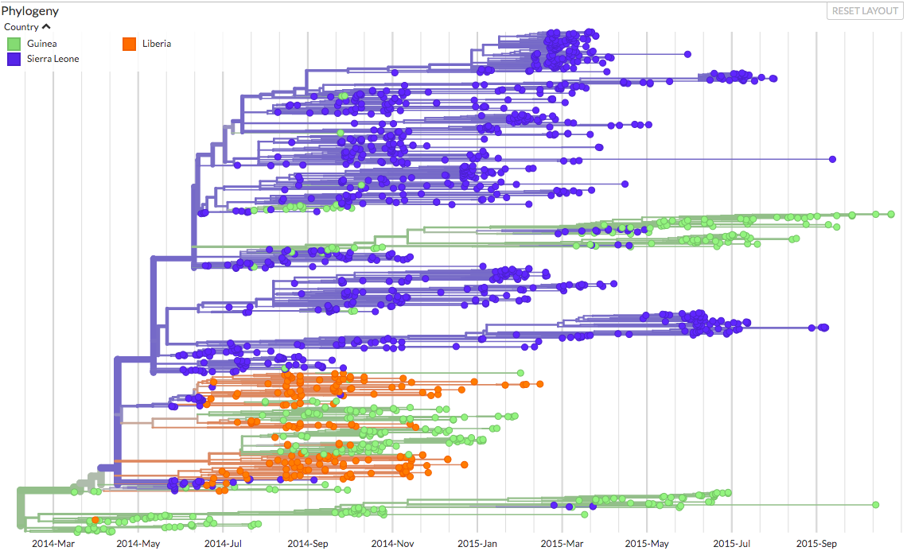
Ebola virus

Slide 10
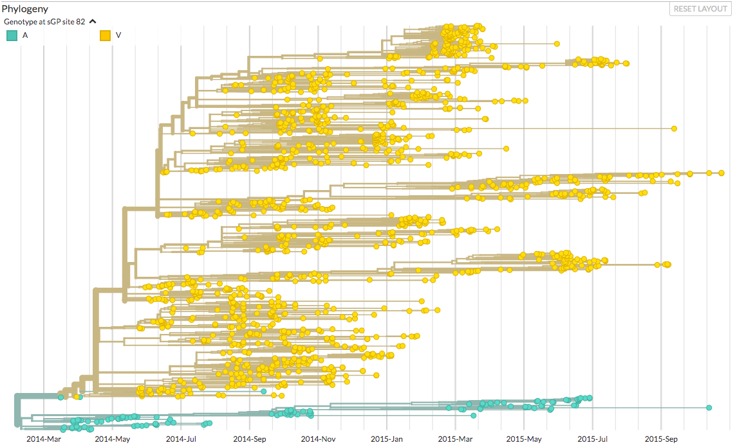
Ebola virus

Slide 11
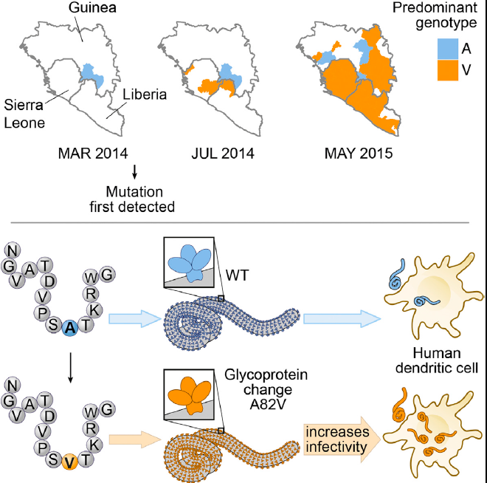
Ebola virus
Diehl et al., 2016. Cell

Slide 12
Basic concepts of selection

Slide 13
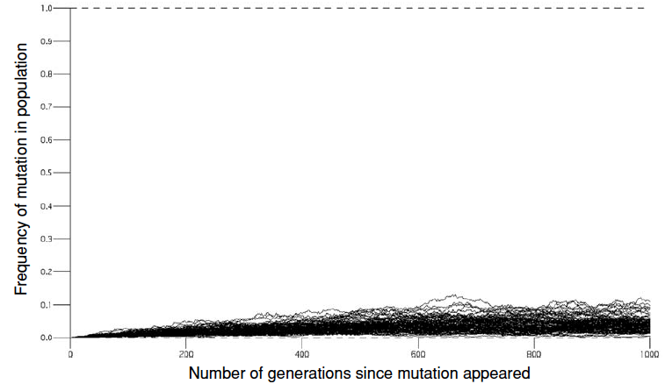
How do new variants arise?
Mutations: The source of all genetic diversity
Alone cannot drive new variants to high frequency.
Mutation in the absence of other forces

Slide 14
How do new variants arise?
Mutations: The source of all genetic diversity
Natural selection and genetic drift impact frequency
Drive all variants to fixation or elimination
Natural selection > driven by fitness
Ability to survive and reproduce
Genetic drift > driven by population size
Ne; bottlenecks during generation/transmission
Random change in frequency until fixed or eliminated

Slide 15
How do new variants arise?
New mutations can be:
Advantageous/beneficial (rare)
Deleterious/lethal (common mutations, rarely detected)
Neutral (most commonly detected)
Positive/diversifying selection:
Increases frequency of advantageous mutation until it becomes fixed in a population
Negative/purifying selection:
Decreases frequency of deleterious mutation until it is eliminated

Slide 16
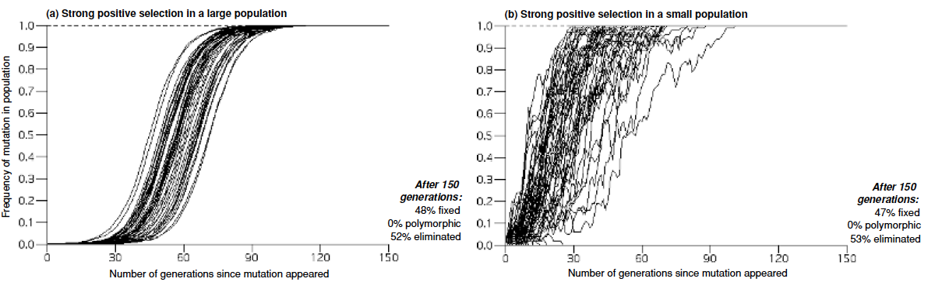

Slide 17
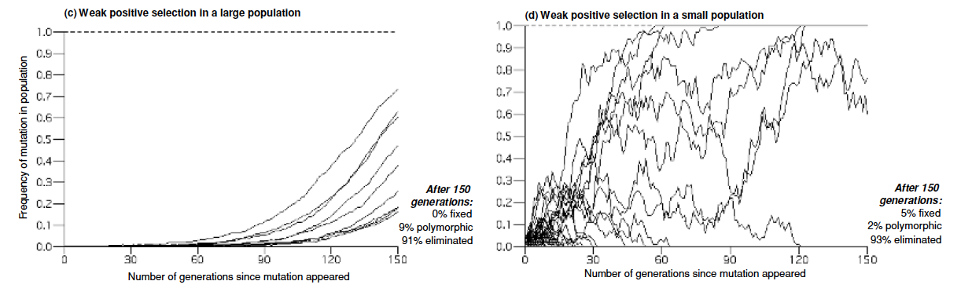

Slide 18
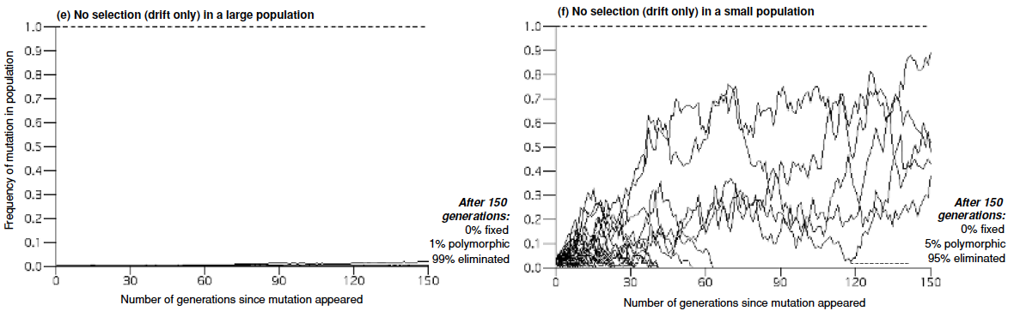

Slide 19
What’s unrealistic about these examples?

Slide 20
What’s unrealistic about these examples?
Our data may not represent a single population
Selection and drift are dynamic processes (environmental variability)
Selection may not occur in isolation
Assess ”molecular footprint” selection among different branches

Slide 21
Estimating selection pressures

Slide 22
Molecular footprint of selection
Frequency
Summary statistic method
Variants at high frequencies most likely neutral or advantageous
Rate of nonsynonymous (N) to synonymous (S) variants
dN/dS method
> 1 typically implies positive selection
< 1 typically implies negative selection
Genetic diversity among sites and populations
Comparative method
Positive selection = lower diversity among other sites (selective sweeps)
Environment-specific selection = differences in diversity at same site in other populations

Slide 23
Maximum-likelihood estimates of selection
Random effects likelihood (REL)
Creates a distribution of dN/dS rates for each site (estimated).
Compares actual rates to what should be expected at random to estimate selection.
Fixed effects likelihood (FEL)
Directly infers dN/dS rates for each site, given coding alignment and corresponding phylogeny.
Compares rates among sites to estimate selection.
Mixed Effects Model of Evolution (MEME)
Estimates mixed dN/dS rates for each site, one under the assumption of pos & neg selection.
Determines if given data matches either model.

Slide 24
What method should I use?
Given enough sequence data, all methods (properly applied) tend to perform similarly, hence the choice of a method is mostly a matter of preference or computational expediency.
In reality, you don’t always know if you have enough data.
Suggest using all available methods and construct a consensus.

