Slide 1
Repositories & Alignments
EMD 531
Lecture 6
nathan grubaugh, phd

Slide 2
Learning objectives
Students will be able to:
Understand how to perform reference guided alignment and reconstruct consensus genomes
Be familiar with public repositories for pathogen sequences (and metadata)
Perform multiple sequence alignments
Start Exercise #2: Public repositories and multi-sequence alignments
Sign up for presentations

Slide 3
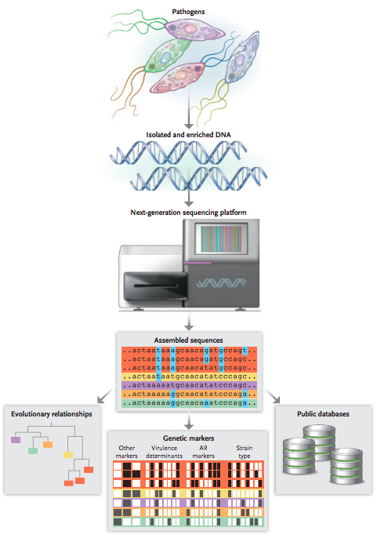
Where are we at?
Class 2: Microbial genomics
Classes 3-4: Library prep and sequencing
Class 5: de novo assembly for metagenomics

Slide 4
Where are we at?
Class 2: Microbial genomics
Classes 3-4: Library prep and sequencing
Class 5: de novo assembly for metagenomics
Today: assembling sequences, mining databases, performing alignments
**For known pathogens

Slide 5
Reference guided alignments

Slide 6


De-multiplexed, quality trimmed, reads (.fastq)
Reference-guided alignment (.bam)

Slide 7
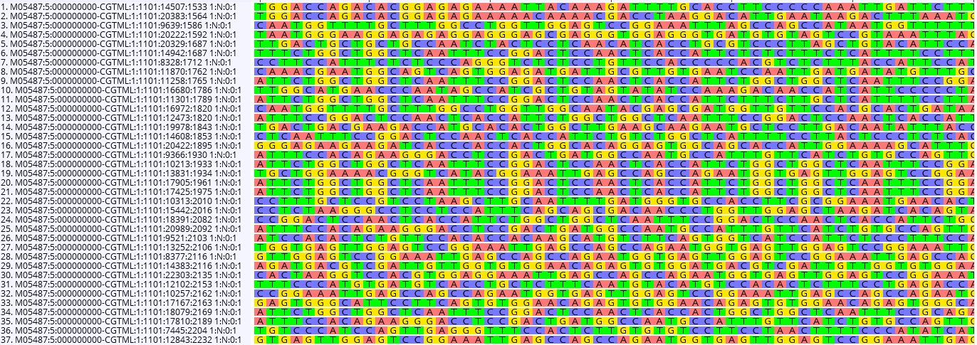
Individual reads in a .fastq

Slide 8
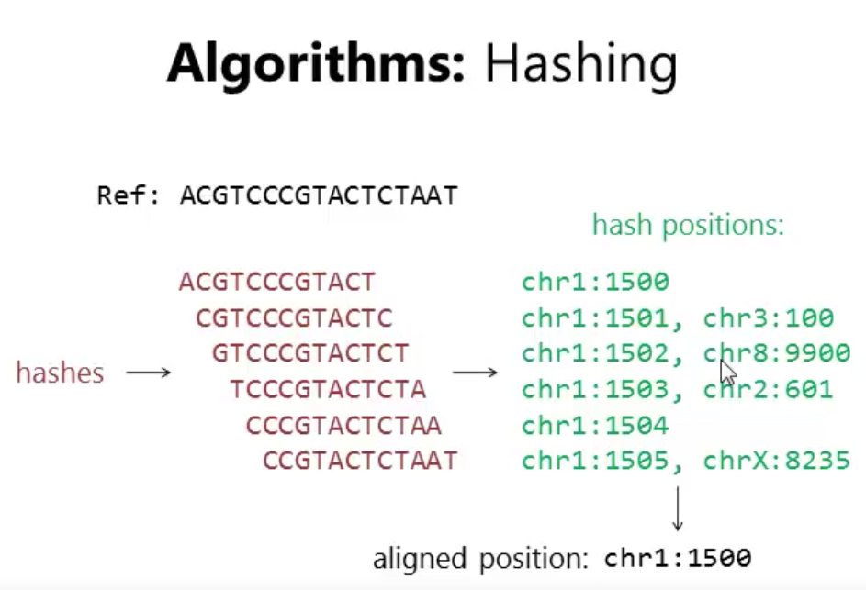
What does an aligner do?
Search for best match on given reference genome with the following considerations:
Score of match
Mismatch penalty
Gap penalty
Can also do competitive alignments with multiple reference genomes
Output format: SAM or BAM (binary) files

Slide 9
Alignment software
Burrows-Wheeler Aligner (BWA)
Recommended for Illumina data
Newer version = BWA-MEM recommended
http://bio-bwa.sourceforge.net/
https://github.com/lh3/bwa
Paper = https://academic.oup.com/bioinformatics/article/25/14/1754/225615
Mimimap2
Recommended for Nanopore data
https://lh3.github.io/minimap2/minimap2.html
https://github.com/lh3/minimap2
Paper = https://academic.oup.com/bioinformatics/article/34/18/3094/4994778
Many other possibilities

Slide 10
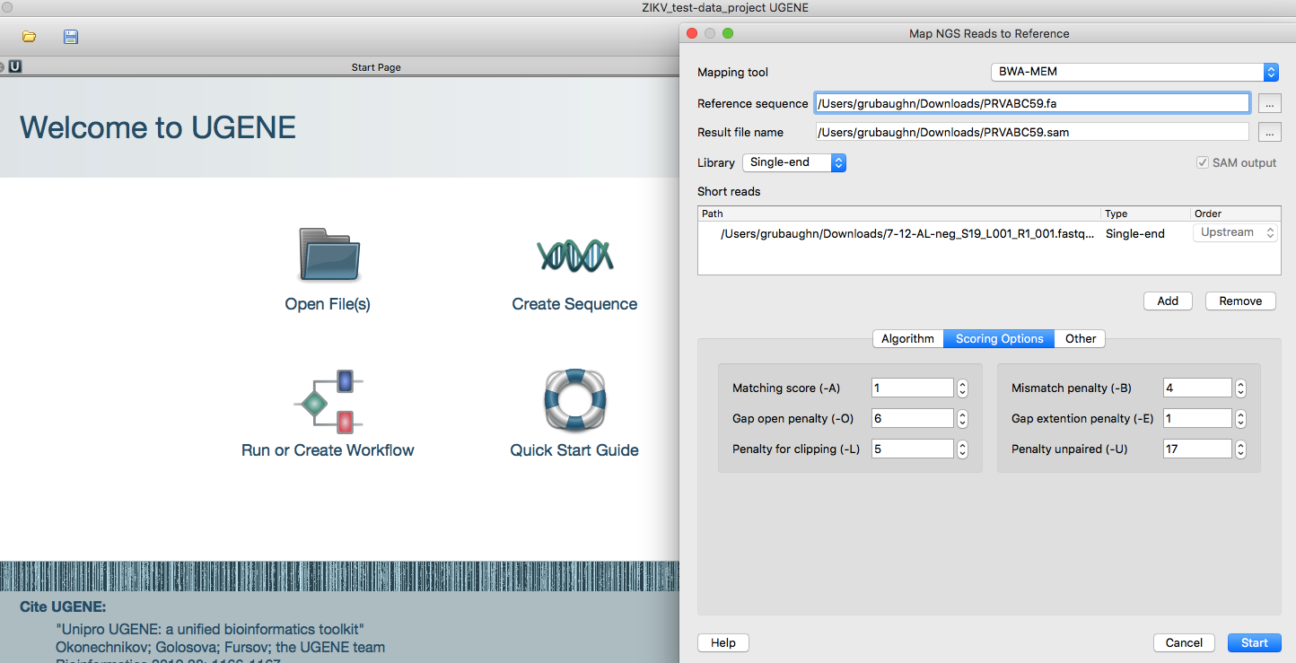
Can run locally (not recommended for large data files and high throughput)

Slide 11
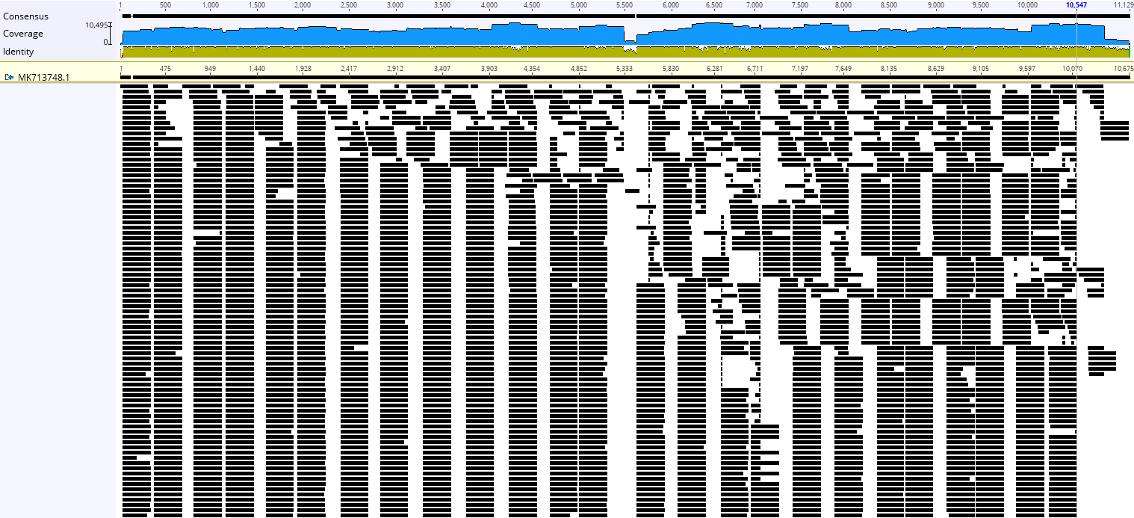
Aligned .bam file (global view)

Slide 12
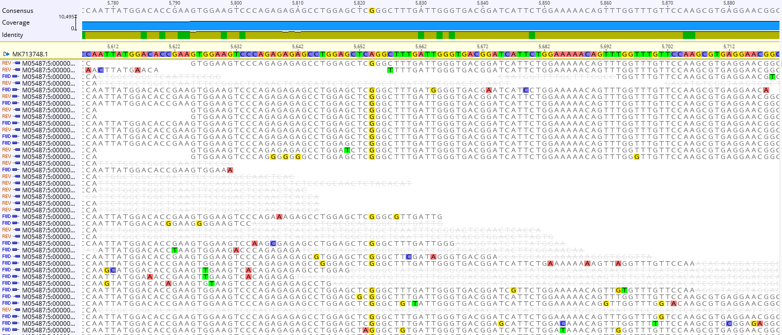
Aligned .bam file (zoom)

Slide 13
Reconstructing consensus genomes

Slide 14
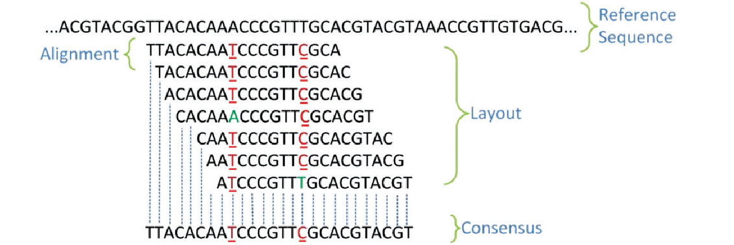
Consensus genomes
Primary considerations
Threshold to call consensus nucleotide
0% = Majority
50% = Strict
100% = Identical
I use a 75% threshold. So if majority nucleotide is present in only 60% of reads at site, calls “N”
Coverage at site
Typically set coverage to 10-100x
Output format: fasta
Wajid & Serpedin, 2016.

Slide 15
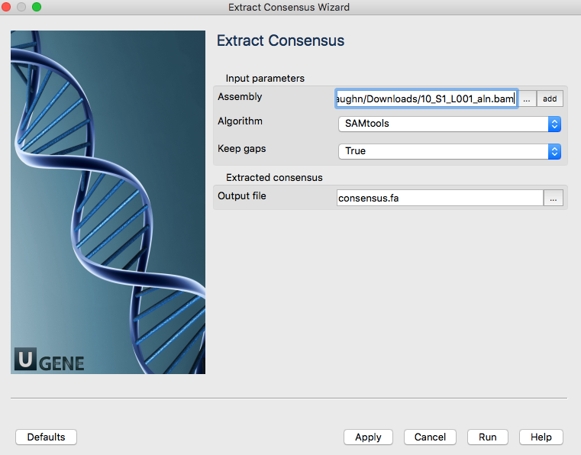
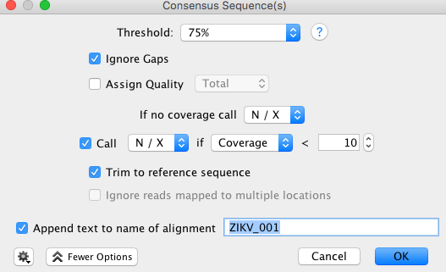
Consensus calling software
Sam tools package = mpileup
http://samtools.sourceforge.net/mpileup.shtml
Desktop graphical interfaces
UGene
Geneious
https://www.geneious.com/
Costs $$$

Slide 16
Public repositories for pathogen sequences

Slide 17
Rapidly growing sequence repositories
Sequencing is getting much cheaper.
Most journals have strict data sharing policies and majority of scientists support data sharing (at some level).
All pathogen genetic sequencing data during outbreaks or other public health emergencies must be made publically available.
WHO Code of Conduct: https://www.who.int/blueprint/what/norms-standards/gsdsharing/en/
Thus, large public sequence repositories exists to aid research and public health investigations.

Slide 18
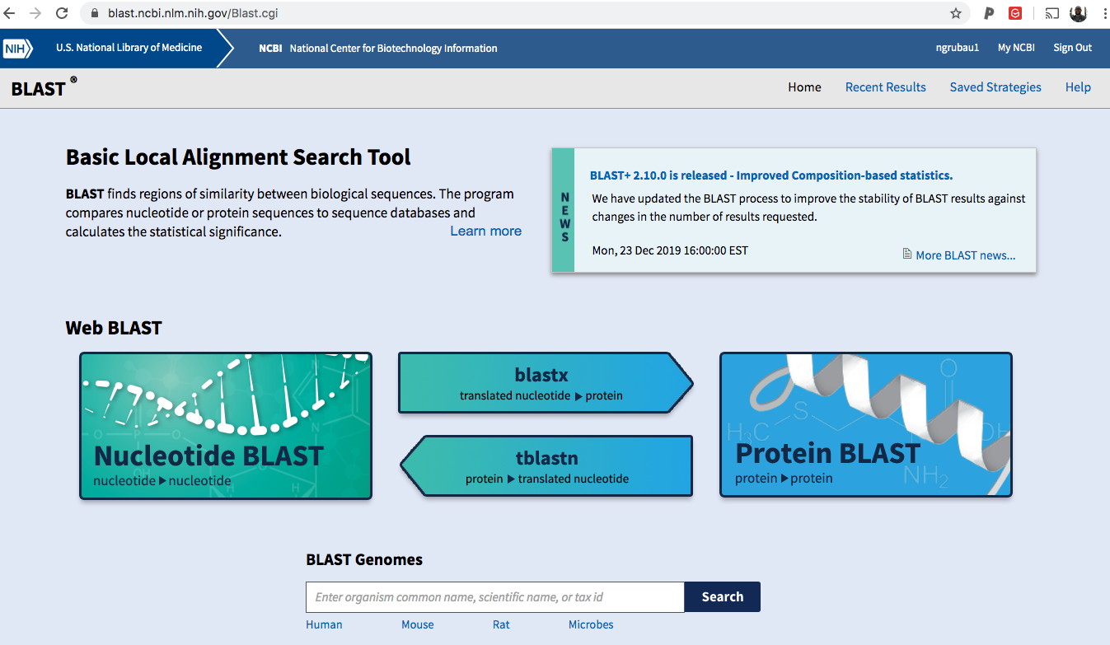
Don’t quite know what you are looking for?

Slide 19
Examples of available repositories
Virus
NCBI – Virus Variation
https://www.ncbi.nlm.nih.gov/genome/viruses/variation/
NCBI – Virus
https://www.ncbi.nlm.nih.gov/labs/virus/vssi/#/find-data/virus
Virus pathogen Resource (ViPR)
https://www.viprbrc.org/brc/home.spg?decorator=vipr
Bacteria
NCBI – Microbial Genomes
https://www.ncbi.nlm.nih.gov/genome/microbes/
Ensembl Bacteria
https://bacteria.ensembl.org/index.html
Microbial Genome Database (MDGB)
http://mbgd.genome.ad.jp/

Slide 20
Pathogen sequences w/o metadata are useless
Minimum information needed
Date of sample collection and/or onset of patient symptoms
YYYY-MM-DD; Only the year is not sufficient!
Location of sample collection and/or location of exposure
Country level minimum; often need higher resolution (beware of IRB restrictions)
Host and sample type used to generate the sequence
E.g., human serum, tissue, environmental, vector, etc;
Additional information
Symptoms/outcomes
Passage history
Sample collection methods
Sequencing & data processing methods (access to raw data)

Slide 21
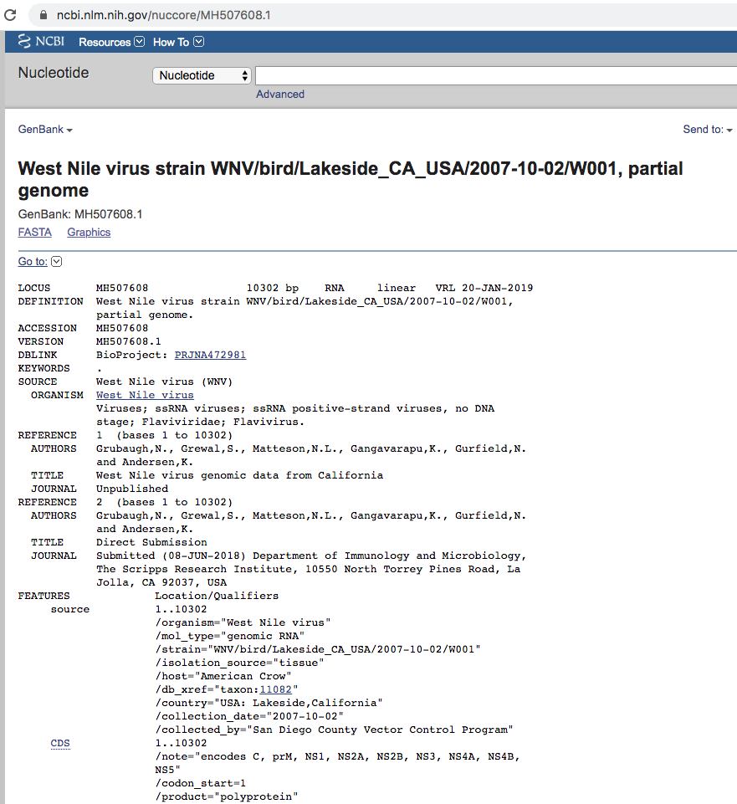
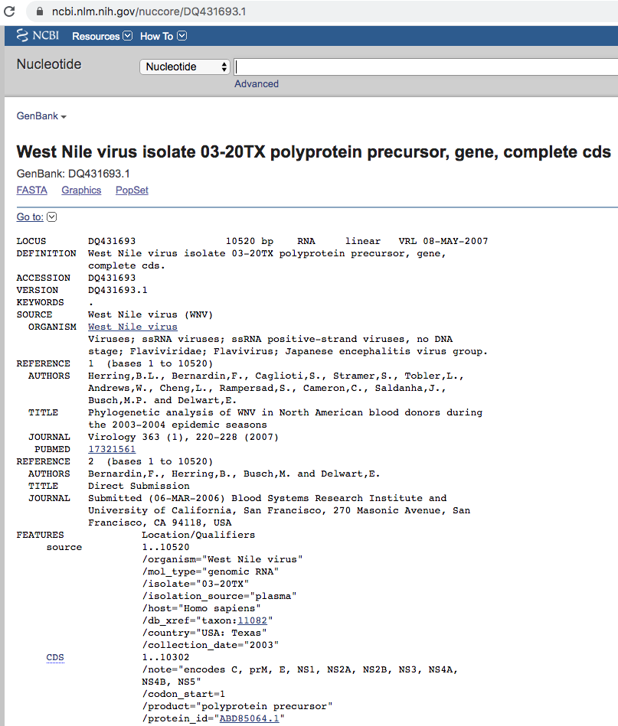

Slide 22
Multiple sequence alignments

Slide 23
Sequence homology and similarity
Phylogenetic methods are used to determine the evolutionary relationship of organisms based on variations at sequence level (mutations)
Due to mutations, sequences derived from common ancestors (homologs) have distinct levels (%) of similarity
Only homologous sequences can be compared, and their variations can be used to determine how closely/distantly related the organisms are to each other
Goal is to get homologous sites arranged in columns.
DENV1 AAAAGTCAGGTCAAACGCAGCTATTGGAGCAGTGTTCGTTGATGAAAATCA
DENV2 AAAGGTGAGAAGCAATGCAGCCTTGGGGGCCATATTCACTGATGAGAACAA
DENV3 AAAGGTCAGAACTAACGCAGCCATGGGCGCCGTTTTCACAGAGGAGAACCA
DENV4 AAAAGTTAGATCAAACGCAGCCATAGGCGCAGTCTTTCAGGAAGAACAGGG
ZIKV CAAGGTGCGCAGCAATGCAGCACTGGGAGCAATATTTGAAGAGGAAAAAGA
WNV AAAAGTCAACAGTAATGCCGCCCTAGGAGCGATGTTTGAAGAACAGAACCA
YFV AAAAGTCCGAAGTCATGCAGCCATTGGAGCTTACCTGGAAGAACAAGAACA
POWV GAAGGTGAGGTCCAACGCTGCTCTAGGTGCATGGTCGGATGAACAGAATAA
*AA*GT********A*GC*GC**T*GG*GC**********GA**A**A***
Multiple sequence alignment (MSA)

Slide 24
Importance and common issues
Cannot estimate genetic relationships or evolutionary rates if sequences cannot be aligned.
Misalignments and sequencing errors can lead to erroneous conclusions.
When nucleotide sequences are too divergent for an accurate alignment, use amino acid sequences.
Read “The Phylogenetic Handbook” Chapter 3 for the problems of repeats, substitutions, and gaps.

