Slide 1
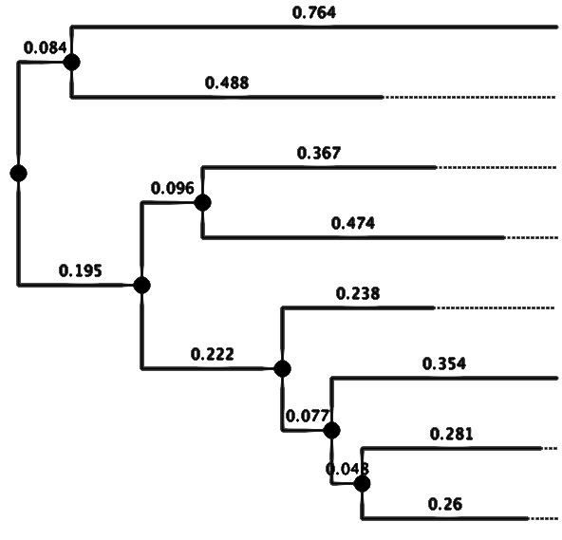
Phylogenetics: Tree building & annotation
EMD 531
Lecture 8
nathan grubaugh, phd

Slide 2
Learning objectives
Students will be able to:
Use software to accurately reconstruct phylogenetic trees; understand choice of method.
Understand important considerations for selecting a distance matrix model (NJ trees), substitution model (ML trees), branch support, and root.
Start Exercise #3: Phylogenetic tree reconstruction
Reminders for exercise 4 next week

Slide 3
What method should I use?

Slide 4
NJ vs ML
Neighbor-Joining (NJ)
Clusters sequences based on genetic distance (not substitution rates)
Fast, good for quick analysis (produces a single tree)
Not the most reliable, especially when dealing with deeper divergence times
Maximum-likelihood (ML)
Applies a model of sequence evolution (substitution rates)
More accurate than NJ, preferred for publications (along with Bayesian)
Computationally more expensive than NJ (takes more memory/time)
Recommendation:
NJ for a quick look at relatedness, determine if you should add/remove
ML (or Bayesian) for final products (publications, presentations)

Slide 5
Tree-building software
Pipelines: aligners, editors, tree building
Geneious (download, $$): https://www.geneious.com/
CLC Workbench (download, $$): https://digitalinsights.qiagen.com/products-overview/analysis-and-visualization/qiagen-clc-main-workbench/
**UGENE (download, free): http://ugene.net/
MEGA (download, free): https://www.megasoftware.net/
Tree software
RAxML GUI (download, free): https://sourceforge.net/projects/raxmlgui/
PHYLIP (download, free): http://evolution.genetics.washington.edu/phylip.html
BEAST (download, free): https://beast.community/index.html
CIPRES (online, free): https://www.phylo.org/portal2/login!input.action
NG Phylogeny (online, free) :https://ngphylogeny.fr/

Slide 6
Considerations during tree building

Slide 7
NJ trees: Distance matrix
Compute best fit distance matrix from your sequence data using Dnadist:
http://evolution.genetics.washington.edu/phylip/doc/dnadist.html
Jukes-Cantor:
Assumes that there is independent change at all sites, with equal probability.
Kimura:
Allows for a difference between transition and transversion rates.
F84
Allows for different transition/transversion rates and different frequencies of the four nucleotides.
LogDet
It computes the distance of the empirically observed matrix of joint probabilities of nucleotides.
From top to bottom: simplest (fastest) to most complex (slowest)

Slide 8
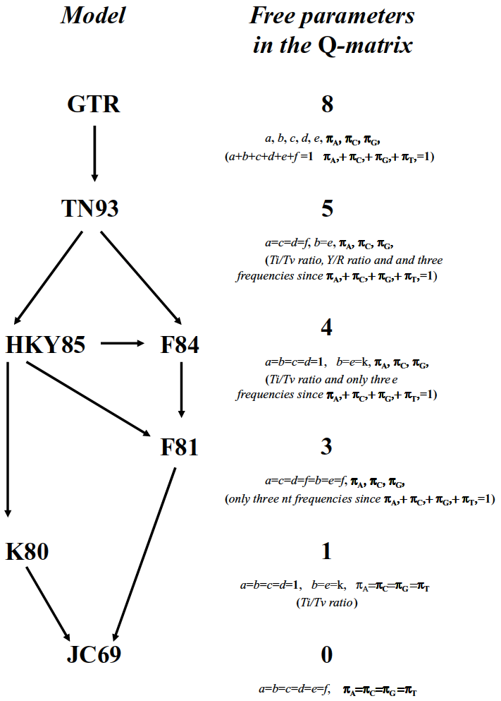
ML trees: nucleotide substitution model
From bottom to top: simplest (fastest) to most complex (slowest)
Compute best fit substitution model using jmodeltest2:
https://github.com/ddarriba/jmodeltest2 (recommend for final products)
GTR is the most common and general model for real-world DNA analysis. Only use simpler model with respect to computational costs.

Slide 9
Branch support
Likelihood-based method vs bootstrap
Approximate likelihood ratio test for branches (aLRT)
Much faster than bootstrap, as ML run just once
Based on the log ratio between the likelihood value of the current tree and that of the best alternative; seems to be close to Bayesian posteriors
Bootstrap
Very low, ML run independently 100-1000 times
The bootstrap proportion is a repeatability measure; when the bootstrap proportion of a given clade is high, one can be quite confident that this clade would be inferred again if another original data sample was available and analyzed by the same tree-building method (which does not mean that the clade is true)
Most common approach

Slide 10
How to read and root a tree

Slide 11
Visualizing and annotating trees
FigTree (download, free): http://tree.bio.ed.ac.uk/software/figtree/
Geneious (download, $$): https://www.geneious.com/
**UGENE (download, free): http://ugene.net/
TreeView (download, free): http://jtreeview.sourceforge.net/
iTOL (online, free): https://itol.embl.de/
ETE Toolkit (online, free): http://etetoolkit.org/treeview/

Slide 12
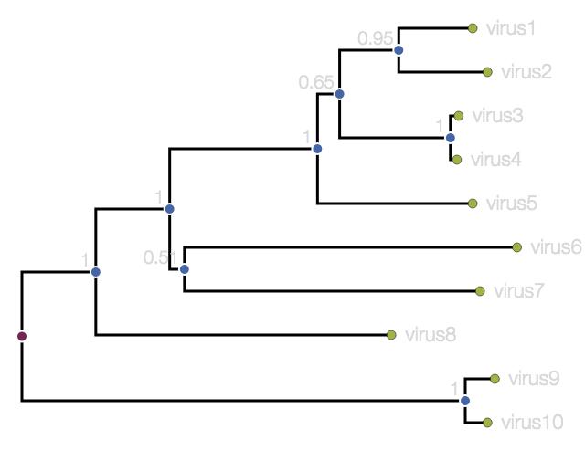
What info does a tree contain?
Support value: support that sequences to right cluster together
External or leaf node: sequenced sample
Internal node: common ancestor to sequences on right
Horizontal branch: evolutionary linkage – distance arbitrary
Root:
common ancestor to whole tree
Branch:
genetic distance
https://artic.network/how-to-read-a-tree.html#what-information-does-the-tree-contain

Slide 13
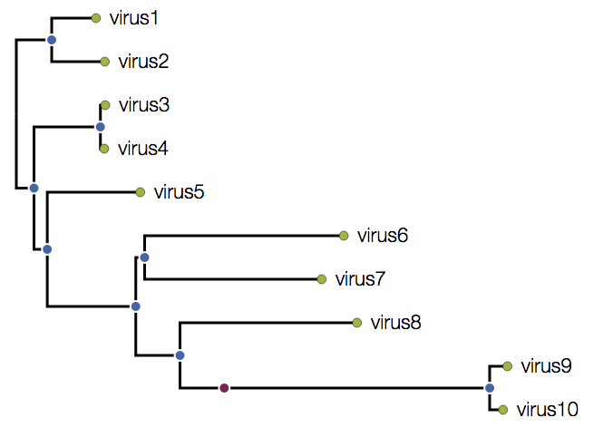
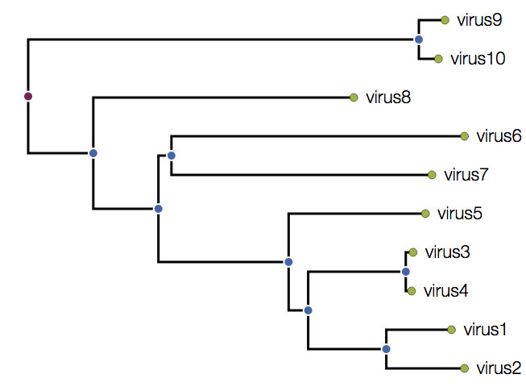
How to root a tree?
https://artic.network/how-to-read-a-tree.html#the-root-of-the-tree

Slide 14
How to root a tree?
Outgroup
Root by the most divergent sequences.
Include one or more sequences in the data set that are known to lie outside the diversity of the sequences of interest
Molecular clock model
Root by the oldest sampled clade (may not be the oldest genomes)
Include one or more sequences from a previous related outbreak
https://artic.network/how-to-read-a-tree.html#the-root-of-the-tree

