Slide 1

FinCoreBank
Smart Banking for a Better Tomorrow
Fin Core
Secure Digital Banking Platform with Transaction Management System
TEAM MEMBERS
NagarJuna Magam
Arfa Saniya
Balkishan
Jayanth
Sulthana
Complete onboarding, transaction, and loan management for modern banking operations.
UNDER THE GUIDANCE OF
Surmaya Biswas
Project Mentor, Infosys Springboard
JAVA • SPRING • REACT • MYSQL
FIN CORE • DIGITAL BANKING MANAGEMENT
01

Slide 2

AGENDA
Presentation flow
01
Problem & Proposed Solution
02
Core Modules & User Roles
03
Customer and Transaction Flow
04
Loan Management Flow
05
Technology Stack & System Architecture
06
Implementation Highlights & Validations
07
Roadmap, Lessons Learned & Conclusion
FIN CORE • DIGITAL BANKING MANAGEMENT
02

Slide 3

PROBLEM IDENTIFICATION
The Challenge
Manual Onboarding
Traditional onboarding can involve paperwork and repeated manual verification.
Balance & Transaction Visibility
Customers need clear validation and immediate balance updates during transactions.
Loan Processing
Loan requests require a clear application, approval/rejection and repayment workflow.
Role Separation
Admin and Customer actions must remain separated through authentication and authorization.
FIN CORE • DIGITAL BANKING MANAGEMENT
03

Slide 4
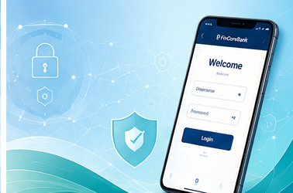
WHAT FIN CORE PROVIDES
Our Approach
Fin Core replaces manual banking processes with a secure, role-based digital workflow for onboarding, transactions, and loans.
Customer Onboarding
Customer submits a request; admin reviews and approves before account access is enabled.
Transaction Management
Deposit, withdrawal and transfer operations with balance and transaction validation.
Loan Workflow
Customer applies for a loan; admin verifies and approves/rejects; repayment is tracked.
Secure Access
Spring Security controls authentication and role-based access for Admin and Customer.
FIN CORE • DIGITAL BANKING MANAGEMENT
04

Slide 5

MAJOR FUNCTIONAL AREAS
Core Modules
Fin Core is organized into four functional areas that together cover the full banking lifecycle.
Customer
Admin
Registration, login, account access, transactions and loan requests.
Review requests, approve/reject customers, manage account information and loan processing.
Transactions
Loan
Deposit, withdrawal, transfer, balance checks and transaction history.
Loan application, approval/rejection, loan account/disbursement and repayment.
FIN CORE • DIGITAL BANKING MANAGEMENT
05

Slide 6
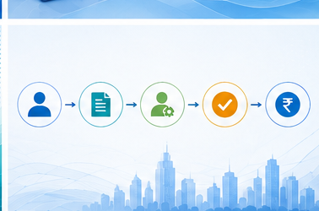
HOW A CUSTOMER USES THE SYSTEM
Customer & Transaction Flow
1
Customer Login
2
Raise Request
3
Admin Review
4
Account Activated
5
Transactions
Logs in after successful authentication
Submits a request for banking access
Admin approves or rejects the request
Approval enables banking access
Deposit, withdrawal & transfer, fully validated
Every transaction — deposit, withdrawal or transfer — passes account, balance and business-rule validation before it is processed.
FIN CORE • DIGITAL BANKING MANAGEMENT
06

Slide 7
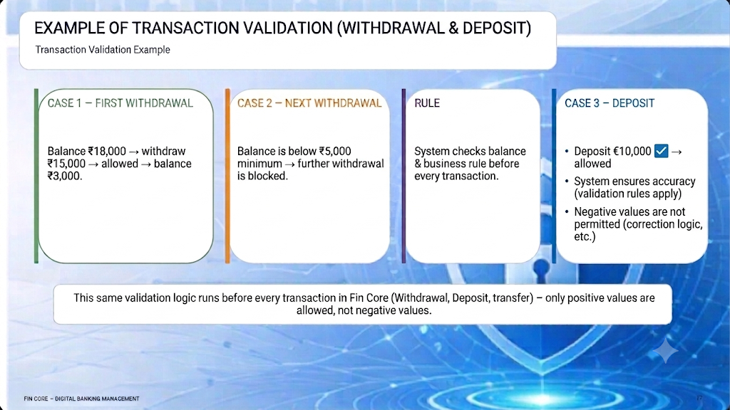


Slide 8

END-TO-END LOAN BUSINESS PROCESS
Loan Management Flow
1
Login & Browse Schemes
2
Apply for Loan
3
Admin Verification
View available schemes & interest rates
Select scheme & submit details
Eligibility & document review
4
Approve / Reject
5
Disbursement
6
Repayment
Decision with reason if rejected
Loan account created & funds released
Tracked automatically until fully paid
Every loan moves through verification and approval before disbursement, with repayment tracked automatically until fully paid.
FIN CORE • DIGITAL BANKING MANAGEMENT
08

Slide 9

WHO USES IT
User Roles & Responsibilities
ADMIN
CUSTOMER
• Manages the platform • Reviews and approves/rejects customer requests • Manages customer/account information • Processes loan applications • Monitors transaction activity
• Registers and logs in • Accesses approved account • Performs transactions • Applies for loans • Views loan and transaction status
FIN CORE • DIGITAL BANKING MANAGEMENT
09

Slide 10
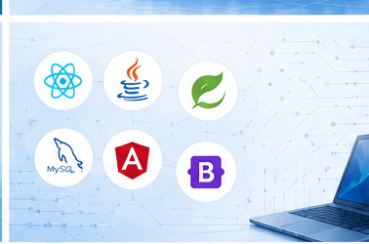
HOW THE PLATFORM IS BUILT
Technology Stack
FRONTEND
BACKEND
DATABASE
React.js Axios React Router Bootstrap / CSS
Java Spring Boot Spring MVC Spring Security
MySQL Spring Data JPA
Secure • Scalable • Reliable • Role-Based
FIN CORE • DIGITAL BANKING MANAGEMENT
10

Slide 11
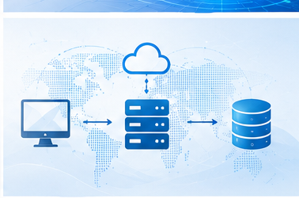
SYSTEM ARCHITECTURE
High Level Architecture
FRONTEND
APPLICATION
DATA LAYER
React.js SPA What customers and admins see and click
Spring Boot REST API + Spring Security Auth & Roles
MySQL + Spring Data JPA Accounts, loans and transactions
CLIENT → API → SECURITY / BUSINESS LOGIC → DATABASE → RESPONSE
Authentication
Role-Based
Business Logic
Data Persistence
Authorization
Access Control
& Validations
& Management
FIN CORE • DIGITAL BANKING MANAGEMENT
11

Slide 12

IMPLEMENTATION HIGHLIGHTS
Key Achievements
Role-Based Security
Spring Security separates Admin & Customer permissions.
Customer Management
Request, approval & account access workflow.
Transaction Management
Deposit, withdrawal, transfer & history with validation.
Loan Management
Application, admin approval/rejection & repayment.
Validation Layer
Account, balance & business rules checked before processing.
FIN CORE • DIGITAL BANKING MANAGEMENT
12

Slide 13

VALIDATIONS & SECURITY
Ensuring Data Integrity
Form Validations
Input validations on all forms to prevent invalid or incomplete data.
Business Rule Validations
Account, balance, loan eligibility and transaction rules enforced.
Secure Access
Spring Security ensures only authorized users can access features.
Data Integrity
Data consistency maintained across all operations.
FIN CORE • DIGITAL BANKING MANAGEMENT
13

Slide 14

ROADMAP
Future Enhancements
Mobile Application
Native mobile app for Android and iOS.
UPI & Payment Gateway
Integrate UPI and payment gateway services.
Advanced Analytics
Reports and dashboards for better insights.
AI/ML Based Risk Assessment
Intelligent loan approval and fraud detection.
FIN CORE • DIGITAL BANKING MANAGEMENT
14

Slide 15
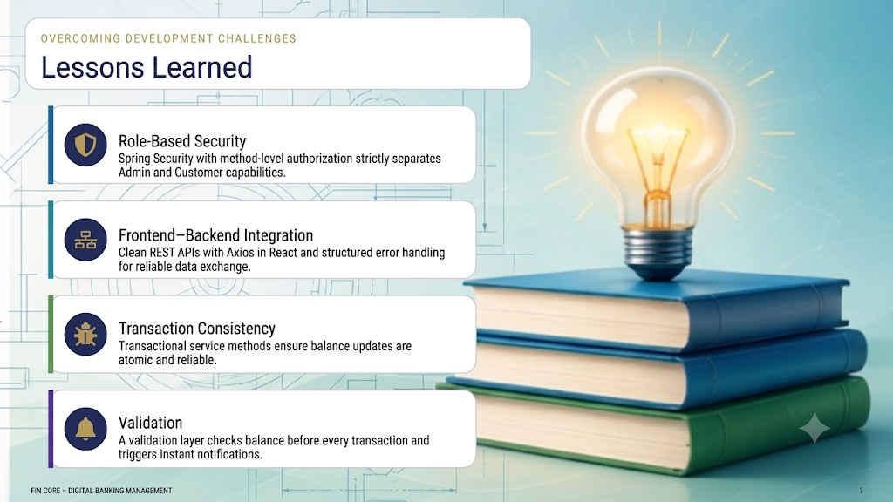


Slide 16

CONCLUSION
Building the Future of Banking
Fin Core demonstrates a complete digital banking solution that streamlines onboarding, transactions and loan management with security, validation and role-based access.
Smart Banking for a Better Tomorrow
Thank You!
Questions & Discussion
FIN CORE • DIGITAL BANKING MANAGEMENT
16

