Slide 1
MULTIMEDIANER
SERIOUS GAME
Sara | Flo | Max

Slide 2
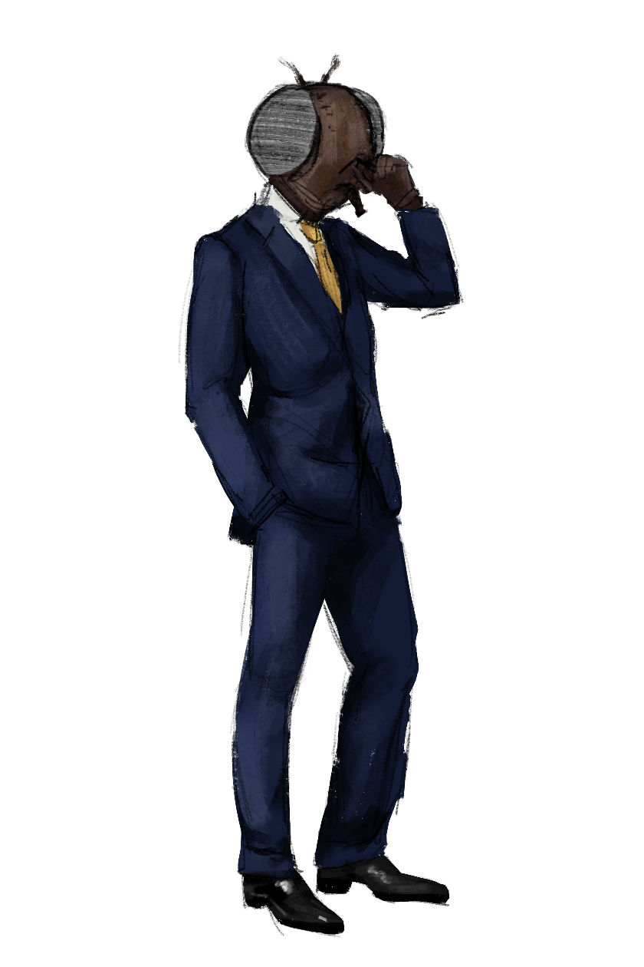
-[
Multimedianer
]-
Grundidee
Fragen mit 4 möglichen Antworten
Richtige Antwort: 10% des Monsters
Falsche Antwort: 0% und Fragenwiederholung am Schluss
Zwischen den Screens: Silhouette mit Monster
Ziel: Multimedianer freischalten.

Slide 3


Slide 4
Implementierung in Unity
STATUS
QUO
Visuelle Aufbereitung
Timer
Scene Switcher
Question Randomizer

Slide 5
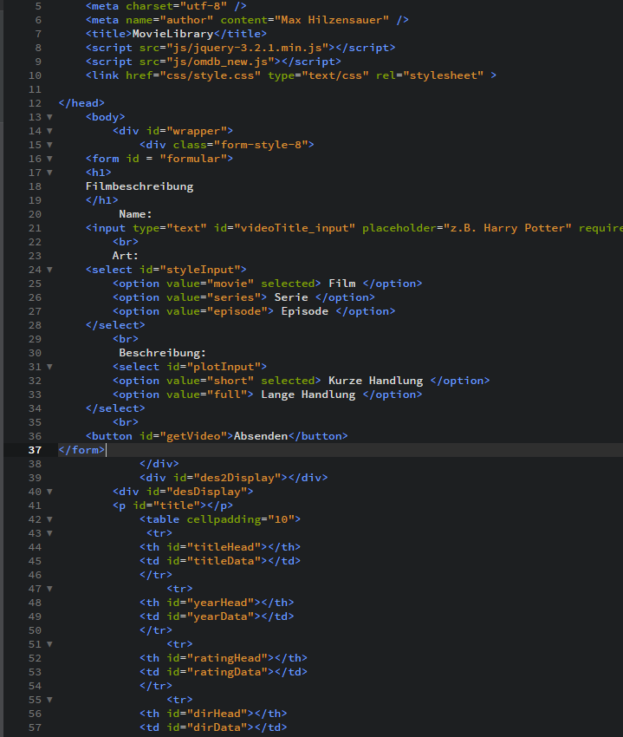
-[
Max Hilzensauer
]-
Learnings
Git Basics
C# Programmierung
Scene Management
C# in Verbindung mit Buttons
Video-Prototyping
Gleichzeitiges Arbeiten an Unity mit GitHub

Slide 7

-[
SLIDE TITLE HERE
]-
Grundidee
Phenomenon whereby something new and somehow valuable is formed the created item may be intangible such as an idea or a physical object such as an invention, a literary work or a painting scholarly interest in creativity

Slide 9
ONE SIDE FULL BLACK THING
STATUS
QUO
Over the course of the last decade, however, we seem to have reached a general agreement that creativity involves the production of novel, useful products words, the.
Beyond these general commonalities reckons that over a hundred different analyses can be found in the literature. As an illustration, one definition given described it as a process of
BY MIKOKIT
-[
F
I
L
]-

Slide 10
Stay Happy
-[
SLIDE TITLE HERE
]-
The rule’s we must follow
Keep Supportive
Over the course of the last decade, however, we seem to have reached a general agreement that creativity involves the production of novel, useful products words, the.
Beyond these general commonalities reckons that over a hundred different analyses can be found in the literature. As an illustration, one definition given described it as a process of
Don’t Panic
Stay Humble

Slide 11
-[
SLIDE TITLE HERE
]-
Fun Fact About Us
5,567
258
5,263
9,263
HAPPY CLIENTS
CUPS OF COFFEE
RETWEETS
DESIGN
Frequently, your initial font choice
Frequently, your initial font choice
Frequently, your initial font choice
Frequently, your initial font choice

Slide 12
-[
SLIDE TITLE HERE
]-
One Columns Preview
Research Project
Over the course of the last decade, however, we seem to have reached a general agreement that creativity involves the production of novel, useful products words, the production of something original and worthwhile. Authors have diverged dramatically in their precise definitions.
Beyond these general commonalities reckons that over a hundred different analyses can be found in the literature. As an illustration, one definition given described it as a process of becoming sensitive to problems, deficiencies, gaps in knowledge, missing elements, disharmonies, and so on identifying the difficulty searching for solutions.

Slide 13
-[
SLIDE TITLE HERE
]-
What We Can Do
Beyond these general commonalities reckons that over a hundred different analyses can be found in the literature. As an illustration, one definition given described it as a process of becoming sensitive to problems, deficiencies, gaps in knowledge, missing elements,

Slide 14
-[
SLIDE TITLE HERE
]-
Our Company
Frequently, your initial font choice is taken out of your awesome hands also we are companies often specify a typeface, or even a set of fonts, part of their brand guides However When selecting a typeface for body text,
Frequently, your initial font choice is taken out of your awesome hands also we are companies often specify a typeface, or even a set of fonts, part of their brand guides However When selecting a typeface for body text,

Slide 15
-[
SLIDE TITLE HERE
]-
Fun Fact About Us
324
1643
2000
PROJECT
CUSTOMERS
WORK HOURS
When selecting a typeface for body text, your
When selecting a typeface for body text, your
When selecting a typeface for body text, your

Slide 16
Hunter
Ranger
Wizard
Product Manager
Product Manager
Product Manager
Beyond these general commonalities reckons that over a hundred different analyses can be found in the
Beyond these general commonalities reckons that over a hundred different analyses can be found in the
Beyond these general commonalities reckons that over a hundred different analyses can be found in the

Slide 17
-[
SLIDE TITLE HERE
]-
Our Team Member’s
What ever you decide to do, Make sure it make’s you happy
Beyond these general commonalities reckons that over a hundred different analyses can be found in the literature. As an illustration, one definition given described it as a process of becoming sensitive to problems, deficiencies, gaps in knowledge,
William

Slide 18
-[
SLIDE TITLE HERE
]-
What ever you decide to do, Make sure it make’s you happy
Beyond these general commonalities reckons that over a hundred different analyses can be found in the literature. As an illustration, one definition given described it as a process of becoming

Slide 19
A SIMPLE TEXT CAN BE AMAZING IN THE HAND OF YOU
TITLE HERE

Slide 20
-[
SLIDE TITLE HERE
]-
Z
30%
Our Mockup Slide Collection
Security
Beyond these general commonalities
Beyond these general commonalities reckons that over a hundred different analyses can be found in the literature. As an illustration, one definition given described it as a process of becoming sensitive to problems, deficiencies, gaps in knowledge,
C
70%
Awarding
Beyond these general commonalities

