Slide 1
Recipe Site Traffic

Slide 2
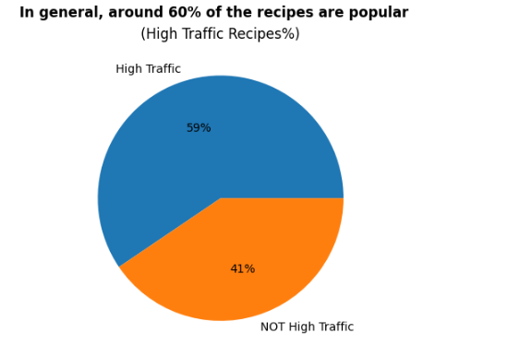
Overview & Summary
SITUATION: At the moment, I choose my favorite recipe from a selection and display that on the home page. We have noticed that traffic to the rest of the website goes up by as much as 40% if I pick a popular recipe.
GOAL: to predict
Which recipes will lead to high traffic
Correctly predict 80% of the time
Achieved a model that can predict a successful recipe with ~70+% precision
Focus on categorizing, in particular: Potato, Vegetable, Pork, Meat, LESS Beverage, Breakfast, More carbohydrates, calories

Slide 3
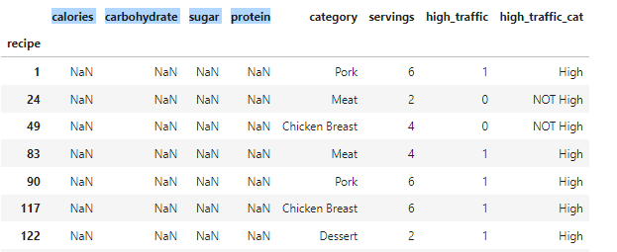
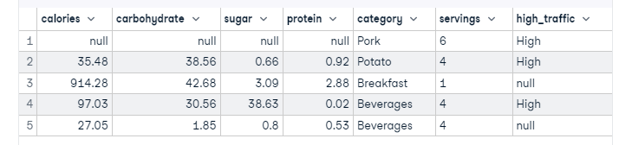
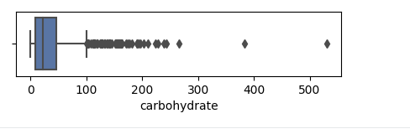
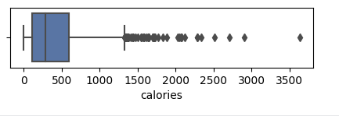
What we have done
Cleaning data
947 recipes
Removed 52 missing values
No duplicates
Removed ~15 outliers (eda)
High traffic, ‘High’, NULL
From text to numeric
Cleaned up serving
881
Cleaned-up type of variables

Slide 4
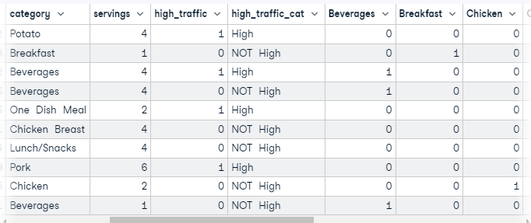
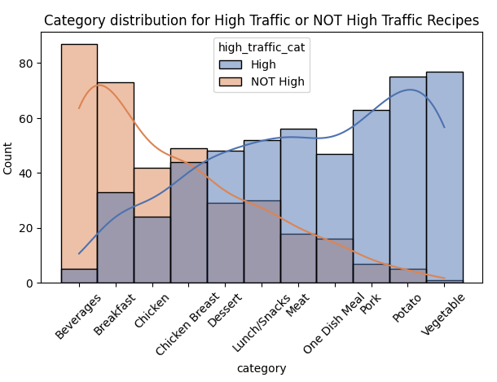
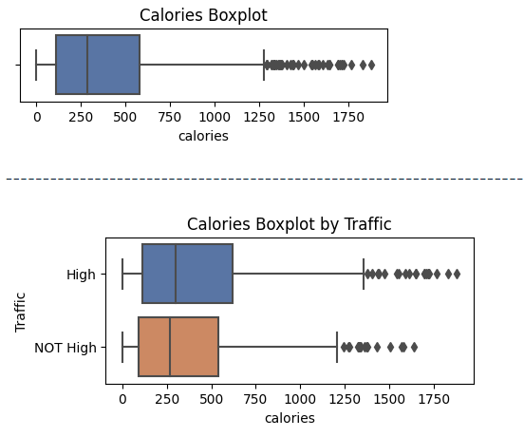
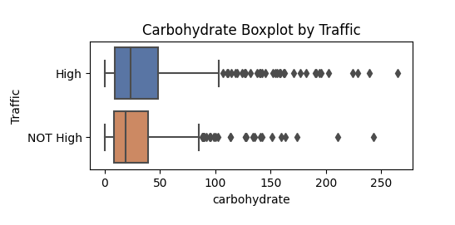
What we have done
Encoded with OneHotEcdoing
EDA
Looked at all variables one by one and difference between recipes that
Generate high traffic and low traffic
Looked at correlation

Slide 5
What we have done
Models
TRAIN
TEST
1. Pre-processing
Divided data into train and test sets (20%)
Standardised variables
Encoded (previous page)
2. Fitting models
- Run two classification models:
Logistic regression
K nearest neighbours
3. Compared results
80%
20%

Slide 6
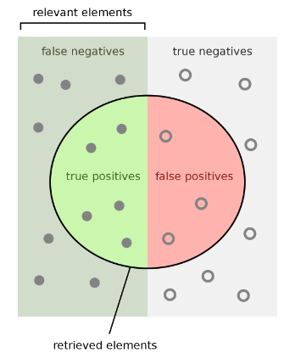

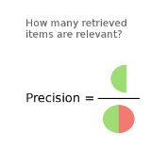
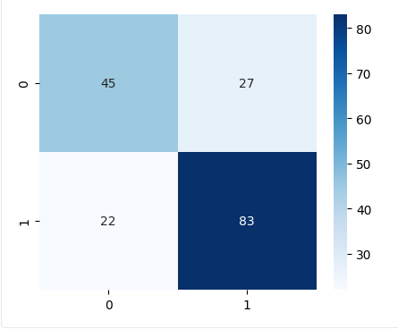
Key findings including the metric to monitor and current estimation
Results of the models
Confusion Matrix – Logistic Regression (test set)
Actual values
Model not good
at generalising
1 – High Traffic
0 – NOT High Traffic
Predicted
values

Slide 7
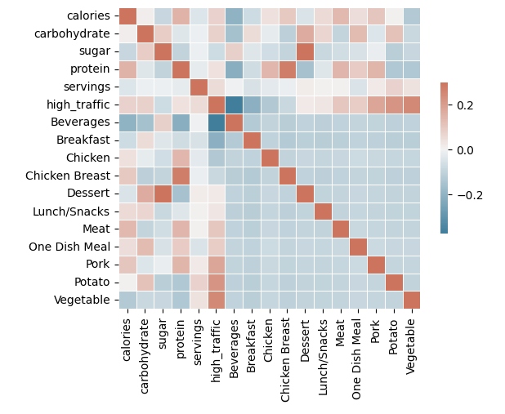
Key findings including the metric to monitor and current estimation
IMPORTANT FEATURES
Tagging of the recipe:
Potato, Vegetable, Pork Meat → UP
Beverage, Breakfast → DOWN
Carbohydrates, calories → UP

Slide 8
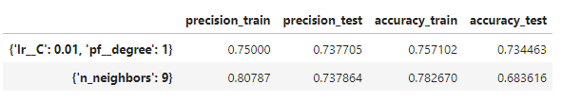
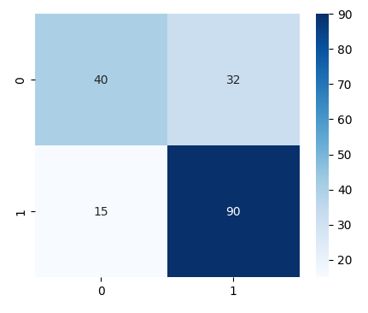
Key findings including the metric to monitor and current estimation
Results of the models – chosen variables
Confusion Matrix – Logistic Regression
Actual values
1 – High Traffic
0 – NOT High Traffic
Better
at generalising
→ less overfitting
Predicted
values

Slide 9
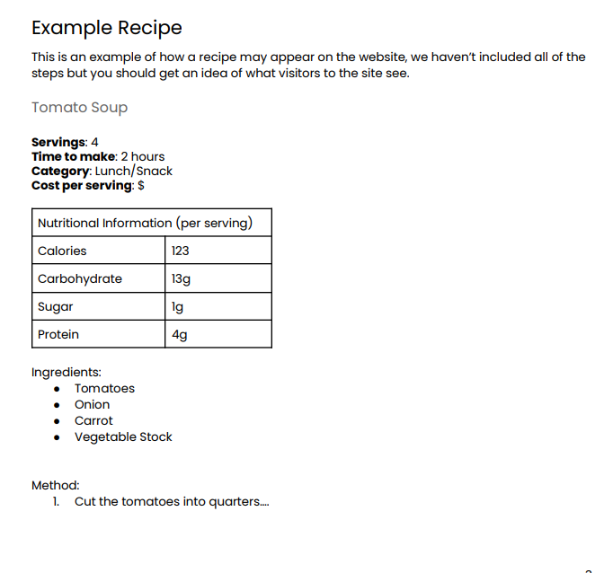
Recommendations to the business
Focus on vegetable,
Potato, less beverage
For now, our models
Indicate success
~70%
COLLECT DATA (SCRAP / PROVIDE)
Add more variables to the data such as:
Cost per serving
Time to make
Ingredients
Others?
Download text and run dome NLP models:
Use of key words
Certain style
Add more data on actual traffic that was
increased (regression problem)
More time
and data

