Slide 1

Medical Equipment Supply Management System
Project Supervisor: Mrs. M. Nafees Muneera, M.E,M.B.A.,PH.D
Name of the Student: Ms.Bibiana Magdelene.D
Register Number: 39110164

Slide 2
Presentation Outline
Course Certificate
Introduction
Objectives
System Architecture / Ideation Map
Module Implementation
Application Snapshots
Results and Discussions
Conclusion & Future work
References

Slide 3
Course Certificate

Slide 4
Introduction
Medical Devices are considered a fundamental component of Health Systems; the benefits they can provide continue to increase as they're essential to prevent, diagnose, treat and rehabilitate illnesses and diseases in a safe and effective way.
From needles and syringes to gloves, masks and flu vaccine, people can sell or buy the medical supplies they need to help keep your patients healthy. This website will find the equipments you need in the right time and also helps to reduce cost for those who need it.

Slide 5
Objectives
The Medical equipment supply management system lets people to sell and donate equipments through the website. It will give the details of equipments to those who need it. The hospitals can take the number from the website and contact them directly to get all their equipments delivered. Those who wish to donate or sell used medical equipments can create posts and will be contacted from buyers through this website. People who cannot afford these equipments can look for used equipments.
The website is an intermediate for buyers who wish to buy medical equipments newly or used ones and for sellers who want to sell these equipments. Many people who can’t afford to buy new equipments are struggling without proper health care. The website is most useful to hospitals, health care centers, and even patients who stay at home.

Slide 6
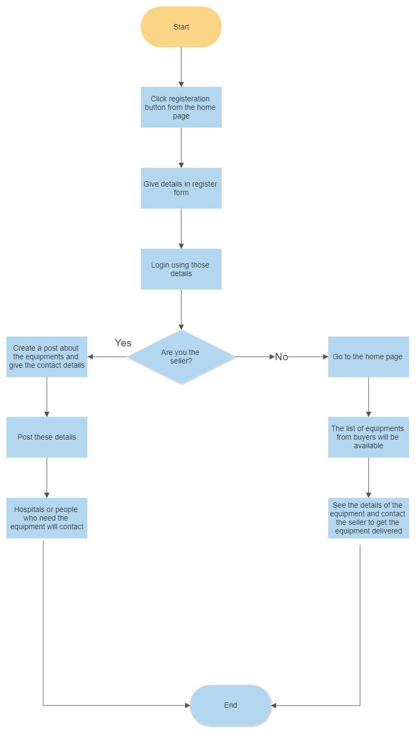
System Architecture

Slide 7
Module Implementation
Framework-Flask:
Flask is a lightweight Python web framework that provides useful tools and features for creating web applications in the Python Language. It gives developers flexibility and is an accessible framework for new developers because you can build a web application quickly using only a single Python file. Flask is also extensible and doesn’t force a particular directory structure or require complicated boilerplate code before getting started.
Flask –SQLAlchemy:
Flask-SQLAlchemy is an extension for Flask that adds support for SQLAlchemy to your application. It aims to simplify using SQLAlchemy with Flask by providing useful defaults and extra helpers that make it easier to accomplish common tasks
SQLAlchemy is the Python SQL toolkit and Object Relational Mapper that gives application developers the full power and flexibility of SQL.

Slide 8
Module Implementation
Critical Elements
Module Init - - required to enable the app
Module URL - - Url definitions of each module
App root Init - - Not necessary to define the entire app within __init__.py
Module Views - - Defines views for each module. Separate ‘.py.’ Files as the project scale to ensure they are accessible to URLs.
Module Templates - Normal template folder.
Routes and View functions
Clients send requests to the webserver, in turn, sends them to the Flask application instance. The instance needs to know what code needs to run for each URL requested and map URLs to Python functions. The association between a URL and the function that handles it is called a route. The most convenient way to define a route in a Flask application is through the (app.route). Decorator exposed by the application instance, which registers the ‘decorated function,’ decorators are python feature that modifies the behavior of a function

Slide 9
Methodology
HTTP Methods
Request
To process incoming data in Flask, you need to use the request object, including mime-type, IP address, and data. HEAD: Un-encrypted data sent to server w/o response.
GET
Sends data to the server requesting a response body.
POST
Read form inputs and register a user, send HTML data to the server are methods handled by the route. Flask attaches methods to each route so that different view functions can handle different request methods to the same URL.
Response
Flask invokes a view function. It has to return a response value to the client. HTTP requires it to be more than a string response, a status code.

Slide 10
Methodology
Templates
To maintain the site. Flask uses a powerful template engine, ‘Jinja2’, in its simplest form. A Jinja2 template is a file that contains the text of a response, returned by a view function that has a dynamic component represented by a variable.
Linking
Dynamic url routing support is included using ‘url_for()’ helper function. For example, url_for('sagar', name='project_file', _external=True) would return http://localhost:5000/sagar/project_file.
Security
CSRF(Cross-Site-Request-Forgery) occurs when a malicious website sends requests to a different website on which the victim logs in. Flask-WTF protects against all such attacks. Apart from that, Flask also implements some common security mechanisms like session-based management, role mgmt, password hashing, basic HTTP and token-based authentication, optional log-in tracking.

Slide 11
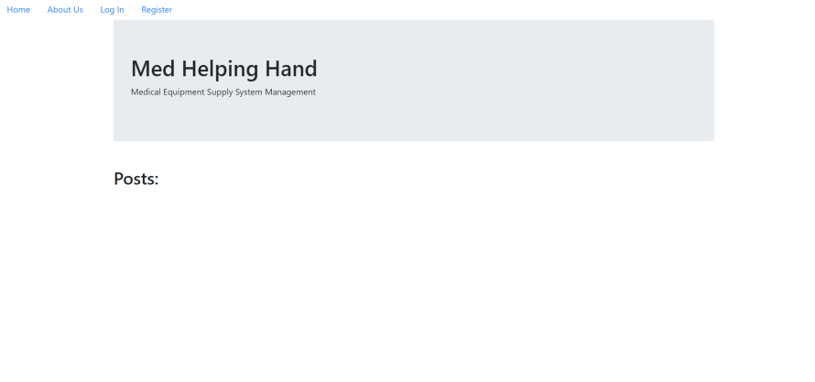
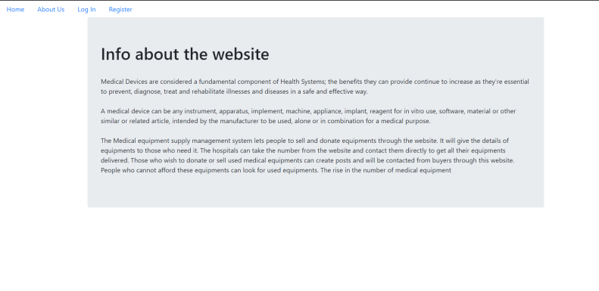
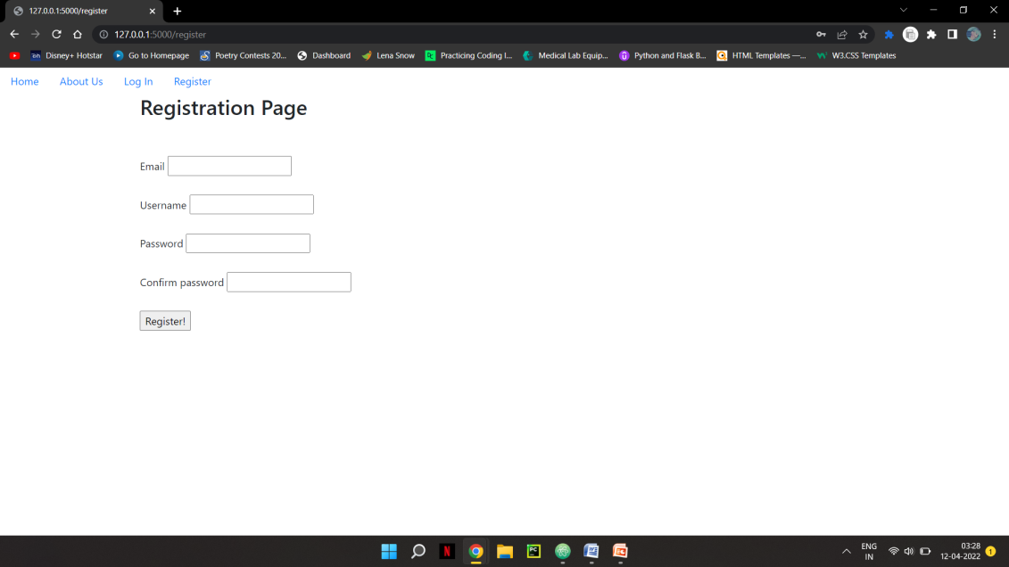
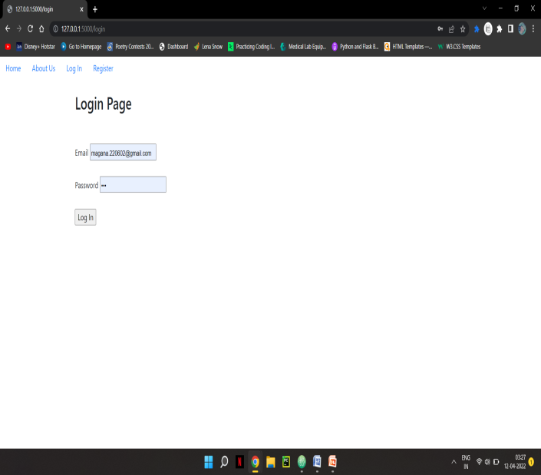
Application Snapshots

Slide 12
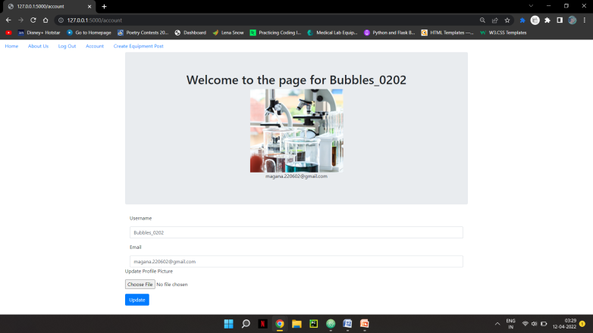
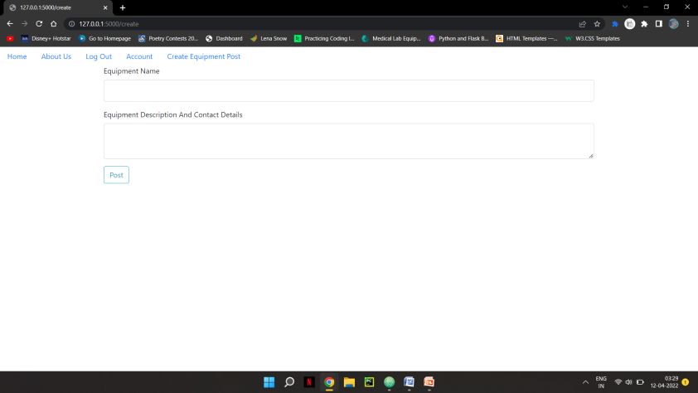
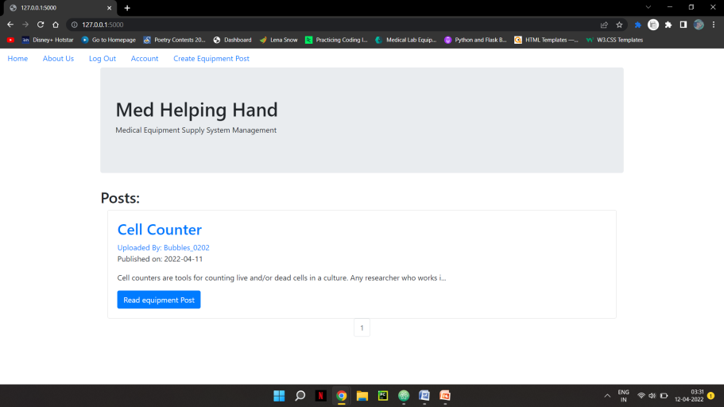
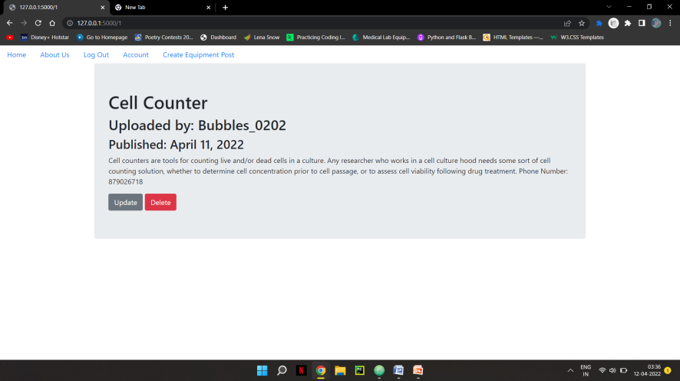
Application Snapshots

Slide 13
Results and Discussion
The Medical equipment supply management system shows all types of equipments from various sellers at all price range in one place. The buyers can search for their needed equipments and get the contact details. Hence, this web application acts as an intermediate between the buyers and the sellers. With just one click people can get the equipment details and the contact details.
The people who wish to donate the used equipments can also sell in this web application. Those who cannot afford to buy new medical equipments can still buy these used equipments at a cheaper rate.

Slide 14
Result
The web based equipment management supply system is created successfully and can be used by hospitals, clinic, and patients who use these equipments at home. Many lives will be saved when there is adequate equipments for everyone. In emergency times medical staff don’t need to worry and can search for sellers easily.
The sellers can update details about their equipments and once their equipments get sold out they can delete the post from the website. Only the account owner can delete the posts and nobody else can.
In case they need to update or change the details they can update the new details by clicking the post and update option.
The account profile pictures, user name, and even email can be changed and updated.

Slide 15
Conclusion
The buyers or the medical staff don’t need to go to various websites and see all the businesses selling equipments. They can see all types of equipment posts in one website and can get all details with just one click.
During the emergency times like Covid-19 many people were in the hospitals without proper beds and adequate medical equipments. So many lost their lives without proper medical attention. This web application helps the medical staff to easily know where they can buy their equipments and keep everything stocked even during these times. They don’t need to worry and can search for sellers easily.

Slide 16
References
https://www.fingent.com/blog/top-5-open-source-erp-systems-for-medical-equipment-suppliers/
https://www.hindawi.com/journals/jhe/2021/6685456/
https://flask.palletsprojects.com/en/2.1.x/
https://www.digitalocean.com/community/tutorials/how-to-make-a-web-application-using-flask-in-python-3
https://www.sqlalchemy.org/

