Slide 1
Software Design Patterns
What are they and how to properly use them?

Slide 2
OOP concepts
Abstraction is the concept of hiding the implementation and un-necessary details or data from the user. It’s the process of hiding complexity and focusing on on what functionalities are available to use.
Encapsulation is the concept of wrapping data and code together as a single unit.
Inheritance is the concept in which one object acquires/inherits all the properties and behaviors of a parent object.
Polymorphism is the concept by which we can perform a single action in different ways. Polymorphism is derived from 2 Greek words: poly and morphs. The word "poly" means many and "morphs" means forms. So polymorphism means many forms.

Slide 3
OOP concepts
Abstraction | Encapsulation
Abstraction solves the issues at the design level. | Encapsulation solves it implementation level.
Abstraction is about hiding unwanted details while showing most essential information. | Encapsulation means binding the code and data into a single unit.
Abstraction allows focussing on what the information object must contain | Encapsulation means hiding the internal details or mechanics of how an object does something for security reasons.

Slide 4
OOP relationships
Association defines a relationship between classes of objects that allows one object instance to cause another to perform an action on its behalf.
Aggregation is a weak type of association that represents the relationship between an owner (whole) object and its aggregated (parts) collection of objects in a way that does not affect the life cycle of the parts objects if the owner is destroyed.
Composition is a strong type of association and its also called death relationship. It represent an owner object that own another object as part of it. This type of relationship controls the life cycle of the owned object in a way that if the owner is destroyed then the owned object is destroyed too.

Slide 6
Design Patterns: Creational Design Patterns
In software engineering, creational design patterns are design patterns that deal with object creation mechanisms, trying to create objects in a manner suitable to the situation. Creational design patterns are composed of two dominant ideas. One is encapsulating knowledge about which concrete classes the system uses. Another is hiding how instances of these concrete classes are created and combined.

Slide 7
Factory Method Design Pattern
Intention: Define an interface for creating an object, but let subclasses decide which class to instantiate. Factory Method lets a class defer instantiation to subclasses.
Also known as: ﻿Virtual Constructor
Example: Dialog, Content validator

Slide 8
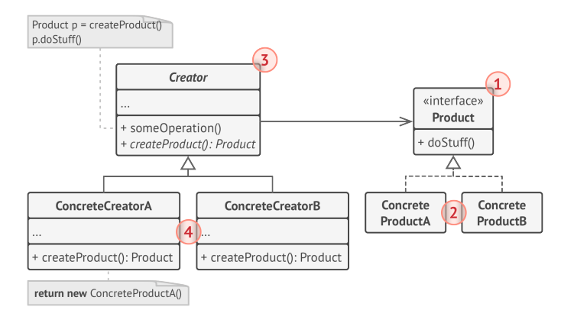

Slide 9
Builder Design Pattern
Intention: Separate the construction of a complex object from its representation so that the same construction process can create different representations.
Example: Computer, Response Interface (Real world scenario)

Slide 10
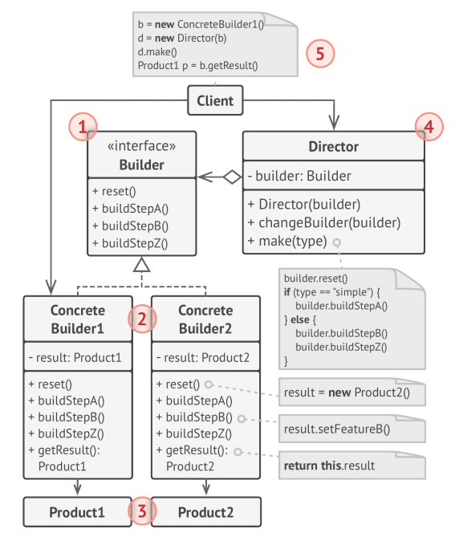

Slide 11
Prototype Design Pattern
Intention: Specify the kinds of objects to create using a prototypical instance, and create new objects by copying this prototype.
Example: Employee Prototype (Real world scenario)

Slide 12
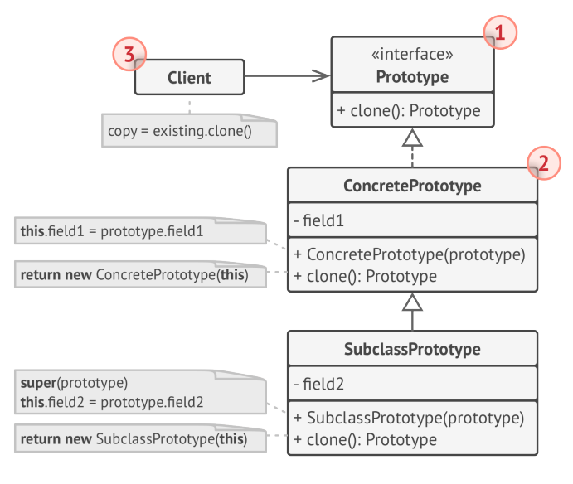

Slide 13
Abstract Factory Design Pattern
Intention: Provide an interface for creating families of related or dependent objects without specifying their concrete classes.
Example: Form Abstract Factory

Slide 14
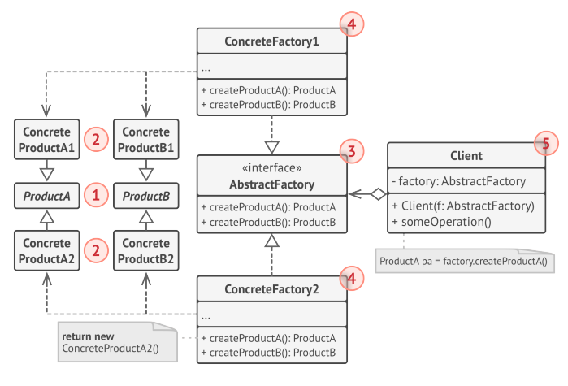

Slide 15
Singleton Design Pattern
Intention: Ensure a class only has one instance, and provide a global point of access to it.
Example: App Settings,

Slide 16
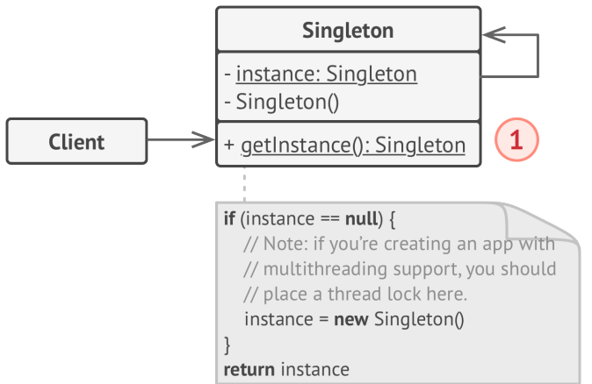

Slide 17
Design Patterns: Structural Design Patterns
Structural patterns are concerned with how classes and objects are composed to form larger structures. Structural class patterns use inheritance to compose interfaces or implementations. As a simple example, consider how multiple inheritance mixes two or more classes into one. The result is a class that combines the properties of its parent classes. This pattern is particularly useful for making independently developed class libraries work together. Another example is the class form of the Adapter pattern. In general, an adapter makes one interface (the adaptee's) conform to another, thereby providing a uniform abstraction of different interfaces. A class adapter accomplishes this by inheriting privately from an adaptee class. The adapter then expresses its interface in terms of the adaptee's.

Slide 18
Adapter Design Pattern
Intention: Convert the interface of a class into another interface clients expect. Adapter lets classes work together that couldn't otherwise because of incompatible interfaces.
Also known as: ﻿Wrapper
Example: SMS Clients, Database Adapter

Slide 19
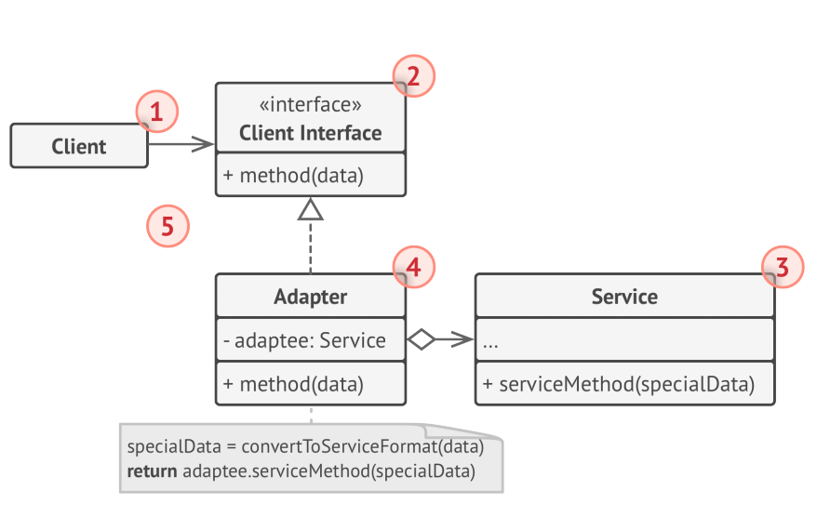

Slide 20
Bridge Design Pattern
Intention: Decouple an abstraction from its implementation so that the two can vary independently.
Also known as: ﻿Handle/Body
Example: Report

Slide 21
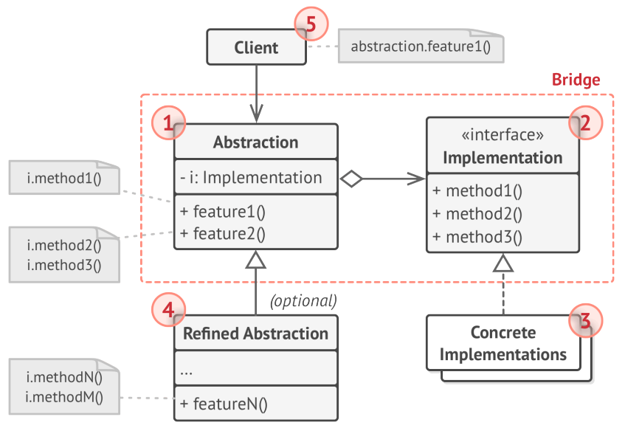

Slide 22
Facade Design Pattern
Intention: Provide a unified interface to a set of interfaces in a subsystem. Facade defines a higher level interface that makes the subsystem easier to use.
Example: File Converter

Slide 23
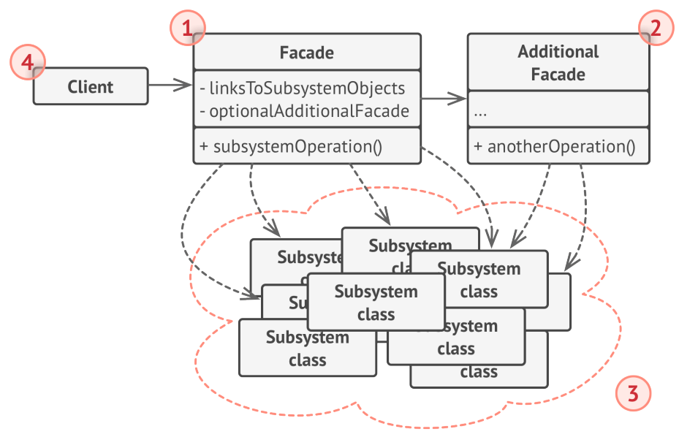

Slide 24
Decorator Design Pattern
Intention: ﻿Attach additional responsibilities to an object dynamically. Decorators provide a flexible alternative to sub classing for extending functionality.
Also known as: Wrapper
Example: Notifier

Slide 25
