Slide 1
Web scrapping using python
Assiut Branch
2022-2023

Slide 2
Objective
After this course you were able to scrap any web page and store it in excel or database
Course Duration
Lectures:18 hrs.
Labs: 18 hrs.
References
Florian Dedov : The Python Bible
Ryan Mitchell : Web Scraping with Python

Slide 3
Grading System
Assignments 25%
Project or Freelancing job 25%
Final Exam 50%

Slide 4
Agenda
Python History.
The Incredible Growth of Python
Why Python
Python Features
How does python work?
Install & Hello World Program

Slide 5
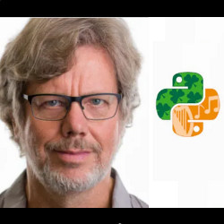
Python History

Slide 6
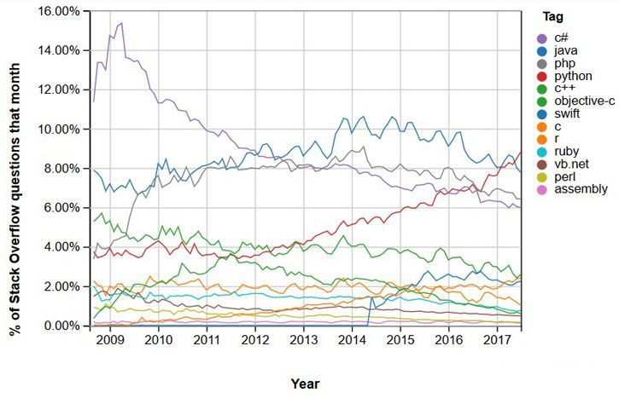
The Incredible Growth of Python

Slide 7
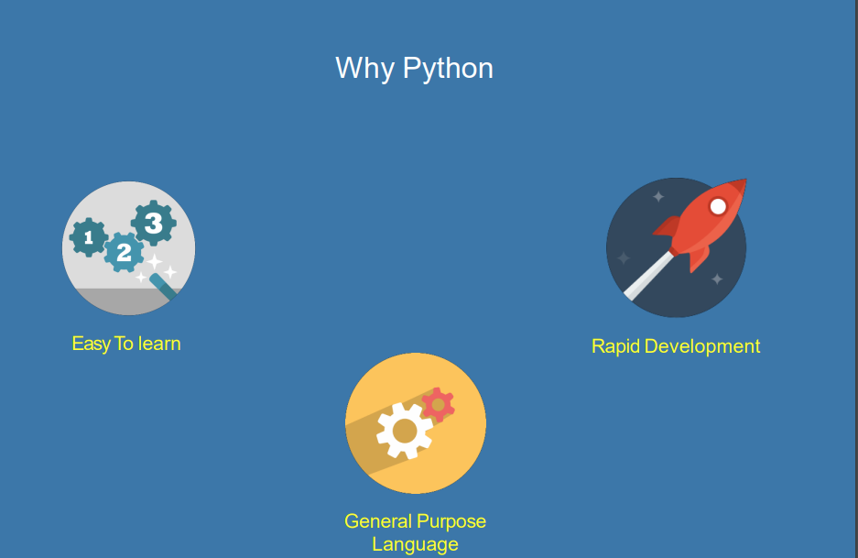
Why Python

Slide 8
Python Features
A simple language which is easier to learn
Free and open-source
Portability
Extensible and Embeddable
A high-level, interpreted language
Large standard libraries to solve common tasks
Object-Oriented

Slide 9
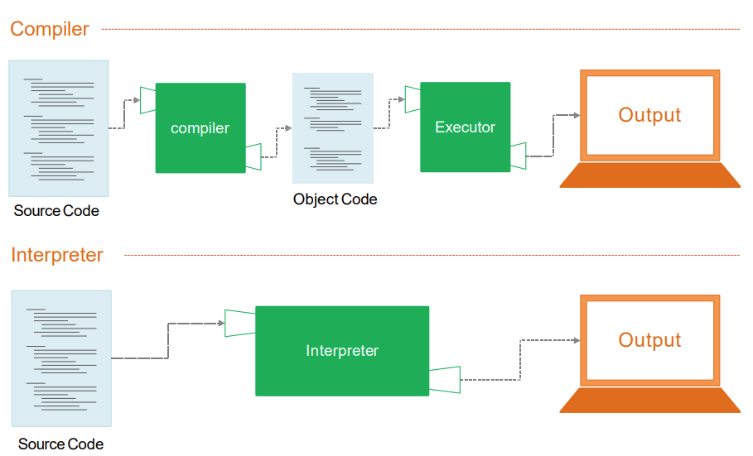
How does python work?

Slide 10
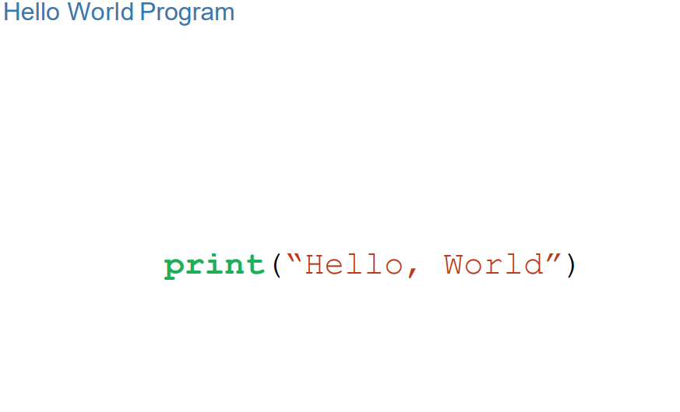
Install & Hello World Program

Slide 11
Questions ?

Slide 12
Thank you
2022-2023

