Slide 1
Web Scraping
Prepared By
Josephine Boles

Slide 2

What is web scraping?
is the process of gathering information from the Internet. Even copying and pasting the lyrics of your favorite song is a form of web scraping! However, the words “web scraping” usually refer to a process that involves automation
Notes:
The basic idea is to create a program that:
Visits a website
Gets the content of the website
Extracts information from the content
Uses the information in some automated way

Slide 3
Web scraping use cases
Searching for Real Estate Listings
Analyzing the Stock Market
Collecting Training Data for Machine Learning
Finding the Cheapest Online Retail Deals
Connecting Apps with Websites
Extracting Any Data from Any Website
Notes:
Really, web scraping can be used to get any types of data from any websites. The possibilities are nearly endless!

Slide 4
Challenges of Web Scraping
Variety: Every website is different. While you’ll encounter general structures that repeat themselves, each website is unique and will need personal treatment if you want to extract the relevant information.
Durability: Websites constantly change. Say you’ve built a shiny new web scraper that automatically cherry-picks what you want from your resource of interest. The first time you run your script, it works flawlessly. But when you run the same script only a short while later, you run into a discouraging and lengthy stack of tracebacks!
Notes:
Really, web scraping can be used to get any types of data from any websites. The possibilities are nearly endless!

Slide 5
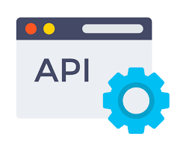
Alternative to Web Scraping
Notes:
Really, web scraping can be used to get any types of data from any websites. The possibilities are nearly endless!

Slide 6

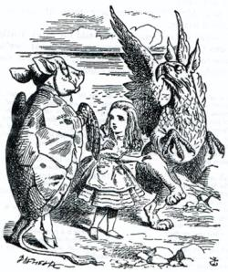

How to scrape a webpage
Manual Preparation
Look at the HTML for a website
Find the information desired
Figure out the data structure
Code
Request the website
Get the raw HTML text
Parse the text for the data
Notes:
Go over the basic steps required to scrape a webpage. Start with the manual preparation. This part does not involve writing code; just looking at code. Visit a website, look at the HTML, and find where the desired information fits in the page. This is the first building block.
Next, get into the code. This is where the magic happens. Request the website, and get the raw HTML. Then, take that HTML and parse it to find the desired information. This will be possible using two Python libraries: requests and beautifulsoup.

Slide 7
Environment
Install external Libs
pip install requests
pip install beautifulsoup4
Notes:
Go over the basic steps required to scrape a webpage. Start with the manual preparation. This part does not involve writing code; just looking at code. Visit a website, look at the HTML, and find where the desired information fits in the page. This is the first building block.
Next, get into the code. This is where the magic happens. Request the website, and get the raw HTML. Then, take that HTML and parse it to find the desired information. This will be possible using two Python libraries: requests and beautifulsoup.

Slide 8
Html review – what is HTML?
<html>
<body>
<div id="content">
<p class="greet">
Hello there!
</p>
<p class="message">
How is it going
</p>
</div>
</body>
</html>
HTML is the most basic building block of a website.
HTML Document
Text Content
HTML Element
Identifying Attribute
Notes:
Before diving too deep into the process, let’s review some basic HTML. Ask the students if they know what html is: the most basic building block of a website.
Ask the student what the HTML Document is.
Ask the students where the Text Content is.
Ask the students for examples of HTML Elements on the page.
Ask the students for examples of Identifying Attributes on the page.

Slide 9
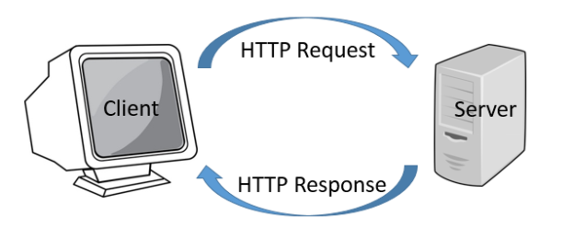
httP as a concept
Where have you seen “http” before?
It’s at the beginning of URLs for websites!
HyperText Transfer Protocol is the process by which web browsers fetch resources, such as HTML documents
Every time you type a URL into a web browser and press enter, HTTP finds the proper server and retrieves the HTML Document.
Then, the web browser takes that HTML document, and renders it into a human-readable format.
For web scraping, there is no rendering – just parsing.
Notes:
Explain a bit about HTTP. First, ask the students where they have seen HTTP before. They have probably seen it in front of URLs.
Give the definition of HTTP (and what it stands for). The illustration shows the process. For the purposes of this lesson, the server-side does not really matter; it’s all about the client.
Go through the explanation of what happens when a person goes to a website. Explain that for web scraping, there is no rendering – just parsing.
So how can we actually use this to scrape data in Python?

Slide 10

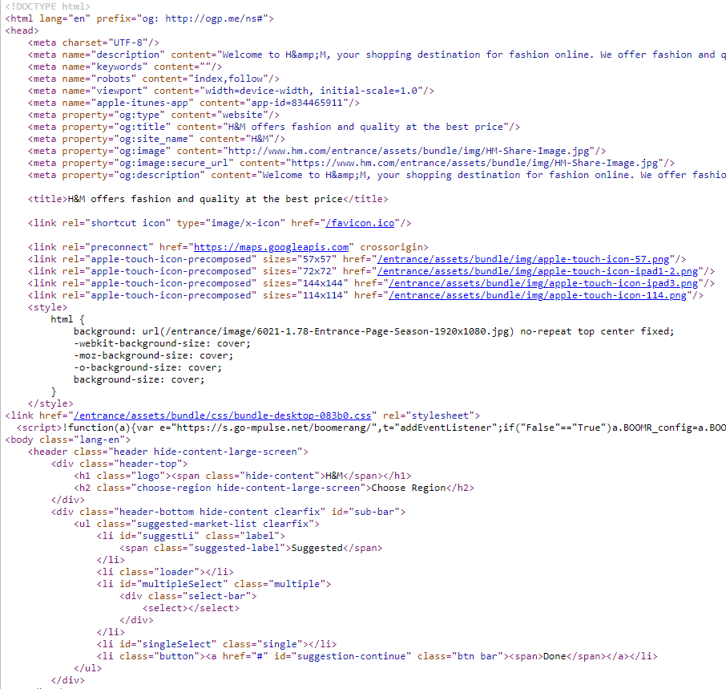
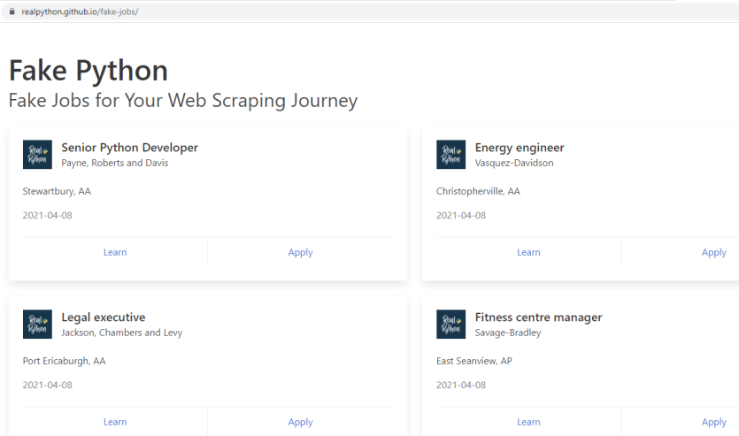
Getting into the code: Requests Library
1. Importing the Library
import requests
2. Getting a Response
URL = "https://realpython.github.io/fake-jobs/" page = requests.get(URL)
3. Getting the HTML Document Text
print(page.text)
Requests is an HTTP Library for Python.
Notes:
So how is this possible in Python? By using the requests library!
Requests is an HTTP library for Python. There are three simple steps to grab some HTML Document text.
Import the Library with an import statement
Use, requests.get, pass in the URL desired, and store in a response variable
Use response.text to get the HTML text
It’s as simple as that to get the raw text of a webpage… but then what?

Slide 11
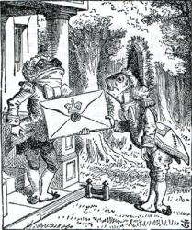
Beautiful soup library
1. Importing the Library
from bs4 import BeautifulSoup4
2. Getting the Soup Object
soup = BeautifulSoup(page.content, "html.parser")
3. Using the Soup Object
Search for elements, find all paragraphs, get text, find attributes from elements, etc…
Beautiful Soup is a Python library for pulling data from HTML and XML files.
Notes:
Introduce the Beautiful Soup Python library. The purpose of this library is to take HTML text, and turn it into a manageable data object.
Start by importing the library.
Next, get the soup object using the BeautifulSoup function. The result should be stored in a variable (not showed)
After that, there is a lot to be done!

Slide 12
Getting all Elements
html_document = BeautifulSoup(html_text, "html.parser")
paragraphs = html_document.find_all("p")
The find_all function returns a list of all elements given the type
Each element can also be searched or manipulated
The get_text function returns the actual text content of the element (without any of the HTML tags)
This is useful for printing information
for p in paragraphs:
text = p.get_text()
print(text)
Notes:
One basic way to use a Beautiful Soup object is to get all elements of a certain type.
Using the html_document variable, call the find_all function, passing in p. This returns a list of all paragraphs.
Once that’s done, it’s possible to loop through each element. The get_text function returns the actual text, which is a great way to print things out!

Slide 13
Searching for an element
search = {
"id": "toc"
}
contents_div = doc.find("div", search)
The search dictionary determines which elements will be found
In this case, it will look for all elements with an id attribute of toc
The find function returns a single element based on the search criteria
The first argument determines the type, and the second has specific items
Notes:
One other ability of a Beautiful Soup object is to search for a specific element. Create some search criteria, for example, looking for an id of toc. Then, using the doc soup object, call the find method. Pass in the element type “div” and the search dictionary. This will return one object, stored in the contents_div variable.

Slide 14
Summary
Web Scraping is the process of extracting data from websites
HTML Documents contain all the content for web pages
HTTP is how HTML documents travel through the internet
The Requests library can get HTML Documents from the web
The Beautiful Soup library can parse HTML text
Python Program
HTML
Doc
Requests
(HTTP)
Information
HTML
Beautiful
Soup
Data Object
Notes:
Go over all of the things learned in this lesson.
The total workflow is like this:
An HTML document exists on a website. Using the Requests library (which wraps around HTTP), the HTML text is pulled into the Python program. Within the Python program, the Beautiful Soup library converts the HTML into usable data objects. From there, the data can be presented nicely!

Slide 15
Questions ?

Slide 16
Thank you
2022-2023

