Slide 1

DEPARTMENT OF COMPUTER SCIENCE AND ENGINEERING
PROJECT PHASE I – FIRST REVIEW
AUTOMATIC KYC VERIFICATION USING MACHINE LEARNING
PROJECT STUDENTS GUIDE
MAGENDRA PRASAD K, 41611106 MRS.N.SENTHAMILARASI.M.Tech.,
LOKESH N ,41611102 (Ph.D.,)

Slide 2
AGENDA
Overview
Objective
Literature Survey
Inferences from Literature Survey
Problem Description
Proposed System
Overall Architecture
Work Flow
Methodology / Algorithm used
Conclusion
References

Slide 3
OBJECTIVE
The aim of this project is to enhance the efficiency and accuracy of customer verification processes while ensuring compliance with regulatory standards through the implementation of an automated KYC system. By leveraging advanced technologies, including Optical Character Recognition (OCR) and Artificial Intelligence (AI), the system seeks to streamline the onboarding process, minimize fraud risk, improve data security, and reduce operational costs. Additionally, the project will address challenges related to data privacy and the need for continual regulatory updates, ensuring a robust and future-proof solution.

Slide 4
Overview
KYC (Know Your Customer) processes are pivotal in the fight against money laundering, transforming traditional manual verifications into seamless digital experiences. By leveraging cutting-edge technologies, these processes authenticate individuals and entities through a series of streamlined steps. This typically involves uploading identification documents, utilizing Optical Character Recognition (OCR) to extract and process data, cross-referencing information with extensive databases, and evaluating risk using advanced artificial intelligence.
The benefits of automated KYC are manifold. It accelerates verification procedures, enhances accuracy, and provides a smoother customer experience. Security is fortified, operational costs are reduced, and regulatory compliance is achieved more efficiently. Industries such as finance, e-commerce, and telecommunications particularly depend on automated KYC systems to facilitate swift onboarding, prevent fraud, and adhere to stringent regulatory requirements.

Slide 5
LITERATURE SURVEY
[1] Mittal et al. (January 2019) conducted a survey on KYC automation using AI. The study highlights the efficiency and accuracy improvements in KYC processes through AI-driven automation, significantly reducing processing time and manpower. This automation ensures accurate document tagging and faster client onboarding, processing over 0.8 million documents daily. The integration of visual recognition, face biometrics, and secure storage underscores the transformation in banking operations due to AI​.
[2] Xiaoqi Li et al. (June 2020) conducted a comprehensive survey on the security of blockchain systems. This survey paper provided an overview of security vulnerabilities and real attacks in blockchain systems. Although not specifically focusedon KYC, it laid the foundation for understanding the security challenges faced by blockchain-based systems.

Slide 6
LITERATURE SURVEY
[3] Diksha Malhotra et al. (August 2021) conducted a systematic review of blockchain technology in KYC processes since 2014. Their research highlighted the inefficiencies of manual KYC procedures and proposed blockchain as a means to improve efficiency, speed, and cost-effectiveness. The authors discussed prominent blockchain platforms like Ethereum and Hyperledger and presented relevant case studies, outlining future directions for KYC automation.
[4] Somchart Fugkeaw (May 2022) proposed a blockchain-based e-KYC scheme called e-KYC TrustBlock. This scheme combined ciphertext policy attribute-based encryption (CP-ABE) and client consent enforcement to ensure trust, security, and privacy compliance in e-KYC systems. The paper presented experimental results demonstrating the efficiency and scalability of the proposed system.
[5] Pradnya Patil and M. Sangeetha (2022) introduced a decentralized KYC verification process using the Ethereum Blockchain platform. Their framework leveraged decentralization, immutability, and security provided by blockchain to
enhance the efficiency and security of the KYC process. Banks within the network could verify and vote for the legitimacy of customer data while preventing tampering with other banks.

Slide 7
LITERATURE SURVEY
[6] Vincent Schlatt et al. (November 2022) addressed the challenges of traditional KYC processes and presented a framework utilizing blockchain-based self-sovereign identity (SSI). This framework overcame inefficiencies and ensured data protection while complying with regulatory requirements. The paper derived design principles exploring the role of blockchain in enabling SSI for the KYC process.

Slide 8
INFERENCES FROM LITERATURE SURVEY
Author & Journal name | Title | Existing techniques | Drawbacks
Mittal et al. | KYC automation using AI | The existing KYC system before AI automation, as described by Mittal et al. (2019), involved manual document handling, slower client onboarding, and higher dependency on human resources, leading to inefficiencies and potential inaccuracies. | While their study focuses on the automation aspect, it does not address the challenges of data verification when relying solely on AI, particularly in the absence of a robust centralized database. Our approach leverages existing government-controlled databases (Aadhaar and PAN), eliminating the need for additional AI security layers, thus reducing overhead.

Slide 9
Author & Journal name | Title | Existing techniques | Drawbacks
Xiaoqi Li et al. (June 2020) | Comprehensive survey on the security of blockchain systems. | This paper provided a detailed overview of various security vulnerabilities and documented real-world attacks that have targeted blockchain systems. While the study wasn't specifically focused on KYC, it played a crucial role in establishing a foundational understanding of the security challenges inherent in blockchain-based systems. | Although their insights into blockchain security are valuable, they may not be directly applicable to our system, which relies on the centralized, secure nature of government-controlled databases. Introducing blockchain could unnecessarily complicate the system without providing added security benefits, creating overhead in implementation and maintenance

Slide 10
Author & Journal name | Title | Existing techniques | Drawbacks
Diksha Malhotra et al. (August 2021) | Systematic review of blockchain technology in KYC processes since 2014. | Their research underscored the inefficiencies inherent in traditional, manual KYC procedures and proposed blockchain as a solution to enhance efficiency, speed, and cost-effectiveness | Their solution may overlook the fact that our approach already utilizes a centralized database, which inherently addresses the inefficiencies without requiring theoverhead of blockchain. Implementing blockchain in our context could lead to unnecessary complexity and operational costs without significantly enhancing the KYC process.

Slide 11
Author & Journal name | Title | Existing techniques | Drawbacks
Somchart Fugkeaw (May 2022) | blockchain-based e-KYC | This scheme integrates ciphertext policy attribute-based encryption (CP-ABE) with client consent enforcement mechanisms to ensure high levels of trust, security, and privacy compliance within e-KYC systems. | While the focus on privacy compliance is important, our system benefits from existing government regulations governing Aadhaar and PAN databases, which provide a level of trust and security without additional blockchain layers. The added complexity of integrating a blockchain solution may detract from the streamlined verification process we aim to achieve.

Slide 12
Author & Journal name | Title | Existing techniques | Drawbacks
Pradnya Patil and M. Sangeetha (2022) | decentralized KYC verification process utilizing the Ethereum Blockchain platform. | Their framework harnesses blockchain’s key attributes decentralization, immutability, and security to revolutionize the KYC process. By enabling banks to verify customer data and engage in a consensus-driven voting mechanism, the system prevents data tampering and enhances transparency, addressing traditional challenges in data verification, security, and efficiency within the KYC process. | Although decentralization offers advantages, our centralized approach simplifies the verification process by relying on government databases that are already secure and reliable. The overhead of managing a decentralized system can introduce operational challenges and costs that our approach seeks to avoid

Slide 13
Author & Journal name | Title | Existing techniques | Drawbacks
Vincent Schlatt et al. (November 2022) | blockchain-based self-sovereign identity (SSI) | This innovative approach aims to address inefficiencies, strengthen data protection, and ensure compliance with regulatory requirements. The framework leverages blockchain technology to empower users with greater control over their identity data while streamlining the verification process. The authors derived key design principles that explore how blockchain can facilitate the integration of SSI within KYC, ultimately enhancing both security and efficiency in the process. | While SSI provides a promising avenue for data ownership and control, our approach leverages the established authority of government databases, which offer a streamlined process without the complexities associated with implementing SSI. The introduction of SSI could create unnecessary overhead and potential confusion in identity management when the centralized database already fulfills the necessary requirements.

Slide 14
Author & Journal name | Title | Existing techniques | Drawbacks
Assistant Professor Mrs. Mamatha S K, along with Ranjita Ramachandra Hegde, Kamala M, and Shreevidhya S, published a paper in the International Journal of Novel Research and Development (IJNRD), Volume 8, Issue 6, June 2023 | inefficiencies and security challenges inherent in traditional Know Your Customer (KYC). | Their framework harnesses blockchain’s key attributes decentralization, immutability, and security to revolutionize the KYC process. By enabling banks to verify customer data and engage in a consensus-driven voting mechanism, the system prevents data tampering and enhances transparency, addressing traditional challenges in data verification, security, and efficiency within the KYC process. | The paper addresses inefficiencies and security challenges in traditional KYC processes by proposing a blockchain-based solution for KYC verification. Utilizing blockchain and smart contracts on the Ethereum platform, the system creates a decentralized, secure, and efficient KYC process. This approach aims to mitigate risks and limitations of traditional methods, enhancing overall process effectiveness and security

Slide 15
PROBLEM DESCRIPTION
In the digital landscape, Know Your Customer (KYC) processes are essential for financial institutions to verify customer identities and comply with regulations. Traditional KYC methods are slow and prone to errors. This project aims to develop an automated KYC system using Optical Character Recognition (OCR) and facial recognition technologies to streamline the verification of Aadhaar and PAN cards. By automating the extraction and comparison of key information, and ensuring accurate identity verification through facial recognition, the system significantly enhances accuracy, reduces processing time, and minimizes manual intervention in the KYC process. Additionally, the system includes measures to detect and flag potentially fraudulent, further ensuring the integrity and authenticity of the KYC process. This solution offers a more efficient and reliable approach to meeting regulatory requirements and improving customer onboarding experiences.

Slide 16
PROPOSED SYSTEM
Image Pre-processing Module
This module optimizes the quality of uploaded images, which is crucial for the performance of Optical Character Recognition (OCR) and facial recognition systems. Techniques like noise reduction, contrast enhancement, and normalization improve image clarity, while resizing and cropping adjust image dimensions to meet the specific requirements of OCR and facial recognition algorithms. These enhancements significantly boost the accuracy and reliability of the KYC process.
Text Extraction Module
Using the Tesseract OCR library, this module extracts relevant information from uploaded documents by converting scanned text images into machine-readable formats. It includes a Data Validation component that checks the extracted data against predefined formats, such as identification numbers and dates, ensuring accuracy and preparing the data for further verification, thereby streamlining the KYC process.
Facial Recognition Module
This module verifies user identity by comparing a selfie with the photograph on an official document, like an Aadhaar or PAN card. Using OpenCV, it detects and analyzes facial features, computing similarity scores to confirm a match. This step is vital for ensuring that the person submitting the documents is the rightful owner, enhancing the security of the KYC process.
Data Validation Module
The Data Validation Module cross-references the extracted data with centralized databases, such as Aadhaar and PAN. It verifies the information's accuracy by comparing it with data retrieved from these databases, enhancing the reliability of the KYC process and reducing the risk of fraud.
Fraud Detection Module
This module uses machine learning algorithms to detect unusual patterns or behaviors that might indicate fraudulent activities. It assigns risk scores to submissions, flagging high-risk cases for further review, thus minimizing fraud risk.
Reporting, Security, and Monitoring Modules
The Reporting Module generates detailed reports on KYC activities, aiding transparency and compliance. The Security Module ensures data integrity and confidentiality through encryption and access controls. Finally, the Logging and Monitoring Module tracks system performance and user activities, ensuring optimal operation and quick resolution of issues.

Slide 17
SYSTEM REQUIREMENT
Operating System:
Any
Programming Language:
Python
Framework and libraries:
FastApi(web api)
Tesseract(OCR)
OpenCV(image reading and analysis)
Requests (for making API calls)
Database:
MySQL(for storing user data, KYC documents, etc.)

Slide 18
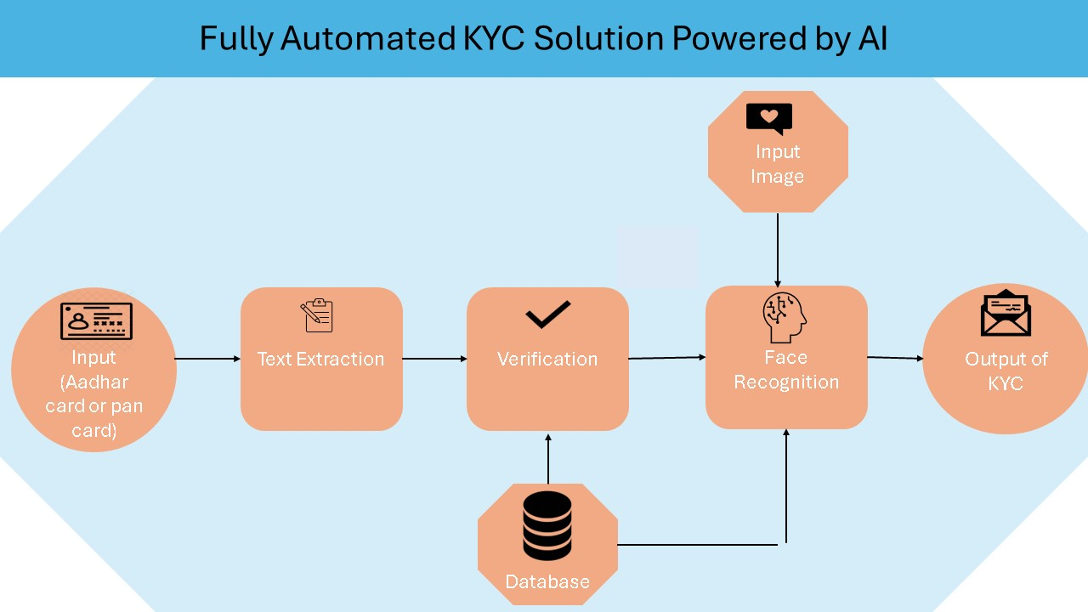
WORK FLOW

Slide 19
Algorithm
input ( Aadhaar/PAN card and a selfie image )
Image Pre-processing
Text Extraction
Parse the extracted_text and retrieve name, date of birth, ID number
Compare the extracted information with the database
Facial Recognition
Face Encoding/Embedding
Face Similarity Matching
Output Generation

Slide 20
CONCLUSION
An automated KYC system utilizing Optical Character Recognition (OCR) and facial recognition significantly improves customer verification processes by enhancing efficiency, accuracy, and compliance with regulatory standards. By automating tasks such as data extraction, validation, and identity verification, this system reduces manual processes, lowers operational costs, and streamlines the customer onboarding experience.However, implementing this system involves challenges, including high computational demands, potential latency from API interactions, and complex machine learning algorithms. Additionally, robust security measures are crucial to protect sensitive data.Despite these challenges, the automated KYC system offers substantial benefits by reducing fraud risk and improving data security compared to traditional methods. It sets a new standard for verification in finance, e-commerce, and telecommunications, fostering greater trust and transparency. This advancement paves the way for a more secure and efficient digital landscape, aligning with regulatory requirements and enhancing customer relationships.

Slide 21
REFERENCES
1 Mittal et al. (January 2019) conducted a survey on KYC automation using AI.
2 Diksha Malhotra, Poonam Saini & Awadhesh Kumar Singh ,(25 August 2021) , How Blockchain Can Automate KYC Systematic Review
3 Pradnya Patil, M. Sangeetha, (2022), Blockchain-based Decentralized KYC Verification Framework for Banks
4 Somchart Fugkeaw, (05 May 2022 ), Enabling Trust and Privacy-Preserving e-KYC System Using Blockchain
5 Vincent Schlatt, Johannes Sedlmeir, Simon Feulner, Nils Urbach, (November 2022), Designing a Framework for Digital KYC Processes Built on Blockchain-Based Self-Sovereign Identity
6 Xiaoqi Li, Peng Jiang, Ting Chen, Xiapu Luo, Qiaoyan Wen, (June 2020), A Survey on the Security of Blockchain Systems
7 Malhotra, D., Saini, P., Singh, A. K. (2021). How Blockchain Can Automate KYC: Systematic Review. Wireless Personal Communications, 122 (2), 1987–2021. doi: https://doi.org/10.1007/s11277-021-08977-0
8 Liu, Y., James, H., Gupta, O., Raviv, D. (2021). MRZ code extraction from visa and passport documents using convolutional neural networks. International Journal on Document Analysis and Recognition (IJDAR), 25 (1), 29–39. doi: https://doi.org/10.1007/s10032-021-00384-2

Slide 22
THANK YOU
We thank God, Our Department, Guide, Panel Members, Supportive Professors and all Technical and non Technical staff who helped us in our Project.

