Slide 1
Using Kubernetes with Docker
19 Oct 2019
Kevin E Ford

Slide 2
What is Kubernetes (other than a weird name)?
Kubernetes is an open source system for managing applications in a container technology environment. Kubernetes automates the manual processes to deploy and scale containerized applications.

Slide 3
Some Things to Know
Came from Google in 2014 from a project called Borg
Confusingly also known as K8s
Open Source
Can work with a variety of container types and hosting platforms
Allows for much easier migration capabilities between providers
Be prepared to hate YAML

Slide 4
What Problems does Kubernetes Solve?
Provisioning containers
Instantiation of containers
Visibility of containers to outside entities
Health and restarting
Scaling up and down

Slide 5
Some Kubernetes terms
Node – a machine or virtual machine where Kubernetes is running
Master node – the main controller for the Kubernetes cluster of nodes
Worker Node - an individual node where containers can be run
Pod – A single unit that contains one or more containers
Deployment – A deployment of one or more pods, deployments can be scaled
Normally deployments will be worked with, not pods
Replica Set – Ensures how many replicas of a pod should be running
Labels – Key value pairs attached to entities such as pods to identify attributes such as release type, environment, etc
Selectors – Equality based and set based, allows to find items with certain labels

Slide 6
Let’s look at the parts
kubectl
Master Node
Kubernetes API
Work Nodes
Work Nodes
Work Nodes
Work Nodes
Scheduler
etcd
Controller Manager

Slide 7
What’s in a Work Node?
Work Node
Master Node
Kubelet
Docker
Pod
Pod
Pod
Container
Container
Container
Container
Container
Container
Container
Container
Container
Internet
Kubeproxy
Notes:
Normal for work node to be on a single machine or virtual machine.
Kublet is service that allows the Master node to control the Work Node
Kubproxy handles external networking from the pods
Pods are the simplest unit to work with and are created, deployed and removed as a unit
Pods represent a single running process
In many cases a pod only has one container

Slide 8
Node Requirements
Kublet running
Kubeproxy running
Some sort of Container (Docker for us)
A way to restart containers

Slide 9

Some thoughts on pods
Come and Go
Don’t self heal/restart - replaced
Don’t use directly, use controllers instead:
Node states:
Pending
Running
Succeeded
Failed
CrashLoopBackOff

Slide 10
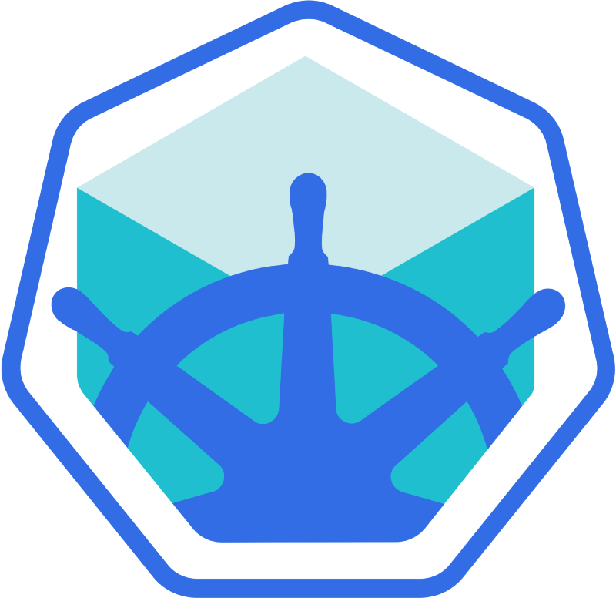
Installing MiniKube
Lightweight version of Kubernetes with single work node and master node
Normal recommendation for production Kubernetes is to have at least a three node cluster
Need to set up a container service first and make sure the network is properly configured
In this case we are using Docker

Slide 11
Setting up Networking for Kubernetes on Windows
Enter Hyper-V Manager (Search Hyper-V)
In Virtual Switch Manager Create internal network switch and call it Minikube
In Control Panel enter Network and Sharing Center
Update the “internet” connection by clicking on it to open window
Click properties button
Go to “Sharing”
Turn on “Allow other network users to connect…”
Select the Minikube virtual network under “Home networking connection”
Press OK
It is a good idea to restart the adapter at this point (I’ve found resetting this step fixes several network problems)
Lab 1: Set up networking for Kubernetes (5 minutes)

Slide 12
Install Kubectl and Minikube
Browse to https://kubernetes.io/docs/tasks/tools/install-kubectl/#install-kubectl-on-windows
Click “this link” to download
Create c:\Kube directory and place kubectl.exe in there
Browse to https://github.com/kubernetes/minikube/releases/tag/v1.4.0
Download minikube-windows-amd64.exe and copy to c:\kube
Rename minikube-windows-amd64.exe to minikube.exe
Add c:\Kube to path (under system\system environment variables)
Open new command prompt and call kubectl version and minikube version
Lab 2: Download kubectl and minikube (10 minutes)

Slide 13
Starting MiniKube
Run in Powershell as administrator:
minikube start --kubernetes-version="v1.16.0" --vm-driver="hyperv" --hyperv-virtual-switch="Minikube"
Run kubectl get pods
Should return “No resources found.”
Run kubctl get nodes
Should return a single node
Run minikube dashboard
Lab 3: Setup Minikube (15 minutes)

Slide 14
Some Common Kubernetes Commands
Kubernetes create deployment –Creates a deployment and a pod with one or more containers
Kubernetes get (pods, containers, rc, services, nodes, all)
Kubernetes delete (pod, container, rc, service, node) {name}
kubectl get (pod, container, rc, service, node)/{name} -o yaml}

Slide 15
The Kubernetes Hello World
Run in Powershell as administrator:
docker pull karthequian/helloworld
Create a deployment / will also create a pod
kubectl create deployment first-deployment --image=karthequian/helloworld:latest
Create a service
kubectl expose deployment first-deployment --type=LoadBalancer --port=80
kubectl get services
Run the service
minikube service first-deployment
Lab 4: Kubernetes Hello World, when done remove the service and deployment we created (20 minutes)

Slide 16
Scaling our deployment
First look at our replica set
kubectl get rs
Scale the deployment
kubectl scale --replicas={# replicas} deploy/{deployment name}
Check that everything is running
kubctl get deployments
kubctl get rs
Lab 5: Scale as above with two replicas and browse to the website. Get the list of pods and delete them both (kubectl delete pod {pod name}). If you go and browse to the website, does it still work? (10 minutes)

Slide 17
YAML
Configuration files can be used to create entities in Kubernetes
YAML configurations allow
Deployments to be moved from one provider to another with relative ease
Configuration changes tracked in source control
We can use kubectl to get the yaml of our current deployement
kubectl get deployment/first-deployment -o yaml
If we have a YAML file we can use it to create our deployment without running many commands
Unfortunately there are a lot, and I mean a lot, of settings that can be set
Required information: apiVersion, Kind, metadata, spec

Slide 18
Minimal YAML File (Part 1)
---
apiVersion: apps/v1
kind: Deployment
metadata:
labels:
app: {deployment name}
name: {deployment name}
namespace: default

Slide 19
Minimal YAML File (Part 2)
spec:
replicas: 2
selector:
matchLabels:
app: {deployment name}
template:
metadata:
labels:
app: {deployment name}
spec:
containers:
- image: {image name}
name: {name of image}
dnsPolicy: ClusterFirst

Slide 20
Kubectl delete deployment/{deployment name}
kubectl create -f {filename.yaml}
Lab 6: Delete your current deployment, create a new yaml from scratch to make a new deployment for the hello world container with two scaled to two replicas (15 minutes)

Slide 21
A more Complex Example, Our Docker Containers
To deploy our docker example we need to ensure the following can happen
We can send configuration information to the ASP.Net app
We can send secret configuration information to the ASP.Net app
Kubernetes can find our container images
The Asp.Net web service can communicate with our MySQL database
Our MySQL database has persistent storage
Both services will be deployed at the same time
The Asp.Net web service can scale independently from the MySQL database

Slide 22
Sending Configuration Information to our ASP.Net App
We wouldn’t want things like port numbers and the ip address of the MySql database compiled in to the app
We can set environment variables that our containers can use
To do this:
Create a file to contain three static variables: MySqlLocation, UserId, Pwd
we modify the Startup.cs file’s ConfigurationBuilder() line to add:
.AddEnvironmentVariables();
Pull out the environment values to set the static variables we created:

Slide 23
Q&A
Notes:
Nodes usually correspond to a physical or virtual machine

