Slide 1
2.25.2021
Introduction to Xamarin.Forms
Kevin Ford
kevinf@magenic.com
617 359-5192

Slide 2
https://github.com/Magenic/IntroToXamarinForms

Slide 3
Navigation Topics
Navigation Controller
Modal Navigation
Tabbed Navigation
Flyout Navigation

Slide 4

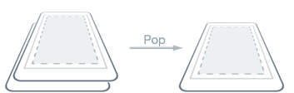
Navigation Page
Contains other pages
Handles transition animation
Creates a stack
Doesn’t require a hardware back button
Page A
< Page B
Page A
A
B
A

Slide 5
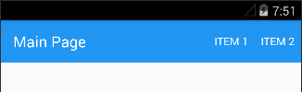
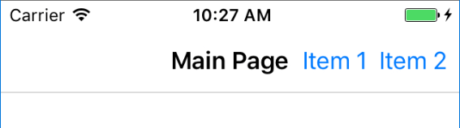

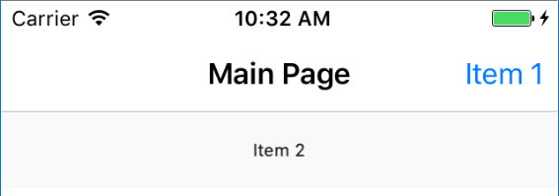
Navigation Toolbar can have Actions
Left or right
Drop down / more / Secondary
Icons, text (but not both), click
Can change with page

Slide 6
Adding Actions to a Toolbar
<ContentPage.ToolbarItems>
<ToolbarItem Name="MenuItem1" Order="Primary" Icon="Microsoft.png" Text="Item 1" Priority="0" />
<ToolbarItem Name="MenuItem2" Order="Primary" Icon="Xamarin.png" Text="Item 2" Priority="1" />
</ContentPage.ToolbarItems>

Slide 7
Demo 1: Navigation Page

Slide 8
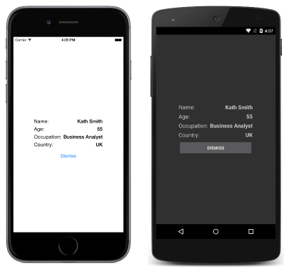
Modal Navigation
A separate stack
Denotes an operation or operations that need to be finished or cancelled
Native to iOS, simulated on Android
No back button on toolbar
await Navigation.PushModalAsync (detailPage);
xmlns:ios="clr-namespace:Xamarin.Forms.PlatformConfiguration.iOSSpecific;assembly=Xamarin.Forms.Core”
ios:Page.UseSafeArea="true"

Slide 9
Demo 2: Modal Page

Slide 10
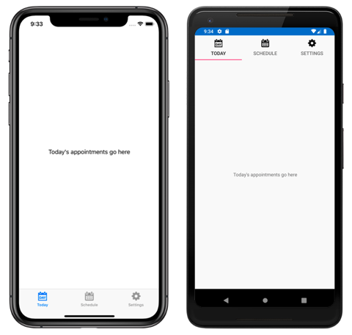
Tabbed Navigation
Bottom (iOS), top/bottom (Android)c
Text and or Image
Always root (not in NavigationPage) (iOS)
More than five tabs results in “more” tab when bottom tabs
xmlns:android="clr-namespace:Xamarin.Forms.PlatformConfiguration.AndroidSpecific;assembly=Xamarin.Forms.Core" android:TabbedPage.ToolbarPlacement="Bottom"

Slide 11
Demo 3: Tabbed Page

Slide 12
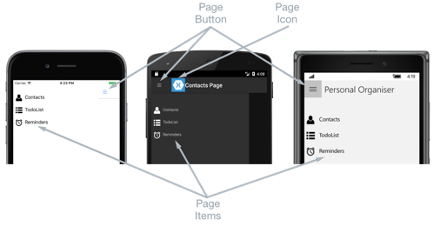
FlyoutPage (was MasterDetailPage)
List or items and details
Flyout (Menu)
Detail (detail pages)
Adaptive with tablet size devices
Always root (not in NavigationPage) (iOS)

Slide 13
Demo 4: Flyout Page

Slide 14
Homework
Experiment with navigation

Slide 15
Q & A
Next week – Binding

