Slide 1
2.25.2021
Introduction to Xamarin.Forms
Kevin Ford
kevinf@magenic.com
617 359-5192

Slide 2
https://github.com/Magenic/IntroToXamarinForms

Slide 3
Binding Topics
Basic Binding
Binding to lists and complex objects
Changing the values for display
Creating bindable views
Advanced Binding

Slide 4
What is Binding
BindableProperty
INotifyPropertyChanged
Object (source)
Connection from a source of information to a view
View
(Target)
OneWay
OneTime
Object to view
Object (source)
View
(Target)
OneWayToSource
View to view
Views have a default binding mode
Object (source)
View
(Target)
TwoWay
A view has a CindingContext
A binding’s Path is the property or sub property it is bound to
Bindings should generally be done to properties, not methods

Slide 5
Simple Binding Syntax
<Label Text="{Binding Foo}"></Label>
<Label Text="{Binding Foo, Mode=OneTime}"></Label>
Need to set BindingContext
Views do implement INotifyPropertyChanged
Use OnPropertyChanged method

Slide 6
Demo 1: Basic Binding

Slide 7
ViewModels
Generally bad practice to bind views to a page
Xamarin Forms is designed to Support MVVM
Page
Event
View Model
(View Specific logic, business logic? )
Event
Model (Data, business logic?)
Views
Reference
BindingContext
Reference
Views bound to ViewModels and sometimes Models
Business logic belongs in the ViewModel or Model ?

Slide 8
ViewModels
ViewModels need to implement INotifyPropertyChanged
MVVM frameworks have different methods to map the View to the ViewModel
ViewModels should know nothing about about the views that use them
Any UI specific logic (dialogs, navigation, etc) needs to be abstracted from the ViewModel

Slide 9
Commands
In MVVM rarely should buttons, etc call code in the views
ViewModels can implement readonly properties that return an ICommand object
Many views have a Command property that can be bound to a property that return ICommand
Many views have a CommandParameter property return information sent to the command

Slide 10
Precompiled Bindings
Better Performance - intellisense
Add location of view model to page header
xmlns:local="clr-namespace:IntroToXamarin.ViewModels;assembly=IntroToXamarin"
If static information, setup data source
<StackLayout.BindingContext> <local:ViewModelB /> </StackLayout.BindingContext>
Tell the parent container the datatype
x:DataType="local:ViewModelB"

Slide 11
Demo 2: Basic Binding

Slide 12
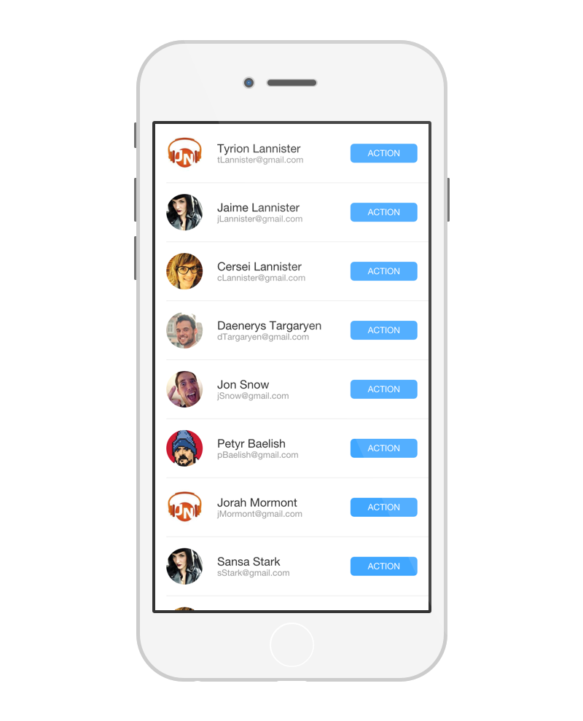
Lists
Lists where the number of items is static can inherit from any IList or array
This is true even if the items in the list are editable
Lists where items can be added or removed should inherit from ObservableCollection
ListViews generally have an ItemsSource property to bind to

Slide 13
Demo 3: Lists

Slide 14
Value Converters
The format data is stored in is not always the format needed for display
Changing the format for display is display logic and belongs in the presentation layer
ValueConverters convert back and forth from the format needed by the source to target
Use IValueConverter interface
ValueConverters can be general or specific to the ViewModel/Model

Slide 15
Converting using multiple pieces of information
ValueConverters can only be bound to one item, usually the property they are converting
This causes problems when two or more properties are needed for conversion
Consider the display of a local currency where the value converter needs to know the amount to display in the saved currency and the currency type they want to display.
Enter the ViewModel/Model/Interface specific ValueConverter
Properties can be bound to objects where a ValueConverter uses multiple properties to determine what to use

Slide 16
Demo 4: ValueConverters

Slide 17
Homework
Experiment with navigation

Slide 18
Q & A
Next week – Binding

