Slide 1
2.25.2021
Introduction to Xamarin.Forms
Kevin Ford
kevinf@magenic.com
617 359-5192

Slide 2
https://github.com/Magenic/IntroToXamarinForms

Slide 3
Styling
Xamarin Forms Styles
Themes
Material Themse
Implementing Native Android and iOS Styles

Slide 4
Explicit Styling
Conceptually like css
<ContentPage.Resources>
<ResourceDictionary>
<Style x:Key="labelRedStyle" TargetType="Label">
<Setter Property="HorizontalOptions" Value="Center" />
<Setter Property="VerticalOptions" Value="CenterAndExpand" />
<Setter Property="FontSize" Value="Large" />
<Setter Property="TextColor" Value="Red" />
</Style>
</ResourceDictionary>
</ContentPage.Resources>
…
<Label Text="These labels" Style="{StaticResource labelRedStyle}" />
Put in form or layout’s resource dictionary
A style has a unique key on the form and a TargetType
Control specifies that is is using a style given a key
Most properties can be set with a style

Slide 5
Implicit Styles
No key, only TargetType
<ResourceDictionary>
<Style TargetType="Entry">
<Setter Property="HorizontalOptions" Value="Fill" />
<Setter Property="VerticalOptions" Value="CenterAndExpand" />
<Setter Property="BackgroundColor" Value="Yellow" />
<Setter Property="FontAttributes" Value="Italic" />
<Setter Property="TextColor" Value="Blue" />
</Style>
</ResourceDictionary>
…
<Entry Text="These entries" />
Put in form or layout’s resource dictionary
Applies to all child controls of the TargetType
ApplyToDerivedTypes can be used for a view’s subclasses

Slide 6
Demo 1: Form level implicit and explicit styles

Slide 7
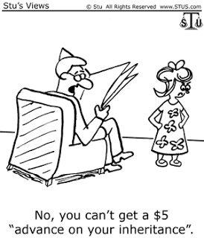
Style Inheritance
Create a single style for every control type would be unwieldy
Styles can be based on other existing styles
The base style could be based on something like a View class
Use the BasedOn property to base a style on another
Can be extremely limited by the finite properties in classes like View

Slide 8
Global Styles
Styles do not need to be setup per form
<Application.Resources>
<ResourceDictionary>
<Style x:Key="buttonStyle" TargetType="Button">
<Setter Property="HorizontalOptions" Value="Center" />
<Setter Property="VerticalOptions" Value="CenterAndExpand"
</Style>
</ResourceDictionary>
</Application.Resources>
Implicit and Explicit styles can be created in:
App Class’s Xaml
App Class’s ResourceDictionary through code
Styles defined lower in the view hierarchy take precidence

Slide 9
Demo 2: Global Styles and inheritance

Slide 10
Dynamic Styles
StaticResource Styles are read only
<Style x:Key=”blackStyle" TargetType="Label">
…
</Style>
Dynamic styles are base on DynamicResources
Can be set and changed to different style as the application runs
<Label Text="foo" Style="{DynamicResource labelStyle}" />
Dynamic styles can also be inherited from using BaseResourceKey
StaticResources are less expensive
Resources["labelStyle"] = Resources["blackStyle"];

Slide 11
Demo 3: Dynamic Style

Slide 12
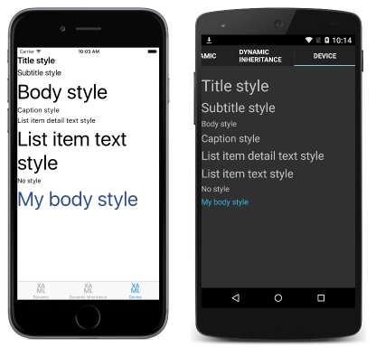
Device Styles
Only apply to Labels
Tie into underlying platforms for styling – particularly iOS for accessibility
Six predefined styles
BodyStyle
CaptionStyle
ListItemDetailTextStyle
ListItemTextStyle
SubtitleStyle
TitleStyle
These are dynamic styles that can be inherited from using BaseResourceKey

Slide 13
Demo 4: Device Styles

Slide 14

Style Classes
Views can only reference a single style with a key
Views can only reference a single style with a key
Styles can share same class name but target different types
<Style TargetType= "Label" Class=”myStyle">
…
<Style TargetType= "Entry" Class="myStyle">
<Entry StyleClass="myStyle, myOtherStyle" />

Slide 15
Demo 5: Style Classes

Slide 16
Themes
A theme is a single ResourceDictionary
Label
Multiple themes can use the same keys
Label
TextColor = primaryColor
Styles can refer to keys in the current theme as DynamicResources
MergedDictionary
MergedDictionaries Contain information on current theme
Theme A
primaryColor
Property
Theme B
primaryColor
Property

Slide 17
Demo 6: Using a Theme

Slide 18
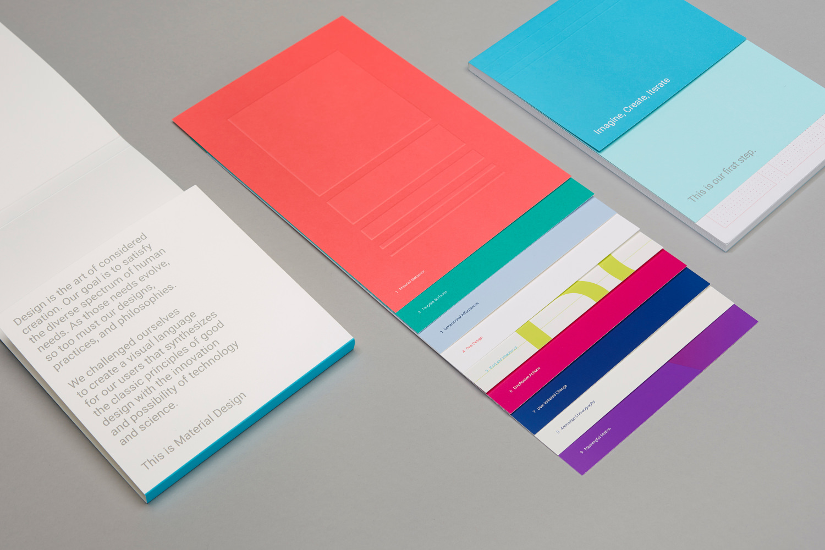
MaterialVisual
Applies Material Design Scheme entire application for all platforms
Not just colors and layout, but unified control look and feel
Subset of controls supported
Ios: AppDelegate: global::Xamarin.Forms.FormsMaterial.Init();
Android: Main Activity: global::Xamarin.Forms.FormsMaterial.Init(this, savedInstanceState);
Add Visual="Material” to page to implement
Uses nuget pagkage:
Xamarin.Forms.Visual.Material
Default for VisualElements to inherit from parent

Slide 19
Demo 7: Material Visual

Slide 20

Native Theming
When all else fails…
iOS controls have Appearance property to set global styles
Can be done in AppDelegate
UIButton.Appearance.BackgroundColor = UIColor.Red;
In Android themes can be setup as Value resources
The MainActivity can have its theme set to your custom theme
Theme = "@style/MyCustomTheme"

Slide 21
Demo 8: Native Styling

Slide 22
Capstone project
Create a Xamarin Forms App that:
Has at least three pages
Uses at least two different layouts
Uses at least five different view
Uses at least two different navigation
Implements bindings to a custom view model
Has at least one custom value converter
There is no need for the app to save data
Due in 2 weeks (extension available on request)

Slide 23
Q & A

