Slide 1
2.25.2021
Introduction to Xamarin.Forms
Kevin Ford
kevinf@magenic.com
617 359-5192

Slide 2
https://github.com/Magenic/IntroToXamarinForms

Slide 3
Binding Topics
Basic Binding
Binding to lists
Changing the values for display
Creating bindable views
Advanced Binding

Slide 4
What is Binding
BindableProperty
INotifyPropertyChanged
Object (source)
Connection from a source of information to a view
View
(Target)
OneWay
OneTime
Object to view
Object (source)
View
(Target)
OneWayToSource
View to view
Views have a default binding mode
Object (source)
View
(Target)
TwoWay
A view has a CindingContext
A binding’s Path is the property or sub property it is bound to
Bindings should generally be done to properties, not methods

Slide 5
Simple Binding Syntax
<Label Text="{Binding Foo}"></Label>
<Label Text="{Binding Foo, Mode=OneTime}"></Label>
Need to set BindingContext
Views do implement INotifyPropertyChanged
Use OnPropertyChanged method

Slide 6
Demo 1: Basic Binding

Slide 7
ViewModels
Generally bad practice to bind views to a page
Xamarin Forms is designed to Support MVVM
Page
Event
View Model
(View Specific logic, business logic? )
Event
Model (Data, business logic?)
Views
Reference
BindingContext
Reference
Views bound to ViewModels and sometimes Models
Business logic belongs in the ViewModel or Model ?

Slide 8
ViewModels
ViewModels need to implement INotifyPropertyChanged
MVVM frameworks have different methods to map the View to the ViewModel
ViewModels should know nothing about about the views that use them
Any UI specific logic (dialogs, navigation, etc) needs to be abstracted from the ViewModel

Slide 9
Commands
In MVVM rarely should buttons, etc call code in the views
ViewModels can implement readonly properties that return an ICommand object
Many views have a Command property that can be bound to a property that return ICommand
Many views have a CommandParameter property return information sent to the command

Slide 10
Precompiled Bindings
Better Performance - intellisense
Add location of view model to page header
xmlns:local="clr-namespace:IntroToXamarin.ViewModels;assembly=IntroToXamarin"
If static information, setup data source
<StackLayout.BindingContext> <local:ViewModelB /> </StackLayout.BindingContext>
Tell the parent container the datatype
x:DataType="local:ViewModelB"

Slide 11
Demo 2: Basic Binding

Slide 12
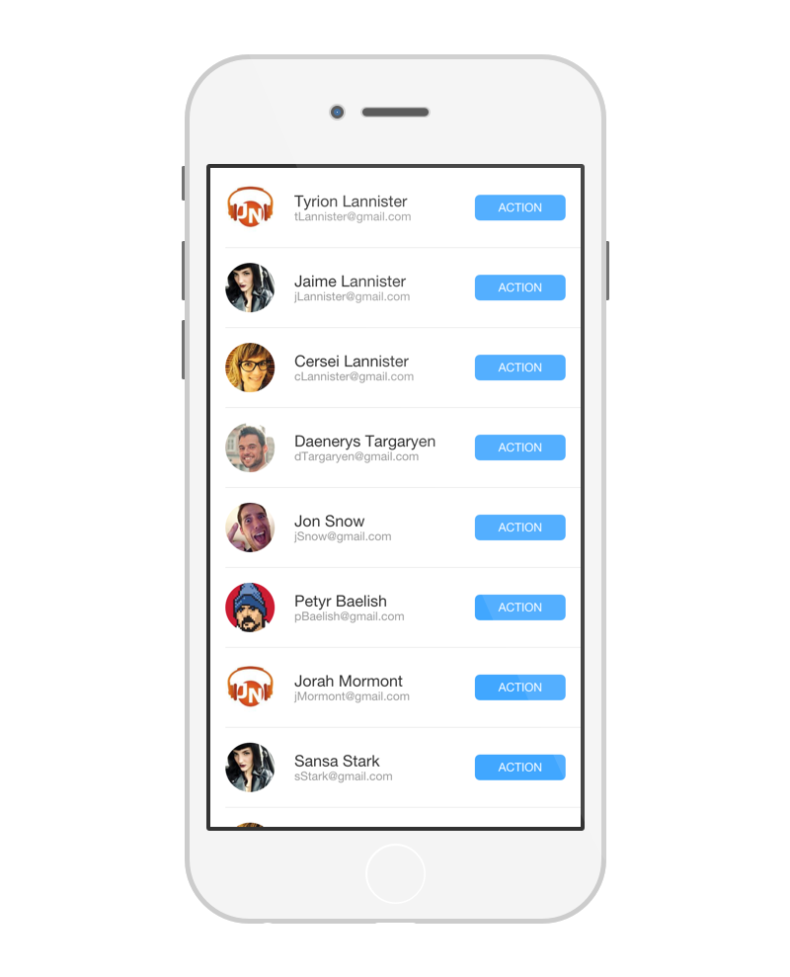
Lists
Lists where the number of items is static can inherit from any IList or array
This is true even if the items in the list are editable
Lists where items can be added or removed should inherit from ObservableCollection
ListViews generally have an ItemsSource property to bind to

Slide 13
Demo 3: Lists

Slide 14
Value Converters
The format data is stored in is not always the format needed for display
Changing the format for display is display logic and belongs in the presentation layer
ValueConverters convert back and forth from the format needed by the source to target
Use IValueConverter interface
ValueConverters can be general or specific to the ViewModel/Model

Slide 15
Converting using multiple pieces of information
ValueConverters can only be bound to one item and an object parameter
This causes problems when two or more properties are needed for conversion and both could update
Consider the display of a local currency where the value converter needs to know the amount to display in the saved currency and the currency type they want to display.
Bindable properties CAN be added and bound to in a value converter
ValueConverters are not part of the view stack so won’t inherit Source information

Slide 16
Binding Syntax with a ValueConverter
<ContentPage.Resources>
<ResourceDictionary>
<local:myConverter x:Key=”ConverterType" />
</ResourceDictionary>
</ContentPage.Resources>
<Button Text=”Save"
IsEnabled="{Binding MyProperty, Converter={StaticResource myConverter}}" />

Slide 17
Demo 4: ValueConverters

Slide 18
Creating your own views
Custom views are reusable controls that can be bound to
If the view in turn contains other views it will be both the source and target of bindings
this.BindingContext set when used as a target
this.Content.BindingContext set when used by internal views as a source
Container
customView.BindingContext
Custom View
customView.Container.BindingContext
View
View
View

Slide 19
BindableProperty
Normally used in class that inherits from BindableObject
Name format is important for binding
Should not normally be used in binding sources who are not also a binding target
Properties using BindableProperty can be a source OR target of a binding
public static BindableProperty Address1Property = BindableProperty.Create(nameof(Address1), typeof(string), typeof(AddressView), defaultValue: "", defaultBindingMode: BindingMode.TwoWay);
public string Address1
{
get => (string)GetValue(Address1Property);
set => SetValue(Address1Property, value);
}

Slide 20
Demo 5: Custom Bindable Views

Slide 21
Other Binding Properties
Path – references sub objects on a binding
{Binding Source={x:Reference timePicker}, Path=Time.TotalSeconds}
FallbackValue – Something to use if a binding cannot be found
<Label Text="{Binding Population, FallbackValue='Population size unknown'}" />
TargetNullValue – Something to use if a binding can be found but returns a null value
<Label Text="{Binding Location, TargetNullValue='Location unknown'}" />

Slide 22
Multi-Bindings
Allow multiple properties on a source to determine a property on the target
Must use a converter to convert from the list of source properties to what the target expects
Can be used bi-directionally in some instances
ValueConverter must inherit from IMultiValueConverter

Slide 23
Demo 6: Multi-binding

Slide 24
Ancestor Bindings
Allows to look up parent stack of views to find binding higher up
Consider the case of a list of items where a collection of views are used to display each item in a list. Each one of these detail views is given a binding to a single item in the list. An ancestor binding allows that detail view to look for the parent list of items in the visual tree and bind to that.
A type of RelativeBinding
Matching done by type, AncestorLevel can be used if parents on the visual tree have multiple sources of the same type
Works with any source in the visual tree, including views and layouts
<Label Text="{Binding Source={RelativeSource AncestorType={x:Type Entry}, AncestorLevel=2}, Path=Text}" />

Slide 25
Homework
Work with Bindings

Slide 26
Q & A
Next week – Binding

