Slide 1
5.5.2020
Machine Learning In TensorFlow
Kevin Ford
kevinf@magenic.com
617 359-5192

Slide 2
https://github.com/Magenic/MMLTensorflow
https://www.amazon.com/Deep-Learning-TensorFlow-Keras-Regression-ebook/dp/B082MBMFVF/ref=sr_1_4?dchild=1&keywords=tensorflow+2.0&qid=1587071084&sr=8-4

Slide 3
Last week recap – What was the best optimization?
tf.random.set_seed(1234)

Slide 4
Moving Beyond Dense Networks
In a dense network every neuron is connected to every other neuron in the adjacent layers
To do this we lost all special information in our images, just a collection of pixels
This is a brute force method for images

Slide 5
Enter the Convolutional Neural Network (CNN)
Summarizes groups of adjacent information and may capture features of the image
Groups may overlap with other groups
Summary information can then be used to train the model in a way that preserves special information
Convolution – The treatment of a matrix by a second matrix as a filter/aggregator

Slide 6
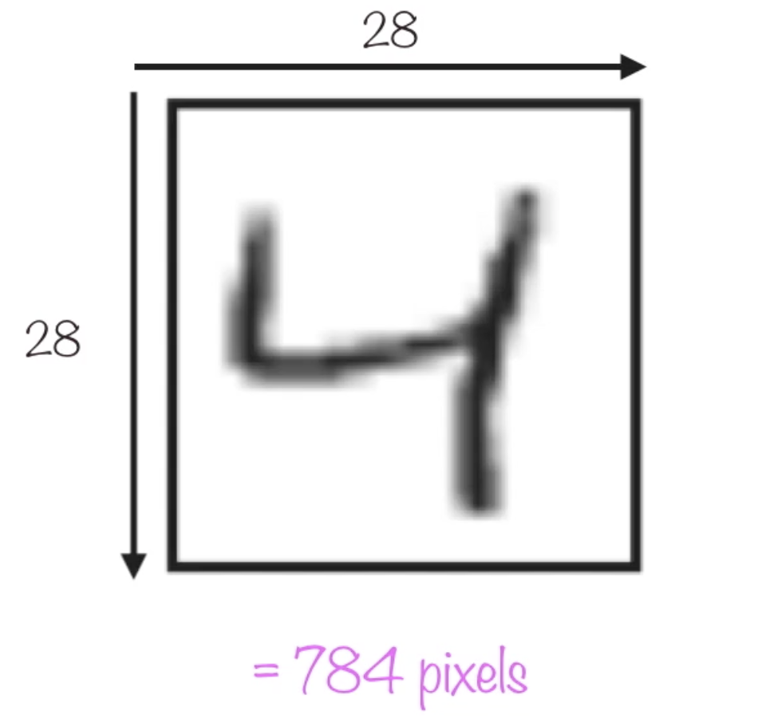
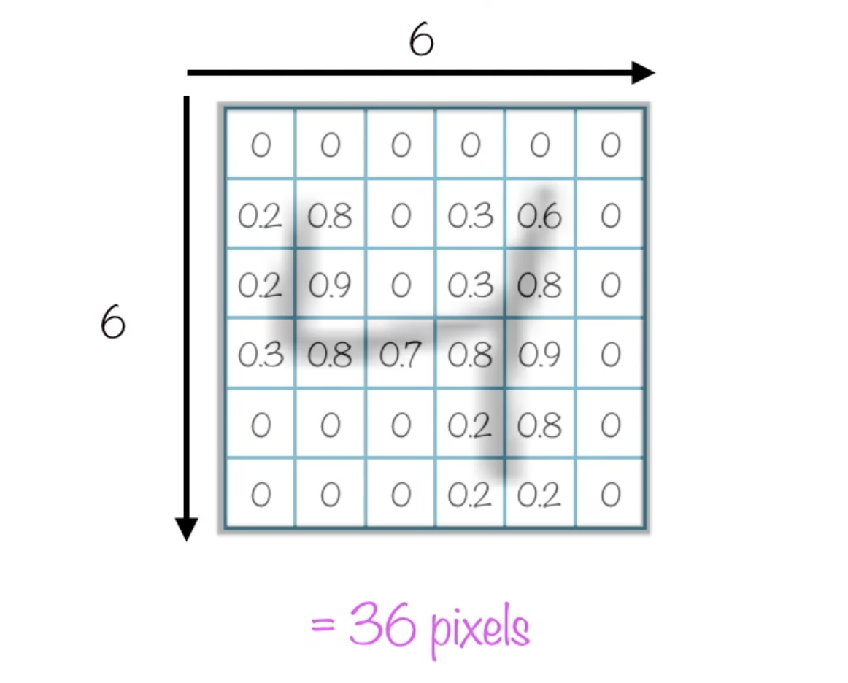
Convolution
Matrix of pixels
Submatrix

Slide 7
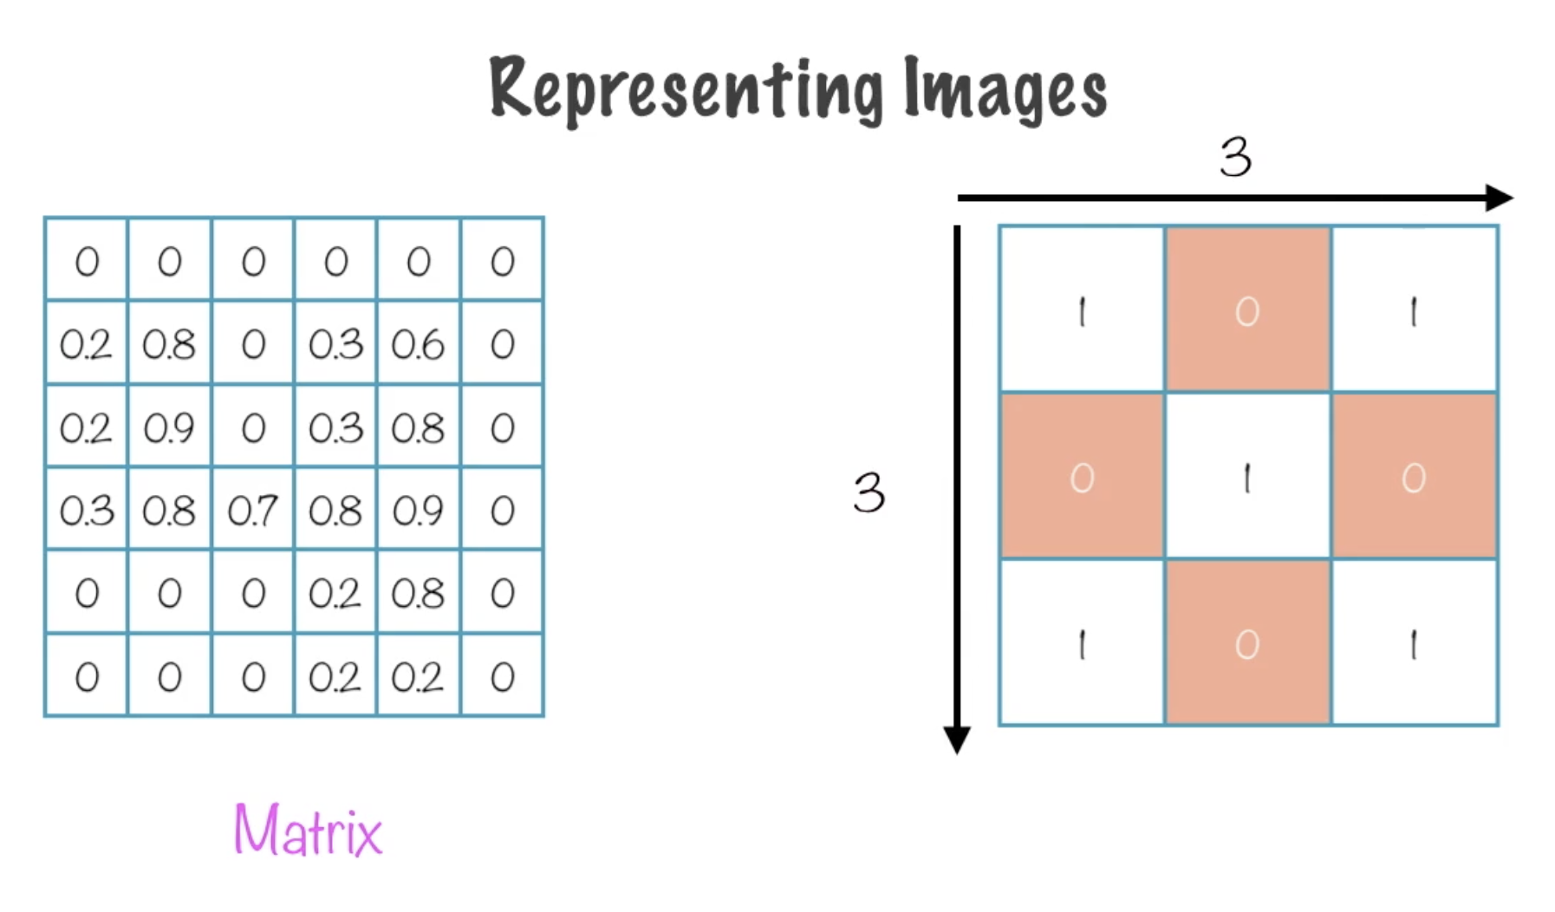
Convolution
Submatrix of pixels
Kernel
Kernel size

Slide 8
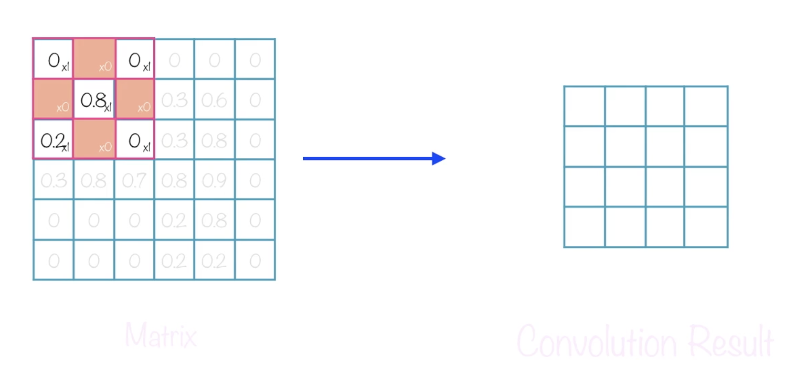
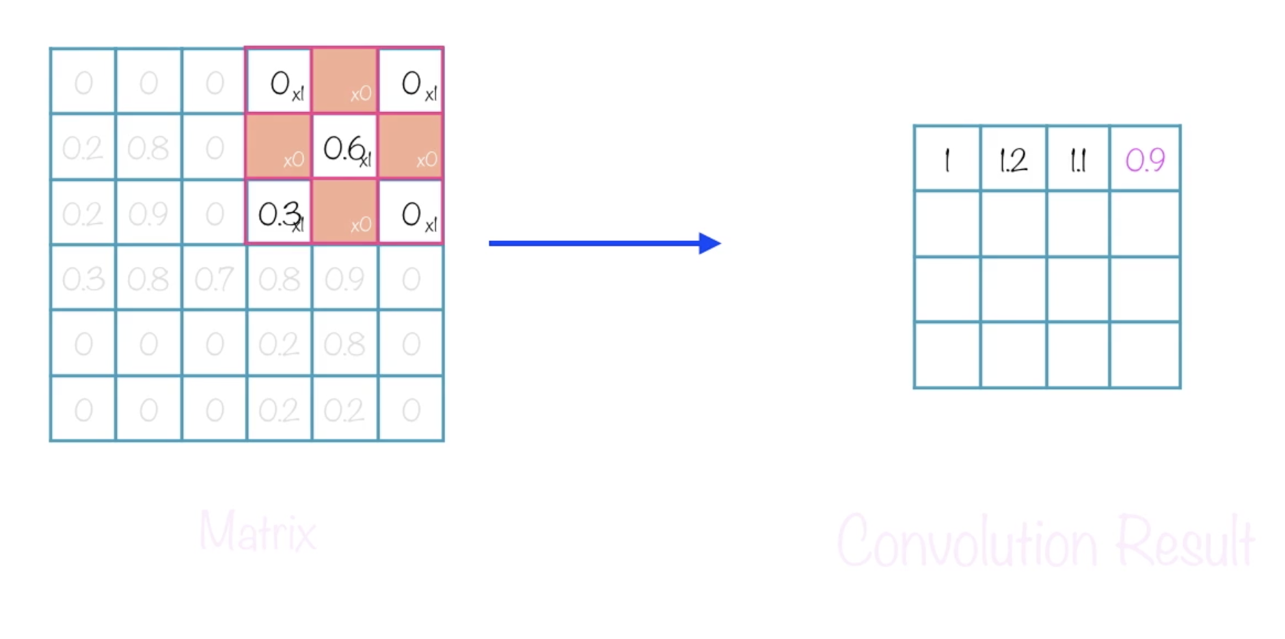
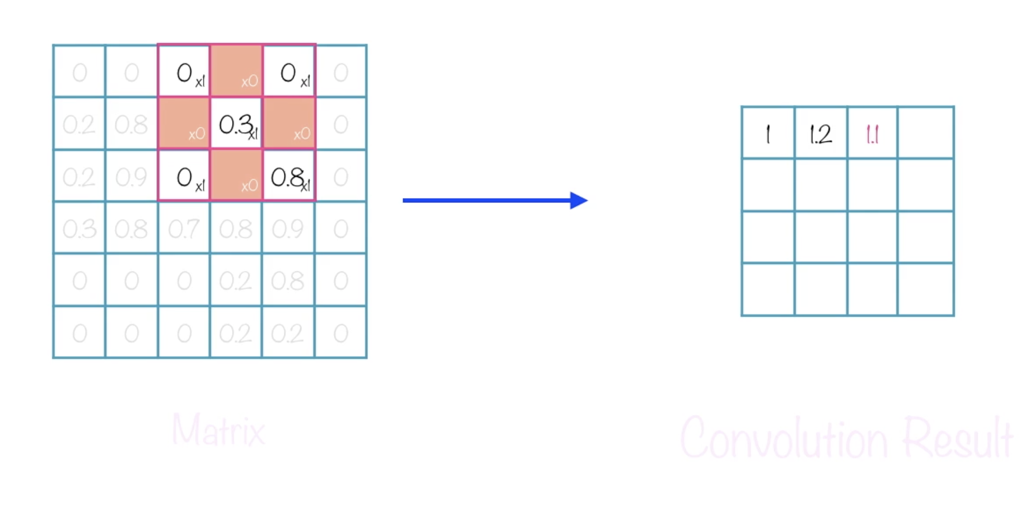
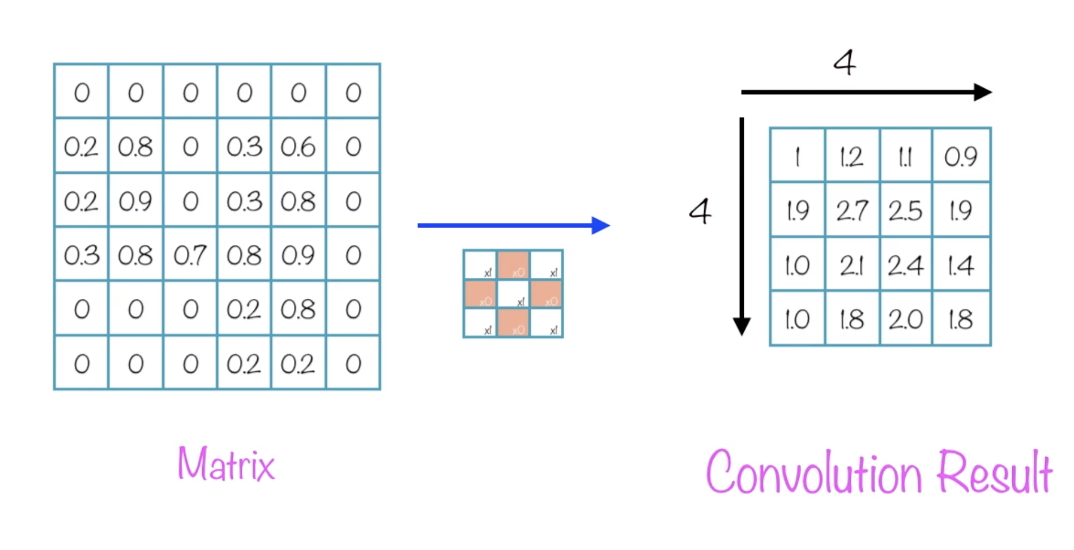
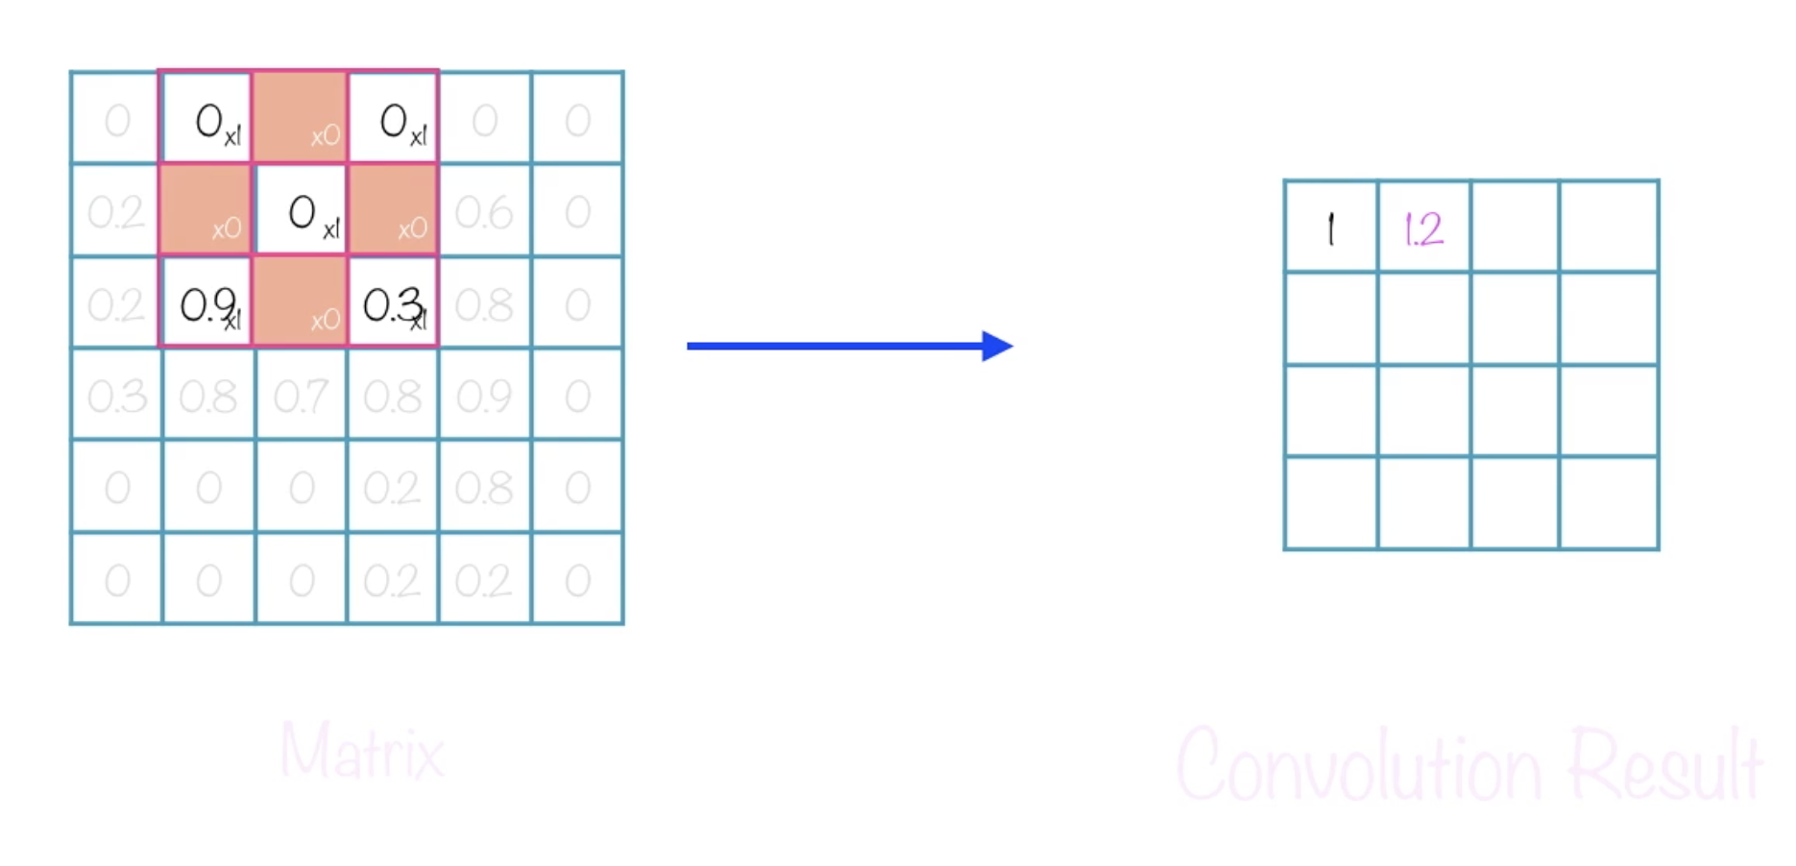
Convolution
Submatrix (4x4)
Local receptive field Neuron
This shows a stride length = 1, i.e. the kernel is moving one position at a time across the matrix for a stride of (4x4)
Borders with can be added to get edge data using 0 values, this is called padding
Notes:
Moving a filter across the image
Finite number of convolutions as filters make the images “smaller”

Slide 9
Convolution
Matrix of pixels
Kernel: ?
Stride: ?
Padding: ?
Submatrix
Notes:
Kernel size 8, stride 4, padding 0
Kernel size 5, stride 5 , padding 1

Slide 10
Creating a convolution in Tensorflow
Each convolution requires to lines to be added to the model
model.add(keras.layers.Convolution2D({number of filters}, ({x,y kernel size}), padding={'valid' or 'same'}, strides=({x,y stride size}), activation='relu'))
model.add(keras.layers.MaxPooling2D(pool_size=(x,x pool size), strides=(x,y strinde size)))
A pooling layer is used for ordering layers within a convolutional neural network that may be repeated one or more times in a given model.
Reduces the size of the features to more generalized ideas
Padding of 'same' pads the image with 0s to retain the same size
A ‘flatten’ layer converts the special representation back to normal tensor shapes
model.add(keras.layers.Flatten())

Slide 11
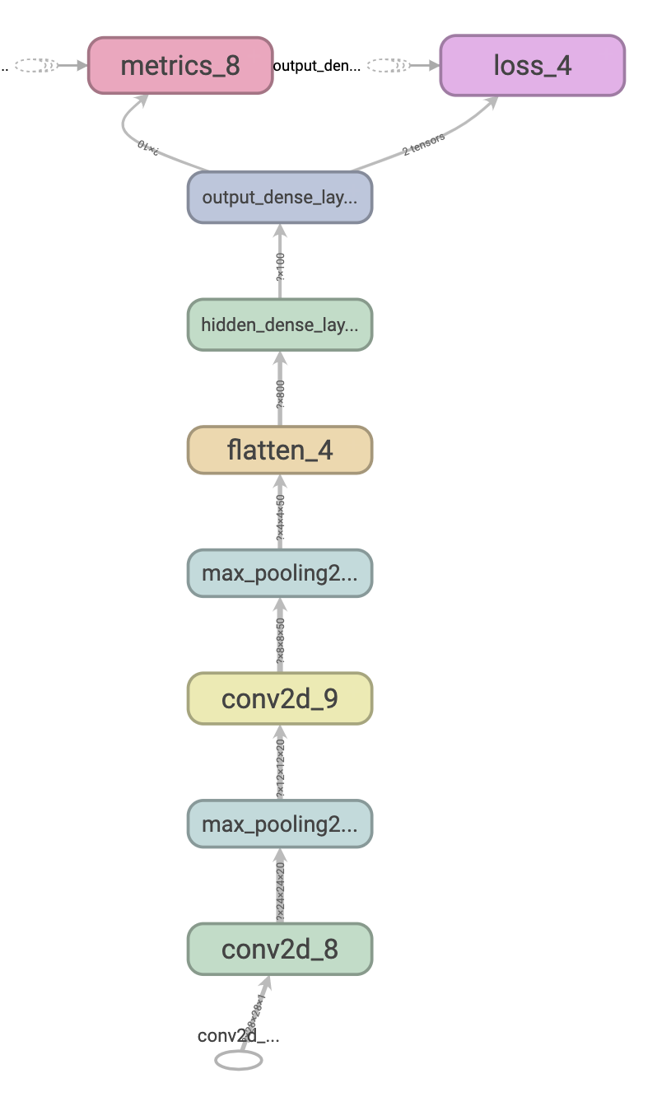
A sample CNN

Slide 12
Demo 1: A CNN with our Handwritten Images

Slide 13
Tensorboard
Allows detail information about runs to be displayed
To setup
When starting image include extra port mapping
-p 6006:6006
In new terminal window get list of running images
docker ps –a
Start a new bash session in new window
docker container exec -it {container id} bash
Start tensorboard in bash prompt
tensorboard --logdir={location of logs} --bind_all
Browse to tensorboard on host machine
http://127.0.0.1:6006/

Slide 14
Writing to logs for Tensorboard
Add callback array
callbacks = [
tf.keras.callbacks.TensorBoard(log_dir='./logs’)
]
Add callbacks to fit operation
callbacks=callbacks

Slide 15
Demo 2 – Working with the Tensorboard

Slide 16
Why more data can be better
More data can give more variation
More of the SAME data may not be helpful
As the amount of data decreases it may not be easy to classify information outside our set
We can use real world data over time to update our models

Slide 17
Demo 3 – Reducing the amount of training data

Slide 18
Homework reading
https://machinelearningmastery.com/pooling-layers-for-convolutional-neural-networks/
Book pages 108-122
Modify Wk03-Homework-Model02-Experiment03 to convert to a CNN and optimize its accuracy and loss. Send me your final figures. Next week the winner can explain what they did.

Slide 19
Q & A
New week – Regressions

