Slide 1

MAL06: Developer Testing
Jason Bock
Principal Lead Consultant
Andy Tinkham
Principal Lead, QAT
Level: Intermediate

Slide 2


Intros
Jason
http://www.jasonbock.net
http://www.twitter.com/jasonbock
jasonb@magenic.com
Andy
http://www.testerthoughts.com
http://www.twitter.com/andytinkham
andyt@magenic.com

Slide 3
Overview
Quality & Testing in general
Unit Testing
Why Unit Tests?
Principles and Techniques
Tools and Frameworks
Unit Tests in Action
Expanding the scope of information from developer-focused tools

Slide 4
What is Quality?
The right functionality working the right way
A solution to a problem the user has
Value

Slide 5
Quality comes from…
The Whole Team
Working in a coordinated fashion
Testing isn’t only quality activity … but it’s the one we’re talking about today

Slide 6
What’s the point of testing?
It isn’t necessarily to prove (or disprove) the app works
The goal is to provide information
Project leadership then can factor this into their decisions
What’s been tested (and what hasn’t)
What didn’t work in the tested areas (and what did)
What functionality-related risks remain

Slide 7

Maximizing that information
As part of planning, discuss as team
Who/What/Where/How/When
Plan testing activities so that
People best suited to get information do so
Information provided when it is needed
Duplication only occurs when it provides additional value (different perspectives, different understandings)
Ongoing communication between ALL team members is critical

Slide 8
Today’s Focus
The information best provided by developers
The ways the developers can get that information
We’ll talk about the testers tomorrow
(MAL12, 9:30-10:45AM)

Slide 9
Developer Information
When a feature is done
Whether each component is working the way it’s intended
Whether a change had unanticipated consequences
Unit tests are the primary vehicle to get this information

Slide 10
Why Unit Test?
public static class Adding
{
public static int Add(int x, int y)
{
return x + y;
}
}

Slide 11
Why Unit Tests
There’s no interface!
It’s not using generics!
You only take two parameters!
Your naming conventions are horrible!
The performance stinks!
You’re not using Code Contracts!
You forgot about overflows!
You shouldn’t be allowed near a compiler!

Slide 12
Why Unit Test?
public static class Adding
{
public static int Add(int x, int y)
{
return x + y;
}
}

Slide 13
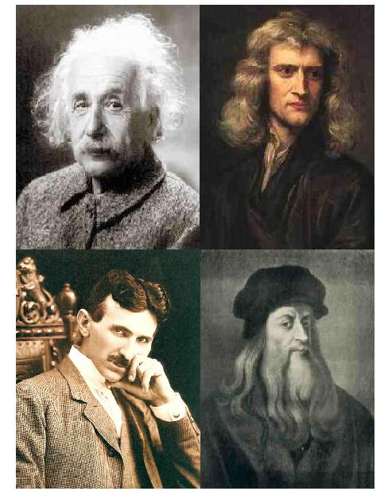
Why Unit Test?
http://www.geniusintelligence.com/4geniuses.jpg

Slide 14

Why Unit Test?
http://www.dvorak.org/blog/wp-content/uploads/2011/01/homer_simpson_brain.jpg

Slide 15

Why Unit Test?
http://celebrating200years.noaa.gov/magazine/tct/01_misaligned_bridge_503.jpg

Slide 16

Why Unit Test?
http://chellem.com/wp-content/uploads/2009/08/stress.jpg

Slide 17

Why Unit Test?

Slide 18

Principles and Techniques
http://petsinyourhome.com/wp-content/uploads/Dry-Dog-Food.jpg

Slide 19
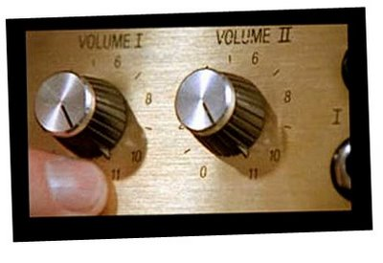
Principles and Techniques
http://4.bp.blogspot.com/_5xHhfW50Z_s/SV2r-ql-TvI/AAAAAAAABMQ/JxXHtJIo_uU/s400/these+go+to+11.jpg

Slide 20
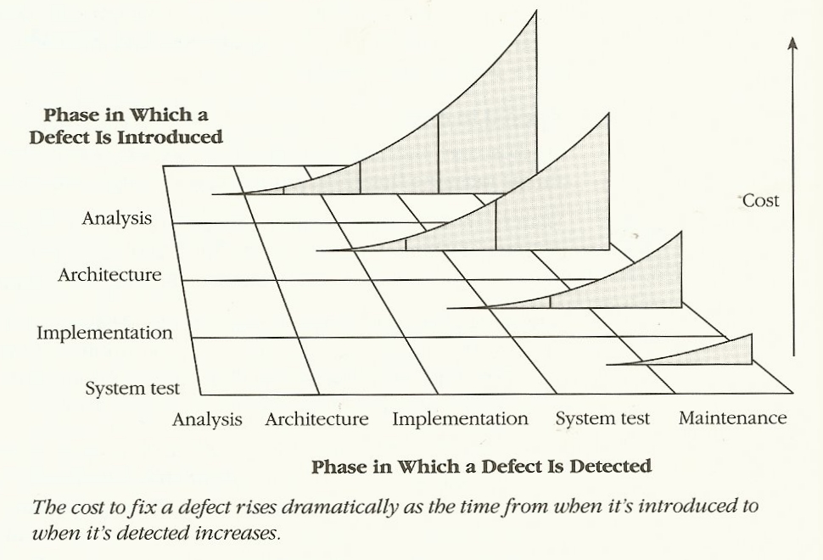
Principles and Techniques

Slide 21

Principles and Techniques
http://3.bp.blogspot.com/_SYXsu6Lrhd8/TKtsUUeHaEI/AAAAAAAAAFY/JIuXn4t7Lxk/s1600/piece.jpeg

Slide 22
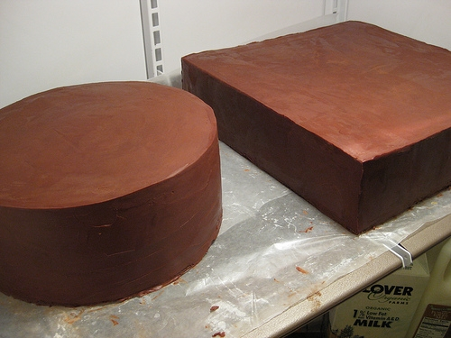
Principles and Techniques
http://scratch.typepad.com/.a/6a00e551da83098833012875abba3b970c-800wi

Slide 23
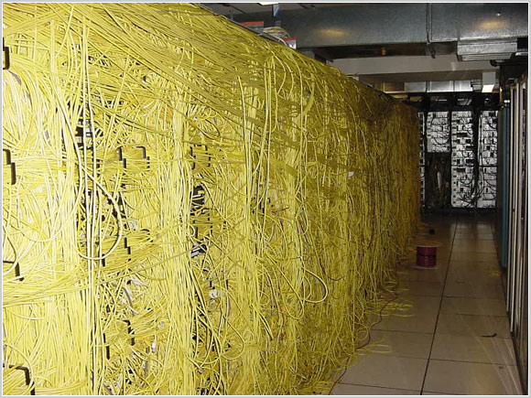
Principles and Techniques
http://www.justcabling.com/images/badcable15.jpg

Slide 24
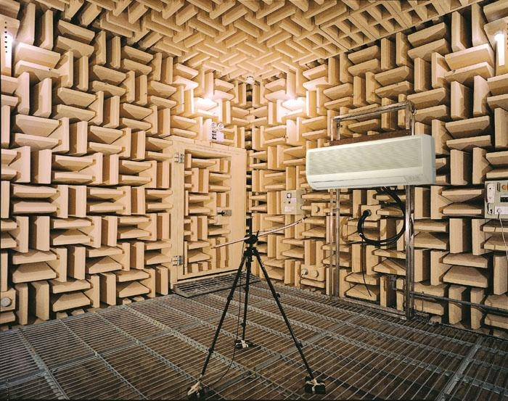
Principles and Techniques
http://img.diytrade.com/cdimg/1425754/20255693/0/1302060158/Sound_testing_system.jpg

Slide 25
Principles and Techniques
“Program to an interface, not an implementation” – Design Patterns, pg. 18

Slide 26
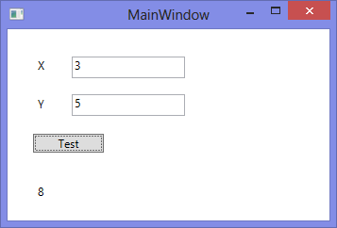
Principles and Techniques

Slide 27
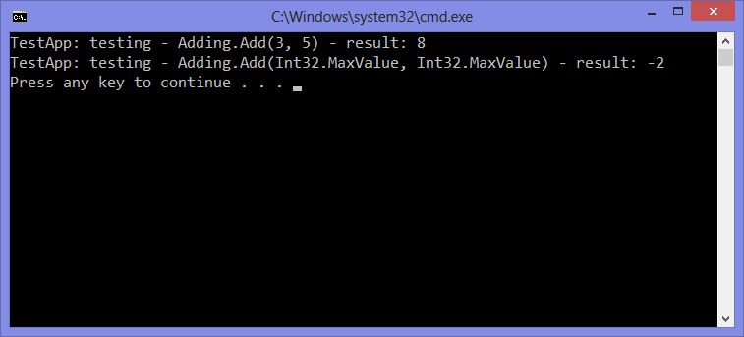
Principles and Techniques

Slide 28

Principles and Techniques
http://www.theworldsstrongestman.com/wp-content/uploads/2011/07/Keg1.jpg

Slide 29
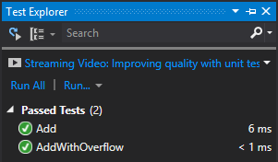
Principles and Techniques

Slide 30
Principles and Techniques
TDD, BDD, *DD, etc.

Slide 31
Principles and Techniques
AAA: Arrange, Act, Assert

Slide 32
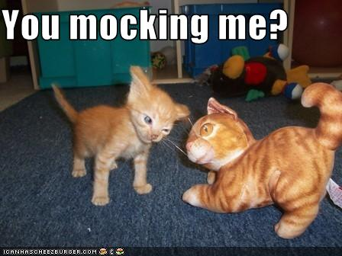
Principles and Techniques
http://bit.ly/12NjkUn

Slide 33
Tools and Frameworks
Unit testing
MSTest
NUnit
xUnit
MbUnit
Mocking
Moq
NSubstitute
RhinoMocks
TypeMock
Fakes

Slide 34

Tools and Frameworks
http://www.dangerouslyawesome.com/wp-content/uploads/2009/01/simpsons_nelson_haha2uwr.jpg

Slide 35
Demo: Unit Testing in Action

Slide 36
What about the testers?
Just because a technique has developer focus doesn’t mean it’s not useful to testers though!

Slide 37
Unit Tests
Help to avoid wasted effort
Remove need for separate smoke test
Identifying areas to focus on
Testing inspiration
Provide additional information for hard-to-reproduce bugs
Examples of how functions work

Slide 38
Coverage
The fact that a line is covered by a test set doesn’t tell us all that much about the quality of that testing
The absence of coverage is more interesting – nothing has hit that line yet!
Looking at coverage gaps can provide additional test ideas

Slide 39
Fakes
For some tester tests, using fakes may make some things easier
Automation that directly interacts with app code
Highly unstable or unpredictable system components
Be careful to not rely too much on fakes though – some testing likely needs to use the real component

Slide 40
Summary
Everyone on the team is responsible for delivering quality
Developers & testers need to work together to get the information the team needs
<Jason’s points>
Testers can get benefit from “developer” tools

