Slide 1

Leveraging Azure Services
Kevin Ford
Mobile Practice Lead
Level: Intermediate

Slide 2


Notes:
Server in the barn
As developers we want to backend what we are playing with
We are not infrastructure experts
We have to deal with keeping the server up to date, licenses, SQL Server up to date, etc.

Slide 3
Service Types
IAAS – Infrastructure as a service
PAAS – Platform as a service
SAAS – Software as a Service
Notes:
Each level gets closer to the user.
PAAS commoditizes infrastructure and SAAS attempts to commoditize software development. Generally companies are more likely to need software that is unique to their business than infrastructure.

Slide 4

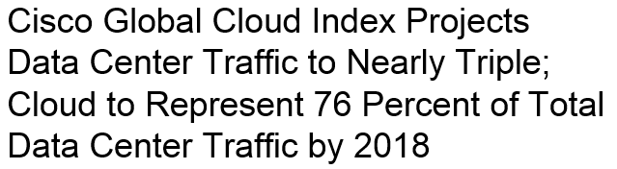
Why You Should Care
Competitive costs
Moves infrastructure off the balance sheet
Easy to wind and unwind
Removes time roadblocks when spinning up new services
Easy to access
Distributed data centers
Offers a level of redundancy not usually found in private clouds
Ok, It’s cool – like really cool in a geeky kind of way

Slide 5

99.9 – Good or Bad?
Azure uptime generally is 99.9%
8.76 hours down per year – max (calculated monthly)
If you currently don’t track your availability you probably have no more than 99.5% uptime
Notes:
99.99% for SLQ Azure on Basic, Standard and Premium tiers.
99.99% for read data requests on read access-geo redundant storage
99.95% for cloud services with two or more role instances
99.95% for VMs with two or more in same availability set
Calculated monthly
Four nines is less than an hour per year of downtime

Slide 6



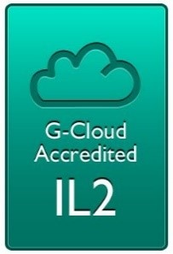



Compliance
Notes:
ISO/IEC 27001:2005 Audit and Certification
SOC 1 and SOC 2 SSAE 16/ISAE 3402 Attestations
Cloud Security Alliance Cloud Controls Matrix
Federal Risk and Authorization Management Program
Payment Card Industry (PCI) Data Security Standards (DSS) Level 1
United Kingdom G-Cloud OFFICIAL Accreditation
HIPAA Business Associate Agreement (BAA)
Life Sciences GxP Compliance
Family Educational Rights and Privacy Act (FERPA)
Federal Information Processing Standard (FIPS)
http://azure.microsoft.com/en-us/support/trust-center/compliance/

Slide 7
My Vote Azure Usage
Windows Azure SQL Databases (WASD)
Main System DB
Windows Azure Mobile Services (WAMS)
Authentication
Table Storage
Server Side Scripts
Windows Azure Web Sites
HTML 5 website
Auto deployment
Windows Azure Storage Accounts
Blob storage for poll images
Windows Azure Cloud Services
Web Role - CSLA DataPortal

Slide 8
Mobile Services Authentication
Support for four providers
Facebook (http://developer.facebook.com)
Google (https://code.google.com/apis/console)
Microsoft (https://account.live.com/developers/applications)
Twitter (http://dev.twitter.com/apps)
Now allows access to Azure AD and by extension the opportunity to authenticate against internal AD
Application needs to be registered with each STS
Users need to associate account
Identifier – What app am I?
Shared Secret – Prove it

Slide 9
Secure Token Service
Login Info
STS Provider
Token
Facebook
Custom Application

Slide 10
Using Authentication
Add Azure Mobile Services
Call to open connection
Windows Store, Windows Phone 8
var user = await this.mobileService.LoginAsync(provider);
Xamarin Android
var user = await this.mobileService.LoginAsync(context, provider);
JavaScript
client.login(provider).then( result => {
});
Notes:
MobileService.cs line 28
Auth.ts line 68
http://developer.facebook.com

Slide 11
Demo: Setting up Authentication

Slide 12
Mobile Services (WAMS) Tables
Data backed by underlying SQL database
Underlying SQL types
float(53)
Bit
DateTimeOffset(3)
nvarchar(max)
Ways to create/Modify schema
Dynamic generation
Change schema in SQL Server Management Studio
Management portal tool for SQL database
Id (string) field required
Transactions
Separate calls, separate transactions
One call with multiple records, possibly one transaction using “mssql” object

Slide 13
WAMS – Server Side Scripts
Allowed Scripts
Insert
Update
Delete
Read
Written in JavaScript
Or .Net
Several Options
Change request data
Add/update fields not part of request (auditing fields for example)
Disallow
Alter query
Check other existing data
Must have either
Respond()
Execute()

Slide 14
Demo: WAMS Tables and Scripts

Slide 15
Windows Azure SQL Databases (WASD)
SQL Database
Fault Tolerant
Size
20 MB – Free
Basic – up to 2 GB
Standard – up to 250 GB
Manage
SQL Server Management Studio
Azure Management Portal
Access Allowed by IP
Premium – up to 500 GB

Slide 16
WASD - Redundancy
Backup Server 1
Backup Server 2
Primary Server
Notes:
This is within a data center.
Geo-Replication is available with standard and premium databases. Secondaries can be offline (only come online with a failure) and online (read-only) (always accessible but read only copies, Premium only). Only with premium can you control the region, for standard backup region is assigned.

Slide 17
Demo - WASD
Notes:
Show adding server
Connection strings
Configuring ips
Sizing
Backup
Online tool
SQL Server Management Studio access
LinqPad

Slide 18
WASD – Advanced Features
Replication
Backup/Restore
Goes to Azure BLOB
Automated
SQL Data Sync
Doesn’t happen immediately
Can sync to other Azure DB or on premise
Retention depends on Database tier
Notes:
3:32
Elastic Scale replaces Federation as the Sharding technology
Azure SQL Database provides up to 200% of your maximum provisioned database storage of backup storage at no additional cost.
Full database backup once a week, differential database backups once a day, and transaction log backups every 5 minutes. Only Full DB and differential are done across regions.
For Backup the tiers are:
Basic – 7 day retention
Standard – 14 day retention
Premium – 35 day retention
Get-Restore – Weekly full backup and one daily differential backup stored in deo-redundant storage. Can Restore to most recent daily backup.
Can restore deleted database during retention period.
Point in Time restore

Slide 19
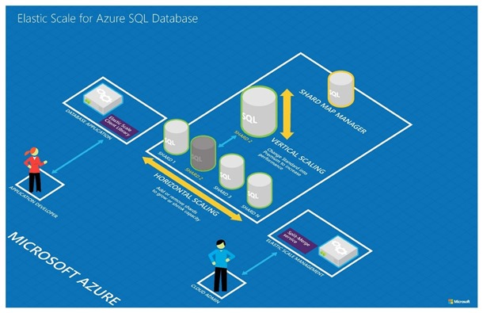
Elastic Scale
Notes:
Replacing Federation
Split Merge is a customer-hosted service with one worker and one web role – updates shard map. While shards are moving shardlet in map marked as offline until complete. Connections may be killed while this is occurring. Retry is king.
Scenarios
Grow Capacity – Splitting Ranges: The ability to grow aggregate capacity at the data tier addresses increasing capacity needs. In this scenario, the application provides the additional capacity by sharding the data and by distributing it across incrementally more databases until capacity needs are fulfilled. The ‘split’ feature of the Elastic Scale Split/Merge Service addresses this scenario.
Shrink Capacity – Merging Ranges: Capacity fluctuates due to the seasonal nature of a business. This scenario underlines the need to easily scale back to fewer scale units when business slows. The ‘merge’ feature in the Elastic Scale Split/Merge Service covers this requirement.
Manage Hotspots – Moving Shardlets: With multiple tenants per database, the allocation of shardlets to shards can lead to capacity bottlenecks on some shards. This requires re-allocating shardlets or moving busy shardlets to new or less utilized shards.

Slide 20
Demo – Elastic Scale

Slide 21




What are Windows Azure Web Sites?

Slide 22




WAWS: Manual Deploy

Slide 23
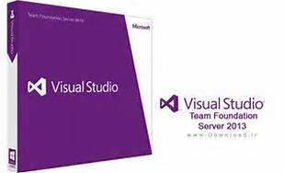




WAWS: Source Control Deploy

Slide 24
Windows Azure Storage Accounts
Account has 0-n containers
Blob Container
Table Container
Queue Container
Blob Type
Page : Changing information 1 TB in size –VHD
Block : Static information 200 GB – items cannot be updated - Images
Normally Stored
Name
URL
Metadata can be inserted with entries (key/value)
Metadata is only optionally retrieved
Can be retrieve and updated without retrieving the item it refferrs to
Can create snapshots of Blob
No backups
Three copies made in data center

Slide 25
Demo: MyVote Blob
Notes:
PollImageController line 20

Slide 26
Windows Azure Cloud Services
Creates “Services”
Web Role
Worker Role
Deployment
Manual
TFS
Can access underlying virtual machines
Scaling
Can setup to increate based on metrics
Scaling can change based on schedule
Day/Night
Week day/ Week end
Data Ranges

Slide 27
Azure Cloud Services Web Role vs. Web Sites
Web Role
Need access to underlying Virtual Machine (to install software, for example)
Network isolation
Support for Virtual Networks
Run over non standard ports
Can scale higher (hundreds of VMs vs 10)
99.95% SLA
Web Site
Abstracts out complications of dealing with setup
Automated deployment from multiple sources
Very easy to scale
Simpler to deal with in Visual Studio (just another website)
Swappable staging/production environments
Have WebJobs for asynchronous processing
Easy to backup
Notes:
Options slowly moving from Web Roles to Azure Web Sites who look to be getting a lot of the focus.
Worker roles are also under siege with the new Webjobs.
Azure Websites now support Hybrid Connections to set up VPN connections to your own data center.
Azure Websites now have deployment slots that act as alternate environments like staging/production slots in Azure Web Roles. Only available in standard mode.

Slide 28
Thank you!
Kevin Ford
Twitter: @Bowman74owman74
kevinf@magenic.com
http://windingroadway.blogspot.com

