Slide 1

Reusing Business and Data Access Logic Across Platforms
Kevin Ford
Mobile Practice Lead
Level: Intermediate

Slide 2

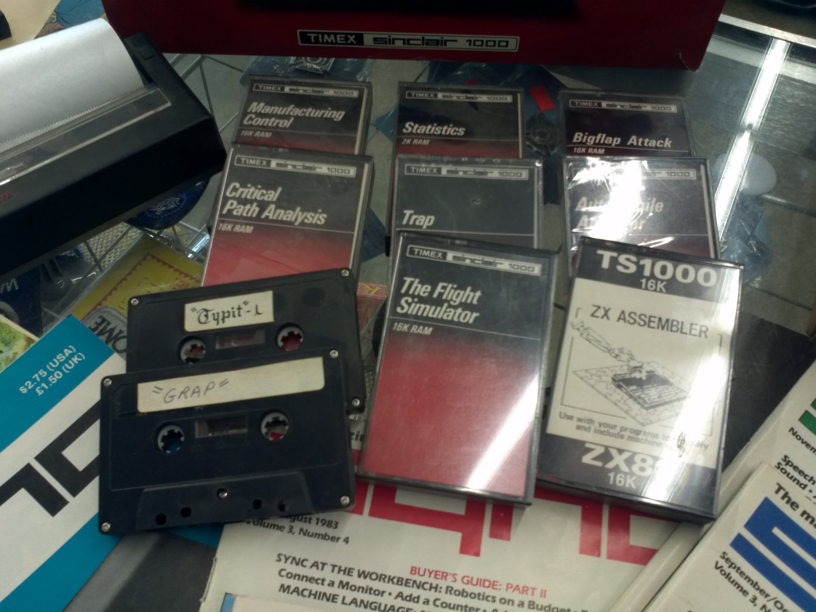
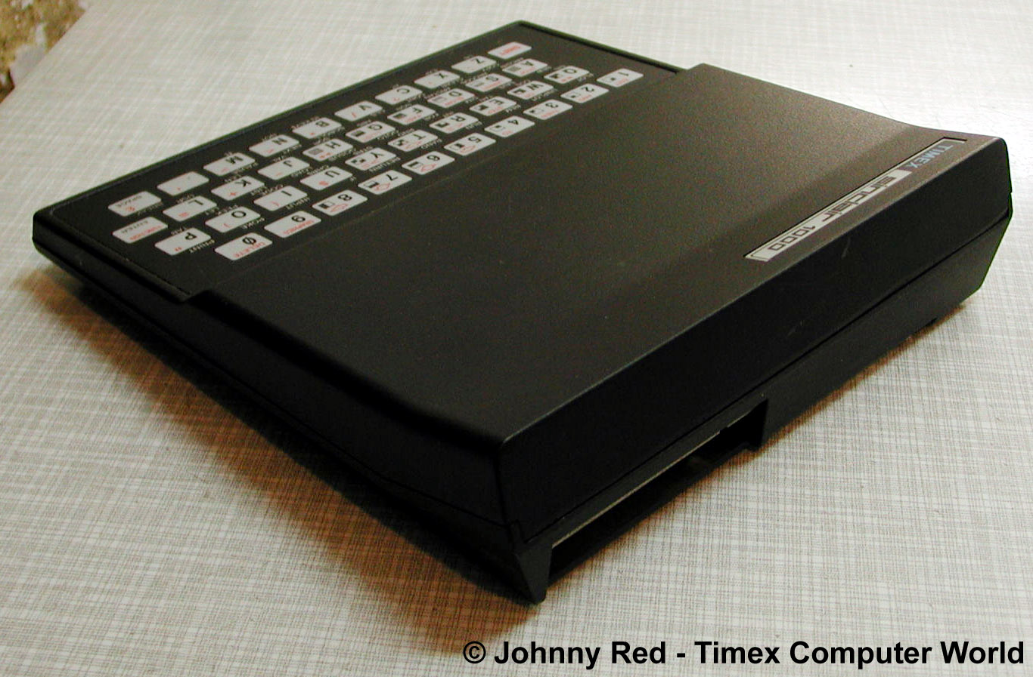
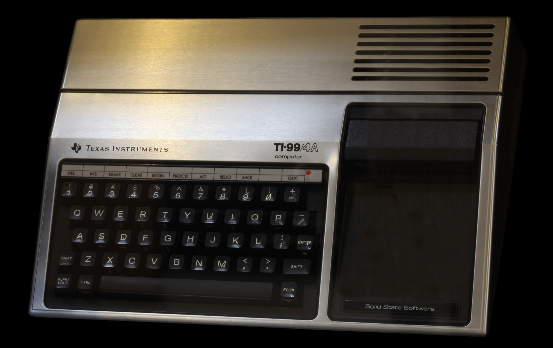
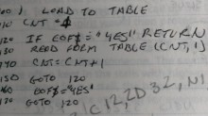
Notes:
Anyone know what this is?
First computer was a Timex Sinclair 1000 with an amazing 2k of ram and both colors, black and white
At that time my problem wasn’t sharing code, it was saving it (maybe)
Then I got this and the basic wasn’t the same nor were the files saved on tape.
My idea was shared code was wiring it down on a piece of paper

Slide 3
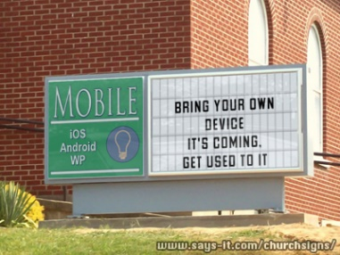
Number of workers using their own device by 2018: 70%
Notes:
- Gartner predicts 70% of workers will be using their own devices for work by 2018
http://www.telephonyyourway.com/gartner-predicts-byod-boom-by-2018/

Slide 4


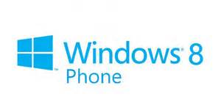
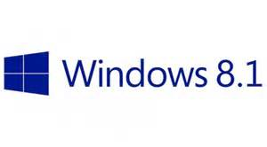


Platforms
Notes:
What platforms do I need to target, not just today, but tomorrow.
We are at an industry inflection point. Impossible to see the direction of the industry just yet. Is the safe bet all bets? Do I worry about wearable's? Should I?

Slide 5
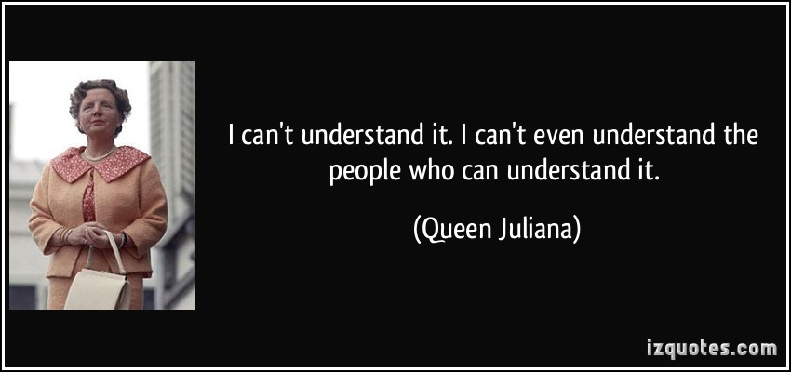
Languages?
Notes:
What Internal competencies do your people have. If all your people are writing PHP apps with JS, then the code sharing techniques mentioned here may not be as useful
Netherlands

Slide 6

User Expectations
Notes:
App looks the same on all platforms, good or bad?
What do the users expect?
The design of the UX and user experience expectations may very well dictate what technology you use for code sharing.

Slide 7




Application Architecture
HTML 5 UI
iOS UI
WinPhone UI
WinRT UI
Android UI
JavaScript BL
BL
BL
BL
BL
Service Proxy
Data Portal
Data Portal
Data Portal
Data Portal
Reports
SQL Reporting
REST API
Data Portal
ASP.NET WA
BL
Excel
DAL
PowerPivot
SQL Database
Blobs
Notes:
Do you want your business logic to span clients?
How about the server?
If you do want BL on the client, how much. Remember that if you are dealing with machines that may be out of your control, any BL on the client may be subject to inspection.

Slide 8
File Linking
Android App
iOS App
WP 8 App
Android Class Library
iOS Class Library
WP 8 Class Library
Code.cs
Code.cs
Code.cs
Notes:
Shared files is sharing at the source code level.

Slide 9
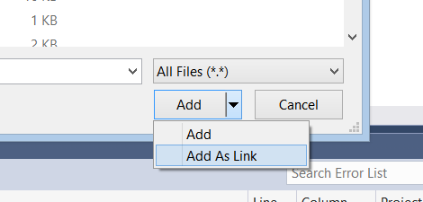
Adding a Linked File

Slide 10
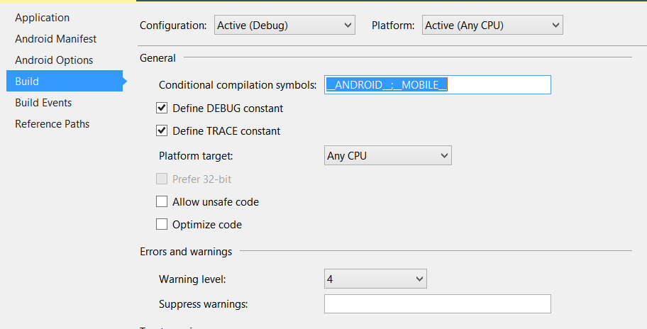
Conditional Compilation
#if __ANDROID__
request.ContentLength = uploadViewModel.PictureStream.Length;
#elif !WINDOWS_PHONE_APP && !WINDOWS_APP
request.Headers["Content-Length"] = uploadViewModel.PictureStream.Length.ToString();
#endif

Slide 11
Partial Classes
Xamarin Android
Xamarin iOS
Windows WPF
Timer Class
Timer Class
Timer Class
Timer Class

Slide 12
Partial Classes
In shared class file
public partial class Timer
{
public Timer()
{
// do stuff
ShowTime();
// do more stuff
}
}
In Android only class file
public partial class Timer
{
public void ShowTime()
{
Toast.MakeText (this, currentTime, ToastLength.Long).Show();
}
}

Slide 13
Taking a look at code linking

Slide 14
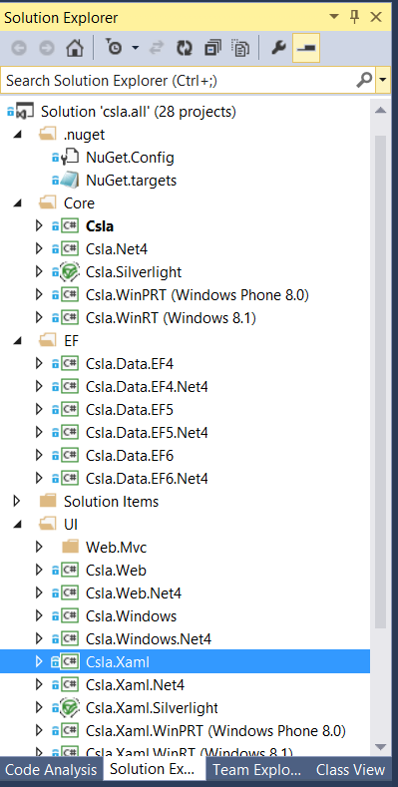

Problems?

Slide 15
Shared Projects
Android App
iOS App
WP 8 App
Shared Universal Project
Code.cs
Code.cs
Code.cs

Slide 16

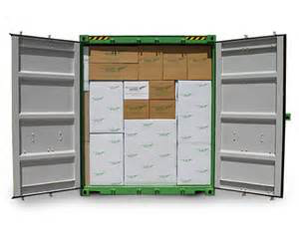
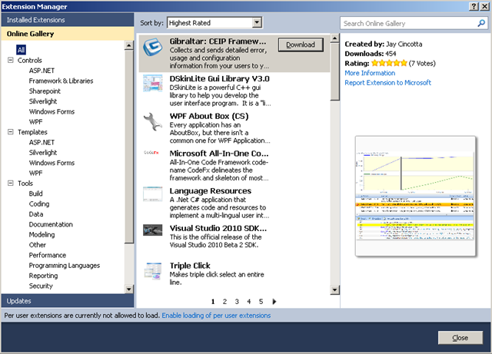

Shared Projects
Notes:
Introduced with VS 2013 update 2
Act as a shared container for file references
Need Extension to manage references (Shared Project Reference Manager)
Shared projects get references to projects that reference them

Slide 17
Taking a Look at Shared Projects
Notes:
Quick Demo on shared projects
Show:
adding the VS extension
Making a new shared project
Referencing a shared project from multiple projects
Switching between project contexts
Getting the correct project reference depending on the context
As a reminder share projects work like code linking, they just make it easier.

Slide 18
PCL
Android App
iOS App
WP 8 App
Portable Class Library
Code.cs
Code.cs
Code.cs
Notes:
Unlike Shared projects, PCLs share code at the binary level
PCLS are a type of DLL
PCLs can be referenced by projects from many platforms and other PCLs
What platforms to target is specified
Show Creating a PCL

Slide 19

PCL Limitations
Notes:
Only use features common to all selected platforms
Can only reference other PCLs
Can only select supported platform combinations
Cannot access platform specific code (directly)
Can only add references to PCLs that support compatible platform combinations

Slide 20
Platform Specific Code - IoC
Xamarin iOS DLL
PCL
Interface
Xamarin Android DLL

Slide 21
Platform Specific Code – abstract classes
In PCL
public abstract class MyBaseClass
{
public void DoGeneralFunction()
{
this.PlatformCommand();
}
protected abstract void PlatformCommand();
}
In platform specific class file
public class PlatformClass : MyBaseClass
{
protected override void PlatformCommand()
{
//Do platform specific commands
}
}

Slide 22
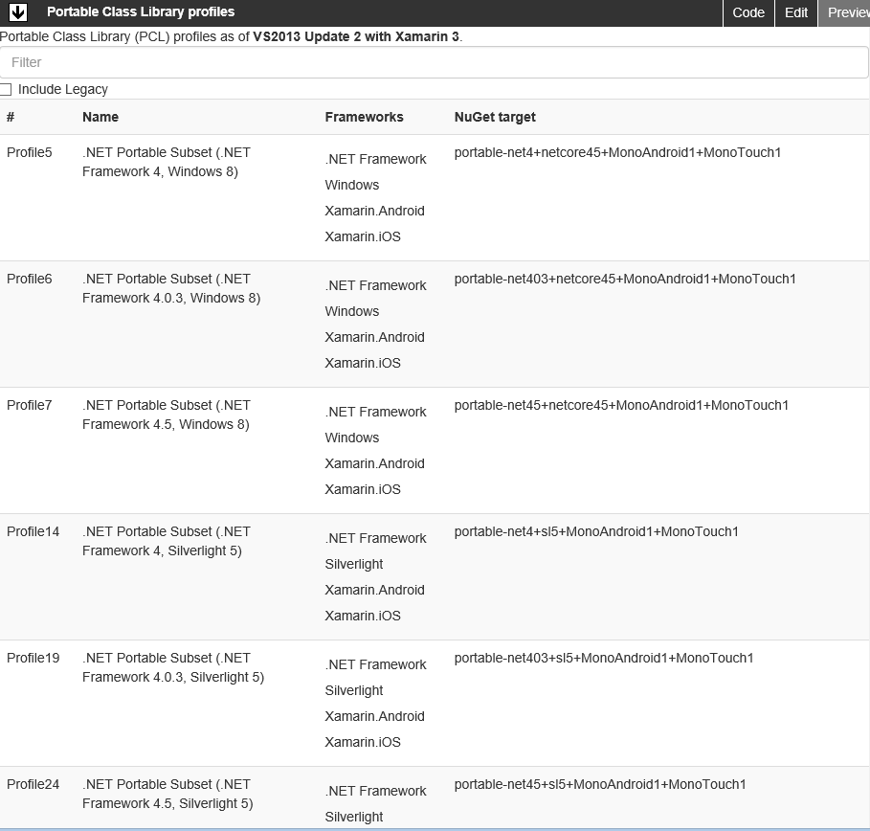
PCL Profile
http://blog.stephencleary.com/2012/05/framework-profiles-in-net.html
Notes:
http://embed.plnkr.co/03ck2dCtnJogBKHJ9EjY/preview
A lot of different profiles.
Need to select an existing profile
VS may add in platforms if they complete a profile

Slide 23
Shared Project vs. PCL
 | Shared Project | PCL
Public library (nuget deployment) |  | X
Multiple platforms in same logical application | X
Corporate application building block library |  | X
Current solution uses file linking and you want to simplify | X

Slide 24
Single Logical App – Multiple Platforms
iOS
Android
Windows Universal
Web Site
UI Shared
Business Logic Shared
View Models
Views
Models
Data Access

Slide 25
Reusable Library – Multiple Platforms
iOS
Android
Windows Universal
iOS
Android
Windows Universal
iOS DLL
Android DLL
Windows DLL
PCL
Implementation Classes
Implementation Classes
Implementation Classes
Interfaces
Models / DAL / Utilities

Slide 26
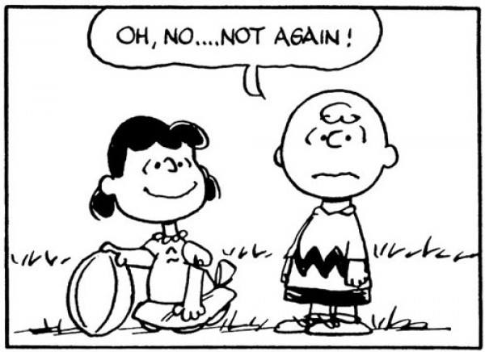
Bait and Switch
Notes:
Bait an switch is normally seen as bad but not always so with technology
Sometimes you have to fool the system into doing what you want it to do.
PCLS cannot reference platform specific DLLs
PCLs can only reference PCLs with compatible profiles
The profile of the PCL doesn’t actually run anywhere
Nuget will deploy platform specific versions before cross platform ones

Slide 27
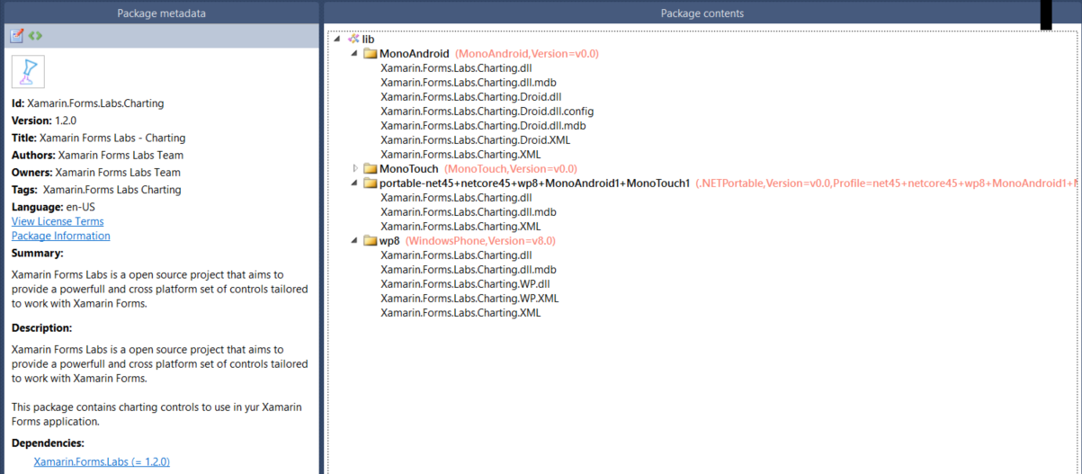
Anatomy of a Nuget Package
Notes:
Different installation profiles for what is asking for them. A compatible PCL will get the PCL profile but a Windows Phone 8 app wll get the dlls under the wp8 section.

Slide 28
Bait and Switch
Demo - Creating your own nuget repository and implementing bait and switch

Slide 29

Selecting Packages
Notes:
Make sure you use libraries that are compatible with the different platforms you are targeting.

Slide 30


MVVM Frameworks

Slide 31
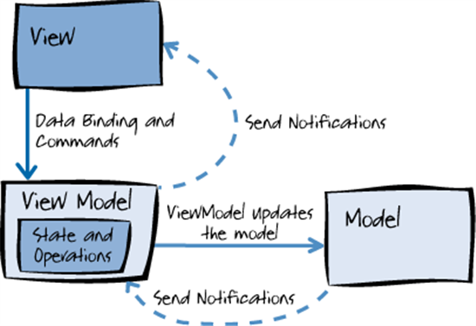
MVVM

Slide 32
Code Sharing and MVVM
Combination of tools and frameworks make this possible
View Models can be shared across multiple platforms
Windows Store
Windows Phone
Android
iOS
Similar techniques can be used with models and frameworks like CSLA

Slide 33
Universal???
Universal app – an app made to run on the iPad and iPhone
Universal Windows app – an app made to run on Windows 8.1 (Windows Store Applications) and Windows Phone
Unified API – An API to write code that can run on iOS and OSX
Android apps are “universal” in that they can work on phones and tablets
Notes:
Lots of other attempts to cross platforms, usually tied to a specific vendor.
I’m getting a but tired of the “universal” term and “unified” is just close enough to be confusing.

Slide 34
Thank you!
Kevin Ford
Twitter: @Bowman74
kevinf@magenic.com
http://windingroadway.blogspot.com

