Slide 1

Workshop: Intro to HTML5, TypeScript and Angular JS
Kevin Ford
Mobile Practice Lead
Level: Introductory
Notes:
Welcome
housekeeping
What is a modern app
This track is somewhat unique
What we will be doing today
Html
Getting at data
Mobile platforms through Xamarin

Slide 2





Overview of HTML 5 Development
HTML 5 Introduces new elements and attributes to enhance the development and client experience
Can create richer client applications
Different levels of browser adoption
Java libraries have become more important than ever
TypeScript
Angular JS
Notes:
New elements
HTML 5 allows you to make smart client applications using HTM/CSS/Js
Not all browsers are created equal when it comes to html 5 (html5test.com)
Frameworks and tools have become increasingly important (Angular, Knockout, Jquery, TypeScript)
Still in a high state of flux.
Scores from HTML 5 reports. Chrome went up and FireFox and IE both went down.

Slide 3
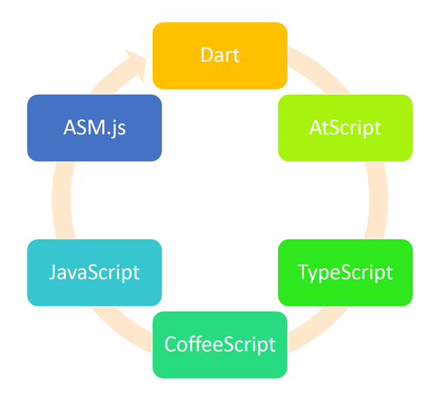
Anything but JavaScript
Notes:
Posted by Scott Hasselman. Lot’s of js frameworks out there, everyone trying to avoid JS but just end up back at JS.
MS version of avoiding JS is TypeScript. Just released version 1.3.
At the end of the day it all comes back to JavaScript.

Slide 4
TypeScript Introduction
Extends javaScript
Adds strong typing, interfaces, classes, etc
Design time not run time type checking
Still JavaScript!
TypeScript compiler transforms typeScript into normal javaScript files that can be referenced by your web pages
Visual Studio support adds intelliSense
Transpile time type assurance
Can be downloaded from:
http://www.typescriptlang.org/
Notes:
Current Version 1.3
No longer needs to be downloaded, in VS. But it can be and dealt with seperately

Slide 5


TypeScript Strong Typing
Compile time type checking
The following “primitive” types are available
string
number
boolean
null
undefined
Syntax:
var myNumericVariable : number;
var myStringVariable : string = ‘initial value’;

Slide 6

TypeScript Modules
All code in “global” module by default
Modules restrict visibility
Modules create ‘namespaces’
‘export’ command
module Classes {
var internalString: string;
export var externalString: string;
}
Reference another TS file:
///<reference path=“FileToReference.ts" />

Slide 7
TypeScript Demo 1: Strong Types and Modules

Slide 8
Enums
Subtype of number with associated constants
Can use constant numbers
Can use computed values
enum Gender {
Male = 0,
Female = Interfaces.Gender.Male + 1
}

Slide 9
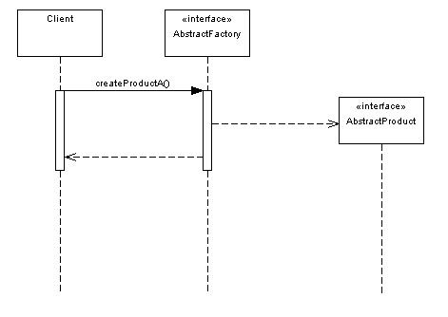
TypeScript Interfaces
Serve same purpose as interfaces in other languages (Contract)
No emitted js code
Interfaces can inherit from 0-n interfaces
extends IOne, ITwo
Interfaces can define properties and methods
interface IRegistration {
Email: string;
ScreenName: string;
IsValid(): boolean;
}

Slide 10
TypeScript Classes
Interface/class inheritance allowed
Default constructor created automatically
public/private members
Members may be static
class Registration implements Interfaces.IRegistration {
public Email: string = null;
public ScreenName: string = null;
protected isNew: boolean;
IsValid(): boolean {
return true;
}
}
Notes:
The protected keyword is new to version 1.3

Slide 11
Using JS with Typescript
Declare variables:
declare var OutsideVSObject;
Use Interfaces
export interface IOutsideVSObject {
SomeProperty: string;
SomeMethod();
}
Use Interface libraries (nuget)

Slide 12
TypeScript Demo 2: Classes

Slide 13

Typescript Inheritance
Only Single inheritance is allowed
Override by using same signature
super keyword allows access to base class methods and properties
export class ExtendedRegistration extends Registration {
public HotelName: string = "";
IsValid(): boolean {
return (super.IsValid() && this.HotelName != "");
}
}

Slide 14
TypeScript Demo 3: Inheritance

Slide 15
Typescript Generics
Generics can be used in
Interfaces
Classes
Methods
One or more generic types may be specified
Generics can be passed to super classes and interfaces
export interface IGetString<T> {
GetString(param: T): string;
}

Slide 16
TypeScript Demo 4: Generics

Slide 17

Angular JS
SPA
Data Binding
IOC
Async
Operations
Validation
Mocking
Factories Services
Directives
Notes:
Current version 1.3
IE support for 8 was dropped in 1.3
Upcoming 2 version includes lots of changes like AtScript and potentially removing directives.
Made for creating Single Page Applications

Slide 18
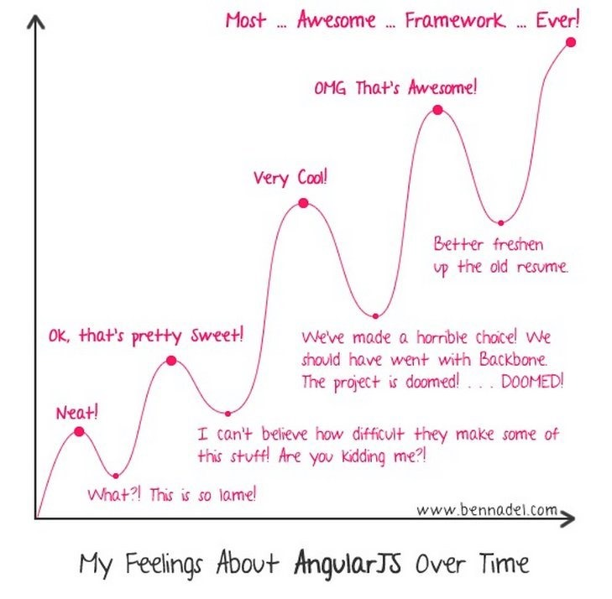
The Angular Learning Curve
Notes:
Ben Nadel

Slide 19
Single Page Application (SPA)
Main Page
<html>
<script src="/Scripts/angular.min.js"></script>
<div data-ng-app=“Module”>
View 1
View 2
View 1
View 2
View 3
View 1
View 4
View 3
View 4
</div>
</html>
Notes:
Create Module
var test1Module1 = angular.module("FirstModule", []);
Setup Routes
test1Module1.config(($routeProvider: ng.IRouteProvider) => { AngularTest1.ResolveRoute($routeProvider); });
Setup Controller(s)
test1Module1.controller('FirstViewController', ($scope: ng.IServiceProvider) => { AngularTest1.FirstViewController($scope); });
Setup Foute Function
export function ResolveRoute(routeProvider: ng.IRouteProvider) : void {
routeProvider.when('/View1', {
controller: 'FirstViewController',
templateUrl: 'Views/AngularTest1View1.htm'
});
routeProvider.when('/View2', {
controller: 'SecondViewController',
templateUrl: 'Views/AngularTest1View2.htm'
});
routeProvider.otherwise({ redirectTo: '/View1' });
}
Create Controller
export function FirstViewController($scope: ng.IServiceProvider): void {
@$scope.SomeProp = “MyString”;
@$scope.SomeMethod = MyMethod();
}
Export function MyMethod(): number {
// do some stuff
}

Slide 20
Angular Flow
Views
Navigation
Controllers
Module and Routing
Factories
Directives
Services
Directives

Slide 21
Angular Demo 1: SPA

Slide 22
Binding Models to Views
Angular JS
$Scope
Model
Controller
View
$Scope
Model Information

Slide 23
Binding Syntax
$scope implied
Will add member to $scope dynamically if needed
Simple display:
<td>{{ registration.ScreenName }}</td>
Simple binding for edit
<input data-ng-style="width: 50%" type="text" id="txtBirthDate" data-ng-model="Model.BirthDate" />

Slide 24
Angular Demo 2: Binding
Notes:
Select
<span data-ng-class="right">
<select id="cboGender" data-ng-model="Model.Gender" data-ng-options="g.id as g.name for g in Genders"></select>
</span>
Click
<button type="button" data-ng-click="SaveData()">Save</button>
Form Submit
<form name="myForm" data-ng-submit=“SomeSubmitFunction()">
Bind Array and <A>
<tr data-ng-repeat=“dataItem in MyArray()">
<td>{{dataItem.Id }}</td><td>{{dataItem.Name }}</td><td><a data-ng-href="#/EditMyData/{{ dataItem.Id }}">Edit</a></td>
</tr>

Slide 25
Validation/Formatting Syntax
Formatting
Validation
Errors
Disabling controls
<td>{{ Name | uppercase }}</td>
<td>{{ OtherName | lowercase }}</td>
<td>{{ SomeDate | date:'MM-dd-yyyy' }}</td>
<input type="text" id="txtName" data-ng-model=“MyText" required />
<input type="text" id="txtName" data-ng-model="MyText" required="" data-ng-required=“IsNameRequired()" />
<input type="text" id="txtZip" data-ng-model=“MyZip" data-ng-required=“IsZipRequired()" data-ng-pattern="PostalCodeMask" />
<span data-ng-show="myForm.txtZip.$error.required">required</span>
<span data-ng-show="myForm.txtZip.$error.pattern">Postal Code Format is not valid</span>
<button type="button" data-ng-click="SaveRegistration()" data-ng-disabled="myForm.$invalid">Save</button>
Notes:
Simple Formatting
<td>{{ Name | uppercase }}</td>
<td>{{ OtherName | lowercase }}</td>
<td>{{ SomeDate | date:'MM-dd-yyyy' }}</td>
Simple Validation
<input type="text" id="txtName" data-ng-model=“MyText" required />
<input type="text" id="txtName" data-ng-model="MyText" required="" data-ng-required=“IsNameRequired()" />
<input type="text" id="txtZip" data-ng-model=“MyZip" data-ng-required=“IsZipRequired()" data-ng-pattern="PostalCodeMask" />
Showing Errors
<span data-ng-show="myForm.txtZip.$error.required">required</span>
<span data-ng-show="myForm.txtZip.$error.pattern">Postal Code Format is not valid</span>
Disabling Controls
<button type="button" data-ng-click="SaveRegistration()" data-ng-disabled="myForm.$invalid">Save</button>

Slide 26
Angular Demo 3: Validation and Formatting

Slide 27
Creating a Custom Directive
Create custom:
Elements
<custom-dir></custom-dir>
Attributes
<div data-custom-dir=“some value” ></span>
Comments
Class Name
<!– directive: custom-dir some value -->
Class Name
<div class="custom-dir: some value;“></div>

Slide 28
Directive Method
module myDirectives {
export function customDir(): any {
return {
restrict: "A",
link: function ($elem, $attr) {
$elem[0].innerHTML = '<b>' + $attr + '</b>';
}
}
}
}

Slide 29
Hooking it up
How Angular sees the name
X- and data- are removed from element attribute directives in HTML
:, - and _ are converted to camel case
Adding a directive registration to the context
myModule.directive('customDir', function () {
return myDirectives.customDir();
});

Slide 30
Angular Demo 4: Creating a Directive

Slide 31
Thank you!
Kevin Ford
Twitter: @Bowman74Bowman74
kevinf@magenic.com
http://windingroadway.blogspot.com

