Slide 1

Application Servers and Windows Azure
Kevin Ford
Practice Lead
Level: Intermediate
Notes:
New Azure Services for developers
Abstraction away from solution – as the end public, private, hybrid clouds are services for the application
-Testing
-Changes to environment
Understand performance implications of different deployment scenarios
3:28

Slide 2
Service Types
IAAS – Infrastructure as a service
PAAS – Platform as a service
SAAS – Software as a Service
Notes:
Each level gets closer to the user.
PAAS commoditizes infrastructure and SAAS attempts to commoditize software development. Generally companies are more likely to need software that is unique to their business than infrastructure.

Slide 3

Why You Should Care
Competitive costs
Moves infrastructure off the balance sheet
Easy to wind and unwind
Removes time roadblocks when spinning up new services
Easy to access
Distributed data centers
Offers a level of redundancy not usually found in private clouds
Ok, It’s cool – like really cool in a geeky kind of way

Slide 4

99.9 – Good or Bad?
Azure uptime is 99.9%
8.76 hours down per year – max
If you currently don’t track your availability you probably have no more than 95% uptime

Slide 5





Challenges in the Enterprise
Long setup and cycle times
High infrastructure costs
Limited data center capacity
Hard to replicate production
Azure Offers
Azure VMs to run dev and test workloads.
Solution
Test Teams
Dev Teams
Seamless connectivity with on-premises data & apps
Azure Connect VPN
Saved VM State
On Premises
Easier access for geographically dispersed teams
Azure storage
Apps
Data
Test/Dev VMs
Notes:
Hos long dies it take to get a new server, a new data center?
Moving from the balance sheet to the income statement. I.e. the impact of capital expenses vs operational expenses
Private clouds create natural and potentially frequent capacity breaks due to limitations on scale
Much of private cloud tooling still around manual or home grown processes
8:47

Slide 6
My Vote Azure Usage
Windows Azure SQL Databases (WASD)
Main System DB
Windows Azure Mobile Services (WAMS)
Authentication
Table Storage
Server Side Scripts
Windows Azure Web Sites
HTML 5 website
Auto deployment
Windows Azure Storage Accounts
Blob storage for poll images
Windows Azure Cloud Services
CSLA DataPortal

Slide 7
Windows Azure SQL Databases (WASD)
SQL Database
Fault Tolerant
Size
20 MB – Free
Web – 1-5 GB
Business – up to 150 GB
Manage
SQL Server Management Studio
Azure Management Portal
Access Allowed by IP

Slide 8
WASD – Advanced Features
Federation – Collection of DB Partitions (Sharding)
SSMS
Management Portal
Export/imports to/from BACPAC files
Goes to Azure BLOB
One Time
Automated
SQL Data Sync
Doesn’t happen immediately
Can sync to other Azure DB or on premise
Notes:
3:32

Slide 9
WASD - Redundancy
Backup Server 1
Backup Server 2
Backup Server 3
Primary Server

Slide 10
Demo - WASD

Slide 11
Mobile Services (WAMS) Tables
Data backed by underlying SQL database
Underlying SQL types
float(53)
Bit
DateTimeOffset(3)
nvarchar(max)
Ways to create/Modify schema
Dynamic generation
Change schema in SQL Server Management Studio
Management portal tool for SQL database
Id (identity) field required
Transactions
Separate calls, separate transactions
One call with multiple records, possibly one transaction using “mssql” object

Slide 12
WAMS – Server Side Scripts
Allowed Scripts
Insert
Update
Delete
Read
Written in JavaScript
Several Options
Change request data
Add/update fields not part of request (auditing fields for example)
Disallow
Alter query
Check other existing data
Must have either
Respond()
Execute()

Slide 13
Demo: WAMS Tables and Scripts

Slide 14
Mobile Services Authentication
Support for four providers
Facebook (http://developer.facebook.com)
Google (https://code.google.com/apis/console)
Microsoft (http://dev.live.com)
Twitter (http://dev.twitter.com/apps)
Azure Access Control Service (Secure Token Service) not currently available with Azure Mobile Services
Application needs to be registered with each STS
Users need to associate account
Identifier – What app am I?
Shared Secret – Prove it

Slide 15
Secure Token Service
Login Info
STS Provider
Token
Facebook
Custom Application

Slide 16
Using Authentication
Add Azure Mobile Services
Call to open connection
Windows Store, Windows Phone 8
var user = await this.mobileService.LoginAsync(provider);
Xamarin Android
var user = await this.mobileService.LoginAsync(context, provider);
JavaScript
client.login(provider).then( result => {
});
Notes:
MobileService.cs line 28
Auth.ts line 68
http://developer.facebook.com

Slide 17
Demo: Setting up Authentication

Slide 18




What are Windows Azure Web Sites?

Slide 19




WAWS: Manual Deploy

Slide 20
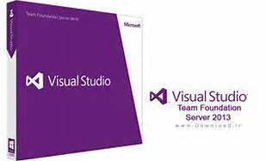




WAWS: Source Control Deploy

Slide 21
Demo: WAWS Setup and Deployment

Slide 22
Windows Azure Storage Accounts
Account has 0-n containers
Blob Container
Table Container
Queue Container
Blob Type
Page : Changing information 1 TB in size –VHD
Block : Static information 200 GB – items cannot be updated - Images
Normally Stored
Name
URL
Metadata can be inserted with entries (key/value)
Metadata is only optionally retrieved
Can be retrieve and updated without retrieving the item it refferrs to
Can create snapshots of Blob
No backups
Three copies made in data center

Slide 23
Demo: MyVote Blob
Notes:
PollImageController line 20

Slide 24
Windows Azure Cloud Services
Creates “Services”
Web Role
Worker Role
Deployment
Manual
TFS
Can access underlying virtual machines
Scaling
Can setup to increate based on metrics
Scaling can change based on schedule
Day/Night
Week day/ Week end
Data Ranges

Slide 25
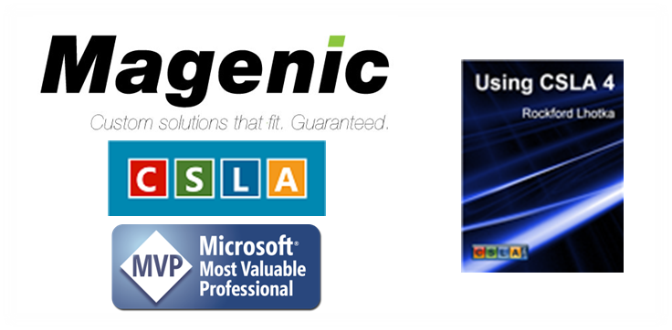
Thank you!
Kevin Ford
kevinf@magenic.com
http://windingroadway.blogspot.com

