Slide 1
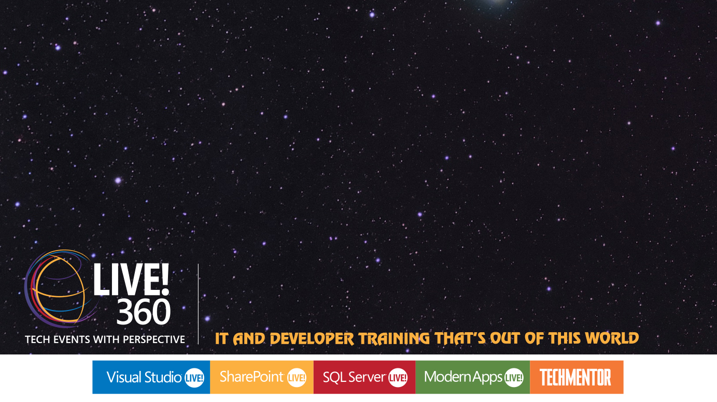
Workshop: Introduction to Frameworks
Kevin Ford
Practice Lead
Level: Introductory

Slide 2


Frameworks

Slide 3




Application Architecture
HTML 5 UI
iOS UI
WinPhone UI
WinRT UI
Android UI
JavaScript BL
BL
BL
BL
BL
Service Proxy
Data Portal
Data Portal
Data Portal
Data Portal
Reports
SQL Reporting
REST API
Data Portal
ASP.NET WA
BL
Excel
DAL
PowerPivot
SQL Database
Blobs
Notes:
Do you want your business logic to span clients?
How about the server?
If you do want BL on the client, how much. Remember that if you are dealing with machines that may be out of your control, any BL on the client may be subject to inspection.

Slide 4
CSLA .NET Goals
Minimize/standardize coding
Decrease maintenance costs
Require software layering
Enforce layering/separation of concerns
Decrease maintenance costs
Enable responsibility-driven business layer
Responsibility-driven business objects
Encapsulate validation/authorization/logic
Support data binding (XAML, Web, Windows)
Abstract object architecture/Plumbing
Codeless switch between 1, 2, 3, 4-tier models
Transport neutral (WCF, Web API, Remoting)
Gain scalability and security
Notes:
Standardize coding
Layering
Responsibility Driven
Abstract mobile architecture

Slide 5
CSLA .NET Primary Features
Data binding
XAML, Windows, Web
Abstract persistence
ADO.NET, Entity Framework, others
Mobile objects
1-, 2-, 3- and 4-tier deployment models
Business rules
Business, validation, authorization
LINQ
Silverlight, WP7, WPF, Windows, Android
Indexing, synced lists, data binding
N-level undo

Slide 6

Layered Architecture
Interface
Tier
Interface Control
Business Objects
Tier
Data Access
Tier
Data Storage and Management

Slide 7
CSLA Stereotypes
BusinessBase
R/W Single Top Level
R/W Leaf Node
BusinessCollectionBase
R/W Top Level
R/W Child Collection
ReadOnlyBase
R/O Single Top Level
R/O Leaf Node
ReadOnlyCollectionBase
R/O Top Level
R/O Child Collection
CommandBase
Execute logic (possibly remotely)

Slide 8
Rule Types
Validation Rules
Indicate if the data is correct
Can’t save an invalid object
Authorization Rules
Indicate if a user is allowed to do something
Role Based
Could be to change a value
Tied to properties or CRUD operations on an object
Business Rules
Business logic that may cause object state to change

Slide 9
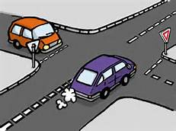
Rule Priority and Dependent properties

Slide 10
Demo: Creating Classes and Validation Rules

Slide 11
Security and Authorization
Uses normal principal and identity
Can create custom providers
CSLA checks underlying roles
Dataportal CRUD and properties can be locked down
Custom authorization rules can be created
Inherit from Csla.Rules.AuthorizationRule

Slide 12
Demo: Creating Authorization Rules

Slide 13
Data Portal Methods
public static IRegistrationList GetAllRegistrations()
{
return DataPortal.Fetch();
}
Data Portal
private async Task DataPortal_Fetch()
{
// Load from data source
}

Slide 14
Demo: Data Access Layer

Slide 15
Remote Data Portal
Remote Data Portal
Business Logic /
Data Access Methods
Data Portal
Data Portal
Business Logic /
Data Access Methods
Local Data Portal
Tier

Slide 16
Demo: Setting up a Remote DP

Slide 17
MVVM Cross High Level (v. 3)
View
Navigation Request
View
View Model
MVVM Framework Navigation
View Model
Model
Navigation Request
Model

Slide 18
MVVM Cross Platforms
Silverlight for WP7, WP8
Mono for Android (or Xamarin.Android)
MonoTouch for iOS (or Xamarin.iOS)
the WinRT XAML framework for Windows 8 Store apps.
WPF
Mono for Mac (or Xamarin.Mac)

Slide 19
Making a View Model
public class MyViewModel : MvxViewModel
{
private ISomeDependency SomeDependency;
public MyViewModel(ISomeDependency someDependency)
{
this.SomeDependency = someDependency;
}
}

Slide 20
ViewModel Lifecycle (CIRS)
Constructor – Uses Dependency Injection
Init() – Parameters passed
ReloadState() – rehydration and tombstoning
Start() – Final item called
Simple type parameters
Single object with simple type properties
InitFromBundle using IMvxBundle

Slide 21
Binding a Property to Xaml
Binding is to object in BindingContext property of a form
Common Xaml binding syntal
<Label Text="{Binding Category}" Font="Bold" />
<Entry x:Name="txtFirstName" Text="{Binding User.FirstName, Mode=TwoWay}" Placeholder="First Name" />
<Button x:Name="btnLogin" IsEnabled="{Binding CanSave}" Text="Save" Command="{Binding Submit}" />

Slide 22
Hooking up Buttons and other Actions
public ICommand Submit
{
get
{
return new MvxCommand(async () => await SubmitHandlerAsync());
}
}
public ICommand ViewPoll
{
get
{
return new MvxCommand<int>(async (id) => await this.ViewPollHandlerAsync(id));
}
}

Slide 23
Binding a Command to Xaml
<MyVoteControls:ExtendedImage WidthRequest="150" HeightRequest="150" Aspect="AspectFill" HorizontalOptions="FillAndExpand" Source="{Binding ImageLink}">
<MyVoteControls:ExtendedImage.GestureRecognizers>
<TapGestureRecognizer Command="{Binding ViewPoll}" CommandParameter="{Binding Id}"/>
</MyVoteControls:ExtendedImage.GestureRecognizers>
</MyVoteControls:ExtendedImage>

Slide 24
Navigation
Stack like Mobile Applications
Close(some view model) – Pops off stack
ShowViewModel(VMRequest) – Shows the view model requested
ShowViewModel<MyViewModel(Parameter) – Show the view model of the specified type

Slide 25
Thank you!
Kevin Ford
Twitter: @Bowman74
kevinf@magenic.com
http://windingroadway.blogspot.com

