Slide 1
PESO Los Baños Web Portal
Empowering Employment Through Digital Services
Presented by: [Your Name / Team Name]

Slide 2
Introduction
What is PESO?
The Public Employment Service Office (PESO) is a non-fee charging multi-employment service facility or entity established or accredited pursuant to Republic Act No. 8759.
Purpose of the Website:
To provide job seekers, OFWs, and employers with a centralized, user-friendly digital hub for employment services in Los Baños.

Slide 3
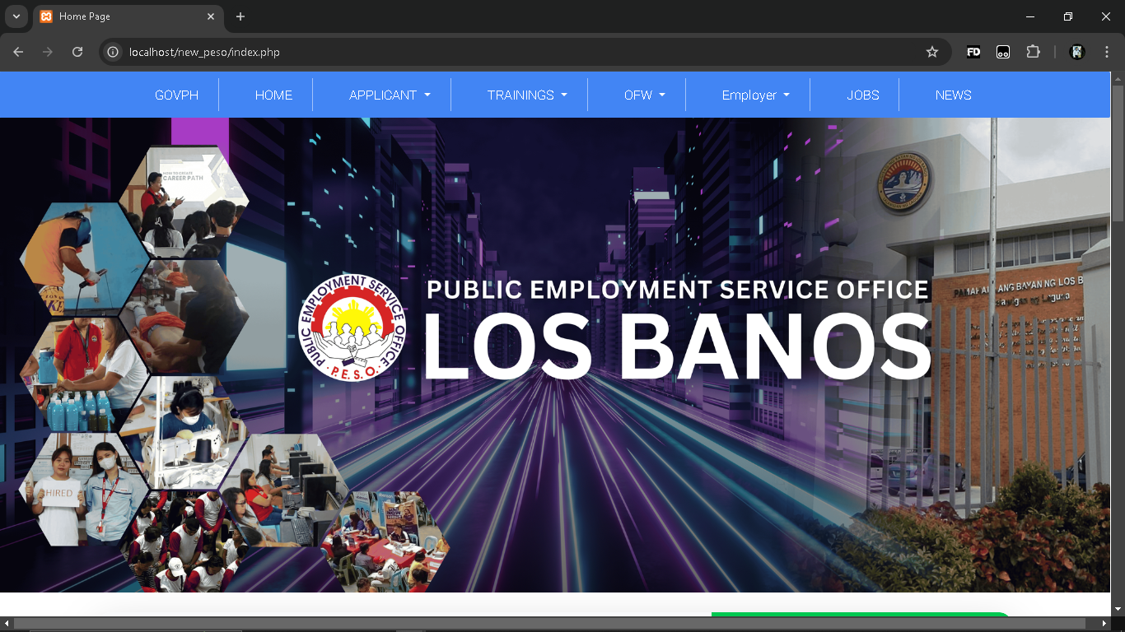
Homepage Overview
Features:
- Intuitive navigation bar (GovPH, Home, Applicant, Trainings, OFW, Employer, Jobs, News)
- Engaging visuals highlighting training and employment services
- Clear PESO branding and municipality representation

Slide 4
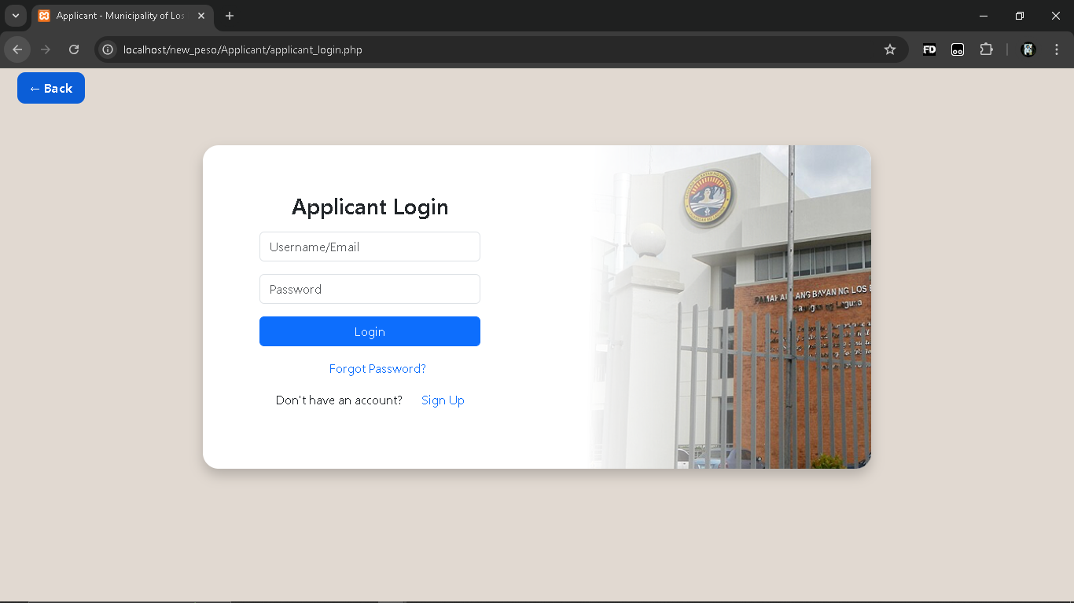
Applicant Login Page
Functionality:
- Login via Username or Email
- Password Recovery option
- Easy navigation back to homepage

Slide 5
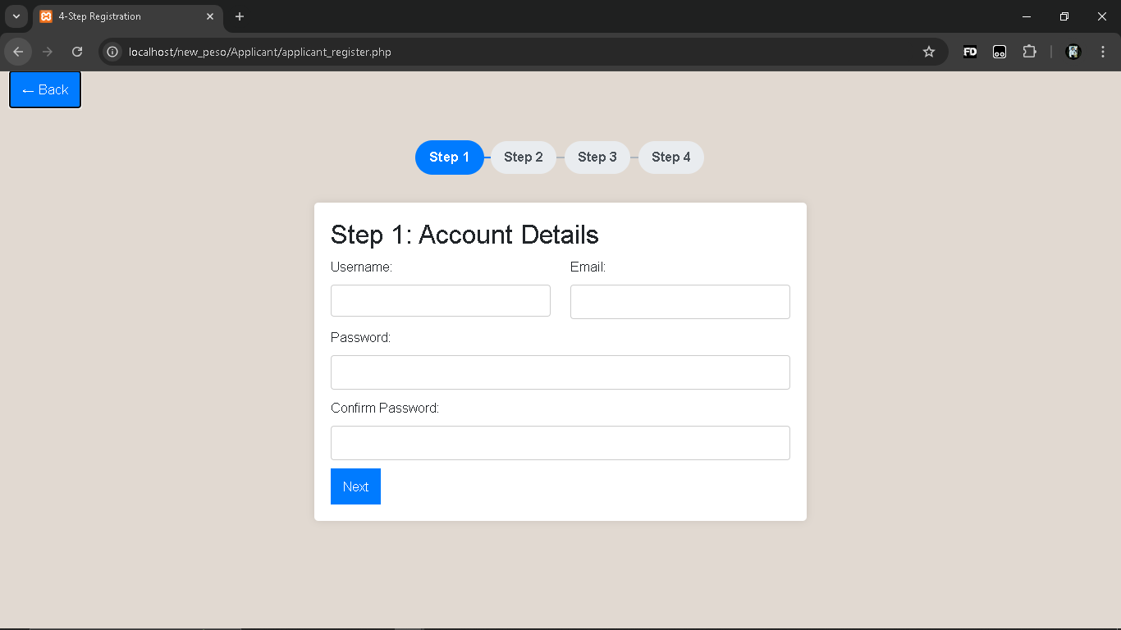
4-Step Registration (Step 1)
Step 1: Account Details
- Collects Username, Email, Password, and Password Confirmation
- User-friendly, step-by-step process to guide applicants
- Leads to further steps to complete applicant profile

