Slide 1

Mastering Persistence: JPA and Hibernate Unleashed
Bharath Ashok

Slide 2
Day 24: Agenda
What is JPA?
Why use JPA?
Key Concepts in JPA
JPA Architecture
Basic JPA Annotations
JPA Entity Relationships
Hands-on
Assignments
Interview Questions

Slide 3
What is JPA?
JPA stands for Java Persistence API. It is a Java specification for managing relational data in Java applications.
JPA provides a standardized way to interact with relational databases using object-oriented principles, making it easier for developers to work with databases in Java applications without needing to write complex SQL queries.
JPA is not an implementation but a specification, which means that different Java Persistence providers, such as Hibernate, EclipseLink, and others. Developers can choose the JPA provider that best suits their needs while still writing code that adheres to the JPA standard.

Slide 4
Key Features of JPA
Object-Relational Mapping (ORM): JPA allows developers to map Java objects to database tables and vice versa.
Entity Classes: In JPA, we define entity classes that represent data stored in the database. These classes are annotated with JPA annotations to specify how they map to database tables and columns.
EntityManager: The EntityManager is a key component of JPA. It is responsible for managing the lifecycle of entity objects, persisting them to the database, and retrieving them from the database. Think of it as the bridge between your Java code and the database.
JPQL (Java Persistence Query Language): JPQL is a SQL-like query language specific to JPA that allows you to perform database queries using entity classes and their relationships rather than writing raw SQL queries.
Transactions: JPA supports transaction management, ensuring that database operations are performed in a consistent and reliable manner. You can use annotations or programmatically manage transactions.
Relationships: JPA allows us to define relationships between entity classes, such as one-to-one, one-to-many, and many-to-many relationships, which are automatically translated into appropriate database schema constructs.
Caching: JPA provides caching mechanisms to improve performance by reducing the need to repeatedly retrieve data from the database.

Slide 5
JPA: The Bridge b/w Java Objects and Relational DB
The primary purpose of JPA (Java Persistence API) is to bridge the gap between Java objects and relational databases.
It achieves this by providing a set of standardized APIs and tools that allow developers to work with Java objects in their application code while seamlessly persisting and retrieving data from a relational database.
Object-Relational Mapping (ORM)
Persistence Context
Query Language (JPQL)
Transaction Management
Relationship Mapping
Caching

Slide 6
Why Use JPA?
Advantages:
Abstraction of Database Details:
JPA abstracts many of the low-level details of interacting with a relational database.
Developers can work with Java objects and entity classes instead of writing SQL queries and handling database-specific operations
Simplifies Database Operations:
JPA provides a powerful ORM framework that automatically maps Java objects to database tables and columns
Portability:
JPA is a standardized API, which means you can write code that is independent of the underlying database system.
Reduces Boilerplate Code:
JPA reduces the amount of repetitive database access code that developers need to write.
Database Agnostic:
With JPA, we can write database-agnostic code, which means your application can work with different databases without major code modifications.
Transaction Management:
JPA provides built-in transaction management capabilities, ensuring that database operations are performed in a consistent and reliable manner.
This helps maintain data integrity and consistency.

Slide 7
JPA Architecture
The architecture of JPA (Java Persistence API) consists of several key components that work together to enable the mapping of Java objects to relational database tables.
Entity Classes:Entity classes represent objects that are persisted in the database.
EntityManagerFactory: The EntityManagerFactory is a heavyweight, thread-safe factory that creates EntityManager instances.
EntityManager: The EntityManager is a lightweight, non-thread-safe object that manages the lifecycle of entity objects and is responsible for performing CRUD (Create, Read, Update, Delete) operations on the database.
Persistence Unit:A persistence unit is a logical grouping of entity classes and their associated configuration.
It is defined in a persistence.xml file within the application and specifies the database connection details.

Slide 8
JPA Architecture
Entity Manager Provider (Provider Implementation):
JPA is a specification, and different providers implement it.
Examples of popular JPA providers include Hibernate, EclipseLink, and OpenJPA.
Each provider offers its implementation of EntityManagerFactory and EntityManager, which is responsible for interacting with the database and managing entity objects.
Transaction Manager:
JPA applications often use a transaction manager, which can be part of the Java EE container or provided by a framework like Spring.
The transaction manager ensures that database operations are performed within a transaction context, providing ACID (Atomicity, Consistency, Isolation, Durability) properties.
Persistence Context:
The persistence context is a first-level cache managed by the EntityManager.
It keeps track of managed entity objects and their state.
Any changes made to entity objects within the persistence context are automatically synchronized with the database when a transaction is committed.

Slide 9
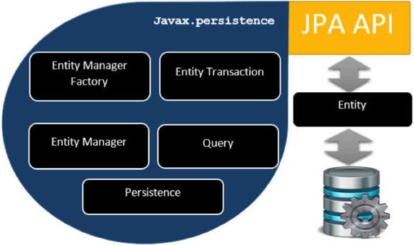
JPA Class Level Architecture

Slide 10
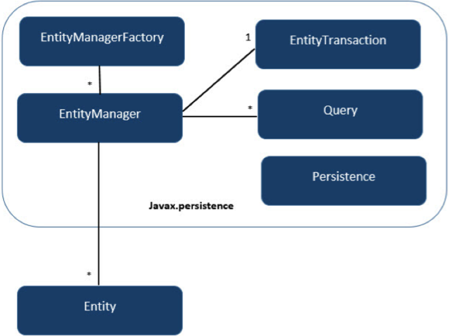
JPA Class Relationships
The relationship between EntityManagerFactory and EntityManager is one-to-many. It is a factory class to EntityManager instances.
The relationship between EntityManager and EntityTransaction is one-to-one. For each EntityManager operation, there is an EntityTransaction instance.
The relationship between EntityManager and Query is one-to-many. Many number of queries can execute using one EntityManager instance.
The relationship between EntityManager and Entity is one-to-many. One EntityManager instance can manage multiple Entities.

Slide 11
Flow of JPA Operations
Create an EntityManagerFactory using the persistence unit configuration.
Obtain an EntityManager from the EntityManagerFactory.
Use the EntityManager to perform database operations (e.g., persist, merge, find, remove) on entity objects.
Write JPQL queries to retrieve and manipulate data stored in the database.
Use the transaction manager to manage database transactions, ensuring data consistency and integrity.
The EntityManager manages the persistence context and synchronizes changes with the database when the transaction is committed.

Slide 12
JPA Annotations

Slide 13
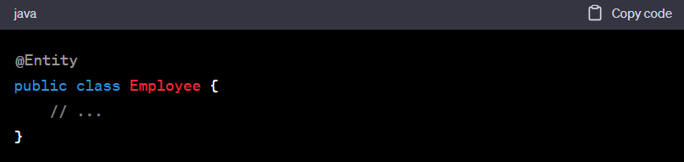
Basic JPA Annotations
@Entity:
Annotates a Java class as an entity, indicating that it should be persisted in the database as a table.

Slide 14
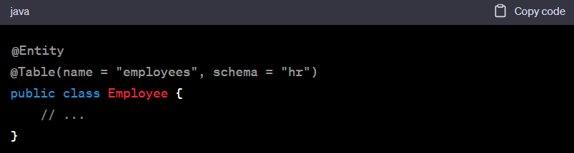
Basic JPA Annotations
@Table:
Specifies the details of the database table to which an entity is mapped, such as the table name and schema.

Slide 15
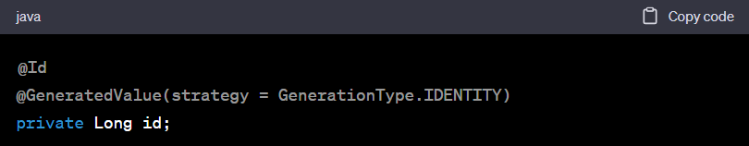
Basic JPA Annotations
@Id:
Marks a field or property as the primary key of the entity
@GeneratedValue:
Specifies the generation strategy for primary key values. Common strategies include GenerationType.IDENTITY, GenerationType.SEQUENCE, and GenerationType.AUTO.

Slide 16
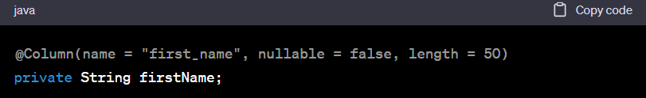
Basic JPA Annotations
@Column:
Defines the attributes of a database column, such as the column name, data type, and constraints.

Slide 17
JPA Entity Relationships

Slide 18
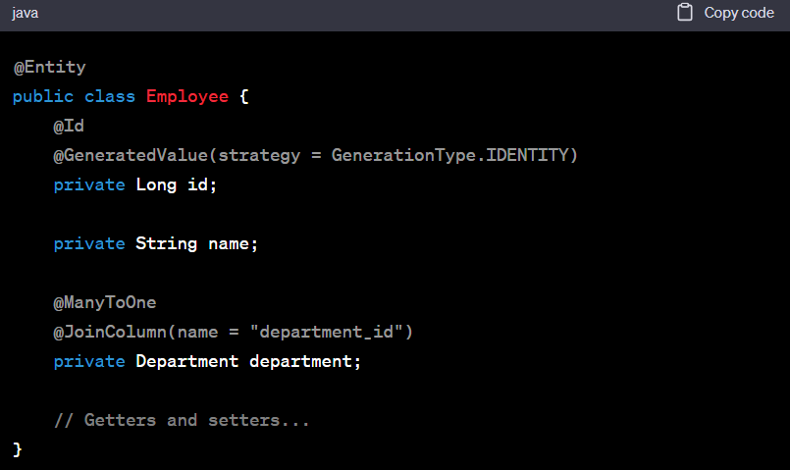
Entity Relationships
@ManyToOne:
@ManyToOne is used to define a many-to-one relationship between two entities.
In a many-to-one relationship, multiple instances of one entity are associated with a single instance of another entity.
For example, in a employee-to-department relationship, multiple employees can belong to the same department (many employees to one department).

Slide 19
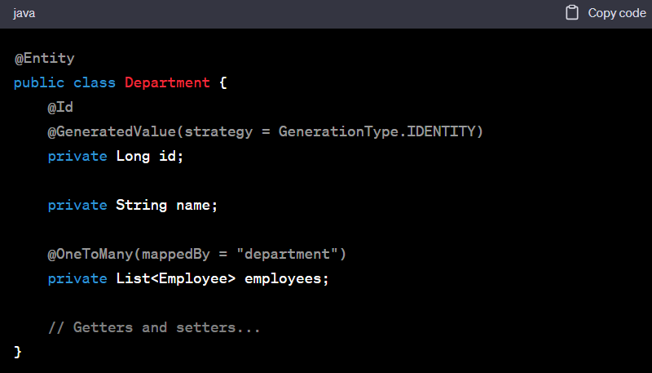
Entity Relationships
@OneToMany:
@OneToMany is used to define a one-to-many relationship between two entities. In a one-to-many relationship, one instance of an entity is associated with multiple instances of another entity.
Continuing with the employee-to-department example, one department can have multiple employees (one department to many employees).

Slide 20
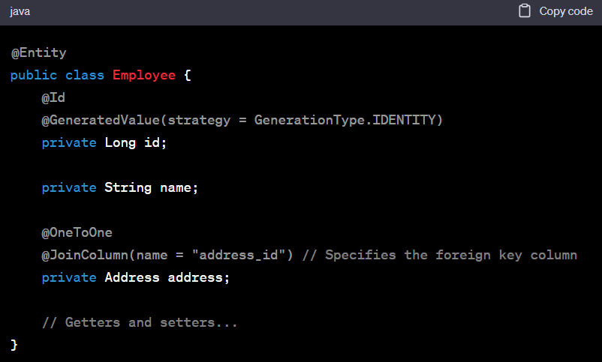
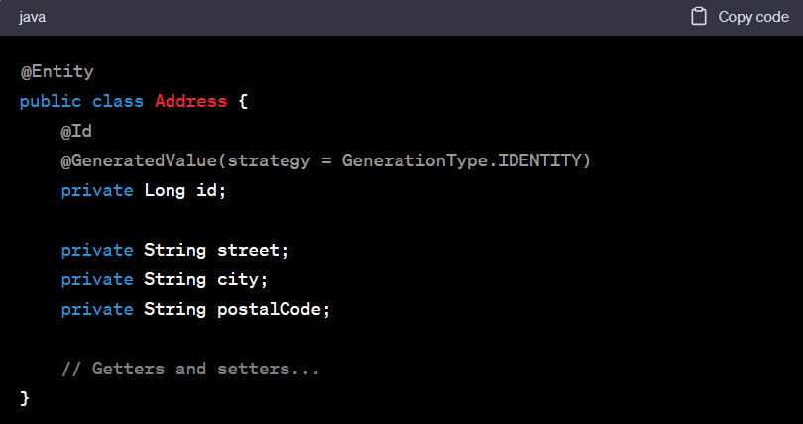
Entity Relationships
@OneToOne:
The @OneToOne annotation is used to define a one-to-one relationship between two entities. In this scenario, each Employee entity will have a one-to-one relationship with an Address entity.

Slide 21
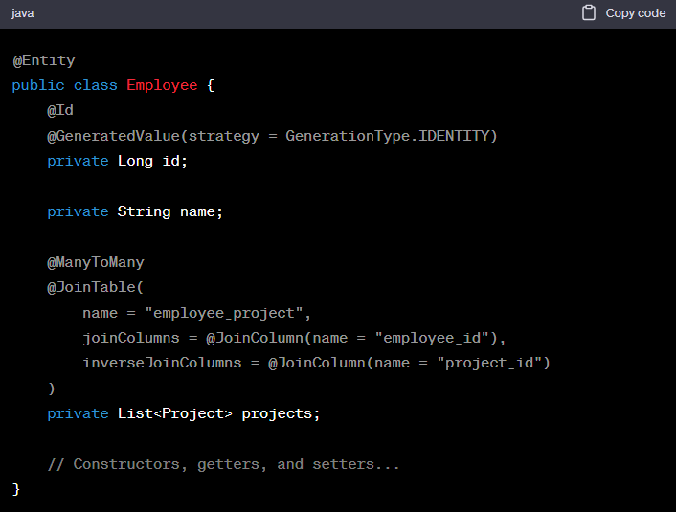
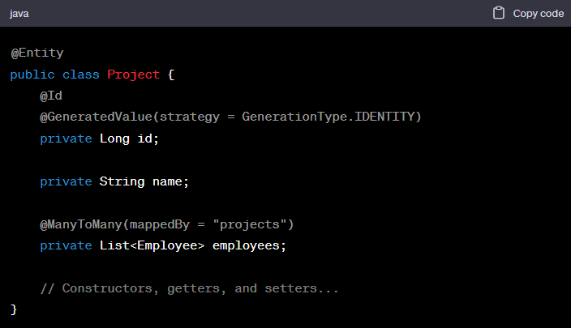
Entity Relationships
@ManyToMany:
@ManyToMany relationship in JPA often represents a scenario where multiple instances of one entity (e.g., Employee) are associated with multiple instances of another entity (e.g., Project). In such cases, a join table is typically used to manage the many-to-many relationship.

Slide 22
Agenda Day 3 : JPA and Hibernate
MySql Installation
AWS Clould RDS Setup
Local Workspace Setup
Dependencies
Hibernate Configuration
JPA Configuration
JPA Properties
JPA Annotations
Entity Relationships

Slide 23
Entity Relationships
Entity Relationships Hands-on
OneToOne Mapping
OneToMany Mapping
ManyToMany Mapping

Slide 24
JPA Queries
Native Queries
Named Queries
JPQL

Slide 25
JPA Entity States

Slide 26
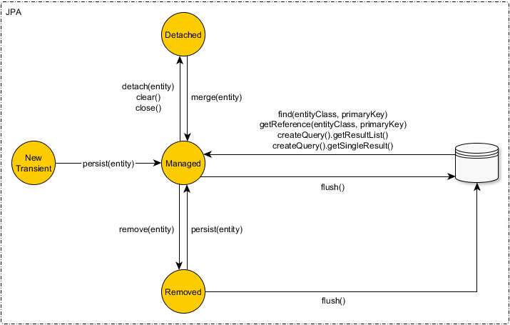
Entity States
Transient State
Persistent/Managed State
Detached State
Removed State

Slide 27
Transient State
When an entity object is initially created, it’s state is New or Transient. In this state, the object is not yet associated with an EntityManager and has no representation in the database.
Objects instantiated using the new operator are not immediately persistent (Managed). Their state is “Transient”. Which means they are not associated with any database table row, and so their state is lost as soon as they are reference removed.
Transient state instances state is lost and garbage-collected as soon as they are no longer referenced.

Slide 28
Example Transient State

Slide 29
Persistent/Managed State
An entity object is in a persistent or managed state when it is associated with a persistence context.
In this state, the entity is being actively managed by the JPA provider, and changes made to the object are automatically synchronized with the database when the persistence context is flushed (typically at the end of a transaction).

Slide 30
Example Persistent State

Slide 31
Detached State
The state, Detached, represents entity objects that have been disconnected from the EntityManager.
An entity object is in a detached state when it was previously associated with a persistence context (i.e., it was in a persistent or managed state), but it is no longer actively managed by that persistence context.
There are several scenarios where an entity can become detached:
Closing the Entity Manager: When the entity manager used to manage the entity is closed, all entities associated with that entity manager become detached.
Explicit Detach: You can explicitly detach an entity using the em.detach(entity) method. This is useful when you want to stop tracking an entity without closing the entire entity manager.
End of Transaction: In container-managed environments like Java EE, an entity often becomes detached at the end of a transaction.
Merging: After calling em.merge(entity), the returned entity is a managed copy of the detached entity, and the original entity becomes detached

Slide 32
Example Detached State

Slide 33
Removed (Deleted) State:
An entity is in the Removed or Deleted state when it has been marked for deletion from the database.
This typically happens when you call the EntityManager.remove(entity) method to instruct JPA to delete the corresponding record from the database during the next transaction commit.

Slide 34
Example Removed State

Slide 35
Q&A

