Slide 1
Unlocking the Power of Microservices: A Journey to Scalability and Flexibility
Bharath Ashok

Slide 2
Microservices

Slide 3
What Is Microservices
Small autonomous services that work together - Sam Newman
In short, the microservice architectural style is an approach to developing a single application as a suite of small services, each running in its own process and communicating with lightweight mechanisms, oken an HTTP resource API....
These services are built around business capabilities and independently deployable by fully automated deployment machinery...
There is a bare minimum of centralized management of these services, which may be written in diﬀerent programming languages and use diﬀerent data storage technologies - James Lewis and Martin Fowler

Slide 4
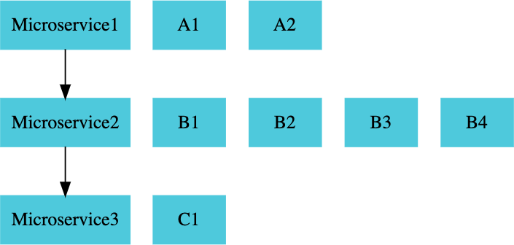
Microservices
REST
Small Well Chosen Deployable Units
Cloud Enabled

Slide 5
Microservices Challenges

Slide 6
Microservices Challenges
Bounded Context Configuration Management
Dynamic Scale Up and Scale Down Visibility
Pack of Cards
Zero Downtime Deployments

Slide 7
Microservice - Solutions

Slide 8
Solutions
Spring Cloud Umbrella Projects
Centralized Configuration Management (Spring Cloud Config Server)
Location Transparency - Naming Server (Eureka)
Load Distribution (Ribbon, Spring Cloud Load Balancer)
Visibility and Monitoring (Zipkin)
API Gateway (Zuul, Spring Cloud Gateway)
Fault Tolerance (Hystrix, Resilience4j)
Docker: Language Neutral, Cloud Neutral deployable units
Kubernetes: Orchestrate Thousands of Microservices

Slide 9
Centralized Configuration

Slide 10
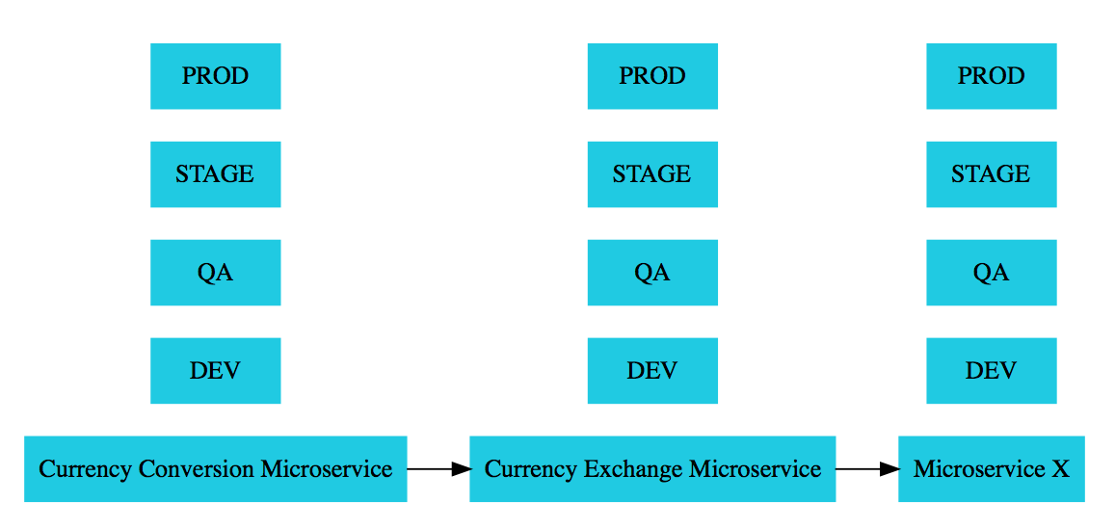
Application Environments

Slide 11
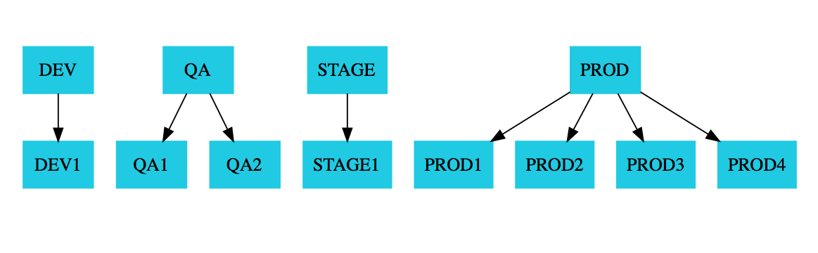
Application Environments

Slide 12
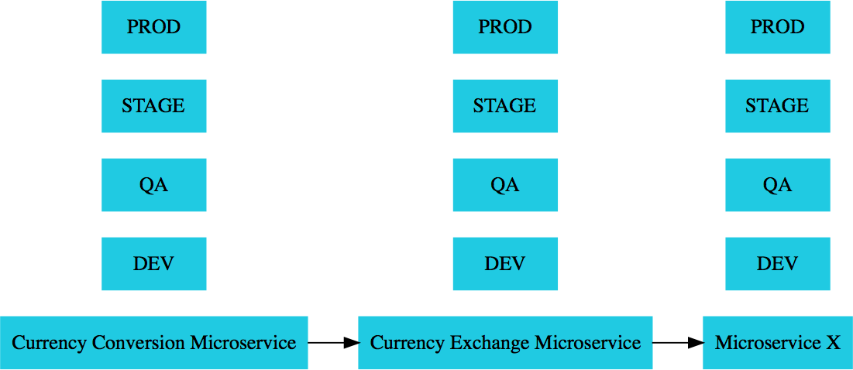
Need For Centralized Configuration
Lot of configuration:
External Services
Database Queue
Typical Application Configuration
Configuration variations:
1000s of Microservices
Multiple Environments
Multiple instances in each Environment
How do you manage all this configuration?

Slide 13
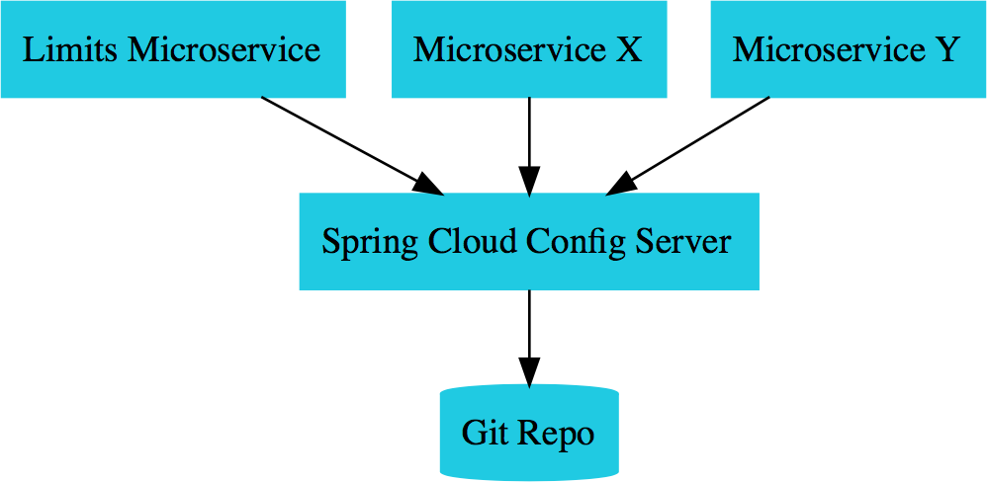
Spring Cloud Config Server

Slide 14
Naming Server or Service Registry

Slide 15
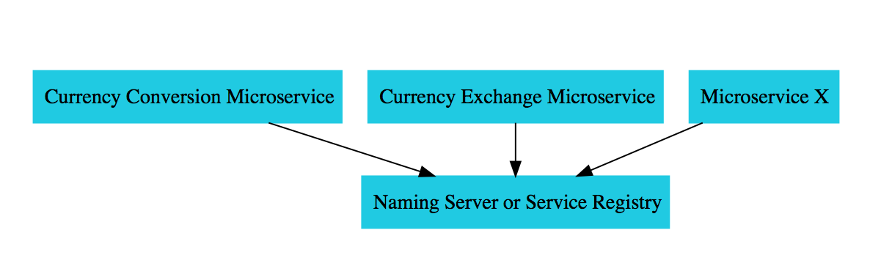
Spring Cloud Eureka Server

Slide 16
Load Balancing

Slide 17
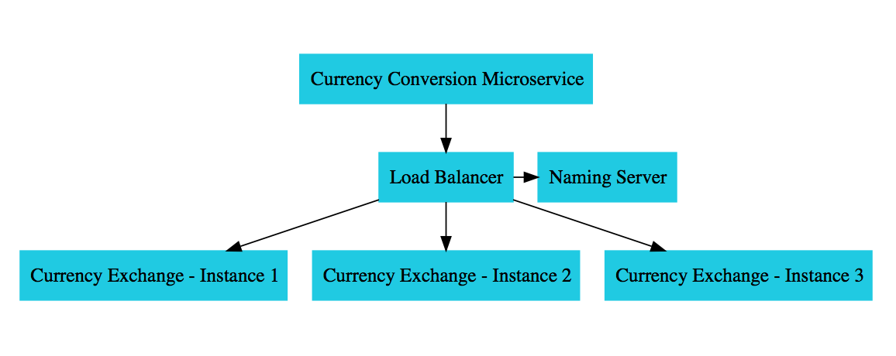
Feign and Ribbon Load Balancing

Slide 18
Distributed Tracing

Slide 19
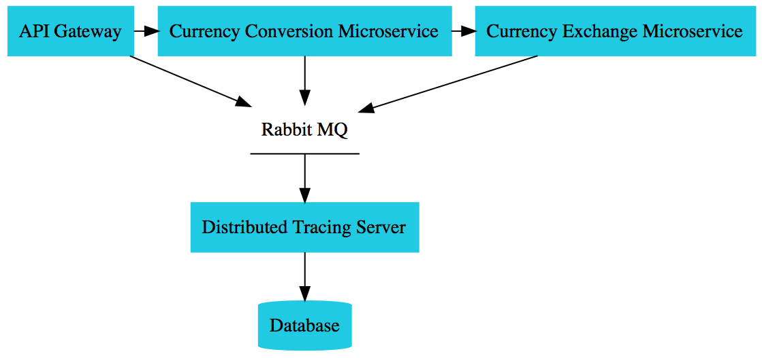
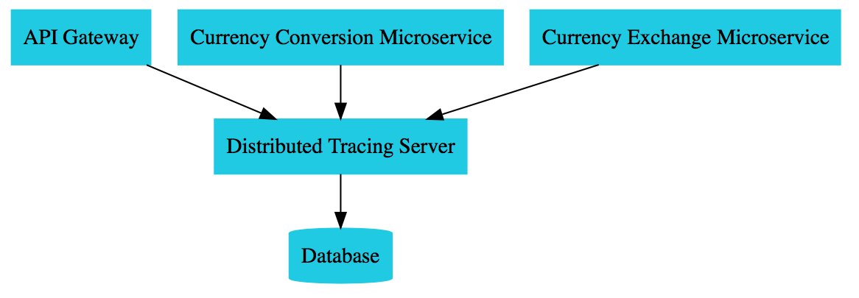
Distributed Tracing - Asynchronous

Slide 20
Fault Tolerance

Slide 21
Circuit Breaker Pattern
What if one of the services is down or is slow?
Impacts entire chain!
Questions:
Can we return a fallback response if a service is down?
Can we implement a Circuit Breaker pattern to reduce load? Can we retry requests in case of temporary failures?
Can we implement rate limiting?
Solution: Circuit Breaker Framework - Resilience4j

Slide 22
Microservices Solutions Implementation

Slide 23








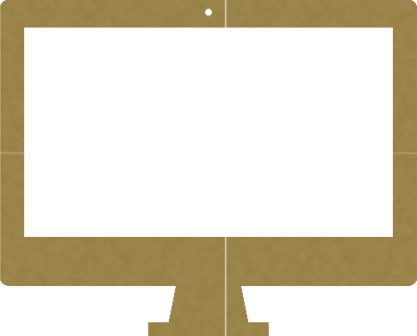












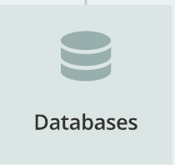
Microservices Architecture using Spring boot and Spring Cloud
Employee
Service
React App
API
Gateway
Department Service
Organization Service

Slide 24









Create Two Microservices
Microservice 1
Microservice 2
Employee Service
Department Service

Slide 25










Synchronous Communication
The client sends a request and waits for a response from the service.
The important point here is that the protocol (HTTP/HTTPS) is synchronous and the client code can only continue its task when it receives the HTTP server response.
RestTemplate, WebClient and Spring Cloud Open Feign library
Microservice 2
Microservice 1
Http Request
Employee Service
Department Service
Http Response

Slide 26








Asynchronous Communication
The client sends a request and does not wait for a response from the service.
The client will continue executing it’s task - It don’t wait for the response from the service.
RabbitMQ or Apache Kafka
Message Broker
Microservice 2
Microservice 1
Message
Message
Employee Service
Queue
Department Service

Slide 27






Microservices Communication 3 Different Ways
RestTemplate _{Queue}
WebClient
Spring Cloud OpenFeign
Microservice 2
Microservice 1
Employee Service
Department Service

Slide 28
Microservices Communication using RestTemplate
Make a REST API call from Employee-Service to Department-Service
Microservice 1
Microservice 2
Http Request
Employee Service
Department Service
Http Response

Slide 29
Microservices Communication Hands-On

Slide 30
Development Steps
Add departmentCode field in Employee JPA Entity
Create DepartmentDto class
Configure RestTemplate as Spring Bean
Inject and use RestTemplate to make REST API call in EmployeeServiceImpl class

Slide 31
RestTemplate Is In Maintenance Mode
As of 5.0, the RestTemplate class is in maintenance mode and soon will be deprecated.
So the Spring team recommended using org.springframework.web.reactive.client.WebClient that has a modern API and supports sync, async, and streaming scenarios.

Slide 32
Microservices Communication Via WebClient
Make a REST API call from Employee-Service to Department-Service
Microservice 1
Microservice 2
Http Request
Employee Service
Department Service
Http Response

Slide 33
Development Steps
Add Spring WebFlux Dependency
Configure WebClient as Spring Bean
Inject and Use WebClient to Call the REST API
Test using Postman Client

Slide 34
Microservices Communication Via Spring Cloud OpenFeign
Make a REST API call from Employee-Service to Department-Service
Microservice 1
Microservice 2
Http Request
Employee Service
Department Service
Http Response

Slide 35
Development Steps
Add Spring cloud open feign Maven dependency to Employee-Service
Enable Feign Client using @EnableFeignClients
Create Feign API Client
Change the getEmployeeById method to use APIClient
Test using Postman Client

Slide 36
Eureka Service Registry And Discovery

Slide 37
Service Registry and Discovery
In the microservices projects, Service Registry and Discovery play an important role because we most likely run multiple instances of services and we need a mechanism to call other services without hardcoding their hostnames or port numbers.
In addition to that, in Cloud environments service instances may come up and go down anytime. So we need some automatic service registration and discovery mechanism.
Spring Cloud addresses this problem by providing Spring Cloud Netflix Eureka project to create Service Registry and Discovery.

Slide 38










Spring Cloud Netflix Eureka Server
Spring Cloud Netflix Eruka Server
Employee Service
Register with
Service Registry
Department Service
Register with

Slide 39
Microservices Service Registry Hands-On

Slide 40
Development Steps
Create Spring boot project as Microservice (service-registry)
Add @EnableEurekaServer annotation
Disable Eureka Server as Eureka Client
Launch Eureka Server (Demo)
Registering Department-Service Microservice as Eureka Client
Run department-service Eureka Client (Demo)
Registering Employee-Service Microservice as Eureka Client
Run employee-service Eureka Client (Demo)
Multiple Instances of Department-Service

Slide 41
API Gateway

Slide 42
API Gateway
API Gateway provides a unified interface for a set of microservices so that clients no need to know about all the details of microservices internals.
API Gateway centralize cross-cutting concerns like security, monitoring, rate limiting etc
Spring Cloud provides Spring Cloud Gateway to create API Gateway.

Slide 43
Roles Of API Gateway
Request Routing
Load Balancing
Security

Slide 44



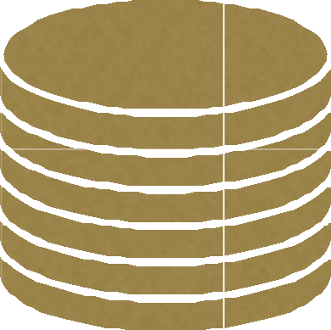








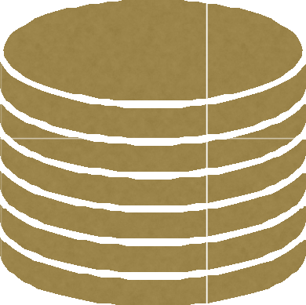


API Gateway
Spring Cloud Gateway
Employee Service
API
Gateway
Client
Eureka Server
Department Service

Slide 45
API Gateway Hands-On

Slide 46
Development Steps
Create Spring boot project as Microservice (api-gateway)
Register API-Gateway as Eureka Client to Eureka Server (Service Registry)
Configuring API Gateway Routes and Test using Postman Client

Slide 47
Spring Cloud Config Server

Slide 48






Spring Cloud Config Server
Employee Service
Register as config client
Spring Cloud Config Server
Department Service
Register as config client

Slide 49
What we will build?
Create a Spring Cloud Config Server which provides the configuration values for all of our microservices.
Use git as a backend to store the configuration parameters.
Next, configure the location of Spring Cloud Config server in our microservices.
Load all the properties when we start the application.
Whenever we update the properties we can invoke /refresh REST endpoint in our microservice
So that it will reload the configuration changes without requiring to restart the application.

Slide 50
Development Steps
Create Spring boot project as Microservice (config-server)
Register Config-Server as Eureka Client
Set up Git Location for Config Server
Refactor Department-Service to use Config Server
Refactor Employee-Service to use Config Server
Refresh Use case

Slide 51
Refresh Use case
Whenever we change configuration file then we don’t have to restart the microservice and it’s instances
We need to call spring boot actuator /refresh API to reload the updated values from config server

Slide 52
Problem using Spring Cloud Config Server
In order to reload the config changes in Config Client applications (department-service and employee-service),
We need to trigger /refresh endpoint manually. This is not practical and viable if you have large number of applications.
Spring Cloud Bus module provides a solution.
Spring Cloud Bus module can be used to link multiple applications with a message broker and we can broadcast configuration changes.

Slide 53
Spring Cloud Bus

Slide 54








Spring Cloud Bus
RabbitMQ
Register as config client
Employee Service
Subscribe
Message Broker
Spring Cloud Config Server
Department Service
Subscribe
Register as config client

Slide 55
Development Steps
Add spring-cloud-starter-bus-amqp dependency to department- service and employee-service
Install RabbitMQ using Docker
RabbitMQ configuration in application.properties of department- service and employee-service
Create Simple REST API in employee-service
Change department-service and employee-service properties file and call /busrefresh

Slide 56
Distributed Tracing

Slide 57







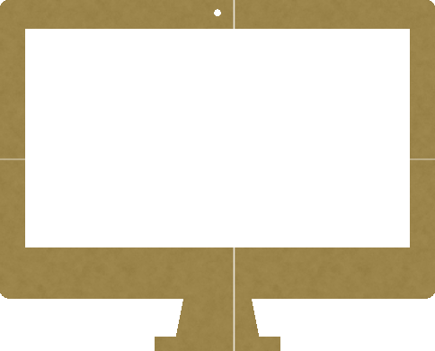





Distributed Tracing
Spring Cloud Slueth
Spring Cloud Slueth
Spring Cloud Slueth
Department Service
API
Gateway
Employee Service
Client
Span id
Span id
Span id
Trace -> trace id

Slide 58



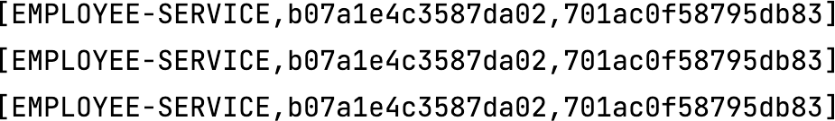
Distributed Tracing with Spring Cloud Sleuth and Zipkin
We use Spring Cloud Sleuth for distributed tracing
We use Zipkin to visualize trace information through UI
App name Trace id Span id

Slide 59
Development Steps
Implementing Distributed Tracing using Spring Cloud Sleuth Library
Using Zipkin to Visualize Trace Information through UI

Slide 60
Circuit Breaker Pattern

Slide 61
Development Steps
Add dependencies
Using @CircuitBreaker annotation to a method (it is calling to external service)
Fallback method implementation
Add Circuit Breaker configuration in application.properties file
Restart employee-service and demo

Slide 62



Retry Pattern Implementation with Resilience4j
Department Service
API
Gateway
Employee Service
Client
Retry Pattern

Slide 63
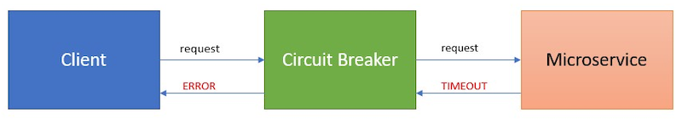
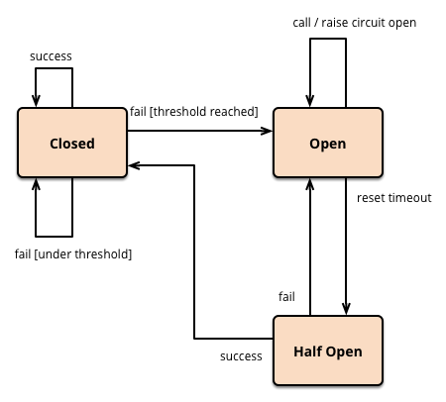
Circuit Breaker States

Slide 64
Development Steps
Using @Retry annotation to a method (it is calling to external service)
Fallback method implementation
Add Retry configuration in application.properties file
Restart employee-service and demo

Slide 65
Ports
App name: API-GATEWAY - Port: 9191
App name: DEPARTMENT-SERVICE - Ports: 8080, 8082
App name: EMPLOYEE-SERVICE - Port: 8081 App name: CONFIG-SERVER - Port: 8888 App name: SERVICE-REGISTRY - Port: 8761
Zipkin Server: 9411

Slide 66
























Microservices
Microservice 1
Microservice 2
Microservice 3
Employee Service
Department Service
Organization Service
MySQL DB
MySQL DB
MySQL DB

Slide 67
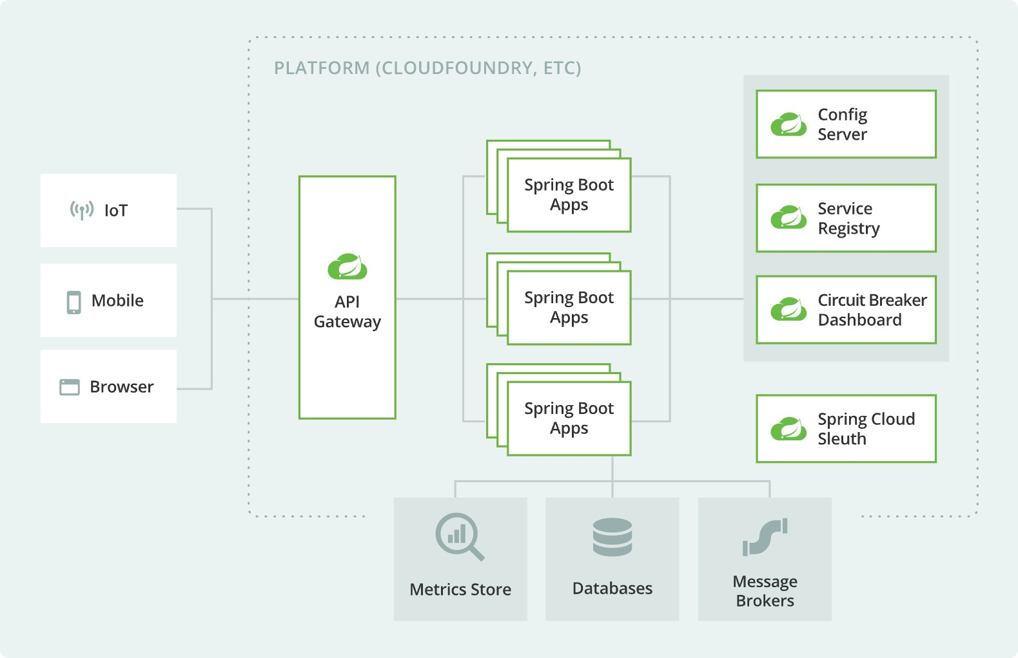

Reference/Credit : Microservices Architecture from Spring official website

Slide 68
Q n A

