Slide 1
Spring's Secrets Unveiled: Mastering the Art of Spring & Spring Boot
Bharath Ashok

Slide 2
Agenda
Spring Architecture
Dependency Injection and IoC (Inversion of Control)
Spring Data Access/Integration
Spring Web
Spring Boot
Spring Cloud for Microservices
Spring Security
Spring Data

Slide 3
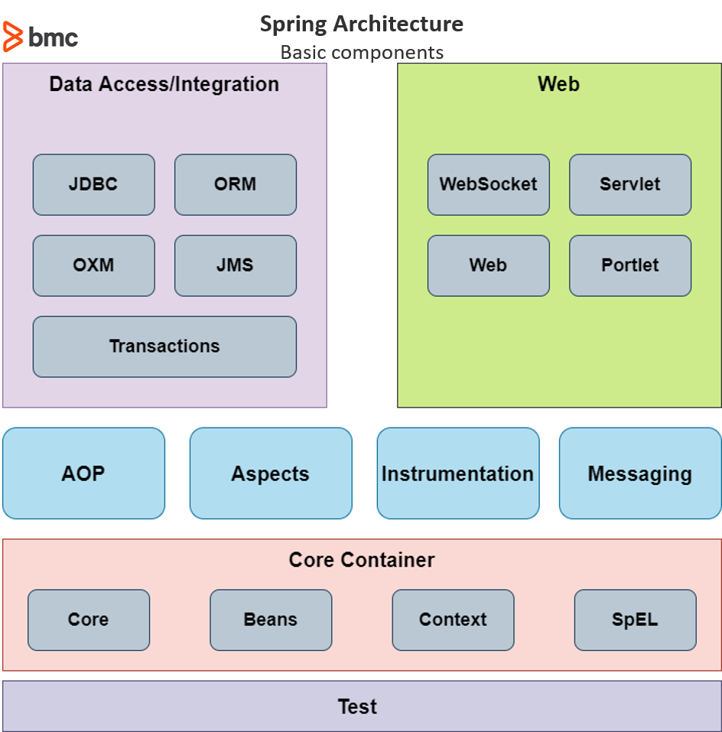
Why Spring Framework
We can build a variety of applications using Java, Spring and Spring Boot:
Web
REST API
Full Stack
Microservices
Irrespective of the application we are building:
Spring framework provides all the core features
Modularity and Loose Coupling
Dependency Injection (DI)
Aspect-Oriented Programming (AOP)
Enterprise Integration
Data Access
Transaction Management
Web Development
Testing

Slide 4
Core Features of Spring Framework
Loose Coupling
IOC Container
Application Context
Component Scan
Dependency Injection
Spring Beans
Auto Wiring

Slide 5
Tight Coupling and Loose Coupling Hands-on

Slide 6
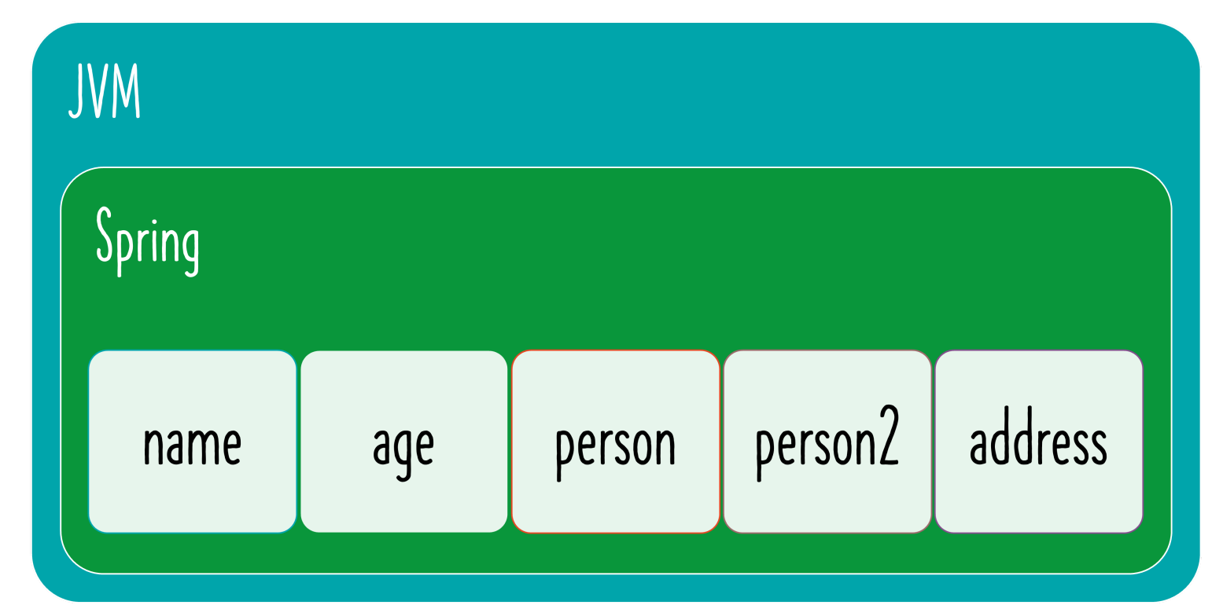
Spring Beans

Slide 7
Creating Spring Beans Hands-On

Slide 8
Understanding Core Components
Spring Container vs Spring Context vs IOC Container vs Application Context
Java Bean vs Spring Bean
How can I list all beans managed by Spring Framework?
What if multiple matching beans are available?
Spring is managing objects and performing auto-wiring.
BUT aren't we writing the code to create objects?
How do we get Spring to create objects for us?
Is Spring really making things easy?

Slide 9
Spring Container
Spring Container: Manages Spring beans & their lifecycle
Bean Factory: Basic Spring Container
Application Context: Advanced Spring Container with enterprise-specific features
Easy to use in web applications
Easy internationalization
Easy integration with Spring AOP
Which one to use
Most enterprise applications use Application Context Recommended for web applications, web services - REST API and microservices

Slide 10
Java Bean vs POJO vs Spring Bean
Java Bean: Classes adhering to 3 constraints
Have public default (no argument) constructors
Allow access to their properties using getter and setter methods
Implement java.io.Serializable
POJO: Plain Old Java Object
A POJO is a class in Java that doesn't have to adhere to any specific Java EE (Enterprise Edition) or framework conventions.
A POJO is simply a Java class that encapsulates data and behavior
No constraints
Any Java Object is a POJO!
Spring Bean: Any Java object that is managed by Spring
Spring uses IOC Container (Bean Factory or Application Context) to manage these objects

Slide 11
POJO vs Java Bean Vs Spring Bean Hands-On

Slide 12
Dependency Injection Types
Constructor-based : Dependencies are set by creating the Bean using its Constructor
Setter-based : Dependencies are set by calling setter methods on your beans
Field: No setter or constructor. Dependency is injected using reflection.
Which one should you use: Spring team recommends Constructor-based injection as dependencies are automatically set when an object is created!

Slide 13
Dependency Injection Hands-On

Slide 14
Pizza App With Dependency Injection

Slide 15
Basic Spring Annotations

Slide 16
Basic Annotations
@Component
@Primary
@Configuration
@Qualifier
@Autowired
@ComponentScan

Slide 17
Auto-Wring In Spring

Slide 18
Auto-wiring
Auto wiring by Type
Auto wiring by Name
Auto wiring by Constructor
Auto wiring by Qualifier

Slide 19
Auto-wiring In Depth
When a dependency needs to be @Autowired, IOC container looks for matches/candidates (by name and/or type)
1: If no match is found Result: Exception is thrown You need to help Spring Framework find a match Typical problems: @Component (or ..) missing Class not in component scan
2: One match is found Result: Autowiring is successful
3: Multiple candidates Result: Exception is thrown You need to help Spring Framework choose between the candidates
1: Mark one of them as @Primary If only one of the candidates is marked @Primary, it becomes the auto-wired value
2: Use @Qualifier - Example: @Qualifier("myQualifierName") Provides more specific control Can be used on a class, member variables and method parameters

Slide 20
Auto-Wring Hands-On

Slide 21
IOC vs DI

Slide 22
Spring IoC
Spring IoC (Inversion of Control) Container is the core of Spring Framework.
It creates the objects, manages their entire life cycle.
The Container uses Dependency Injection(DI) to manage the components that make up the application.
It gets the information about the objects from a configuration file(XML) or Java Code or Java Annotations and Java POJO class.
These objects are called Spring Beans.
Since the Controlling of Java objects and their lifecycle is not done by the developers, hence the name Inversion Of Control.
The followings are some of the main features of Spring IoC,
Creating Object for us
Managing our objects
Helping our application to be configurable
Managing dependencies

Slide 23
Spring Dependency Injection
Dependency Injection is the main functionality provided by Spring IOC(Inversion of Control).
The Spring-Core module is responsible for injecting dependencies through either Constructor or Setter methods.
The design principle of Inversion of Control emphasizes keeping the Java classes independent of each other and the container frees them from object creation and maintenance.
Dependency Injection in Spring also ensures loose coupling between the classes.
There are two types of Spring Dependency Injection.
Setter Dependency Injection (SDI)
Constructor Dependency Injection (CDI)

Slide 24
Spring IoC vs Dependency Injection
Spring IoC (Inversion of Control) | Spring Dependency Injection
Spring IoC Container is the core of Spring Framework. It creates the objects and manages their entire life cycle. | Spring Dependency injection is a way to inject the dependency of a framework component by the following ways of spring: Constructor Injection and Setter Injection
Spring helps in creating objects, managing objects, configurations, etc. because of IoC (Inversion of Control). | Spring framework helps in the creation of loosely-coupled applications because of Dependency Injection.
Spring IoC is achieved through Dependency Injection. | Dependency Injection is the method of providing the dependencies And Inversion of Control is the end result of Dependency Injection.
IoC is a design principle where the control flow of the program is inverted. | Dependency Injection is one of the subtypes of the IOC principle.

Slide 25
Lazy vs Eager Initialization

Slide 26
Lazy Initialization of Spring Beans
Default initialization for Spring Beans: Eager
Eager initialization is recommended:
Errors in the configuration are discovered immediately at application startup
However, we can configure beans to be lazily initialized using @lazy annotation:
NOT recommended (AND) Not frequently used
Lazy annotation:
Can be used almost everywhere @Component and @Bean are used
Lazy-resolution proxy will be injected instead of actual dependency
Can be used on Configuration (@Configuration) class:
All @Bean methods within the @Configuration will be lazily initialized

Slide 27
Spring Bean Scopes

Slide 28
Spring Bean Scopes
Spring Beans are defined to be used in a specific scope:
Singleton: One object instance per Spring IoC container
Prototype: Possibly many object instances per Spring IoC container
Scopes applicable ONLY for web-aware Spring ApplicationContext
Request: One object instance per single HTTP request
Session: One object instance per user HTTP Session
Application: One object instance per web application runtime
Websocket: One object instance per WebSocket instance
Java Singleton (GOF) vs Spring Singleton
Spring Singleton: One object instance per Spring IoC container
Java Singleton (GOF): One object instance per JVM

Slide 29
Singleton vs Prototype Bean Scopes
Singleton | Prototype
Only one instance is created for a single bean definition per Spring IoC container | A new instance is created for a single bean definition every time a request is made for that bean.
Same object is shared for each request made for that bean. i.e. The same object is returned each time it is injected. | For each new request a new instance is created. i.e. A new object is created each time it is injected.
By default scope of a bean is singleton. So we don’t need to declare a been as singleton explicitly. | By default scope is not prototype so you have to declare the scope of a been as prototype explicitly

Slide 30
Spring Bean Scopes Hands-On

Slide 31
Annotations vs XML Configuration Hands-On

Slide 32
Stereotype Annotations

Slide 33
Spring Stereotype Annotations
@Component - Generic annotation applicable for any class
Base for all Spring Stereotype Annotations
Specializations of @Component:
@Service - Indicates that an annotated class has business logic
@Controller - Indicates that an annotated class is a "Controller" (e.g. a web controller) Used to define controllers in your web applications and REST API
@Repository - Indicates that an annotated class is used to retrieve and/or manipulate data in a database

Slide 34
Quick Recap Of Important Spring Annotations

Slide 35
Important Spring Annotations
Annotation | Description
@Configuration | Indicates that a class declares one or more @Bean methods and may be processed by the Spring container to generate bean definitions
@ComponentScan | Define specific packages to scan for components. If specific packages are not defined, scanning will occur from the package of the class that declares this annotation
@Bean | Indicates that a method produces a bean to be managed by the Spring container
@Component | Indicates that an annotated class is a "component"
@Service | Specialization of @Component indicating that an annotated class has business logic
@Controller | Specialization of @Component indicating that an annotated class is a "Controller" (e.g. a web controller). Used to define controllers in your web applications and REST API
@Repository | Specialization of @Component indicating that an annotated class is used to retrieve and/or manipulate data in a database

Slide 36
Important Spring Annotations
Annotation | Description
@Primary | Indicates that a bean should be given preference when multiple candidates are qualified to autowire a singlevalued dependency.
@Qualifier | Used on a field or parameter as a qualifier for candidate beans when autowiring.
@Lazy | Indicates that a bean has to be lazily initialized. Absence of @Lazy annotation will lead to eager initialization.
@Scope (value = ConfigurableBeanFactory.SCOPE_PROTOTYPE) | Defines a bean to be a prototype - a new instance will be created every time you refer to the bean. Default scope is singleton - one instance per IOC container.
@PreDestroy | Identifies the method that will receive the callback notification to signal that the instance is in the process of being removed by the container. Typically used to release resources that it has been holding.
@PostConstruct | Identifies the method that will be executed after dependency injection is done to perform any initialization

Slide 37
Quick Recap of Important Spring Concepts

Slide 38
Important Spring Concepts
Concept | Description
Dependency Injection | Identify beans, their dependencies and wire them together (provides IOC - Inversion of Control)
Constr. Injection | Dependencies are set by creating the Bean using its Constructor
Setter Injection | Dependencies are set by calling setter methods on your beans
Field Injection | No setter or constructor. Dependency is injected using reflection.
IOC Container | Spring IOC Context that manages Spring beans & their lifecycle
Bean Factory | Basic Spring IOC Container
Application Context | Advanced Spring IOC Container with enterprise-specific features - Easy to use in web applications with internationalization features and good integration with Spring AOP
Spring Beans | Objects managed by Spring

Slide 39
Spring Big Picture - Framework, Modules and Projects

Slide 40
Spring Hierarchy
Spring Core : IOC Container, Dependency Injection, Auto Wiring, ..
These are the fundamental building blocks to:
Building web applications
Creating REST API
Implementing Authentication and Authorization
Talking to a Database
Integrating with other systems
Writing great unit tests
Spring Big Picture:
Spring Framework
Spring Modules
Spring Projects

Slide 41
Spring Framework and Modules
Spring Framework contains multiple Spring Modules:
Fundamental Features:
Core: IOC Container, Dependency Injection, Auto Wiring, ..
Web: Spring MVC etc (Web applications, REST API)
Web Reactive: Spring WebFlux etc
Data Access: JDBC, JPA etc
Integration: JMS etc
Testing: Mock Objects, Spring MVC Test etc

Slide 42
Spring Projects
Application architectures evolve continuously
Web > REST API > Micro services > Cloud
Spring evolves through Spring Projects:
First Project: Spring Framework
Spring Security: Secure your web application or REST API or microservice
Spring Data: Integrate the same way with different types of databases : NoSQL and Relational
Spring Integration: Address challenges with integration with other applications
Spring Boot: Popular framework to build microservices
Spring Cloud: Build cloud native applications

Slide 43
Spring Ecosystem
Hierarchy: Spring Projects > Spring Framework > Spring Modules
Why is Spring Ecosystem popular?
Loose Coupling: Spring manages creation and wiring of beans and dependencies
Makes it easy to build loosely coupled applications
Make writing unit tests easy! (Spring Unit Testing)
Reduced Boilerplate Code: Focus on Business Logic
Example: No need for exception handling in each method! All Checked Exceptions are converted to Runtime or Unchecked Exceptions
Architectural Flexibility: Spring Modules and Projects
We can pick and choose which ones to use (We DON'T need to use all of them!)
Evolution with Time: Microservices and Cloud Spring Boot, Spring Cloud etc!

Slide 44
Spring Data Access Hands-On

Slide 45
Spring Data Access Hands-On
Spring Jdbc without Jdbc Template Example
Spring Jdbc with Jdbc Template
Spring Boot with Jdbc Template CRUD Example
Spring Boot with Jdbc and Rest Controller

Slide 46
Spring Data Access With Hibernate Hands-On

Slide 47
Spring Data Access With Hibernate
Developer should manually handle below:
Dependencies Management
Configuration Management
Beans Configuration
Queries and Method Implementation

Slide 48
Spring Data JPA Hands-On

Slide 49
Spring Data JPA Auto-Configuration
Spring Data JPA automatically Manages below:
Dependencies Management
Configuration Management
Beans Configuration
Queries and Method Implementation

Slide 50
Steps to learn Spring JDBC, JPA and Spring Data JPA
01: Create a Spring Boot Project with H2 in Mem DB
02: Create PRODUCT table
03: Use Spring JDBC to play with PRODUCT table
04: Use JPA and Hibernate to play with PRODUCT table
05: Use Spring Data JPA to play with PRODUCT table

Slide 51
JDBC to Spring JDBC to JPA to Spring Data JPA
JDBC
Write a lot of SQL queries! (SELECT from PRODUCT where id=?)
And write a lot of Java code
Spring JDBC
Write a lot of SQL queries (SELECT from PRODUCT where id=?)
BUT lesser Java code
JPA
Do NOT worry about queries
Just Map Entities to Tables!
Spring Data JPA
Let's make JPA even more simple!
I will take care of everything!

Slide 52
World Before Spring Boot!

Slide 53
World Before Spring Boot!
Before Spring Boot, developers working on Spring applications typically followed a series of manual steps to set up and configure their projects.
Here are some of the common steps that developers performed before Spring Boot:
Project Setup
Dependency Management
Manually specify and manage dependencies in a build tool's configuration file (e.g., pom.xml for Maven).
Spring Configuration
Create XML configuration files (e.g., applicationContext.xml) to define Spring beans and configure components, aspect weaving, and other Spring-related settings.
Manually wire beans together by specifying <bean> elements in XML configuration files or using Java-based configuration classes.
Configure data source connections, transaction management, and other persistence-related settings.
Web Application Setup (if applicable)
Set up a servlet container (e.g., Tomcat, Jetty) separately from the application.
Create XML configuration files (e.g., web.xml) for configuring servlets, filters, and listeners.
Define Spring MVC controllers, views, and routing mappings manually using XML.

Slide 54
World Before Spring Boot!
Exception Handling
Write custom exception handling code using try-catch blocks for error handling and logging.
Logging Configuration
Manually configure logging frameworks like Log4j or Java Logging (java.util.logging) using XML or property files.
Set log levels and log file locations.
Database Setup and Migration
Manually create and manage database schemas and tables.
Handle database migrations and updates manually, often using SQL scripts.
Deployment:
Package the application as a WAR (Web Application Archive) or JAR (Java Archive) file.
Deploy the application to a servlet container or application server manually.
Configure server-specific settings and context paths.

Slide 55
World Before Spring Boot - 1 - Dependency Management
Setting up Spring Projects before Spring Boot was NOT easy!
We needed to configure a lot of things before we have a production-ready application.
Manage frameworks and versions
REST API : Spring framework, Spring MVC framework, JSON binding framework, ..
Unit Tests: Spring Test, Mockito, JUnit, ...
<dependency> <groupId>org.springframework</groupId> <artifactId>spring-webmvc</artifactId> <version>6.2.2.RELEASE</version> </dependency> <dependency> <groupId>com.fasterxml.jackson.core</groupId> <artifactId>jackson-databind</artifactId> <version>2.13.3</version> </dependency> <dependency> <groupId>log4j</groupId> <artifactId>log4j</artifactId> <version>1.2.17</version> </dependency>

Slide 56
World Before Spring Boot - 2 - web.xml
Example: Configure DispatcherServlet for Spring MVC
<servlet>
<servlet-name>dispatcher</servlet-name>
<servlet-class>org.springframework.web.servlet.DispatcherServlet</servlet-class>
<init-param>
<param-name>contextConfigLocation</param-name>
<param-value>/WEB-INF/todo-servlet.xml</param-value>
</init-param>
<load-on-startup>1</load-on-startup>
</servlet>
<servlet-mapping>
<servlet-name>dispatcher</servlet-name>
<url-pattern>/*</url-pattern>
</servlet-mapping>

Slide 57
World Before Spring Boot - 3 - Spring Configuration
Define your Spring Configuration
Component Scan
View Resolver
<context:component-scan base-package=“com.bharath.learning" />
<bean class="org.springframework.web.servlet.view.InternalResourceViewResolver">
<property name="prefix">
<value>/WEB-INF/views/</value>
</property>
<property name="suffix">
<value>.jsp</value>
</property>
</bean>

Slide 58
World Before Spring Boot - 4 - NFRs
Logging
Error Handling
Monitoring
<plugin>
<groupId>org.apache.tomcat.maven</groupId>
<artifactId>tomcat7-maven-plugin</artifactId>
<version>2.2</version>
<configuration>
<path>/</path>
<contextReloadable>true</contextReloadable>
</configuration>
</plugin>
<dependency>
<groupId>log4j</groupId>
<artifactId>log4j</artifactId>
<version>1.2.17</version>
</dependency>

Slide 59
World Before Spring Boot!
Setting up Spring Projects before Spring Boot was NOT easy!
1: Dependency Management (pom.xml)
2: Define Web App Configuration (web.xml)
3: Manage Spring Beans (context.xml)
4: Implement Non Functional Requirements (NFRs)
AND repeat this for every new project!
Typically takes a few days to setup for each project (and countless hours to maintain)

Slide 60
Spring Boot

Slide 61
Features Of Spring Boot
Power of Spring Boot
Spring Boot Hands-On
Spring Boot Starter Projects
Spring Boot Auto Configuration
@SpringBootApplication
Build Faster with Spring Boot DevTools
Spring Boot Embedded Servers

Slide 62
Power of Spring Boot
Help you build PRODUCTION-READY apps QUICKLY
Build QUICKLY
Spring Initializr
Spring Boot Starter Projects
Spring Boot Auto Configuration
Spring Boot DevTools
Be PRODUCTION-READY
Logging
Different Configuration for Different Environments
Profiles
ConfigurationProperties
Monitoring (Spring Boot Actuator)

Slide 63
Spring Boot Hands-On

Slide 64
Simple REST API with Spring Boot
1: Create a Spring Boot Project
2: Build a simple REST API using Spring Boot

Slide 65
Spring Boot Starter Projects
I need a lot of frameworks to build application features:
Build a REST API: I need Spring, Spring MVC, Tomcat, JSON conversion...
Write Unit Tests: I need Spring Test, JUnit, Mockito, ...
How can I group them and make it easy to build applications?
Starters: Convenient dependency descriptors for diff. features
Spring Boot provides variety of starter projects:
Web Application & REST API - Spring Boot Starter Web (spring-webmvc, springweb, spring-boot-starter-tomcat, spring-boot-starter-json)
Unit Tests - Spring Boot Starter Test
Talk to database using JPA - Spring Boot Starter Data JPA
Talk to database using JDBC - Spring Boot Starter JDBC
Secure your web application or REST API - Spring Boot Starter Security
(REMEMBER) Starters: Define all application dependencies

Slide 66
Spring Boot Auto Configuration
I need lot of configuration to build Spring app:
Component Scan, DispatcherServlet, Data Sources, JSON Conversion, ...
How can I simplify this?
Auto Configuration: Automated configuration for your app
Decided based on:
Which frameworks are in the Class Path?
What is the existing configuration (Annotations etc)?
Example: Spring Boot Starter Web
Dispatcher Servlet (DispatcherServletAutoConfiguration)
Embedded Servlet Container - Tomcat is the default (EmbeddedWebServerFactoryCustomizerAutoConfiguration)
Default Error Pages (ErrorMvcAutoConfiguration)
Bean<->JSON Parsing (JacksonHttpMessageConvertersConfiguration)

Slide 67
@SpringBootApplication
@SpringBootApplication annotation is combination of below 3 annotations
1: @SpringBootConfiguration: Indicates that a class provides Spring Boot application @Configuration.
2: @EnableAutoConfiguration: Enable auto-configuration of the Spring Application Context,
3: @ComponentScan: Enable component scan (for current package, by default)

Slide 68
Build Faster with Spring Boot DevTools
Increase developer productivity
Why to restart the server manually for every code change?
Remember: For pom.xml dependency changes, we will need to restart server manually

Slide 69
Simplify Deployment with Spring Boot Embedded Servers
How do you deploy your application?
Step 1 : Install Java
Step 2 : Install Web/Application Server
Tomcat/WebSphere/WebLogic etc
Step 3 : Deploy the application WAR (Web ARchive)
This is the OLD WAR Approach
Complex to setup!
Embedded Server - Simpler alternative
Step 1 : Install Java
Step 2 : Run JAR file
Make JAR not WAR
Embedded Server Examples:
spring-boot-starter-tomcat
spring-boot-starter-jetty
spring-boot-starter-undertow

Slide 70
Spring Boot vs Spring MVC vs Spring
Spring Framework: Dependency Injection
@Component, @Autowired, Component Scan etc..
Just Dependency Injection is NOT sufficient (You need other frameworks to build apps)
Spring Modules and Spring Projects: Extend Spring Eco System
Provide good integration with other frameworks (Hibernate/JPA, JUnit & Mockito for Unit Testing)
Spring MVC (Spring Module): Simplify building Web apps and REST API
Building web applications with Struts was very complex
@Controller, @RestController, @RequestMapping("/products")
Spring Boot (Spring Project): Build PRODUCTION-READY apps QUICKLY
Starter Projects: Make it easy to build variety of applications
Auto configuration: Eliminate configuration to setup Spring, Spring MVC and other frameworks!
Enable non functional requirements (NFRs):
Actuator: Enables Advanced Monitoring of applications
Embedded Server: No need for separate application servers!
Logging and Error Handling
Profiles and ConfigurationProperties

Slide 71
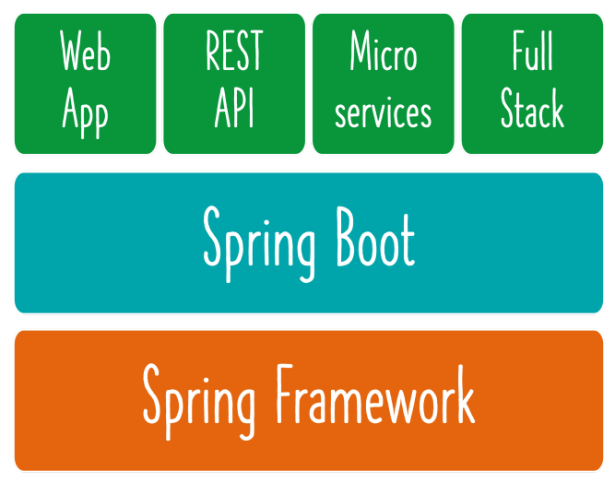
Spring and Spring Boot

Slide 72
Spring REST API Implementation

Slide 73
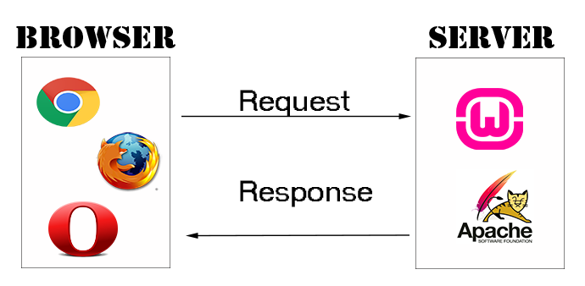
How does Web work?
1: Browser sends a request HttpRequest
2: Server handles the request Your Spring Boot Web Application
3: Server returns the response HttpResponse

Slide 74
HOW to build a great REST API?
Identifying Resources (/users, /users/{id}/posts)
Identifying Actions (GET, POST, PUT, DELETE, ...)
Defining Request and Response structures
Using appropriate Response Status (200, 404, 500, ..)
Understanding REST API Best Practices
Thinking from the perspective of your consumer
Validation, Internationalization - i18n, Exception Handling, HATEOAS, Versioning
Documentation, Content Negotiation and a lot more!

Slide 75
What's Happening in the Background?
Let's explore some Spring Boot Magic: Enable Debug Logging
WARNING: Log change frequently!
1: How are our requests handled?
DispatcherServlet - Front Controller Pattern
Mapping servlets: dispatcherServlet urls=[/]
Auto Configuration (DispatcherServletAutoConfiguration)
2: How does HelloWorldBean object get converted to JSON?
@ResponseBody + JacksonHttpMessageConverters
Auto Configuration (JacksonHttpMessageConvertersConfiguration)
3: Who is configuring error mapping?
Auto Configuration (ErrorMvcAutoConfiguration)
4: How are all jars available(Spring, Spring MVC, Jackson, Tomcat)?
Starter Projects - Spring Boot Starter Web (spring-webmvc, spring-web, springboot-starter-tomcat, spring-boot-starter-json)

Slide 76
Request Methods for REST API
GET - Retrieve details of a resource
POST - Create a new resource
PUT - Update an existing resource
PATCH - Update part of a resource
DELETE - Delete a resource

Slide 77
Response Status for REST API
Return the correct response status
Resource is not found => 404
Server exception => 500
Validation error => 400
Important Response Statuses
200 — Success
201 — Created
204 — No Content
401 — Unauthorized (when authorization fails)
400 — Bad Request (such as validation error)
404 — Resource Not Found
500 — Server Error

Slide 78
Social Media Application REST API
Build a REST API for a Social Media Application
Key Resources:
Users
Posts
Key Details:
User: id, name, birthDate
Post: id, description

Slide 79
Social Media Application - Resources & Methods
Users REST API
Retrieve all Users
GET /users
Create a User
POST /users
Retrieve one User
GET /users/{id} -> /users/1
Delete a User
DELETE /users/{id} -> /users/1
Posts REST API
Retrieve all posts for a User
GET /users/{id}/posts
Create a post for a User
POST /users/{id}/posts
Retrieve details of a post
GET /users/{id}/posts/{post_id}

Slide 80
Social Media Application Hands-On

Slide 81
Spring Security

Slide 82
Spring Dispatcher Servlet

Slide 83
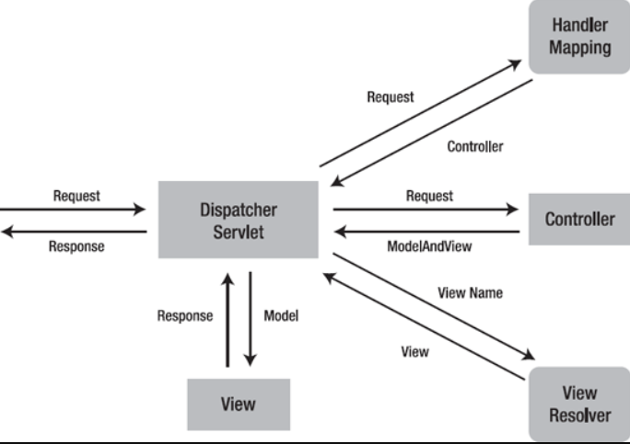
Dispatcher Servlet
DispatcherServlet acts as the Front Controller for Spring-based web applications.
Any request is going to come into our website, the front controller is going to stand in front and is going to accept all the requests
Once the front controller accepts that request then this is the job of the front controller that it will make a decision that who is the right controller to handle that request.

Slide 84
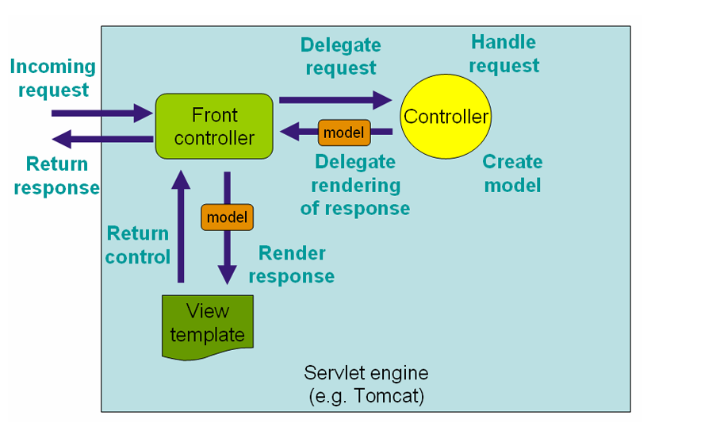
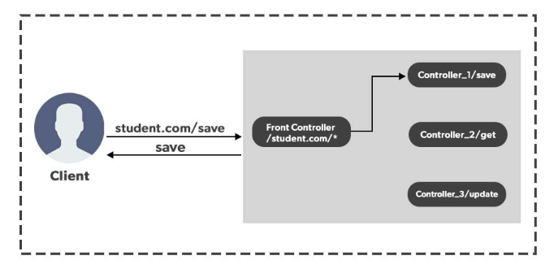
Spring Dispatcher Servlet

Slide 85
Spring Interview Questions

Slide 86
Spring Interview Questions
What is the Spring Framework, and why is it popular in Java development?
Explain the key components of the Spring Framework.
What are the core modules of the Spring Framework, and how do they interact?
What is Inversion of Control (IoC) in the context of the Spring Framework?
Explain the benefits of using Dependency Injection (DI) in Spring.
Compare Constructor Injection and Setter Injection in Spring. When would you use one over the other?
What is a Spring Bean, and how do you define it in a Spring application?
Differentiate between Singleton and Prototype scope for Spring Beans.
What is the purpose of the @Component annotation in Spring, and how is it related to Spring Beans?
Describe the two types of Spring containers and their roles in a Spring application.

Slide 87
Spring Interview Questions
What is the difference between the BeanFactory and ApplicationContext in Spring?
Explain the differences between a JavaBean, a POJO (Plain Old Java Object), and a Spring Bean. When is it appropriate to use each of these types in a Spring application?
What is auto-wiring in Spring, and how does it simplify bean configuration?
List and explain the different auto-wiring modes supported by Spring.
How does Spring achieve Inversion of Control (IoC) in its container?
Explain the role of the Spring IoC container in managing beans and their dependencies.
What are the various ways to configure Spring IoC, including XML configuration and Java-based configuration?

Slide 88
Spring Interview Questions
What is lazy initialization in the context of Spring beans, and why is it used?
How do you enable lazy initialization for a bean in Spring?
What are the advantages and potential drawbacks of using lazy initialization for beans in a Spring application?
Explain the different bean scopes available in Spring, and when would you use each one?
What is the default scope for Spring beans, and how does it differ from other scopes?
How do you define a custom bean scope in a Spring application?
Discuss the use cases for singleton and prototype scopes in Spring.
What are Spring stereotype annotations, and what is their purpose?
List and explain the commonly used stereotype annotations in Spring.
How does the @Component annotation differ from the @Service, @Repository, and @Controller annotations?

Slide 89
Spring Assignments

Slide 90
Spring Assignments
Assignment 1: Spring XML Configuration
Objective: Create a simple Spring application using XML-based configuration.
Instructions:
Set up a Maven or Gradle project with Spring Framework dependencies.
Define a Student class with properties like name and age.
Create an XML configuration file to define a Spring Bean for the Student class.
Create a Java class to load the Spring configuration using ClassPathXmlApplicationContext and retrieve the Student Bean.
Print the details of the Student Bean to the console.

Slide 91
Spring Assignments
Assignment 2: Annotation-Based Configuration
Objective: Build a Spring application using annotation-based configuration.
Instructions:
Set up a Maven or Gradle project with Spring Framework dependencies.
Define a Teacher class with properties like name and subject.
Use annotations like @Component, @Autowired, and @Configuration to configure Spring Beans for the Teacher class.
Create a Java class with a main method to create a Spring ApplicationContext and retrieve the Teacher Bean.
Print the details of the Teacher Bean to the console.

Slide 92
Spring Assignments
Assignment 3: Dependency Injection
Objective: Implement Dependency Injection in a Spring application.
Instructions:
Set up a Maven or Gradle project with Spring Framework dependencies.
Create a Course class with properties like name and duration.
Define two different types of Teacher classes with different specializations.
Use constructor injection to inject the appropriate Teacher into the Course class.
Configure the Spring Beans and injections either through XML or annotations.
Create a Java class to load the Spring configuration and retrieve the Course Bean.
Print the details of the Course Bean to the console.

Slide 93
Q & A

