Slide 1
MidJourney Prompting Presentation
Midjourney

Slide 2


Slide 3
Introduction to MidJourney
AI-powered tool that generates images from text prompts.
Runs through Discord using a chat-based interface.
Ideal for artists, designers, marketers, and creators.
Offers different subscription plans for image generation.

Slide 4
Basic Prompt Structure
Subject: What you want to generate (e.g., a sunset over mountains).
Style: Art style (e.g., cyberpunk, watercolor).
Mood/Lighting: Optional tone (e.g., dramatic, soft light).
Aspect Ratio: Use --ar 16:9 for wide images.

Slide 5
Basic Prompt Structure
Subject: What you want to generate (e.g., a sunset over mountains).
Style: Art style (e.g., cyberpunk, watercolor).
Mood/Lighting: Optional tone (e.g., dramatic, soft light).
Aspect Ratio: Use --ar 16:9 for wide images.
“a futuristic city at night, cyberpunk, neon lights --ar 16:9”

Slide 6
Prompt Parameters
Enhance prompts with:
--v 5 → Version (use latest version)
--ar 3:2 → Aspect Ratio
--stylize 1000 → Controls artistic flair
--quality 2 → Image rendering quality
“ancient temple in jungle, misty, sunrise --v 5 --ar 3:2 --stylize 1000”

Slide 7
Creative Prompt Examples
“A steampunk astronaut exploring an alien planet, oil painting”
“A royal cat in Victorian clothes, studio portrait, soft lighting”
“Surreal landscape with floating islands and waterfalls --ar 21:9”

Slide 8
Example Prompts Demo
Illustrate a team brainstorming ideas around a table --ar 1:1
Illustrate a team brainstorming ideas around a table --ar 16:9
Illustrate a team brainstorming ideas around a table --ar 9:16
Illustrate a team brainstorming ideas around a table --ar 4:5

Slide 9
Example Prompts Demo contd...
llustrate a team brainstorming ideas around a table --ar 1:1 --s 250
Illustrate a team brainstorming ideas around a table --ar 16:9 --s 750
Illustrate a team brainstorming ideas around a table --ar 9:16 --s 0
Illustrate a team brainstorming ideas around a table --ar 4:5 --s 1000

Slide 10
Example Prompts Demo contd...
llustrate a team brainstorming ideas around a table --ar 1:1 --s 250 --r 2
Illustrate a team brainstorming ideas around a table --ar 16:9 --s 750 --r 2
Illustrate a team brainstorming ideas around a table --ar 9:16 --s 0 --r 2
Illustrate a team brainstorming ideas around a table --ar 4:5 --s 1000 --r 2

Slide 11
Negative Prompt Demo
A professional meeting in an office --no background
A professional meeting in an office –no blur
A professional meeting in an office –no background
A professional meeting in an office –no logo
A professional meeting in an office –no text
A professional meeting in an office –no watermark

Slide 12
Video Generation
Image generation prompt is used for image and use the mid journey video generation feature check for your professional use

Slide 13



Slide 14
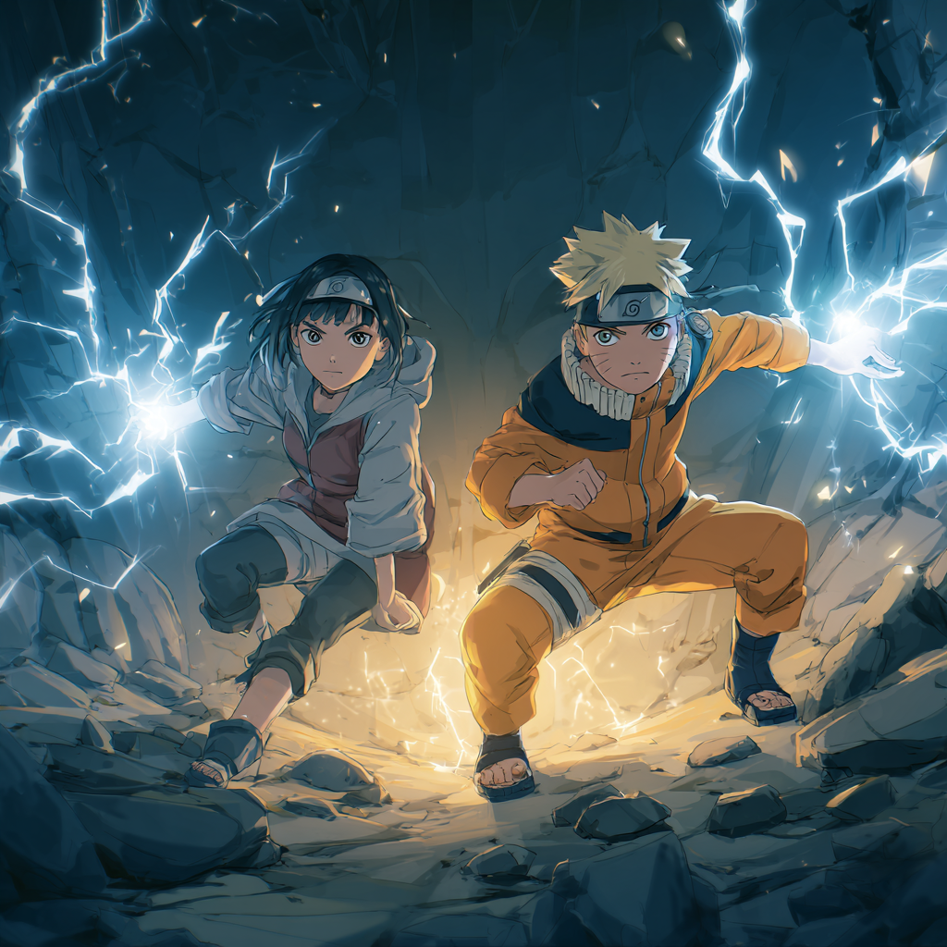

Slide 15
Robotic Process Automation of image generation an overview
Text prompting from python and image generation and download
downloading an image , then posting the same image in social media handles or discord server
Downloaded images will be matched using automated workflow in the landing page tool

