Slide 1
Report on 1)Big Game data analysis(project 2) 2)Entertainers data analysis(project 6)
UNID: CRIN2301334

Slide 2
INTRODUCTion:
About Project 2-Big Game Census Analysis,This Big Game Census data visualization takes a fun look at where Super Bowl 52 players come from, the related population figures, and opens up pathways (via embedded links) to additional census data points. By examining the dataset we can find the fun facts about it.
About Project 6-Entertainers Data Analysis,The entertainment industry is a group of sub-industries devoted to entertainment. These segments include movies, TV shows, radio shows, news, music, newspapers, magazines, and books. Thus by examining the dataset we will know about the entertainers.

Slide 3
Details in dataset:
Big Game data analysis(project 2):
Player Name.
Player Jersey Number.
Player Position.
Player Age.
Player Weight (lbs.).
Years Played.
Player Birthplace (city, town, etc.).
Player Birth State.
Player Birthplace (Combo).
Player College.
Player Team.
Conference 2016 Population Estimates (except where otherwise noted).
State GEO ID.
Full GEOID.
Latitude (player birthplace).
Longitude (player birthplace).
Number from City.
Number of Records.
American FactFinder Link for more Census data points.
Quickfacts Link.
State Data Link.
Source (Population States 2017).
Birthplace, Population Data Source.
Entertainers data analysis(project 6):
Entertainer.
Gender (traditional).
Birth Year.
Year of Breakthrough/#1 Hit/Award Nomination.
Breakthrough Name.
Year of First Oscar/Grammy/Emmy.
Year of Last Major Work (arguable).
Year of Death.

Slide 4
Week 1:
As of now , I have parsed and understood the attributes of the given datasets for both the projects,
For Big Game Data Analysis project , I have plotted a chart for Players' age and their experiences. I have grouped & coloured them based on their age using Treemaps chart in Tableau and labelled them with their name and experience.
For Entertainers data Analysis project, I have plotted the chart using Tableau's Treemaps chart ,here I have divided and coloured them by gender and labelled them with their name and birthyear.

Slide 5
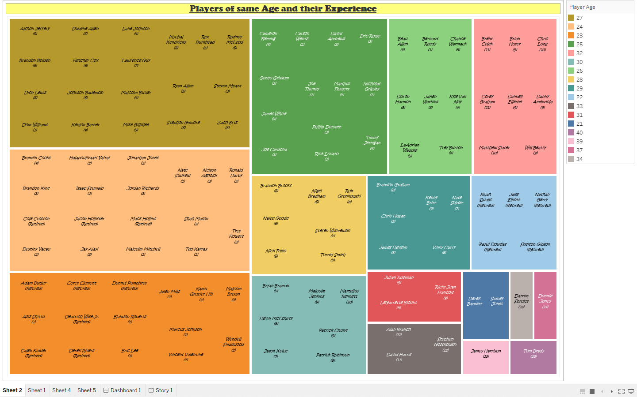
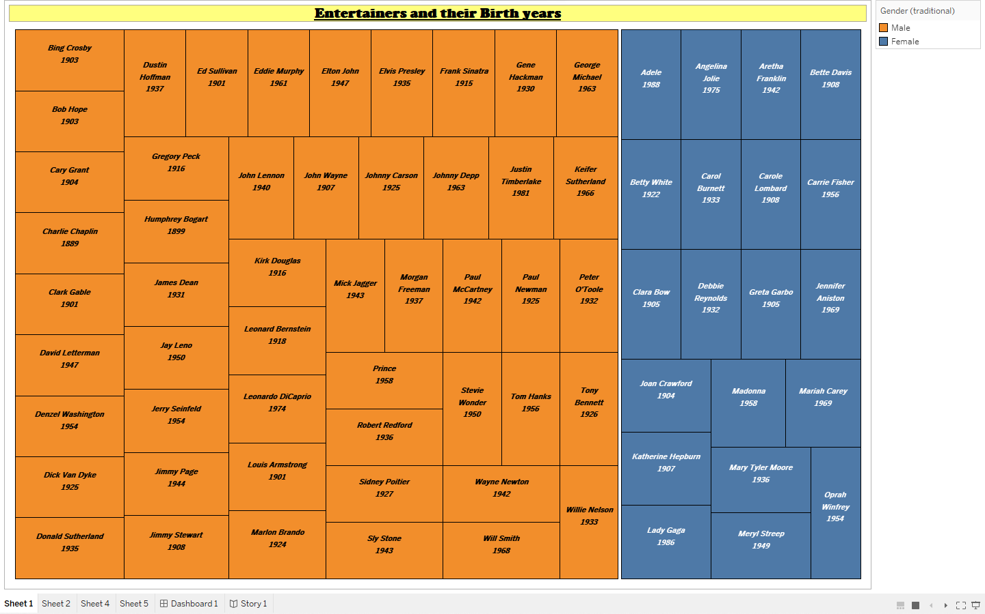
Week 1 works:
Big Game data analysis(project 2):
Entertainers data analysis(project 6):

Slide 6
Week 2:
For Big Game Census Analysis, given the longitude and latitude of Players' birthstate , I have mapped them and found that most of the given Players are from US and particularly from eastern US.
For Entertainers data Analysis, I have made a bar chart holding the Entertainers' first achivement year. And it can be concluded that most of them achieved their first awards after 1950s.

Slide 7
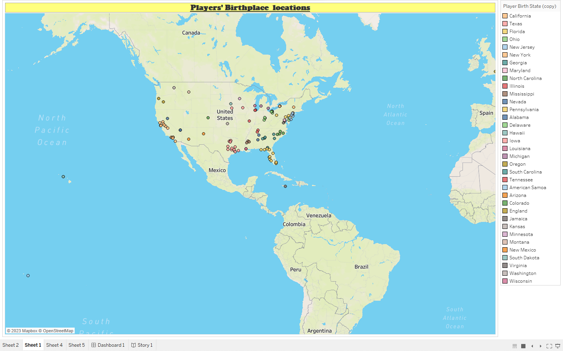
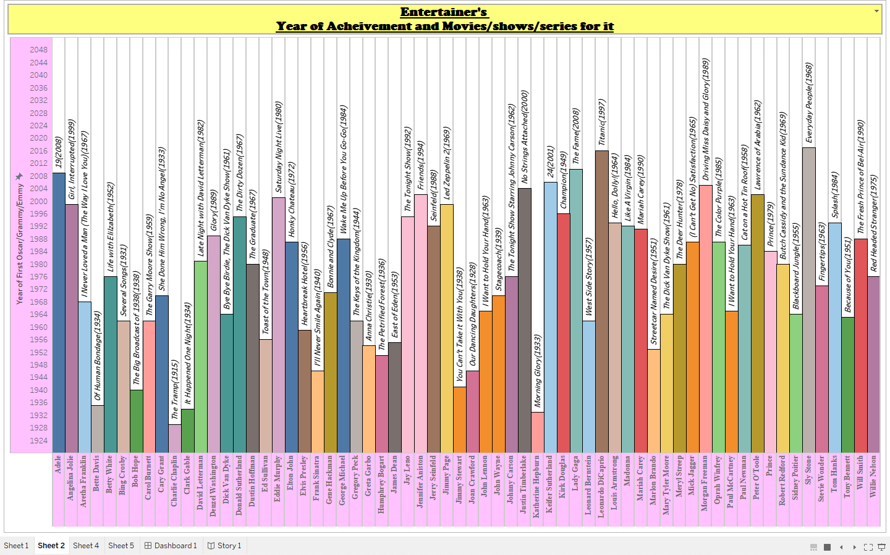
Week 2 works:
Big Game data analysis(project 2):
Entertainers data analysis(project 6):

Slide 8
Week 3:
In Big Game Census Analysis, players' positions were given in non atomic form. So I have normalised the field by using split option and drew a bar chart with the positions and it's count. And found that we have only one Punt Returner(PR) and fifteen Line Backers(LB) in the dataset.
For Entertainers data Analysis, I have displayed the Entertainers who are dead without getting any awards by filtering them (by taking the null values in "year of first achivement" field and by taking the non null values from "year of death" field). It is to be noted that all of them were females.

Slide 9
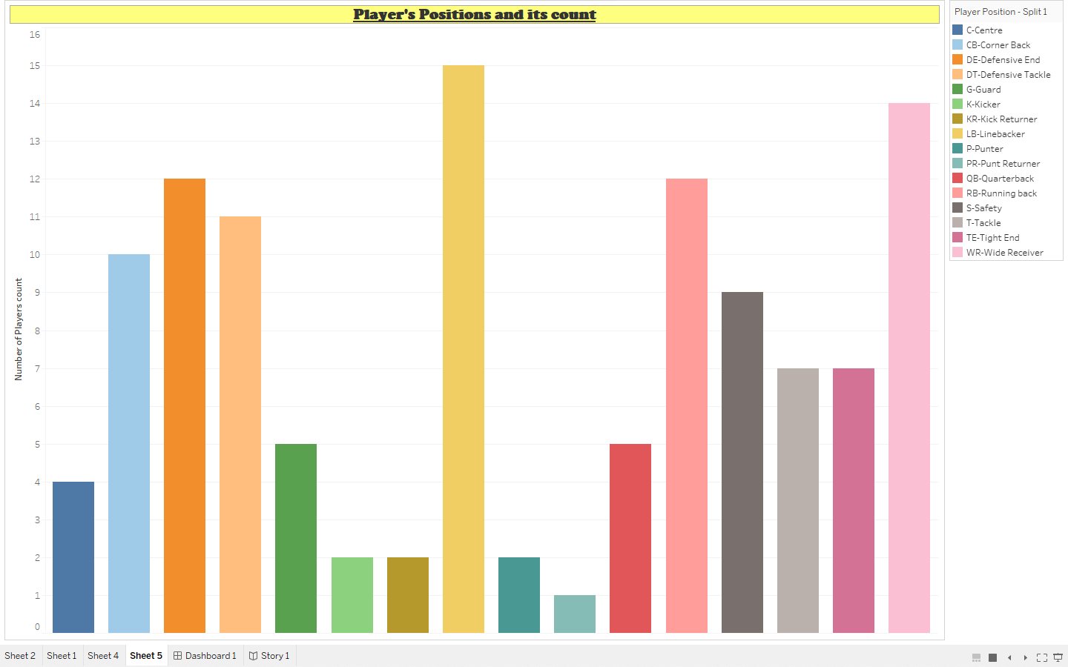
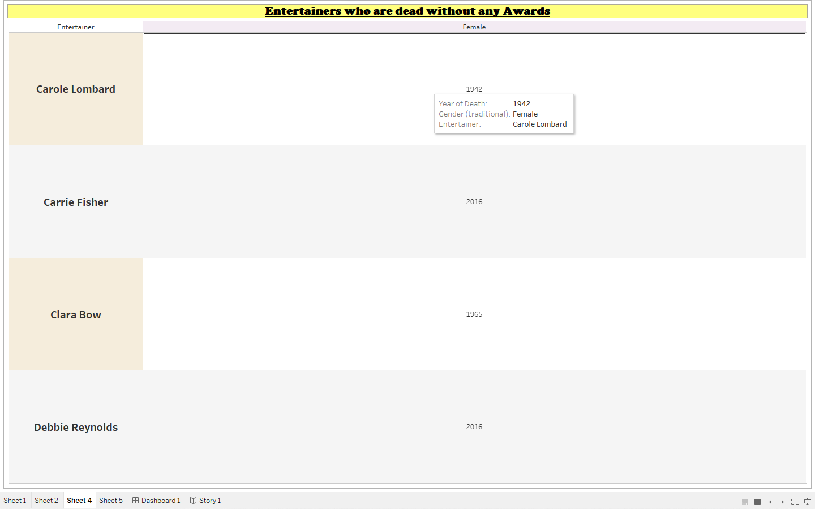
Week 3 works:
Big Game data analysis(project 2):
Entertainers data analysis(project 6):

Slide 10
Week 4:
As I have done analysing the given dataset of both the projects , I started to improvise the visuals ,
In Big Game Census Analysis, I have changed that format for the sheet headings , changed the aliases for the Players' position with their abbreviations, changed the sorting order for scales and adjusted the mapping options too.
In Entertainers data Analysis, Here also I have changed the format of sheet headings and I have made changes to the labels in bar charts and everything.
Finally I have create the dashboard and story for both the projects.

Slide 11
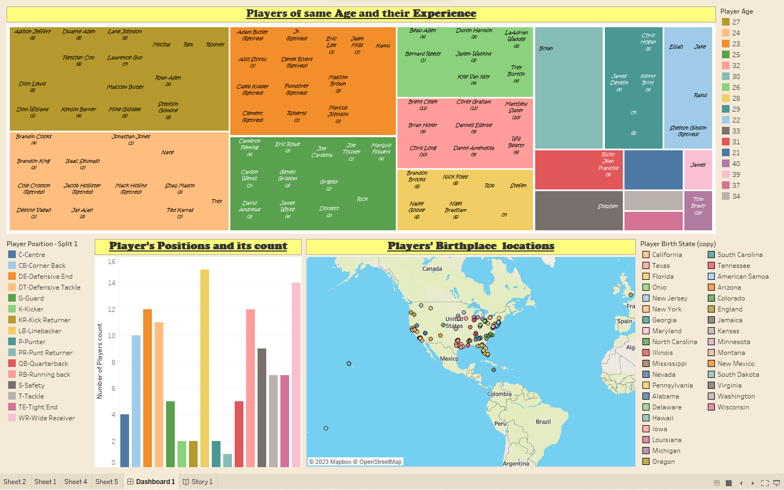
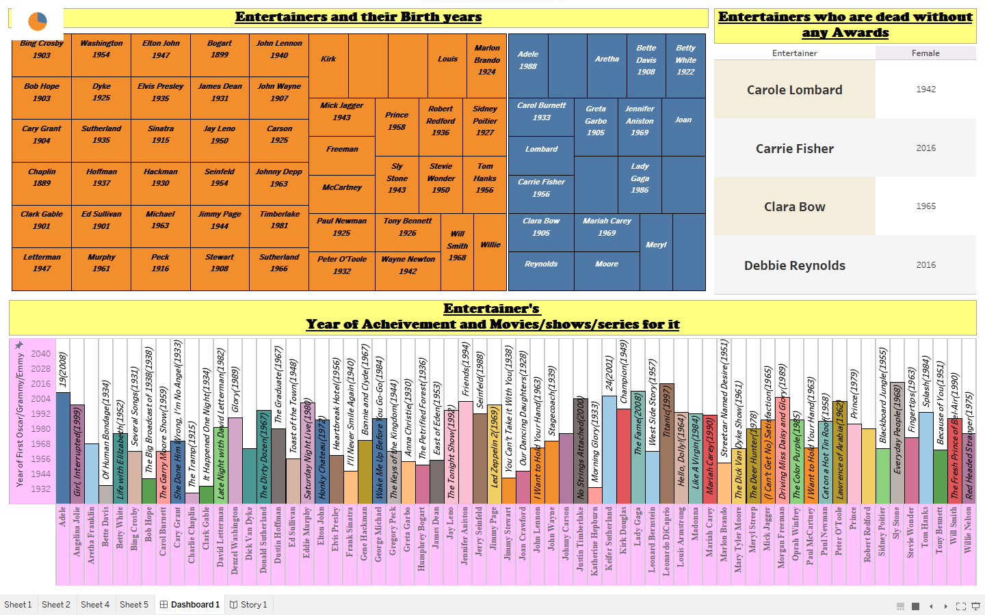
Week 4 works:
Big Game data analysis(project 2):
Entertainers data analysis(project 6):

Slide 12
CONCLUSION:
Thus for both the projects we have made a visual charts and can conclude that,
For Big Game Census Analysis,By examining the dataset we have found some fun facts about their birthstates that most of them were from Eastern US and so on.
For Entertainers Data Analysis, by examining the dataset we found out about entertainer’s age group ,the decades at which most acheivements are made, facts about their award winning movies and so on.

Slide 13
LINKS for the story of the projects:
Big Game data analysis(project 2) Link:
https://public.tableau.com/views/project2_16810125148590/Story1?:language=en-US&publish=yes&:display_count=n&:origin=viz_share_link
Entertainers data analysis(project 6) Link:
https://public.tableau.com/views/Project6_16808477900660/Story1?:language=en-US&publish=yes&:display_count=n&:origin=viz_share_link

Slide 14
Thank you…

