Slide 1
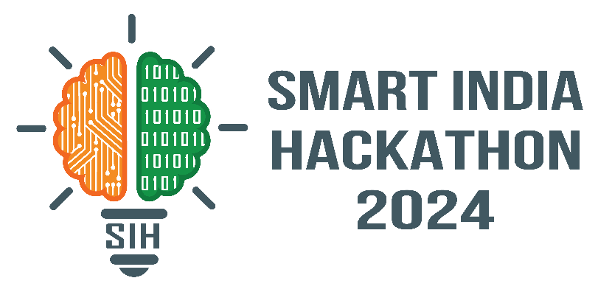
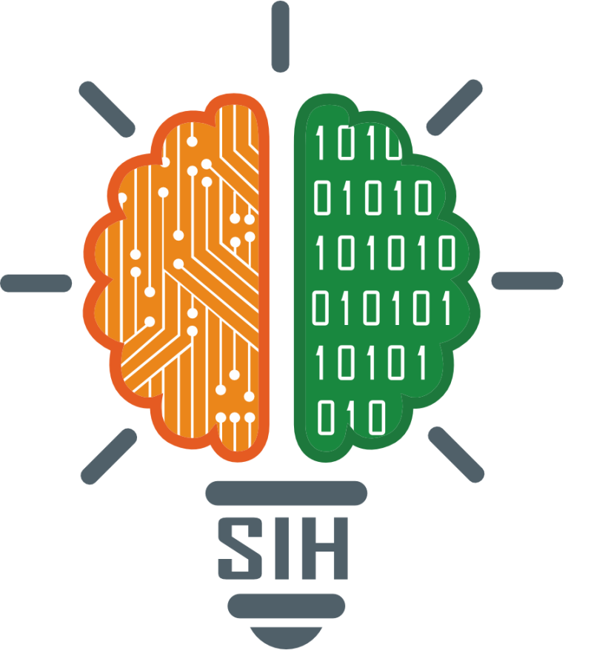
SMART INDIA HACKATHON 2024
Problem Statement ID - SIH1597
Problem Statement Title- Brain Tumor Segmentation and Patient Assistance
Theme- MedTech/Bio Tech/Health Tech
PS Category- Software
Team ID- 7601
Team Name- Black Squad

Slide 2
IDEA TITLE
Black Squad
IDEA / SOLUTION :
Implementing Brain Tumor Segmentation, Classification and 24/7 Patient Assistance to provide continuous, real-time support and accurate medical insights.
Utilizing U-Net architecture to segment the regions of brain tumors.
Deploying an RAG model to effectively assist with patient queries.
Leveraging the Gemini API to thoroughly analyze segmented tumor regions in MRI scans.
Implementing AWS Cloud support to ensure seamless scalability.
Problem Resolution :
We integrated U-Net based tumor segmentation with an RAG model for real-time patient support and accurate insights.
Gemini API and AWS Cloud enable detailed MRI analysis and scalable, robust healthcare solutions.
Unique Value Proposition(UVP) :
Integrated Brain Tumor Segmentation, Classification, and RAG-Based Patient Support System.
Data Encryption.

Slide 3
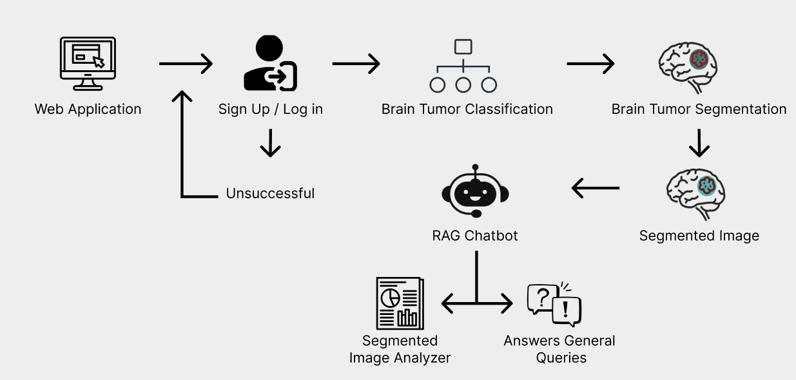
TECHNICAL APPROACH
Black Squad
Work Flow
Algorithm Development:
U-Net architecture using CNN used for developing the algorithm.
Web Application Development:
React and flask used for developing the web application.
Data Encryption:
Implementing the RSA algorithm for robust data encryption in the chatbot, ensuring secure communication
Cloud services:
AWS Bedrock for chatbot.
Project Status: The product is 70% complete, with the remaining build in progress. Testing and validation are the next steps to be undertaken.

Slide 4
FEASIBILITY AND VIABILITY
Black Squad
Analysis of the feasibility of the idea :
U-Net provides accurate brain tumor segmentation in MRI scans.
Metrics like Dice Score and MCC validate model performance.
Potential Challenges and Risks:
Limited access to high-quality labeled MRI datasets may affect accuracy.
API and bedrock service costs could escalate with scaling.
High-performance hardware is required for processing MRI data.
Strategies for Overcoming These Challenges:
Use data augmentation and cross-validation to enhance performance.
Optimize cloud usage and explore cost-effective compute solutions.

Slide 5
IMPACT AND BENEFITS
Black
Squad
Potential impact on the target audience:
Healthcare Professionals: The solution enhances diagnosis efficiency, accuracy, and reduces segmentation time.
Patients: Improved diagnostic accuracy results in better outcomes, faster diagnoses, and lower costs.
Benefits of the solution :
Social: Improves patient outcomes and quality of life with faster, accurate diagnostics.
Economic: Lowers healthcare costs by automating tasks and reducing manual intervention.
Resource Waste: Minimizes repeat scans and unnecessary procedures, reducing supply waste.

Slide 6
RESEARCH AND REFERENCES
Black Squad
LIZ, W. X., & Yung, X. A. (2023). MRI Brain Tumor Region Segmentation Model Based on 3D U-Net. Applied Sciences, 13(20), 2769. https://doi.org/10.3390/app13102769
Crum, W. R., Camara, D. C., & Hill, L. G. (2006). Generalized Overlap Measures for Evaluation and Validation in Medical Image Analysis. IEEE Transactions on Medical Imaging, 25(10), 1451–1465. https://doi.org/10.1109/TMI.2006.884121
Soundarajan, S. R. K. S., Josephinejubilee, A., Anisha, S., & Subburaj, R. (2024). Improved Brain Tumor Segmentation Using UNeXt5Plus Architecture. SN Computer Science, 5(10). https://doi.org/10.1007/s42979-024-09729-9
Scan QR code provided to watch the project video.

