Slide 1
Global Hackathon Data Impersonal Identity

Slide 2
Hive – Team Members
Albert, Magdaleen allen felow.a
Selvasathya Shanumuganaathan
Manikandan Manickam
Boopathi Manogar
Jeganath prabhu Kumaresan
Ramkumar Kamaraj

Slide 3
Task Objective
AI-Based Voice Verification:
Develop AI Algorithm capable of distinguishing between authentic and AI-Generated voice prints.

Slide 4
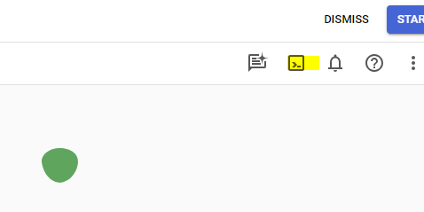
Activate Cloud shell
Activate Cloud shell by clicking on the icon highlighted in the picture

Slide 5
Creating Console in CloudShell
After Activating Cloudshell create console using the syntax
Create Directory for the project

Slide 6
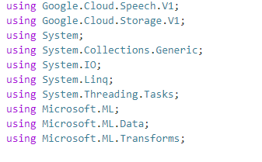
Required Namespaces

Slide 7
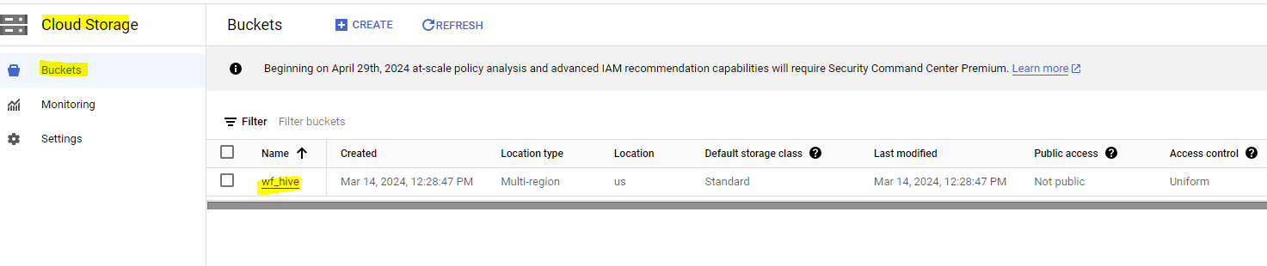
Storage Buckets

Slide 8
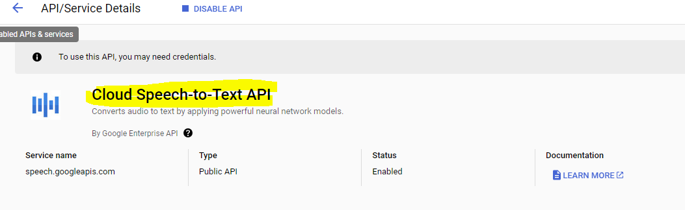
Enabled API Services

Slide 9
Packages to be Included
Naudio
Google.Cloud.Speech.V1
Naudio.Wave
Microsoft.ML
Google.Cloud.Storage.V1

