Slide 1


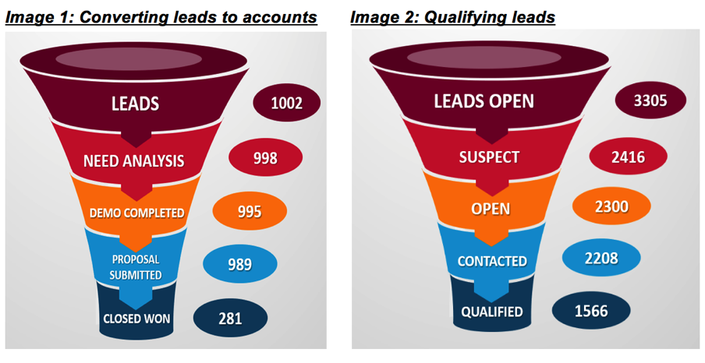
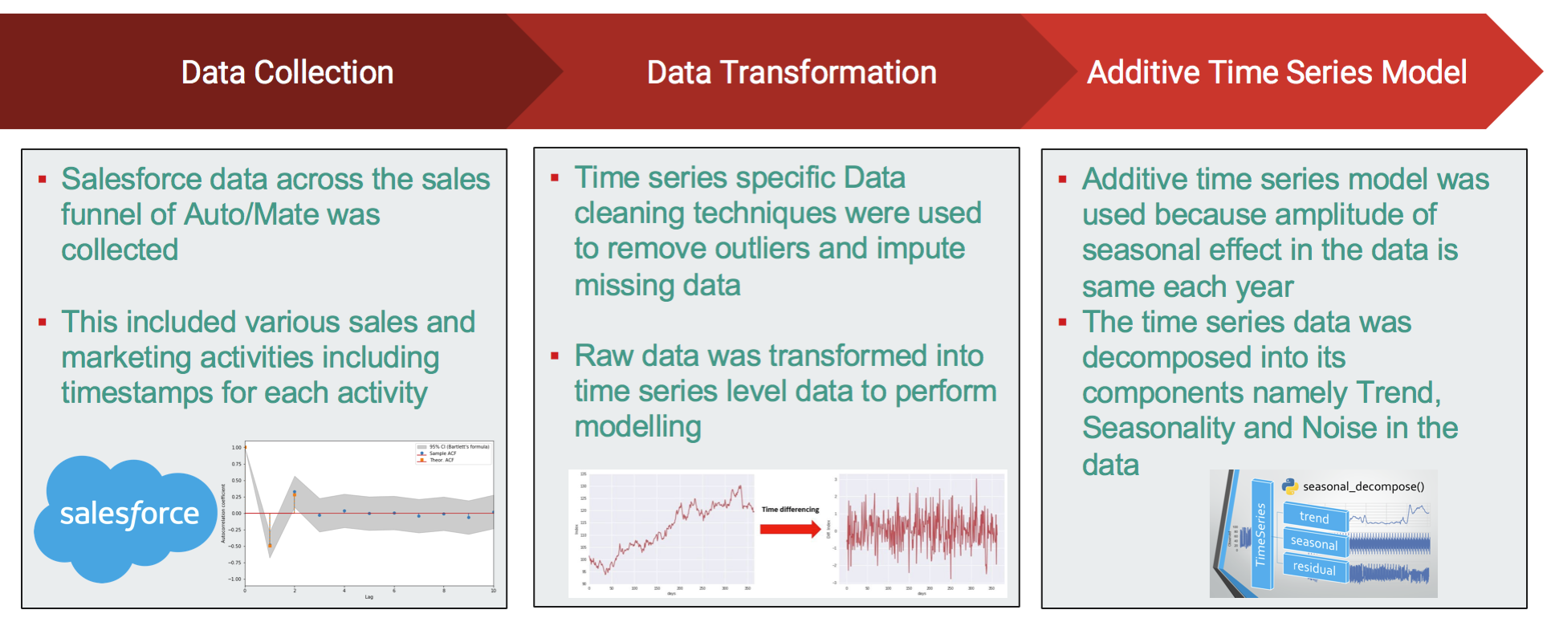
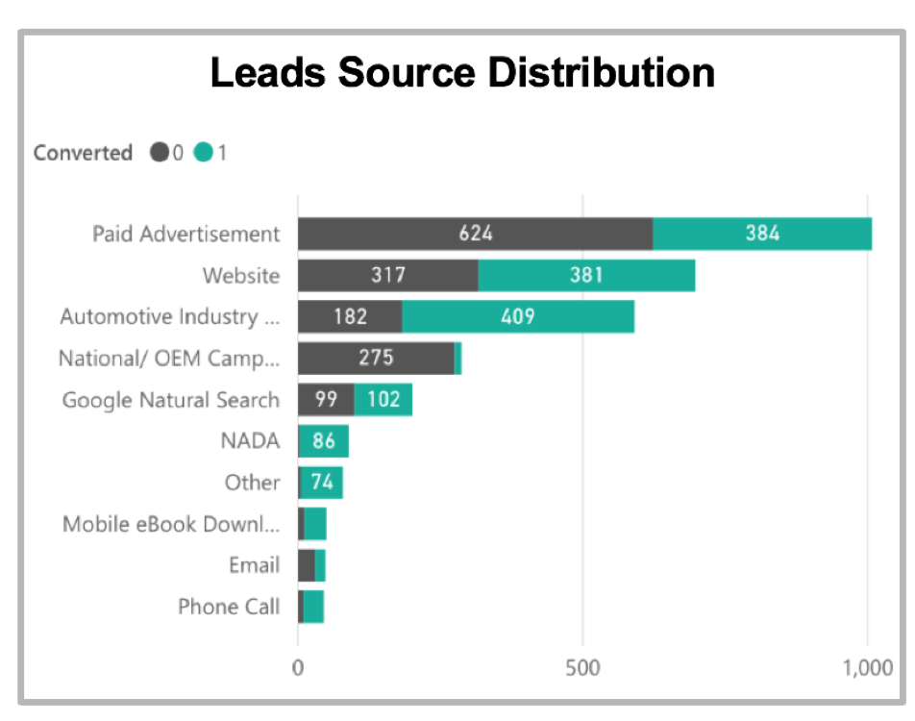
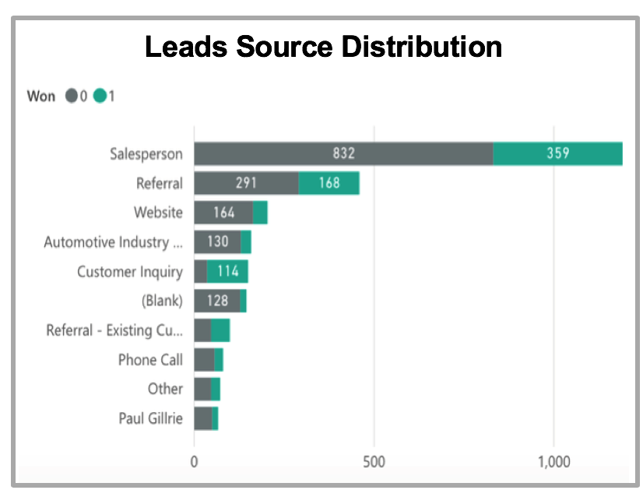
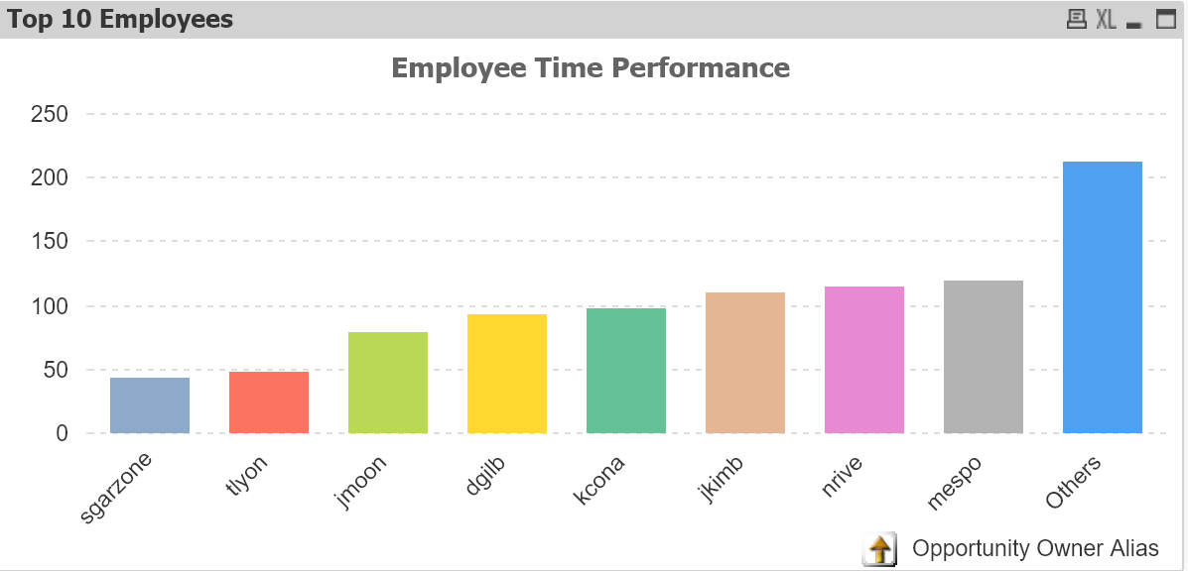
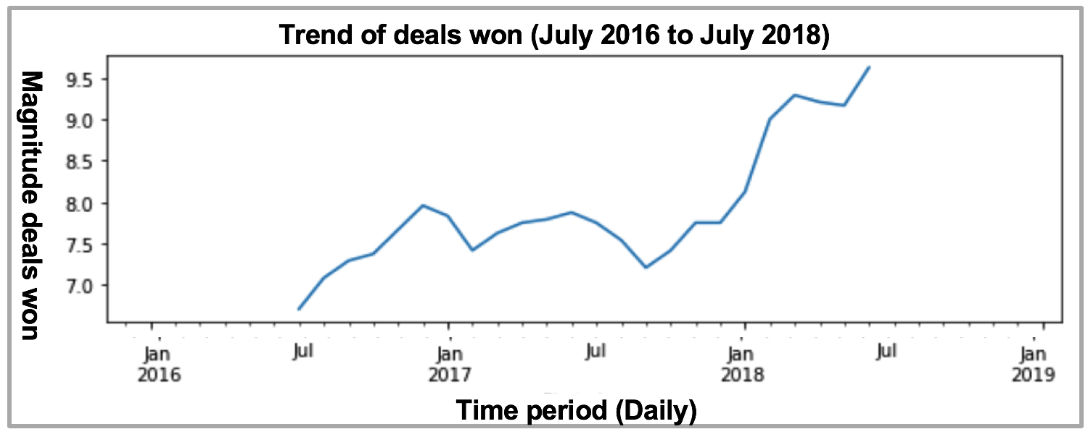
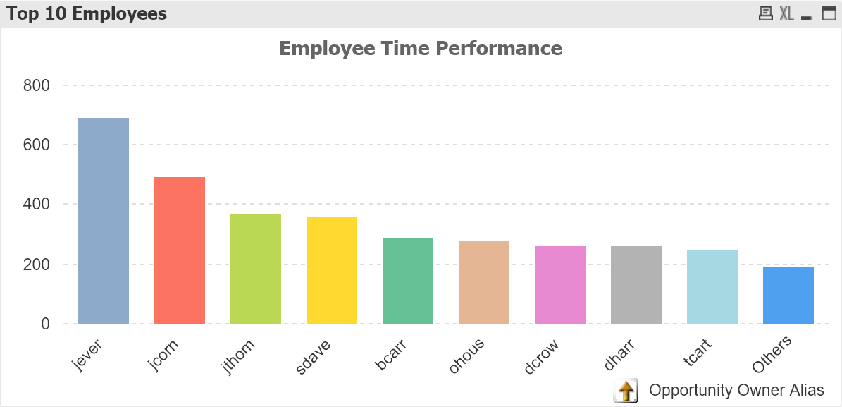


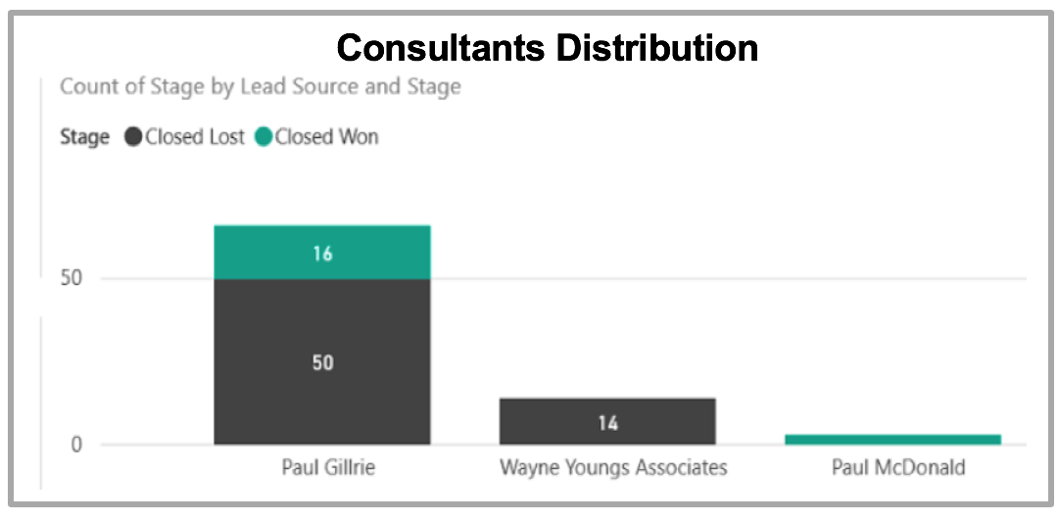
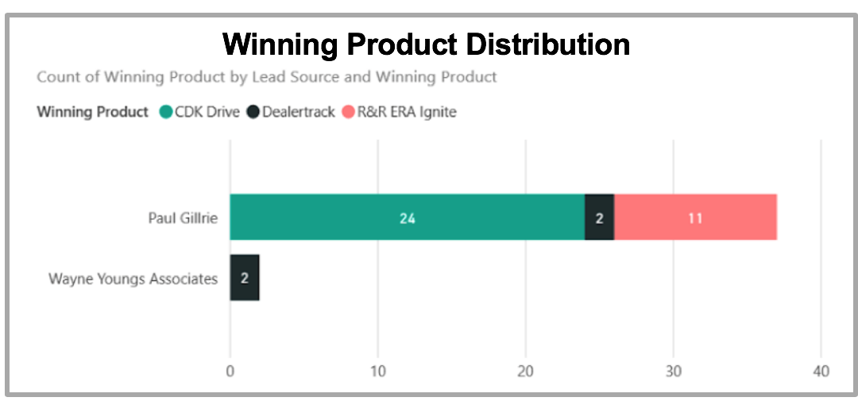

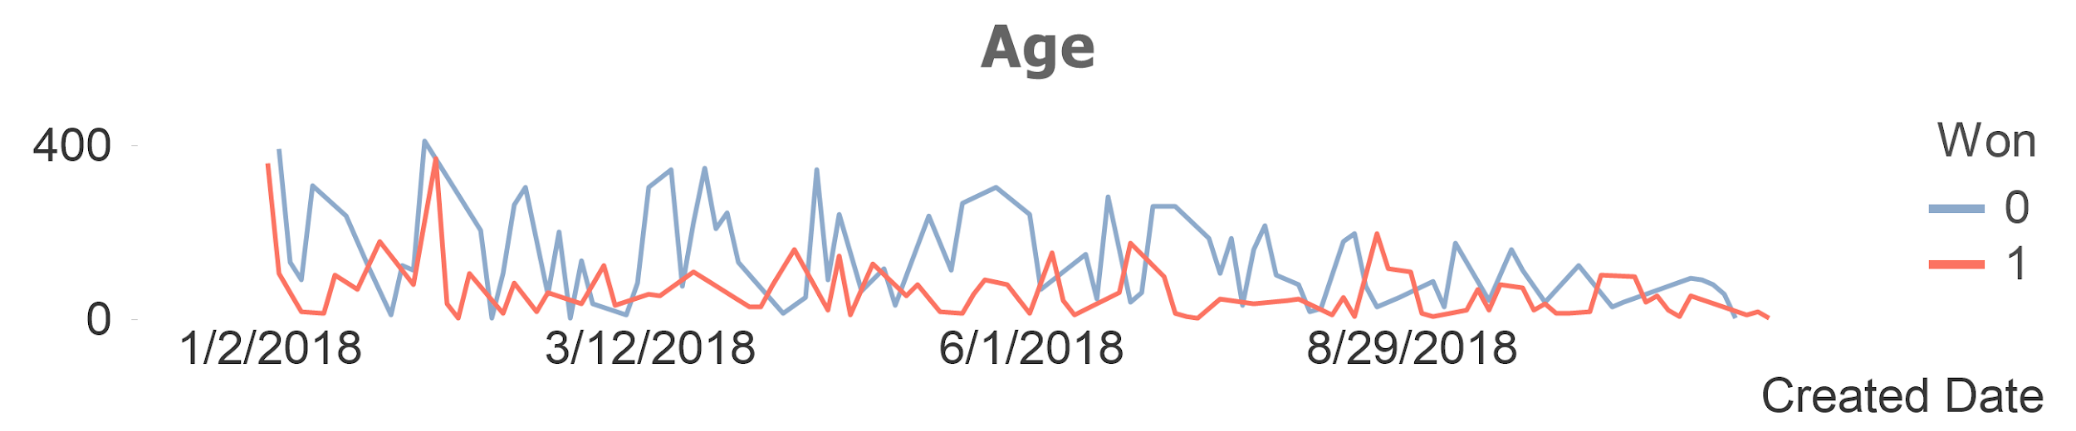

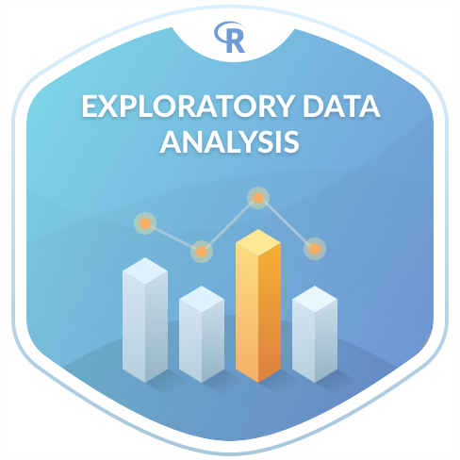
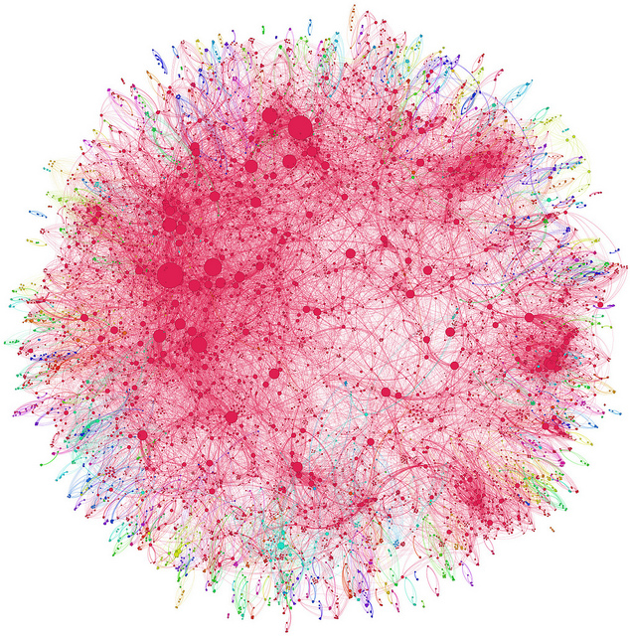
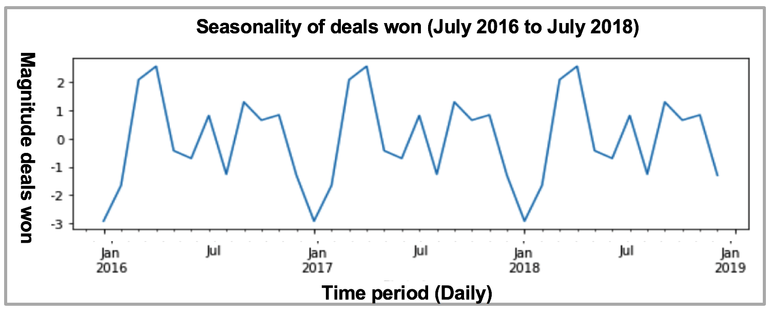


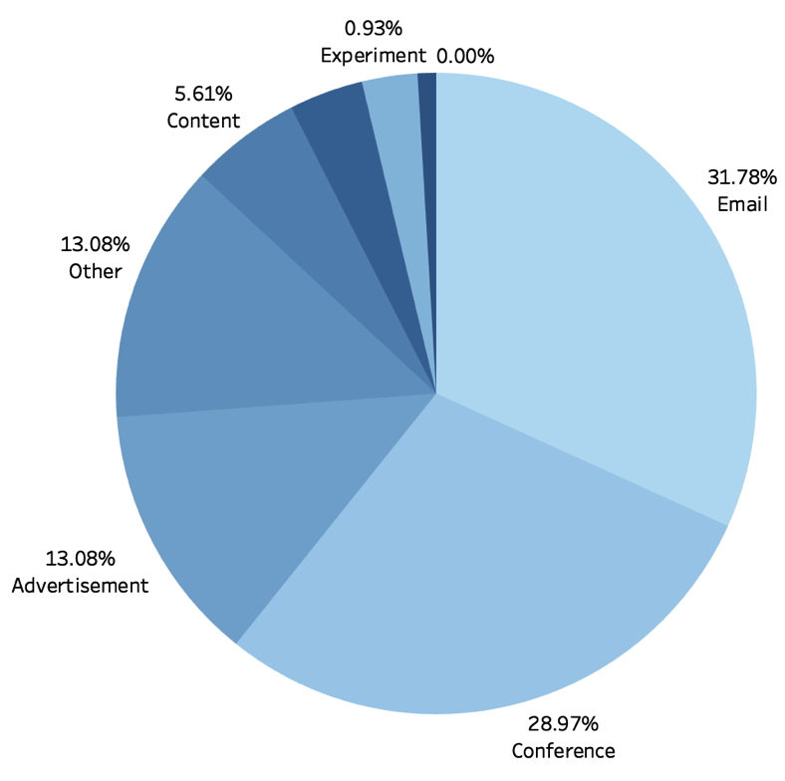
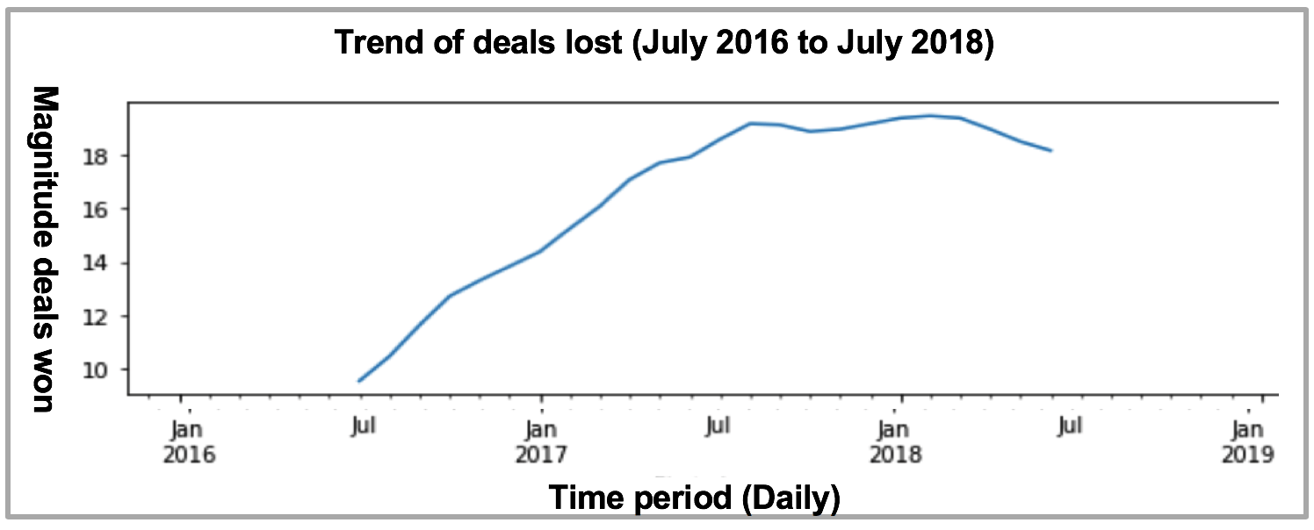
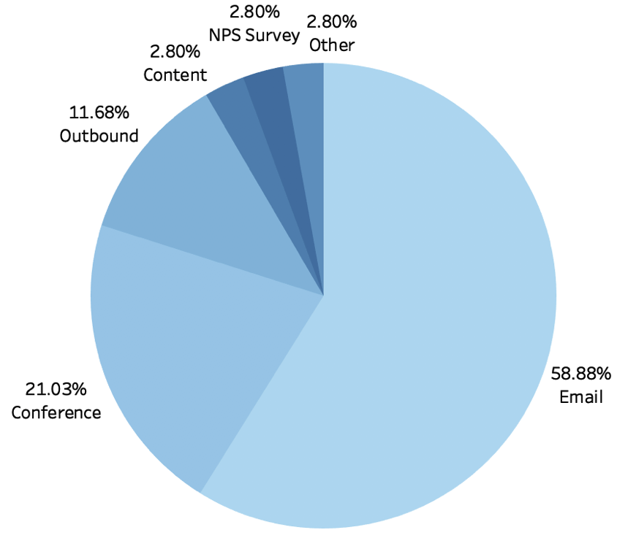
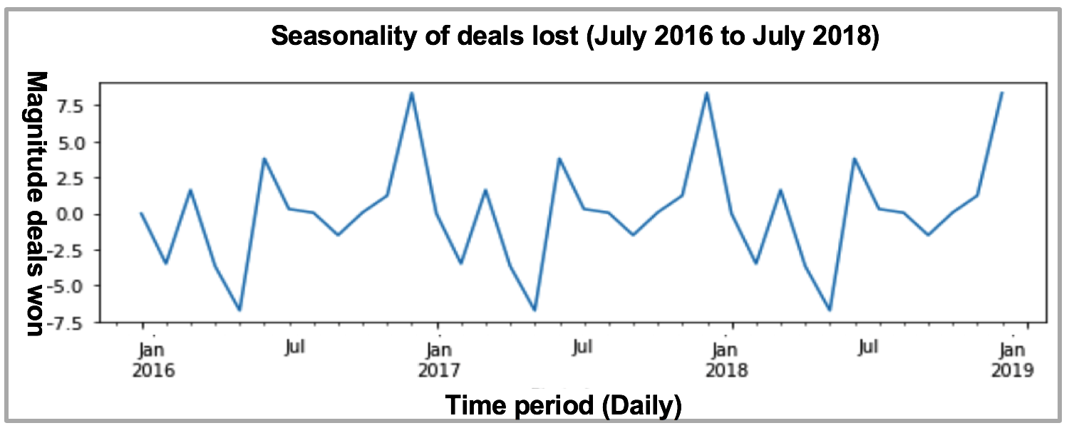
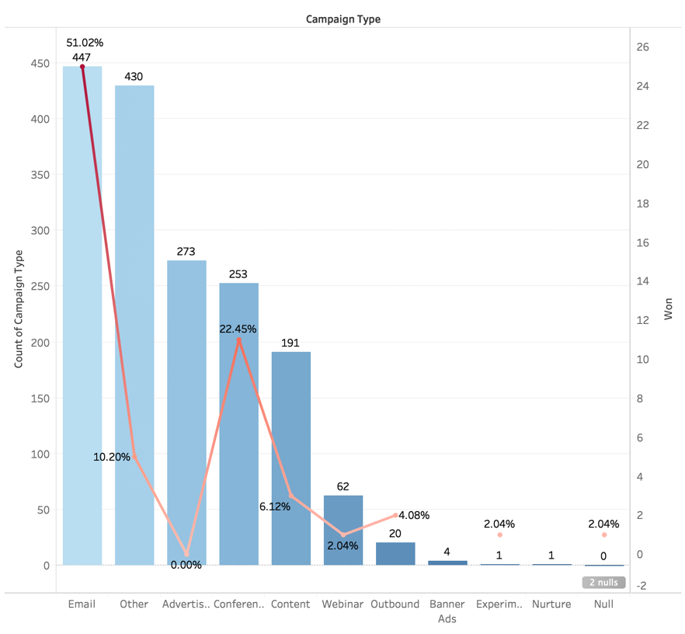
Salesforce Data Analysis
Mengqi Fan, Preetham Jagadeeshan, Seyma Yurduseven, Wanruo Li
Rensselaer Polytechnic Institute
Project Description
Time Series Analysis
Leads Source & Consultants
Employee Performance Analysis
Below graph shows the fastest 10 employees in closing deals.
We are working with the Salesforce data of Auto/mate, to uncover the behavioral patterns of the leads through the sales funnel. Our aim is to help our client make more sales
Salesforce Data from January 2016 to December 2018 was used
High Conversion Rate: Automotive Industry Event, NADA
High Conversion Speed: Paid Ads, Website, Automotive Industry Event
More than half converted within only 1 week, most converted within 1 months
High Won Rate: Customer Inquiry, Referral, Sales Person
High Conversion & Close Speed: NADA, Hiring eBook Download
From leads to closed won: most closed within 6 months
Below graph shows the slowest 10 employees in closing deals.
Tools & Technologies
Models and techniques:
Time series analysis
Logistic regression
Decision trees
Random forest algorithm
The magnitude of deals on had been stagnant from Jan 2017 - December 2018. However, rate of successful deals started increasing from last quarter of 2017
In general, deals lost takes a longer time to close than deals won.
Multiple models and tools were used in different stages of the project
Main consultants source: Paul Gillrie - 24% closed won
All leads that are closed won have only 1 rooftop
Main lost reason: “no change”
Conclusion
Campaigns
TIME SERIES
The time series analysis suggests that aligning your marketing efforts to increase the volume of opportunities at hand in the first quarter of every years will lead to higher deals being won.
CAMPAIGNS
Emails and conferences are the useful campaigns. However, we cannot conclude that using Emails will definitely bring successful business since every dealer received emails, but conferences should be exploited.
CONSULTANTS
We recommend client to make exclusive campaigns whenever consultants are involved since they are an important source and it seems like they have not been utilized enough as of now.
LEAD SOURCE
Automotive Industry events are important to be able to convert leads into opportunities, so they should be prioritized. Referrals are a highly useful source, mostly ending with a successful deal, so we recommend the company to focus on it.
LOST REASON
We recommend the client to lower the upfront payments significantly. In a lot of cases, competitors completely removes the upfront payments to gain clients, so this should be taken into consideration.
Top 5 campaigns that gain most responded dealers are Eamil, Conference, Advertisement, Other and Content. For Conference, 68% are related to ‘NADA’ conference.
.For Advertisement, 41.76% come from Google ads.
The amplitude of deals won has the same seasonal pattern in the past 3 years with high volume of sales in the first quarter of every year
Lost Reason Analysis
To be able to analyze lost reason, we had two variables. First one was a categorical variable “Lost Reason”. The analysis on this variable did not result with key findings that are not already known to the company. So we were left with the second variable; “Lost Reason Comments”. This variable was consisting of long strings without any structure or discernable pattern. We have tried different methods, like NLP techniques, regular expressions, string manipulations, however it did not add up to anything we can use. Moreover, the dataset was too small to implement any advanced methods.
In the end, we have decided to just read these comments. A pattern emerged and we have found one main reason to explain why the company is losing deals : Upfront payments. The company’s payment system includes two types of payment; upfront and monthly.
Top 4 campaigns that gain most closed won dealers are Email, Conference, Outbound, Content. For Conference, 71.1% are related to ‘NADA’ conference. For Outbound, 88% come from outbound calling.Email
The magnitude of deals lost had been increasing from July 2017 - January 2018. However, rate of deals lost started decreasing from first quarter of 2018
Upfront Payments
Monthly Payments
Total Revenue
Installment
Training
No binding contract, continues as long as they stay as a customer
Upfront + Monthly x 12
Considering the number of conference the the percentage it contribute to closed won, conference is the best campaigns.
Considering the number and expense of advertisements, it is a campaign that not really useful.
We found that in the last three years, they have lost 54 deals just because of upfront payments, while the number of deals they have won in total is 300. Considering the ratio between those two, this loss is substantial.
The data indicated that if the company can handle upfront payment issue, by dividing it into monthly installments or any other way, the result would be ;
The amplitude of deals lost has the same seasonal pattern in the past 3 years with high volume of deals lost in the last quarter of every year
Total Annual Revenue Gain = $2,853,307

