Slide 1
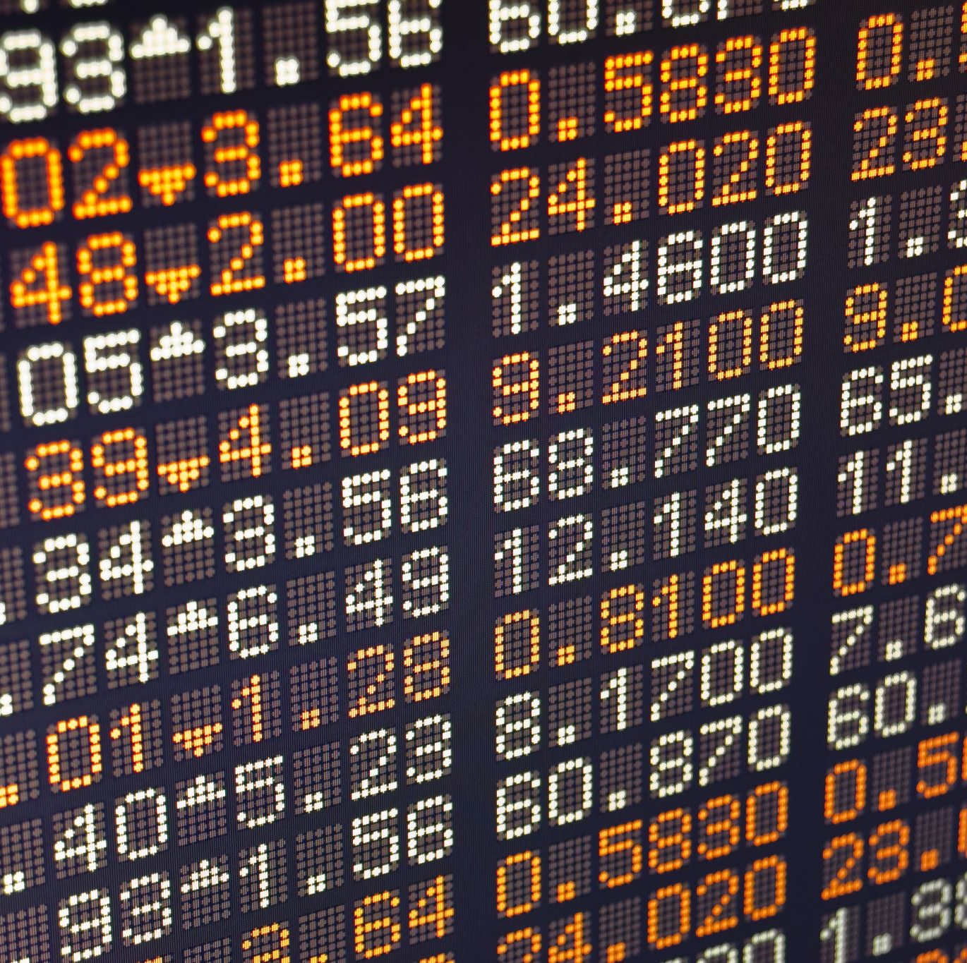
Currency Converter
Maggie Wilson
https://github.com/MaggieWilson/Traveler-s-Conversion-Tool-

Slide 2
Currency Converter: A Traveler’s aid to Quickly and seamlessly convert the currencies of different countries.

Slide 3
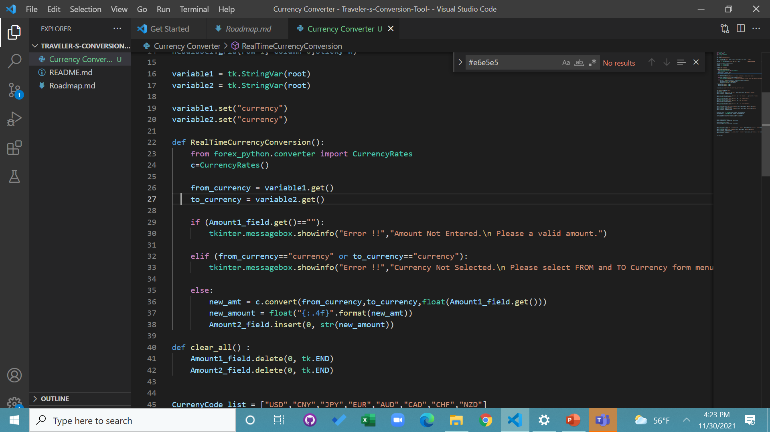
Python will be used to create the program. From python, current currency rates from all over the world will be downloaded into the Currency Converter by importing currency rates from forex_python (foreign exchanges).

Slide 4
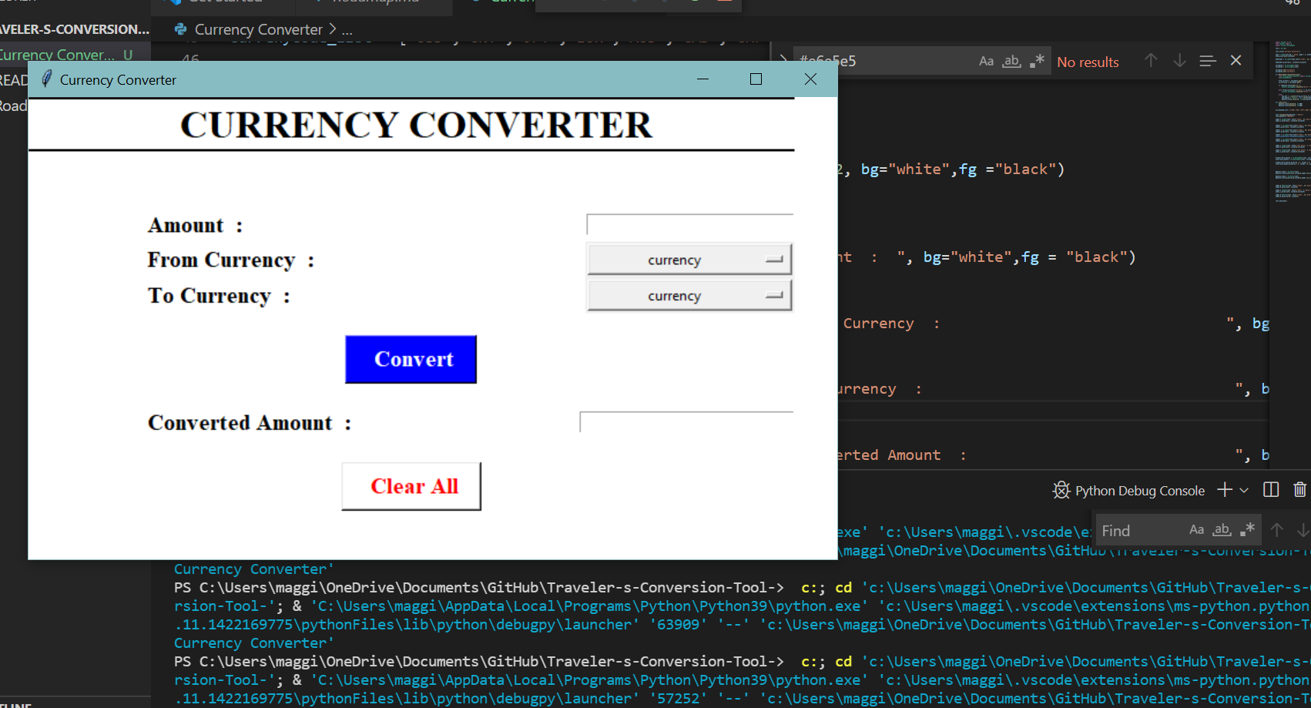
After running the program, a popup appears prompting the user to input the required data. The program then converts the currency of one country to another (the program is still being developed to also be able to convert from cryptocurrencies like Bitcoin).

