Slide 1
SQL Master Class: AI-Powered SQL Learner Platform
CS5200 Final Project Demo

Slide 2
Introduction
Role-based SQL learning platform for Students, Instructors, and Admins
Real dataset + instant autograding + AI tutor
Stores submissions and generates individual + class analytics

Slide 3
Executive Summary & Milestones
Phase I: Requirements, use cases, and initial architecture
Phase II: EER model + logical schema + key analytics queries
Phase III: Implementation of schema, constraints, and performance plan
Phase IV: Data population, autograder workflows, and end-to-end testing

Slide 4
System Architecture
Web-based front-end with role-based navigation
Backend APIs for auth, problem bank, grading, analytics
MySQL database for persistent learning data
LLM-powered Open SQL for chat tutoring and NL-to-SQL analytics queries

Slide 5
Step 14 Requirements Mapping
Dynamic SQL: analytics filters, leaderboard, submission history, role-scoped queries
Open SQL: student & instructor chat assistants convert natural language to SQL
Chat supports safe read queries and controlled updates where applicable

Slide 6
Demo Plan (10 minutes)
1 min: Problem + solution overview
5–6 min: Live walkthrough (Student → Instructor → Admin)
1–2 min: Architecture + dynamic/open SQL highlights
1 min: Lessons learned + next steps

Slide 7
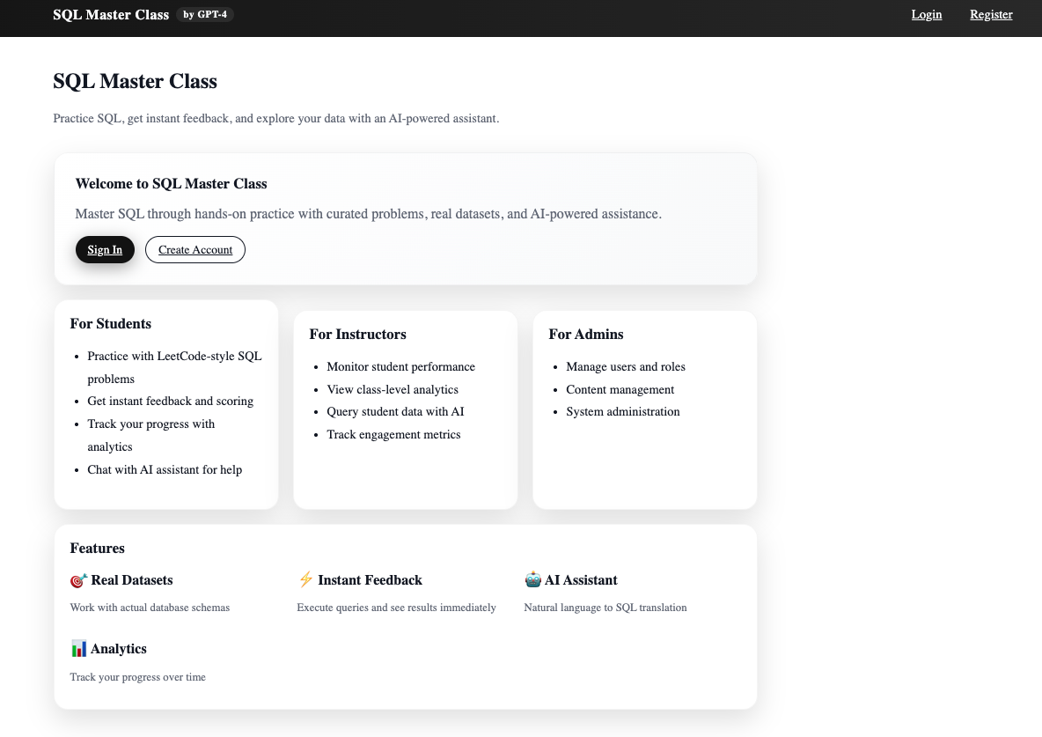
Login Page
Login Page

Slide 8
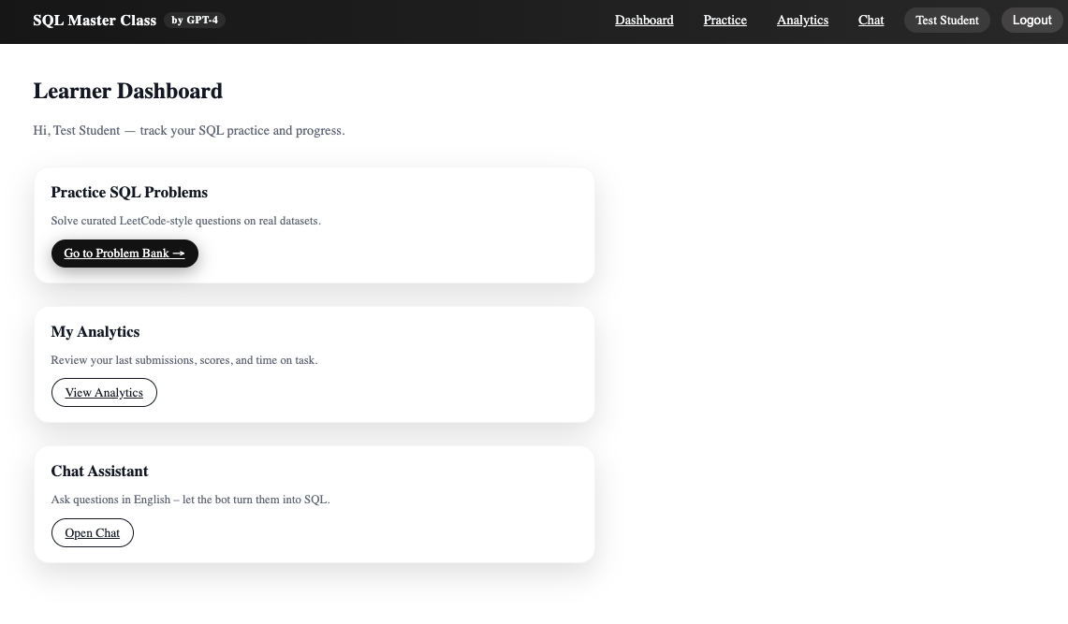
Learner Dashboard
Learner Dashboard

Slide 9
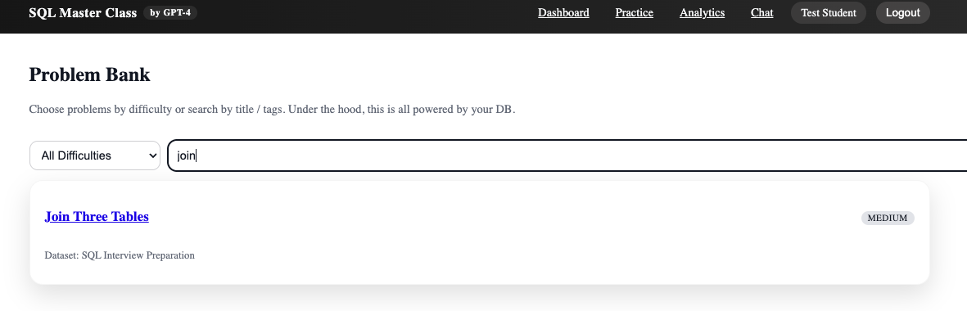
Problem Bank
Problem Bank

Slide 10
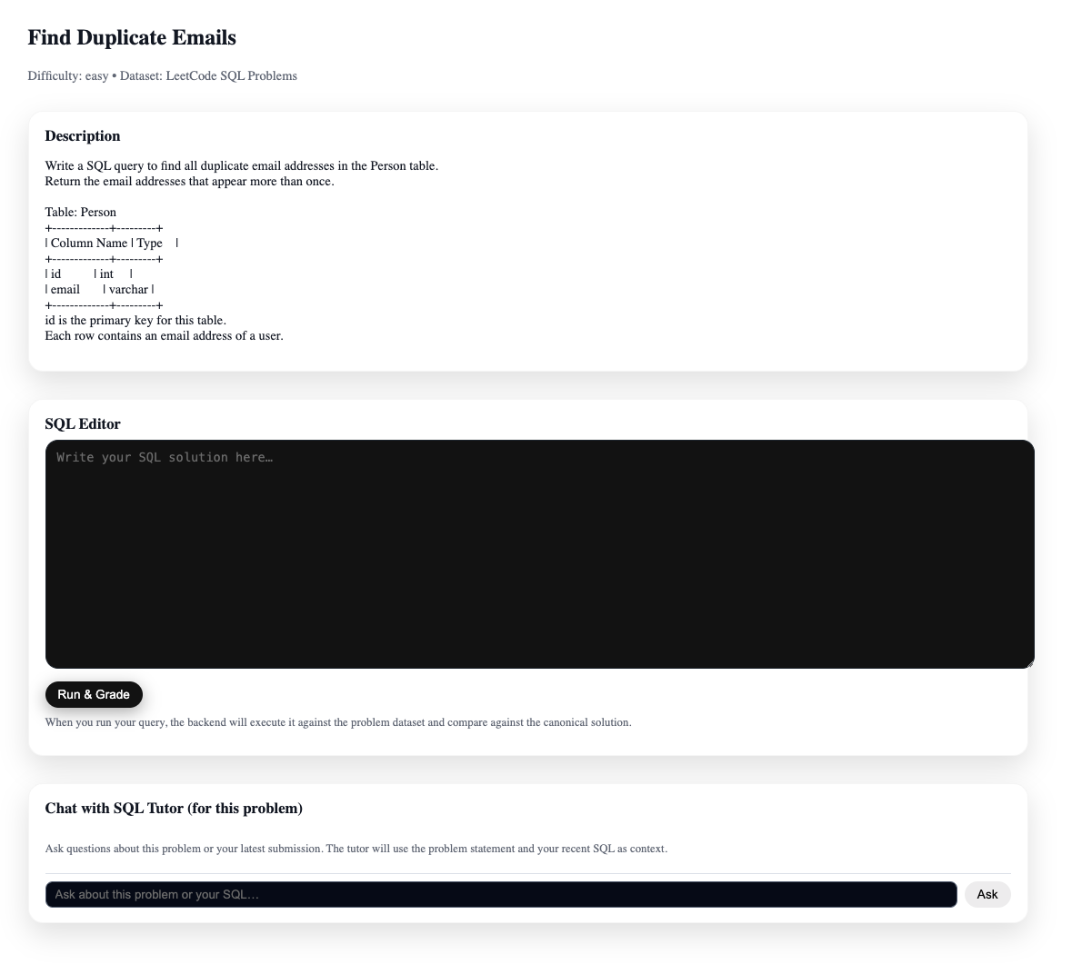
Problem Example
Problem Example

Slide 11
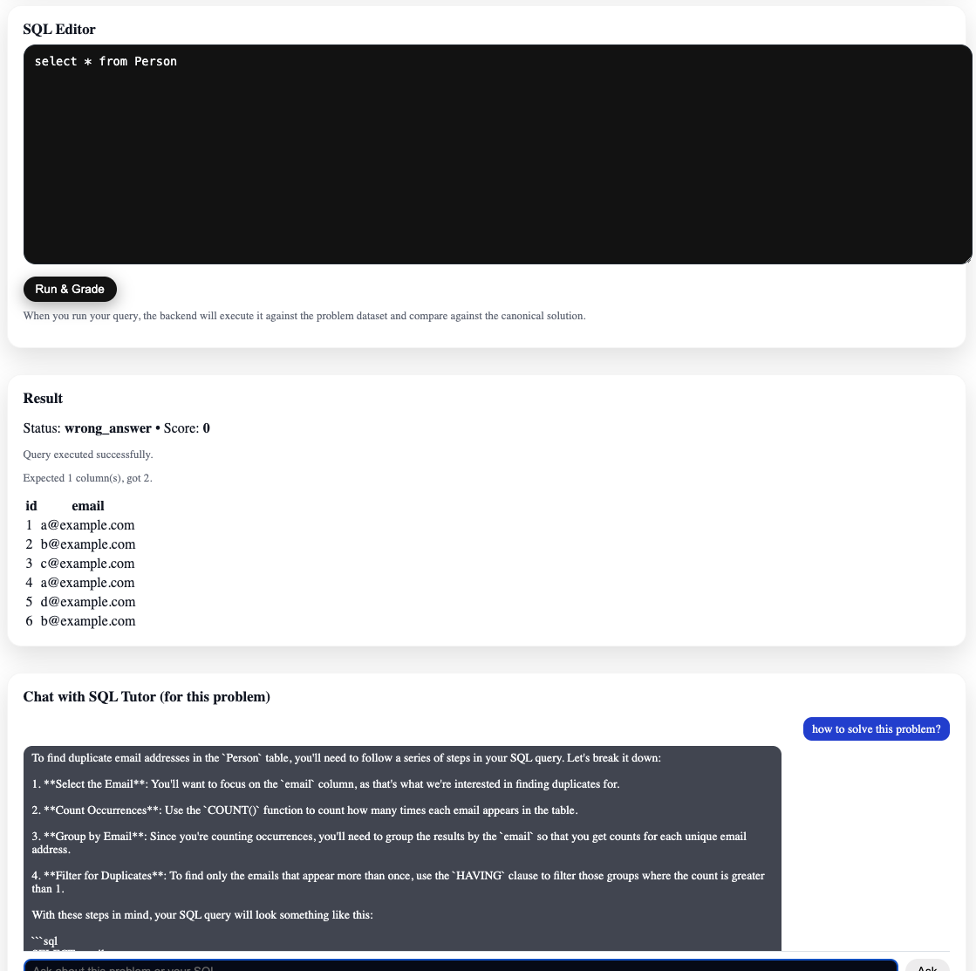
Analytics - Submissions
Analytics - Submissions

Slide 12
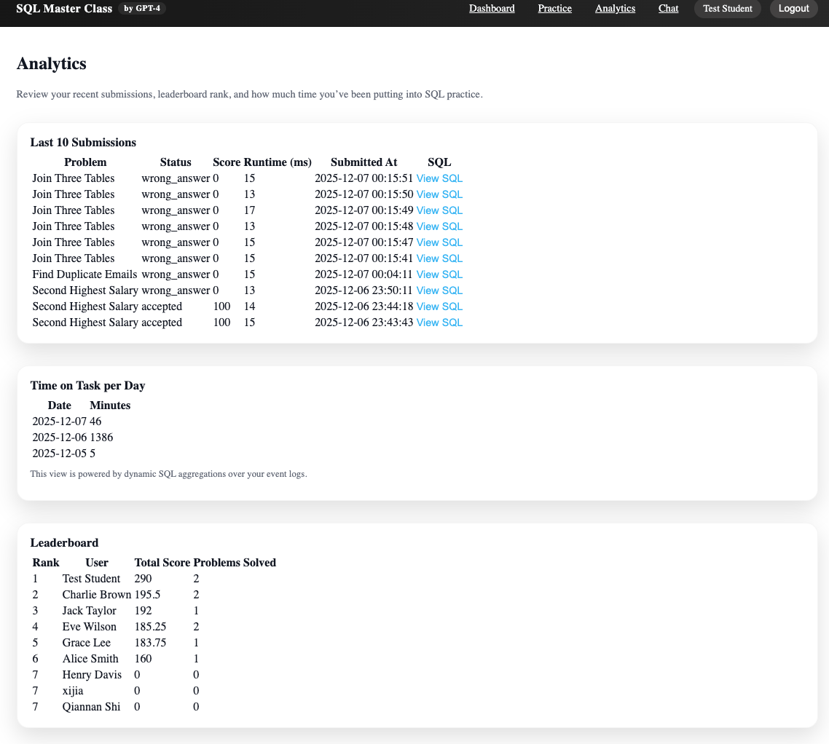
Analytics - Time on Task & Leaderboard
Analytics - Time on Task & Leaderboard

Slide 13
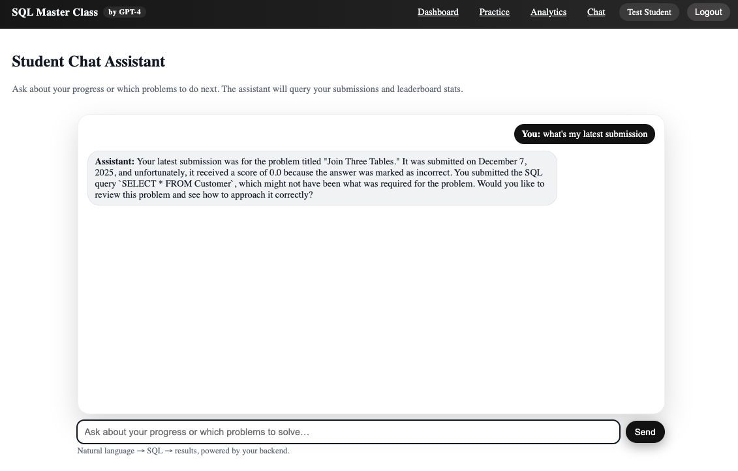
Student Chat Assistant
Student Chat Assistant

Slide 14
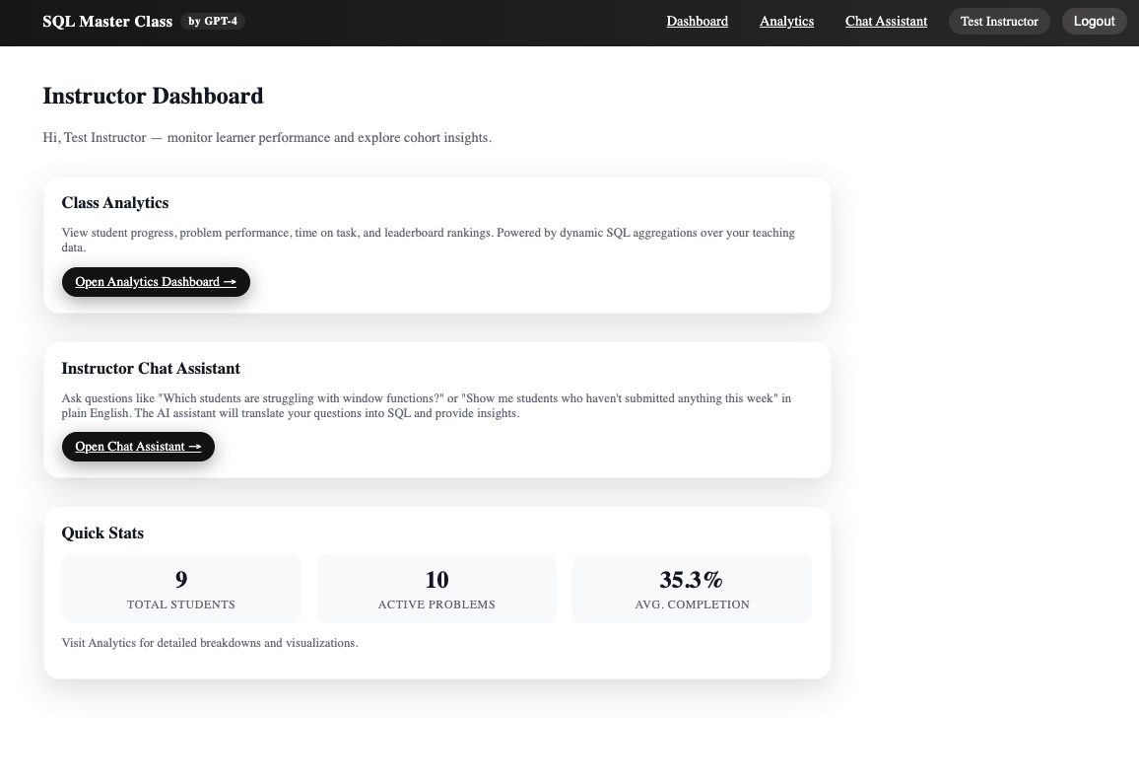
Instructor Dashboard
Instructor Dashboard

Slide 15
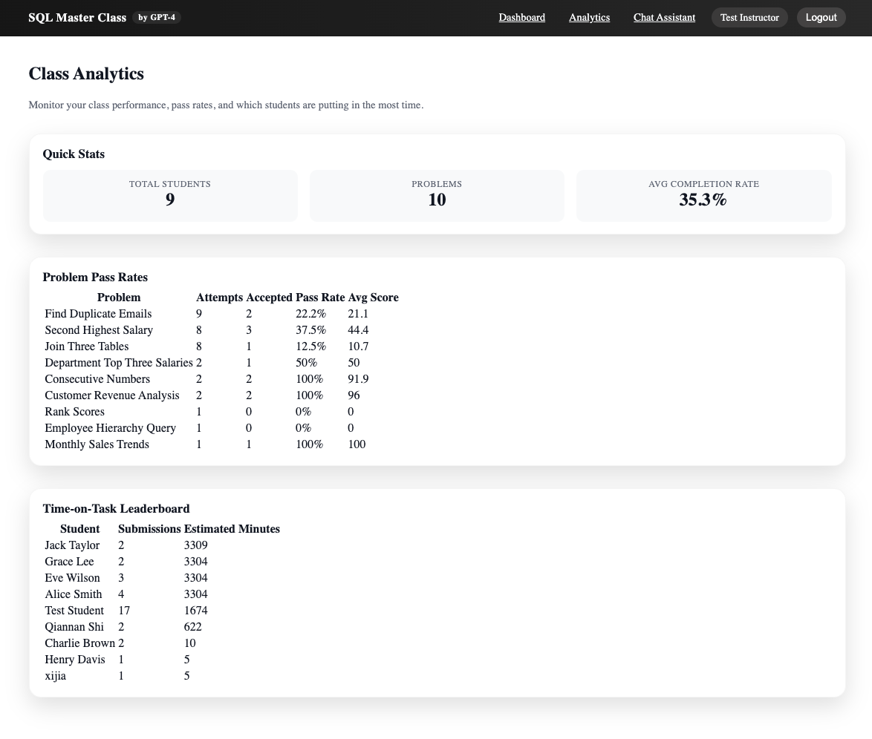
Class Analytics
Class Analytics

Slide 16
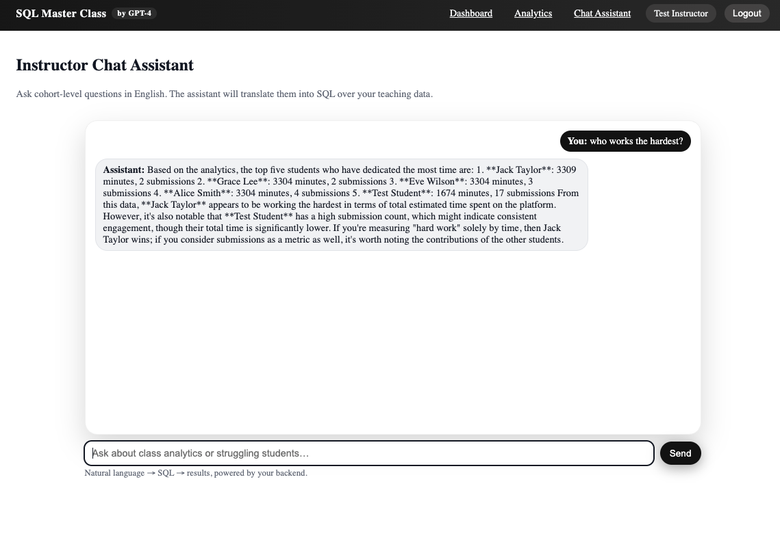
Instructor Chat Assistant
Instructor Chat Assistant

Slide 17
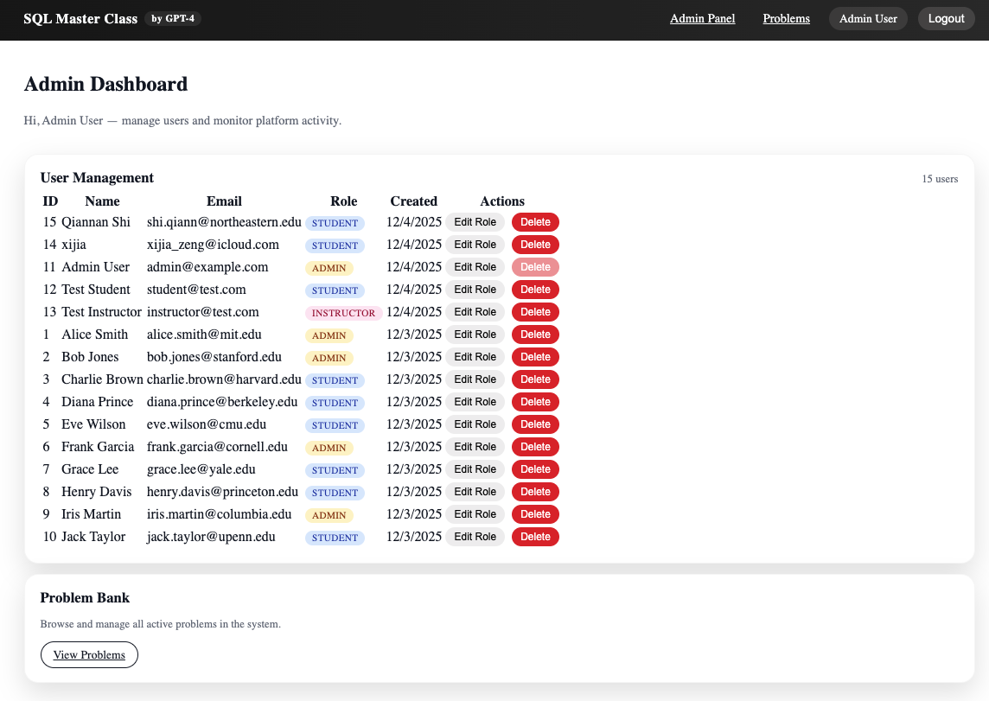
Admin Dashboard
Admin Dashboard

Slide 18
Screencast (Attach Here)
Insert your recorded demo video in this slide before submission:
PowerPoint: Insert → Video → This Device…
Recommended length: ~5–7 minutes covering Student, Instructor, Admin flows

Slide 19
Conclusion
Delivered a complete RBAC SQL learning product with autograding and analytics
Integrated LLM tutoring and natural-language query support
Established a foundation for scalable content and richer instructional insights

