Slide 1
SEER Project
Group 7: Zhen(Maggie) Sha, Zhe Yu, Xiaojia(Max) Liu, Danping Liu

Slide 2
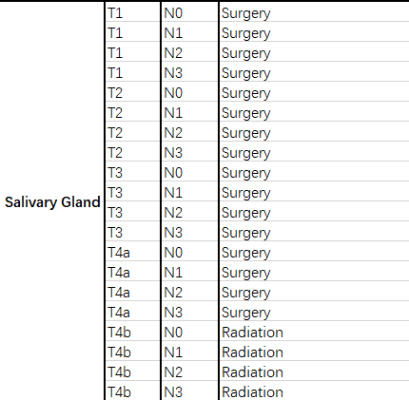
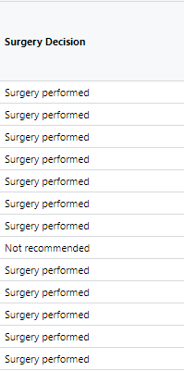

Site: Salivary Gland
Question: Is there bias, in terms of race and gender, between the therapy in guideline and the therapy actually conducted?

Slide 3
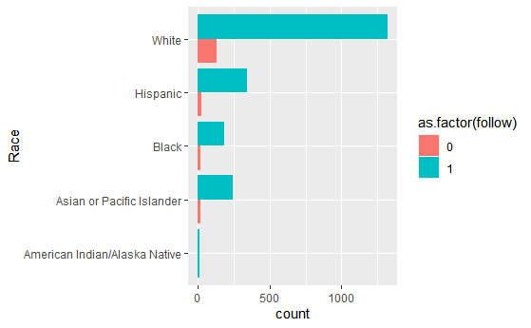
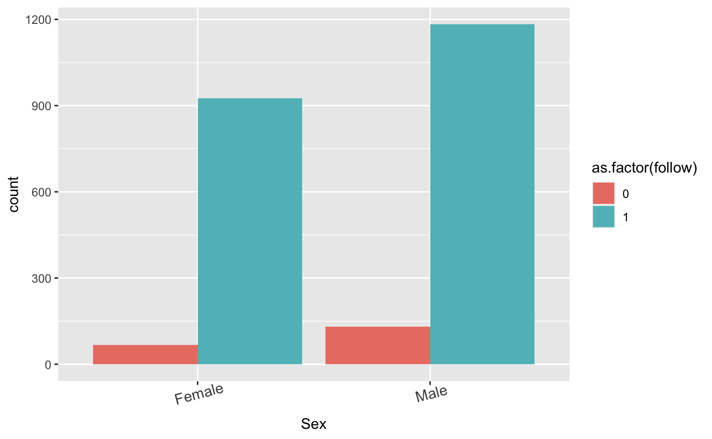
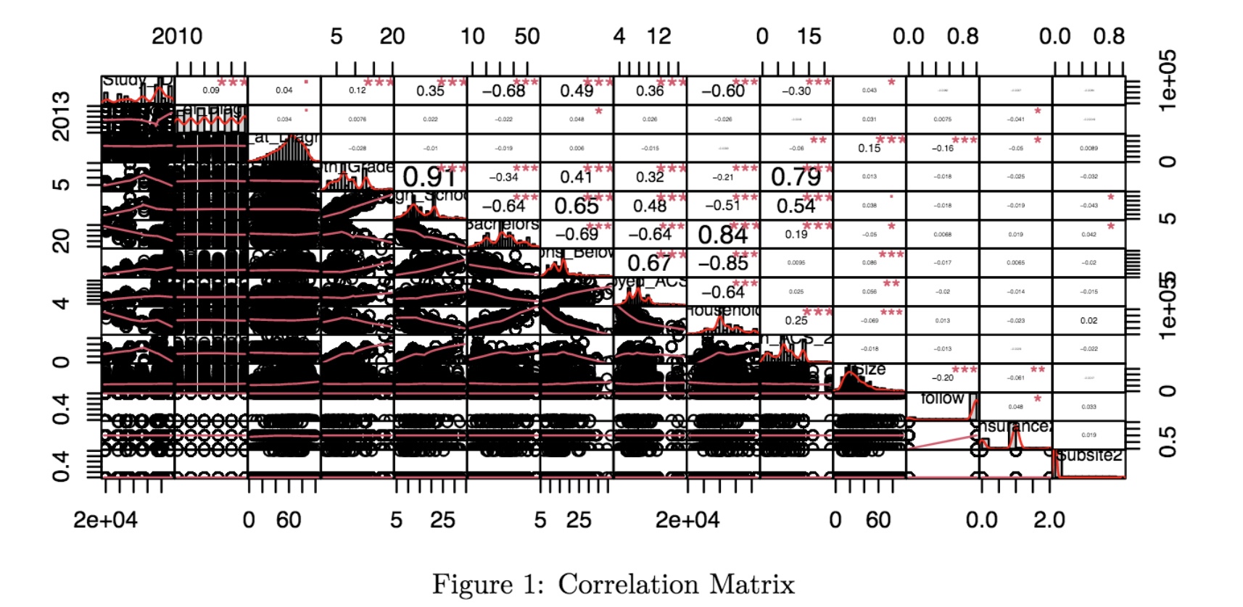
EDA
The response variable is extremely biased in our dataset:
There are some highly correlated features.

Slide 4
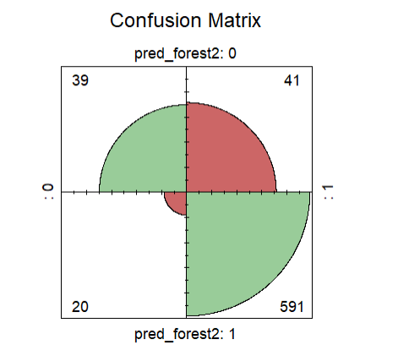
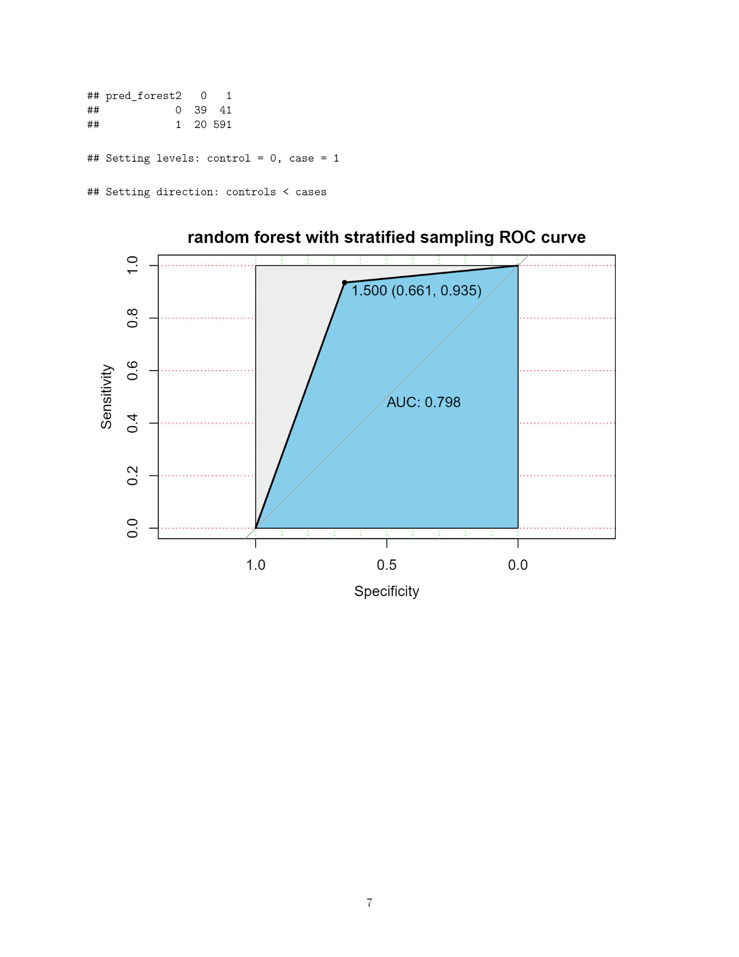
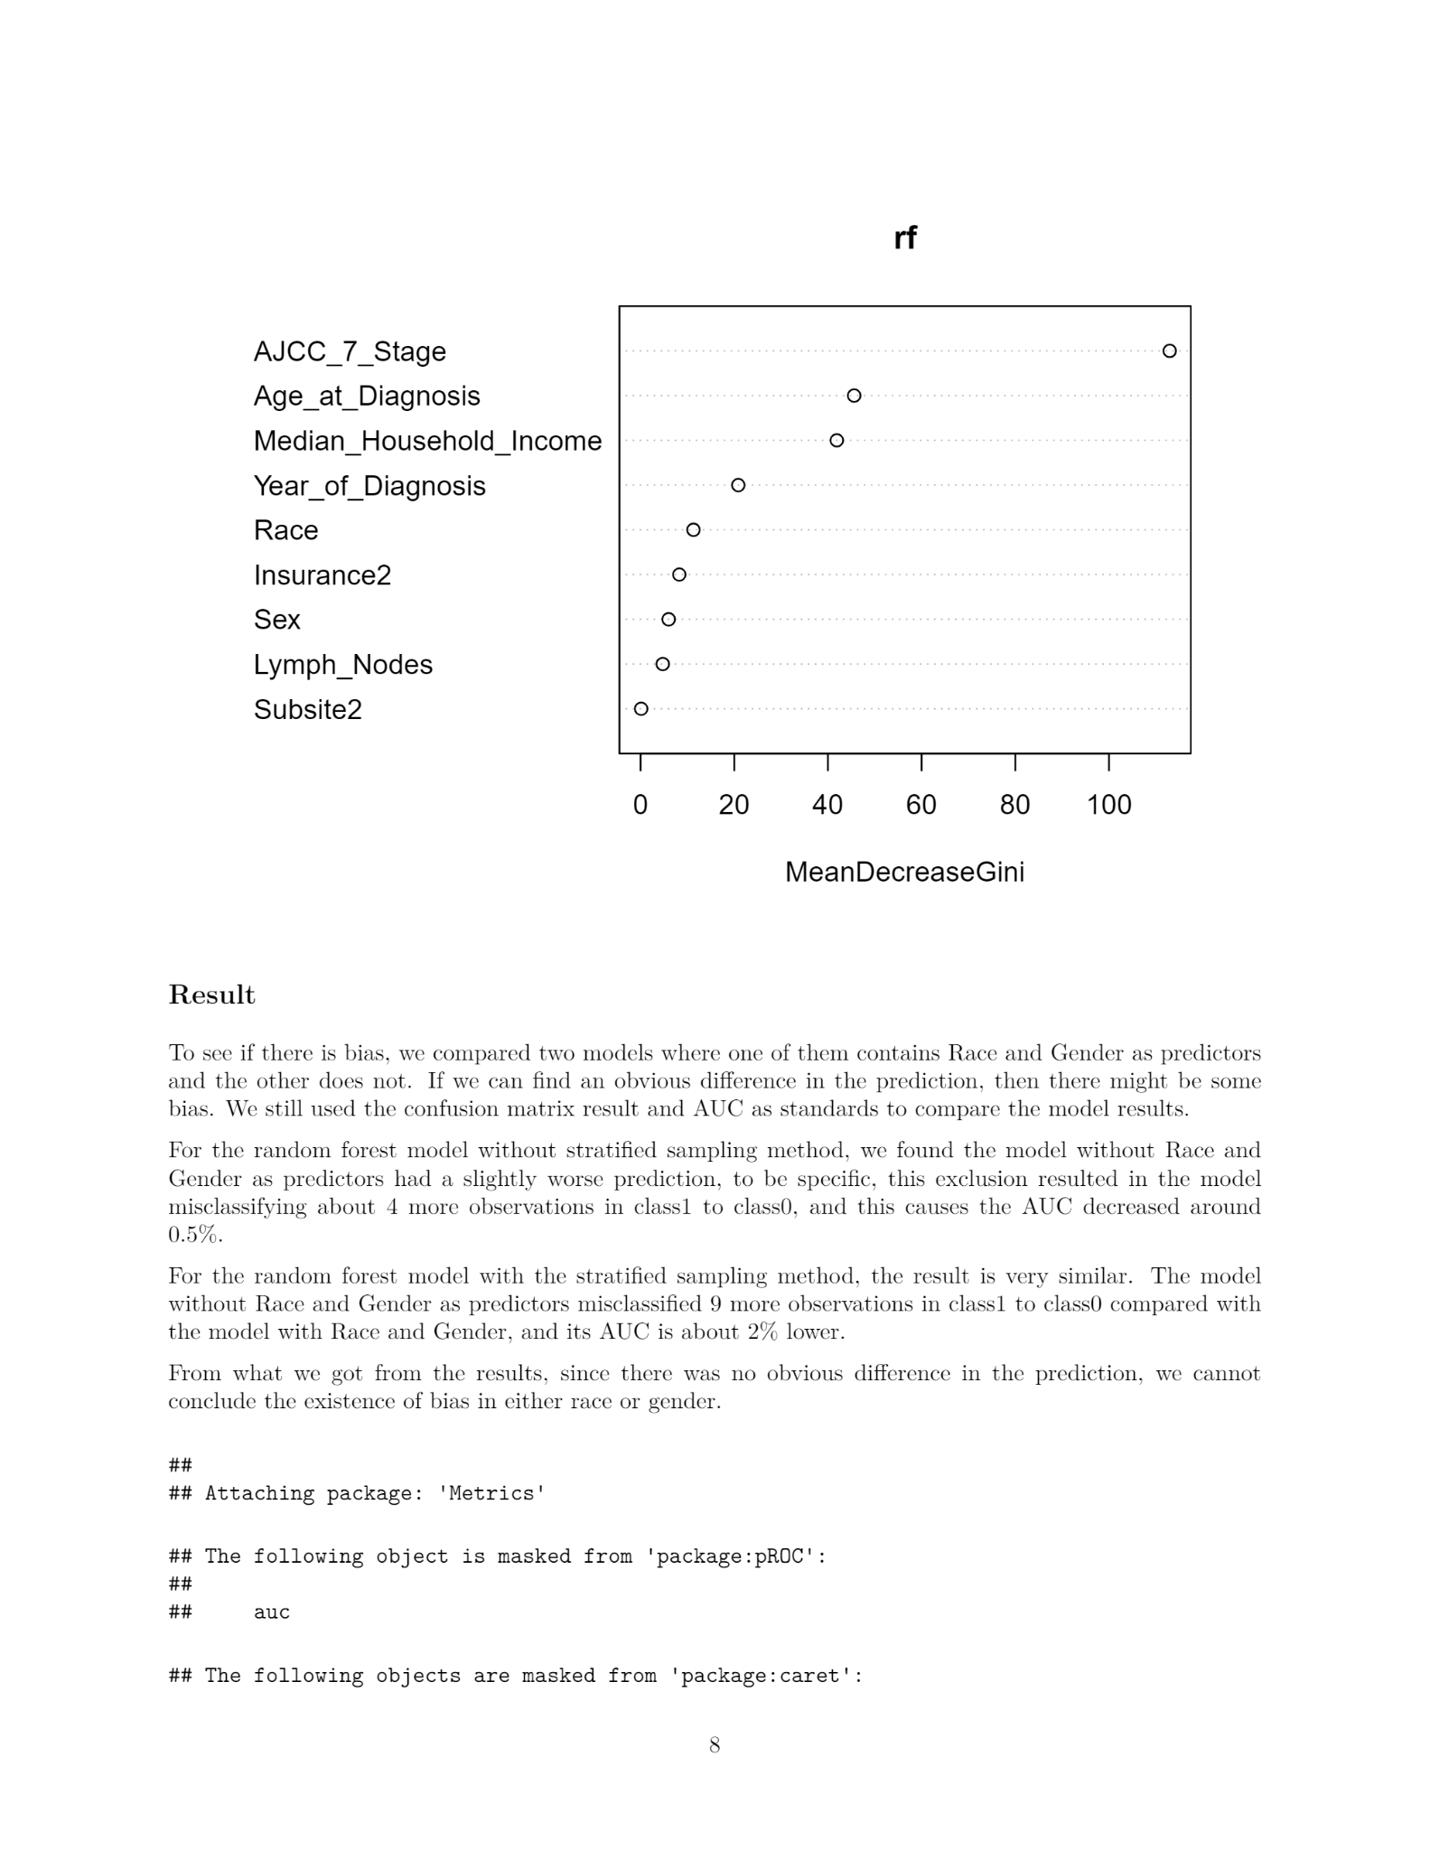
Modeling-random forest
Sex, Race, Year_of_Diagnosis, Age_at_Diagnosis, Insurance2, Lymph_Nodes, Subsite2, AJCC_7_Stage
Tuned parameters
Balanced 0:1 ratio for dataset
mtry = 5; ntree = 3000; 0:1 ratio = 60:90 = 2:3

Slide 5
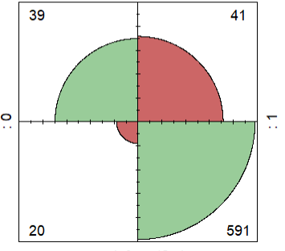
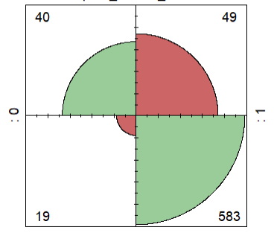
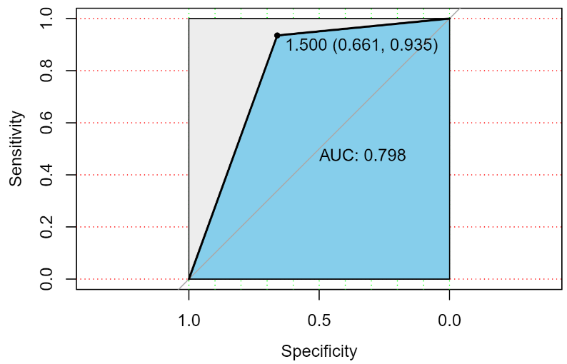
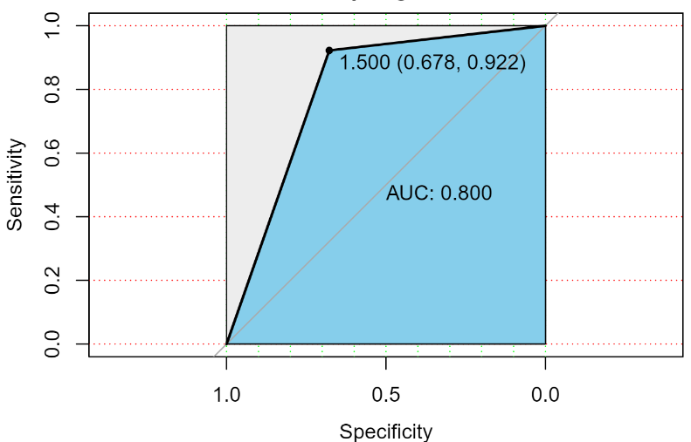
Original model Model without Race and Gender
Confusion Matrix
AUC

Slide 6
Conclusion & Limitations
Conclusion:
based on the Salivary Gland cancer, we cannot draw the conclusion that there are bias in sex and race.
Limitation:
Treatment guidelines missing TNM stage
Imbalanced data in terms of Race, Gender, Insurance type, ...
Imbalanced classes positive : negative=10 : 1

Slide 7
Questions?

